Slide 1

Randomised Evaluation of COVID-19 Therapy: the RECOVERY trial
Quick Guide for international sites completing 28 Day Vital Status form

Slide 2
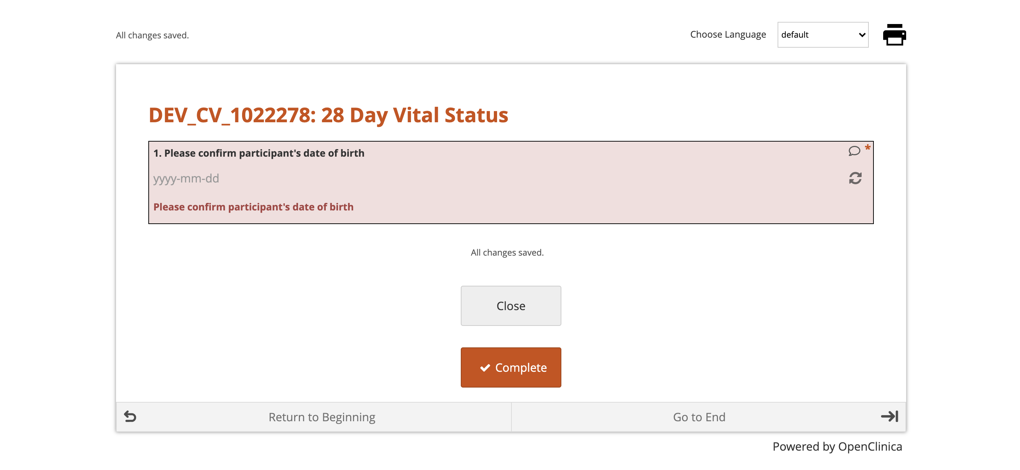
28 Day Vital Status Form
Input the participant’s date of birth.
This must match the date of birth entered on the randomisation form.
If the date of birth was entered incorrectly at randomisation, please enter the same date of birth as the randomisation form and contact the team on recoverytrial@ndph.ox.ac.uk to amend the error

Slide 3
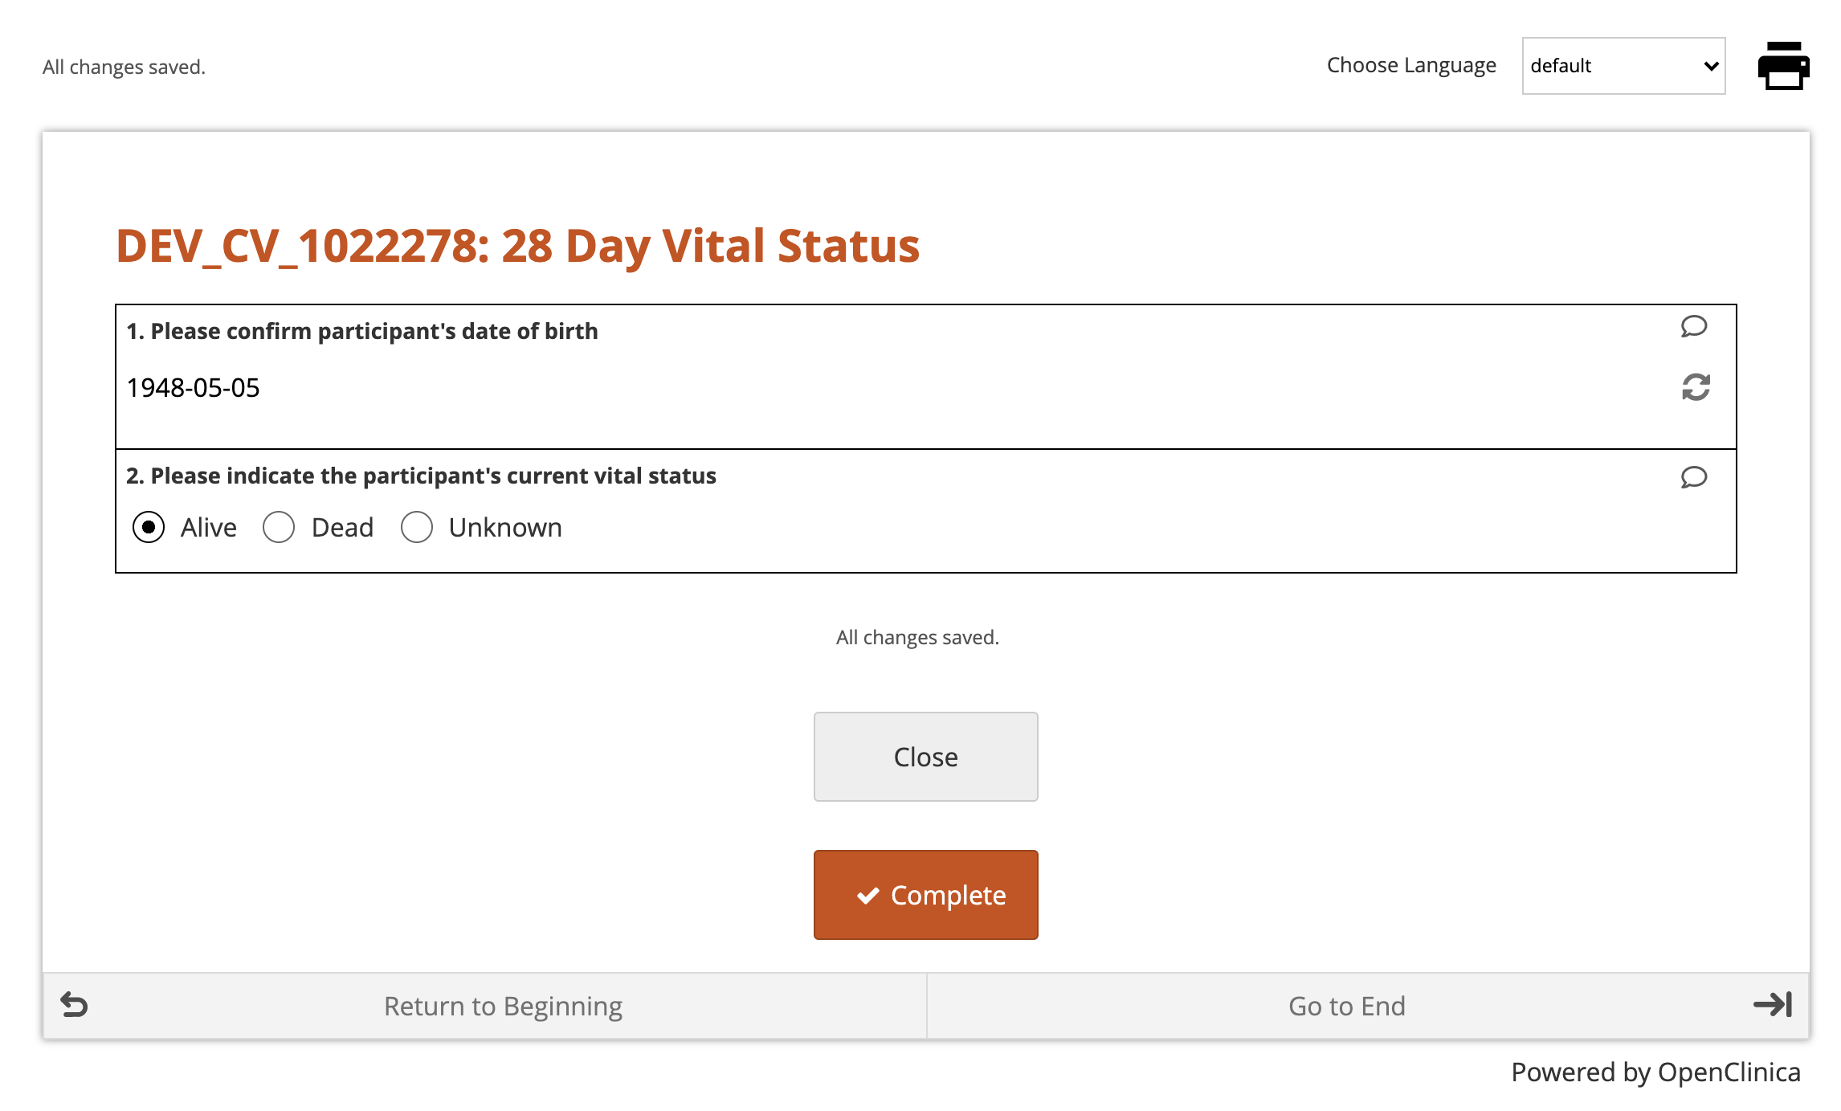
Vital Status
Select the correct vital status for the participant for the time-point of 28 days post-randomisation
If “Alive” is selected, no further information is required
Click the Complete button to finish

Slide 4
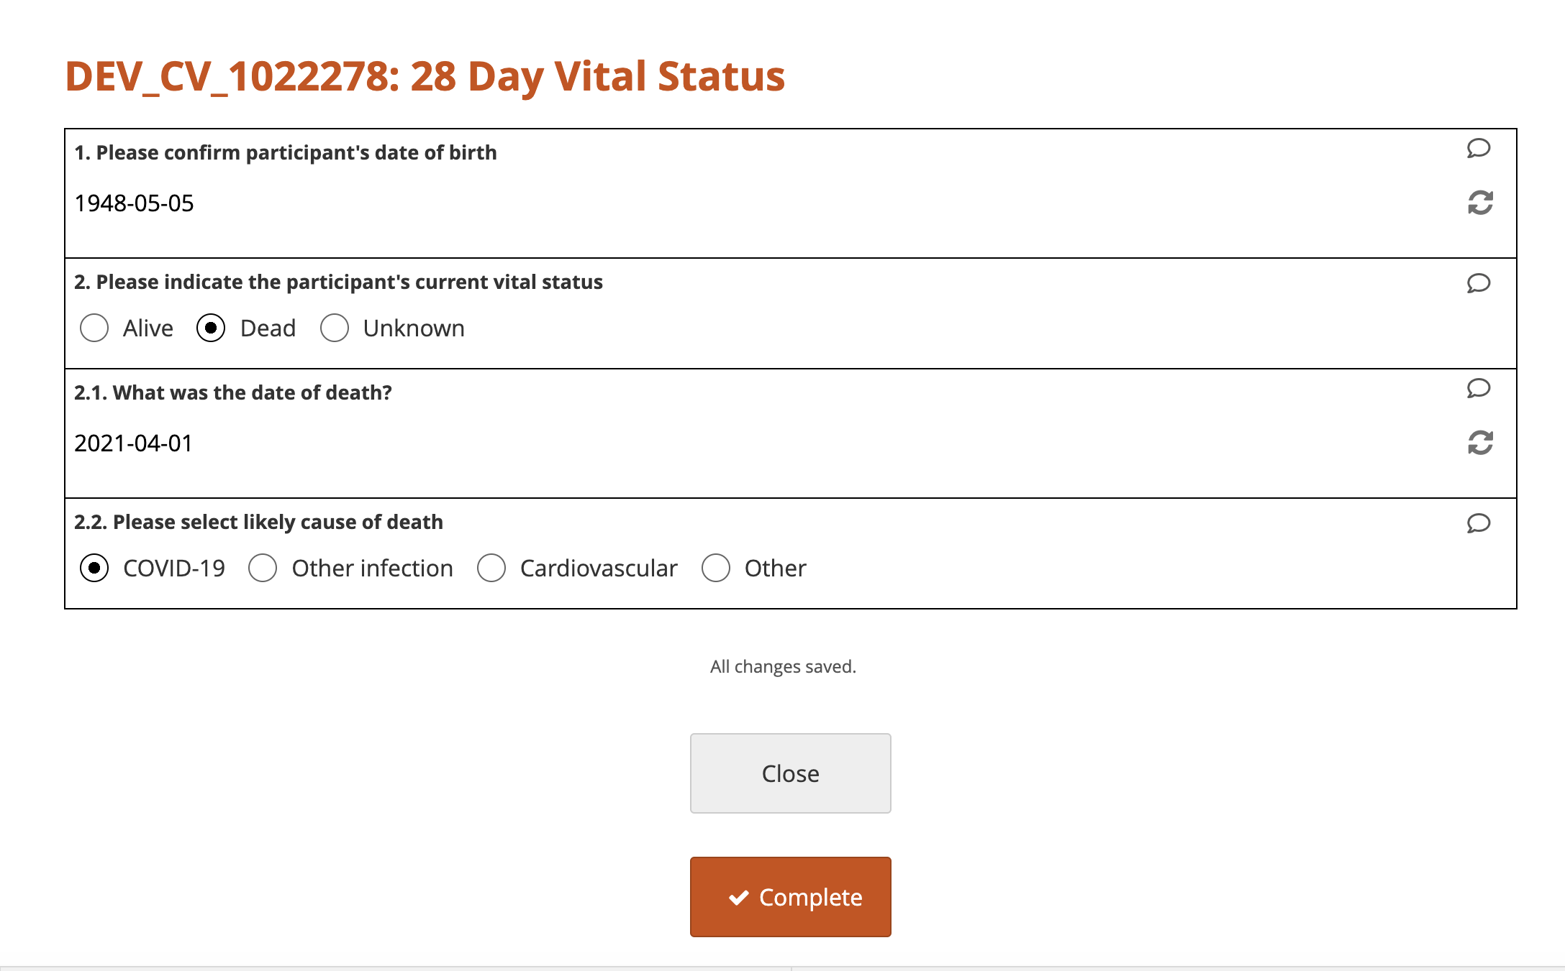
Vital Status
If ”Dead” is selected, please input the date of death as accurately as possible
Please also select the most likely cause of death using the best information available

Slide 5
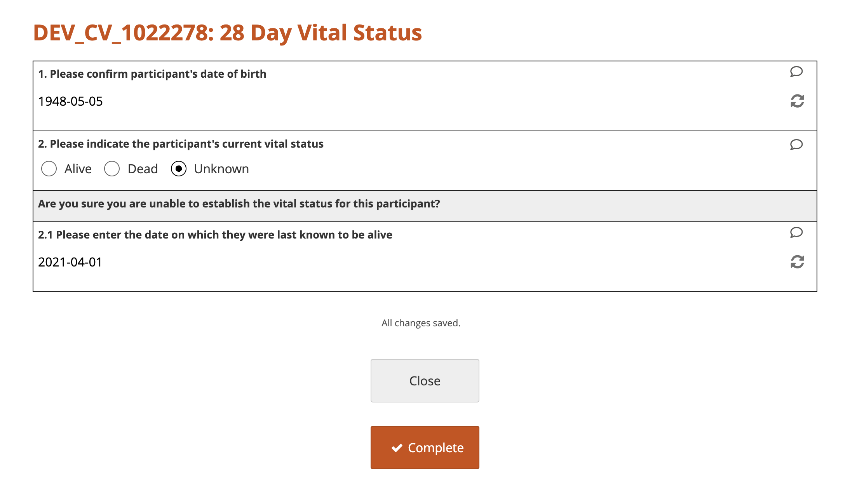
Vital Status
If there is no means possible to identify the participant’s vital status, please select “Unknown”
If “Unknown” is selected, please enter the last date on which they were known to be alive.
For example, this may be the date they were discharged from hospital
Please contact us on recoverytrial@ndph.ox.ac.uk with any questions

