Slide 1

Randomised Evaluation of COVID-19 Therapy: the RECOVERY trial
Local Site Training Material

Slide 2
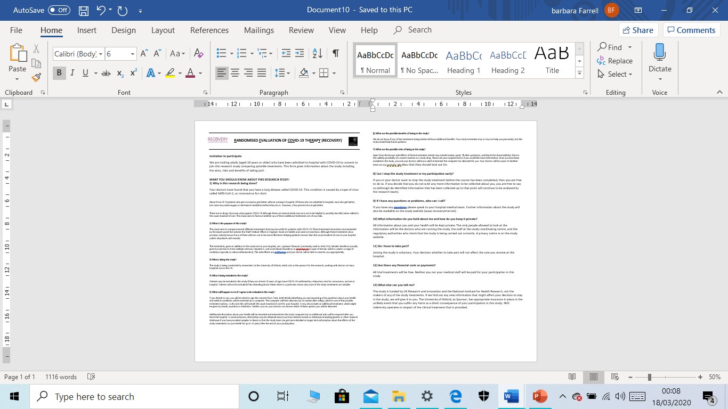
Informed consent
Patient should be provided with Participant Information Sheet (2 pages) and allowed to read and ask any questions

Slide 3
Informed consent
Key points:
Ensure the patient has had time to ask any questions (they will be scared).
Participation is voluntary and they must understand that (and that if they do not enter the trial they still receive the best care currently available).
All treatments have side-effects and they will be monitored for these.
Some of their data will be shared with the trial team outside the hospital (and possibly government officials who might check the trial is being done properly). Anyone who sees their data is bound by strict confidentiality rules.
Their data will be stored on a computer for several years, but will be kept secure. The trial may collect data held about them from other sources (eg, routinely collected data in the NHS) for up to 10 years.
These are all listed on the consent form itself, so use this as your guide.

Slide 4
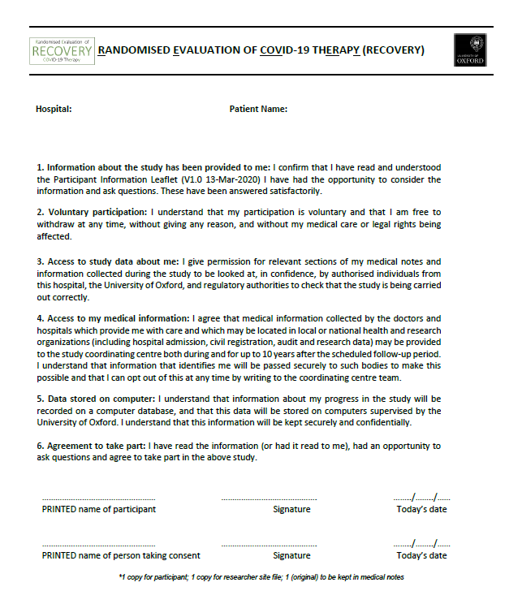
Informed consent
If they are willing then they should write
their name, sign and date consent page
Person receiving consent should do the
same and write the hospital and patient name
at the top
Make copies (or scan):
1 for participant
1 for site file (e-mail to local PI)
1 for medical notes (or scan into EHR)

Slide 5
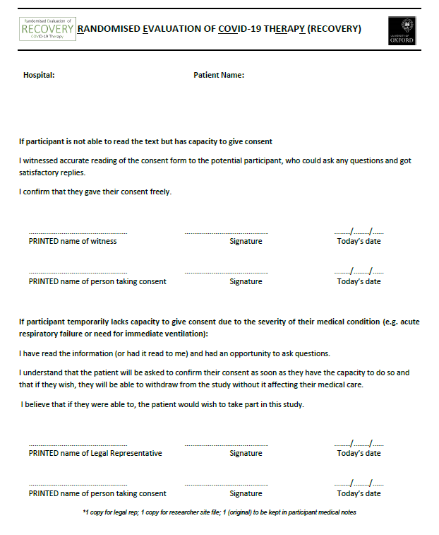
Informed consent
If participant can give consent but is unable
to sign then a witness may complete form
on top of page 2
Person receiving consent should complete
their section
Make copies (or scan):
1 for participant
1 for site file (e-mail to local PI)
1 for medical notes (or scan into EHR)

Slide 6
Informed consent
Some patients will be too ill to give informed consent
In this situation, provide Participant Information Sheet
to legal representative (e.g. close relative, friend or
doctor not involved in trial)
They complete form on bottom of page 2
Person receiving consent should complete their section
Make copies (or scan):
1 for participant
1 for site file (e-mail to local PI)
1 for medical notes (or scan into EHR)

