Slide 1

Randomised Evaluation of COVID-19 Therapy: the RECOVERY trial
Local Site Training Material

Slide 2
Randomisation
Randomisation does not have to be done by the person who took consent
Randomisation must be done online and can be accessed via the trial website: www.recoverytrial.net
Follow links for “Randomisation”
  You will be able to download a Participant Information Sheet/Consent Form here too in case you need it

Slide 3
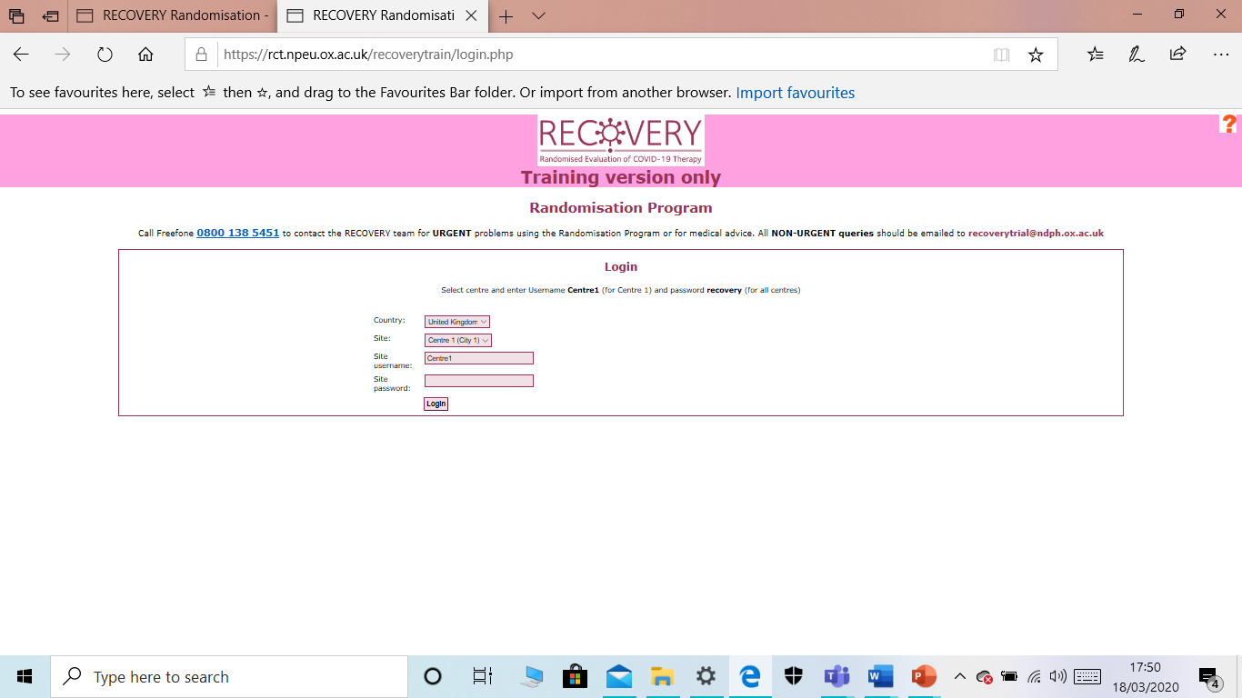
Randomisation
Select your site from the second dropdown list and enter the username and password for your hospital in the password box
Click “Login”

Slide 4
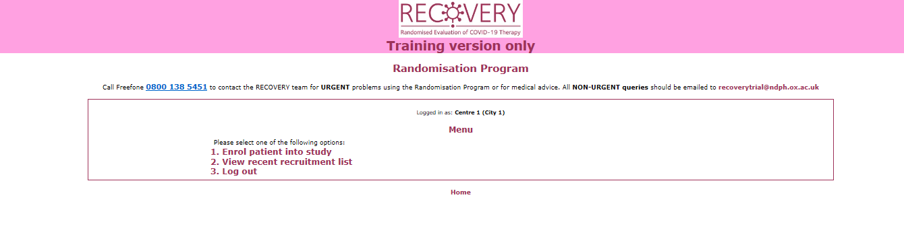
Randomisation
Click on “Enrol patient into study”

Slide 5
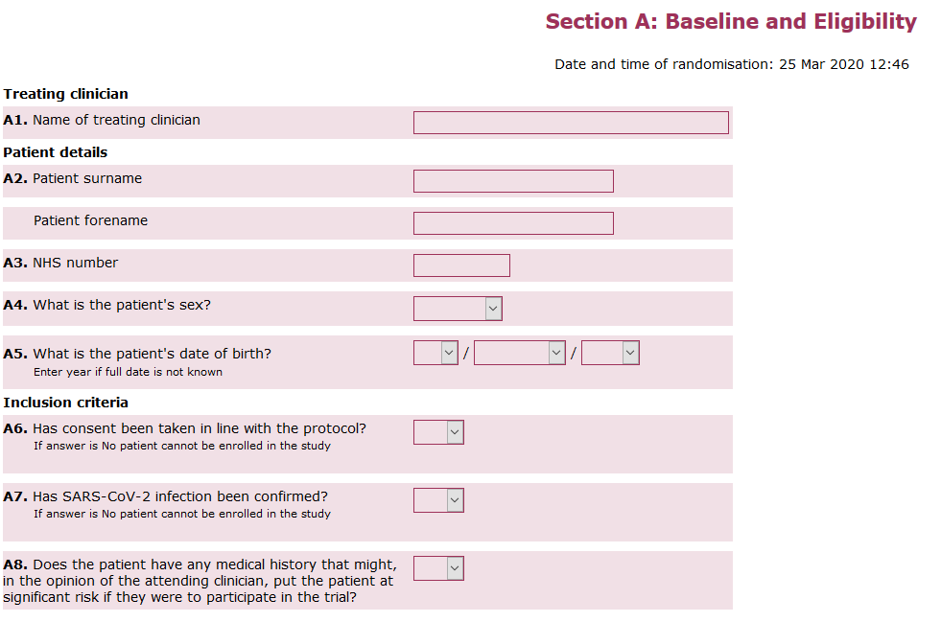
Randomisation
Complete the fields shown
Scroll down the page

Slide 6
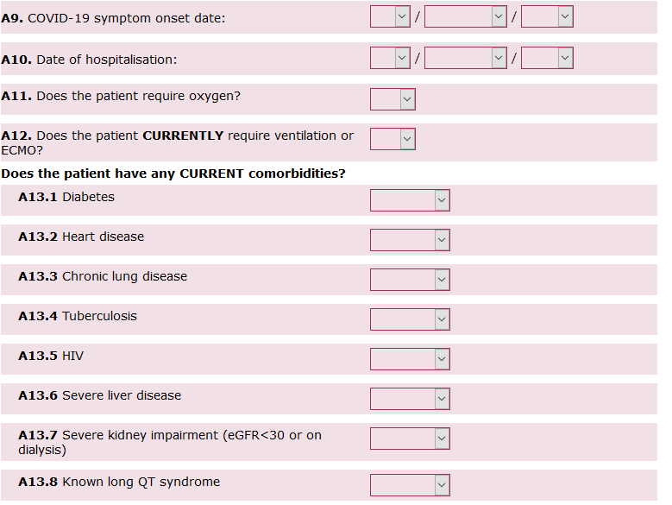
Randomisation
Complete the fields shown
Scroll down the page

Slide 7
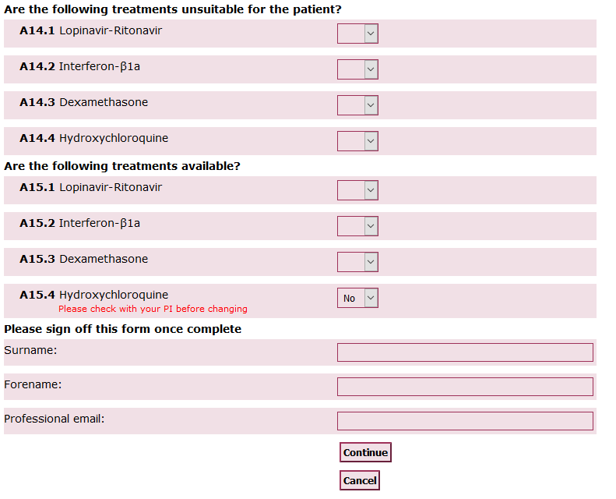
Randomisation
Complete the fields shown
Questions A15.1-3 refer to availability in your hospital (it may be your pharmacy does not have them all)
Please enter your name and an e-mail address at which you can be contacted in case of questions
Then press ‘Continue’

Slide 8
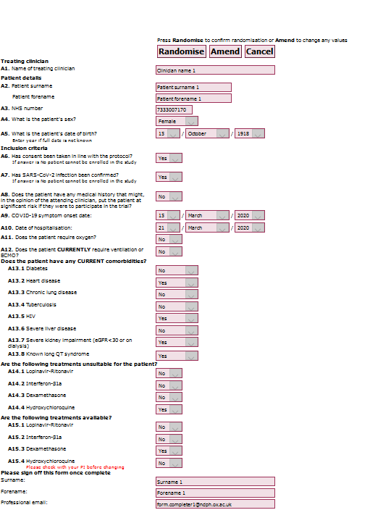
Randomisation
Review the data you have entered.
If you need to correct anything, click ‘Amend’
If you wish to abandon, click ‘Cancel’
Otherwise, click ‘Randomise’

Slide 9
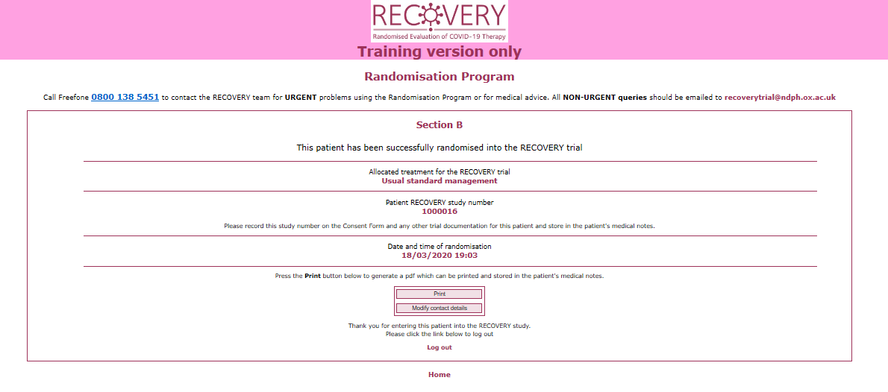
Randomisation
Make a note of the allocation and ensure that it is prescribed on the participant’s drug chart
Record the study number in the medical record and on the consent form if available

Slide 10
Problems
If you have any questions about the process or run into problems with the website please do one of the following:
  Review our Frequently Asked Questions on the study website www.recoverytrial.net
  E-mail the study team at recoverytrial@ndph.ox.ac.uk
  Telephone the study team (24/7) on 0800 1385451 (urgent calls only please)

