Slide 1
Randomised Evaluation of COVID-19 Therapy: the RECOVERY trial
Synthetic monoclonal antibodies against SARS-CoV-2 spike protein
Research Team Training

Slide 2
Trial design
SOC = Standard Of Care
CP = Convalescent Plasma
AZM = Azithromycin
mAb = Monoclonal antibody
R = Randomisation
ELIGIBLE PATIENTS
OUTCOMES
SOC + CP
SOC + mAb
SOC alone
Tocilizumab
R
R2
No additional treatment
AZM + CP
AZM + mAb
AZM + SOC
CP
mAb
SOC

Slide 3
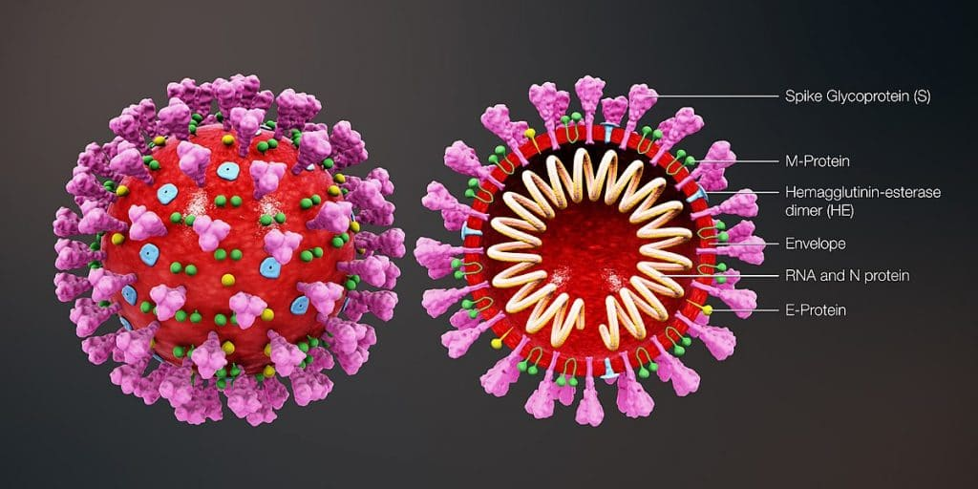
Protocol V9.0
Several companies are now producing monoclonal antibodies (mAbs) against SARS-CoV-2 “spike” protein

Slide 4
Spike protein
Human lung cell
SARS-CoV-2
Spike protein
ACE2 receptor

Slide 5
Spike protein
Human lung cell
Infected human lung cell
SARS-CoV-2
Spike protein
ACE2 receptor

Slide 6
Role of antibody
Human lung cell
SARS-CoV-2
Spike protein
ACE2 receptor

Slide 7
Role of antibody
Human lung cell
Virus binding to its receptor is inhibited, so cells infected less readily
Antibody can activate other parts of immune system to kill infected cells and capture free virus
SARS-CoV-2
Spike protein
ACE2 receptor

Slide 8
REGN-COV2
Most patients with Covid-19 will develop antibodies by day 14
Convalescent plasma contains mixture of many different anti-coronavirus antibodies
Monoclonal antibodies have been developed which are 100% human, but only bind to one epitope on the spike protein
Two different antibodies mean that if virus mutates its spike protein such that one antibody doesn’t bind so well, the other antibody probably still will

Slide 9
Safety of REGN-COV2
REGN-COV2 mAb has been given to ~600 patients so far in early phase trials
No serious adverse reactions
4 patients have had minor infusion reactions which could be controlled symptomatically and infusion completed in 3/4 cases
Other trials ongoing in other clinical scenarios e.g. outpatient, prophylaxis

Slide 10
Pharmacy involvement
REGN-COV2 will be provided in vials which need to be stored in temperature-monitored refrigerator between 2-8C
Stock control will use IWRS system which pharmacists will be given access to, but randomisation still done using main trial system
Pharmacy manual and other materials (eg, risk assessment) available on study website

Slide 11
Pharmacy involvement
If a participant is allocated REGN-COV2, the necessary vials should be taken from refrigerator
IWRS system should be used to record allocation (and will also provide an expiry check – if IWRS indicates that treatment has expired it must not be used)
Pharmacy may prepare infusion depending on local policies

Slide 12
Safety data to date
To date, about 500 people have entered trials of REGN-COV2
No serious adverse reactions
4 participants have experienced minor adverse reactions:
1 x paraesthesiea
1 x urticaria, pruritus and flushing
1 x light-headedness, headache and vomiting
1 x abdominal pain
All except one completed the infusion

Slide 13
Giving REGN-COV2
Infusion is made up in 250 mL bag of 0.9% saline and infused over 1 hour
Infusion reactions may occur and infusion should be stopped and reaction managed symptomatically
Bronchodilator for wheeze
Antihistamine/hydrocortisone for pruritus or rash
Infusion rate can be restarted at 50% previous rate if managing physician is satisfied it is reasonable to do so (not if reaction was severe)

Slide 14
Additional safety data collection
In first 72 hours after randomisation, has the participant had:
Sudden worsening in respiratory status
Infusion reaction
Temperature >39ºC or ≥2ºC rise above baseline
Sudden hypotension (defined as either (i) sudden drop in systolic blood pressure of ≥30 mmHg with systolic blood pressure ≤80 mmHg; or (ii) requiring urgent medical attention)
Clinical haemolysis (defined as fall in haemoglobin plus one or more of the following: rise in lactate dehydrogenase (LDH), rise in bilirubin, positive direct antiglobulin test (DAT), or positive crossmatch)
This information will be collected on additional OpenClinica form
Data will be reviewed by DMC after first 200 participants and may not be required for all participants

Slide 15
Summary
REGN-COV2 is being offered in a factorial randomisation at entry into RECOVERY
REGN-COV2 is a combination of two monoclonal antibodies directed against SARS-CoV-2 spike protein
At least first 200 participants in this randomisation will have extra safety information collected

