Slide 1
Randomised Evaluation of COVID-19 Therapy: the RECOVERY trial
Paediatric Training Slides
(infants and children equal to or over 44 weeks corrected gestational age)
[22/07/2020)

Slide 2
Background: COVID-19
The majority of children who develop COVID-19 present with mild symptoms or are asymptomatic.
For the few children that develop severe or life-threatening acute respiratory presentations of COVID-19, a robust evidence base is essential to guide the use of effective treatments and to avoid potential harm
The RECOVERY trial has demonstrated that dexamethasone reduces the risk of death for adults patients requiring oxygen and this has now become standard of care for adults and children and continues to investigate the efficacy of other treatments for patients with COVID-19.
RCPCH treatment criteria should be used to guide the decision about treatment and therefore enrolment into RECOVERY for patients with acute respiratory presentations of COVID-19. (RCPCH guidelines are constantly being updated please make sure you are aware of the latest version).
It is anticipated that any child with COVID-19 being considered for treatment (over and above supportive care), should be enrolled in RECOVERY

Slide 3
Background: PIMS-TS
A small proportion of children who are exposed to SARS-CoV2 develop an inflammatory syndrome which has been recently identified and termed Paediatric multisystem inflammatory syndrome temporally associated with SARS-CoV-2 (PIMS-TS).
Some of these children will improve with no treatment and others are more unwell and require intensive care and immunomodulation.
Children with PIMS-TS are eligible for inclusion in RECOVERY.

Slide 4
Patient information leaflets and Consent
Children <10 years of age should be provided with the ‘younger’ children information leaflet and this should be read along with their parent(s) or guardian(s). The parent or guardian should sign the consent form.
Children aged 10-15 years of age should be provided with the relevant information sheet and the child given the opportunity to sign the information sheet to indicate their assent, if they are well enough and signature is possible. The parent / guardian should sign the consent form (or witnessed consent used).
Young people aged >16 years should be provided with the ‘adult’ information sheet and they should sign the consent form (or witnessed consent used).
Witnessed consent may be obtained over the telephone or web video link if hospital visiting rules or parental infection mean a parent/guardian cannot be physically present.

Slide 5
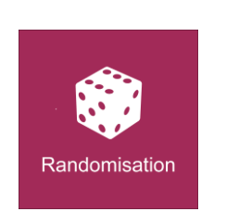
Options for Randomisation
1st stage interventions:
  Randomisation 1 A:
No additional treatment
Azithromycin
IVIg
Methylprednisolone
  Randomisation 1 B: Optional (can be done with or instead of above interventions)
No additional treatment
Convalescent plasma
2nd stage interventions: only open to children > 1year of age
No additional treatment
Tocilizumab
Notes:
If no treatments are both available and suitable, then it may be possible to only be randomised in part B.
For randomisation part B, the randomisation program will allocate patients in a ratio of 1:1 between each of the arms. If the active treatment is not available at the hospital, the patient does not consent to receive convalescent plasma, or is believed, by the attending clinician, to be contraindicated for the specific patient, then this fact will be recorded via the web-based form and the patient will be excluded from Randomisation part B.

Slide 6
RECOVERY for PIMS-TS
Aim: compare steroids vs no additional treatment (in presence and absence of IVIg) and IVIg vs no additional (in presence and absence of steroids).
This design:
Allow investigators to use no treatment, IVIg or steroids or as standard care if deemed necessary
Allow effects of steroids and IVIg to be compared with no additional treatment separately (in presence and absence of other drug)
Allow wide spectrum of severity to be recruited because some treatment can be guaranteed but not absolutely required
Second randomisation to tocilizumab is still available.
Also collects baseline use of steroids/IVIg at second randomisation (although not recommended this is in case clinicians go off-protocol in-between two randomisations)

Slide 7
Acute respiratory presentation of COIVID-19 scenario
Child meets RCPCH criteria for treatment of confirmed or suspected COVID-19 in child with acute respiratory presentation (infants and children >44 weeks corrected gestational age)
www.rcpch.ac.uk/resources/covid-19-clinical-management-children-admitted-hospital-suspected-covid-19
Yes
No
Treat according to standard of care
Randomise to 1st stage interventions:
Randomisation A:
No additional treatment vs
azithromycin (if no contraindications)
Randomisation B:
No additional treatment vs
Convalescent plasma
Not suitable for enrolment into RECOVERY trial
If clinical deterioration, reassess against RCPCH criteria
Evidence of ongoing fever and inflammation or clinical deterioration?
Yes
No
Randomise to 2nd stage interventions:
Tocilizumab no additional treatment
Do not proceed to 2nd stage interventions

Slide 8
PIMS-TS Scenarios
Patient with PIMS-TS enrolled in RECOVERY
Patient received IVIg or corticosteroids prior to enrolment?
IVIg and corticosteroids given
No
IVIg given
Corticosteroids given
1
2
3
4

Slide 9
Scenario 1: Patient with PIMS-TS who has not received treatment* prior to enrolment
*IVIg, methylprednisolone or equivalent to ≥ 2mg/kg prednisolone
Azithromycin should be marked as unsuitable for 1st stage intervention
Randomise to IVIg vs methylprednisolone vs no additional treatment
Notes:
If receives SOC and does not improve (or the clinical team think treatment is essential) then can move to randomisation 2

Slide 10
Scenario 1: Patient with PIMS-TS who has not received treatment* prior to enrolment
*IVIg, methylprednisolone or equivalent to ≥ 2mg/kg prednisolone
Azithromycin should be marked as unsuitable for 1st stage intervention
Randomise to IVIg vs methylprednisolone vs no additional treatment
Evidence of ongoing fever and inflammation or clinical deterioration?
Yes
Can transfer to tertiary centre if clinically necessary
No
Randomise to 2nd stage interventions:
Tocilizumab / no additional treatment
Do not proceed to 2nd stage interventions
Notes:
If receives SOC and does not improve (or the clinical team think treatment is essential) then can move to randomisation 2 – ideally R2 (toci vs SOC) will be the next step.
BUT if at DGH and after R1 is SOC with treatment is considered essential and/or transfer not appropriate, then can use clinical judgement and give IVIg (as per Delphi) but this is not recommended. If continues to deteriorate can still be transferred to tertiary centre AND remain on protocol (R2 toci yes/no).
If R1 is SOC and R2 is SOC and treatment considered essential clinicians can give IVIg or steroid – please record all non-protocol medications in the CRF.

Slide 11
Scenario 2: Patient with PIMS-TS who has already received IVIg prior to enrolment
Select IVIg as unsuitable for 1st stage intervention
Azithromycin should be marked as unsuitable for 1st stage intervention
Randomise to methylprednisolone vs no additional treatment

Slide 12
Scenario 2: Patient with PIMS-TS who has already received IVIg prior to enrolment
Select IVIg as unsuitable for 1st stage intervention
Azithromycin should be marked as unsuitable for 1st stage intervention
Randomise to methylprednisolone vs no additional treatment
Evidence of ongoing fever and inflammation or clinical deterioration?
Evidence of ongoing fever and inflammation or clinical deterioration?
Yes
Yes
Can transfer to tertiary centre if clinically necessary
No
No
Randomise to 2nd stage interventions:
Tocilizumab no additional treatment
Randomise to 2nd stage interventions:
Tocilizumab / no additional treatment
Do not proceed to 2nd stage interventions
Do not proceed to 2nd stage interventions
Notes:
If receives SOC and does not improve (or the clinical team think treatment is essential) then can move to randomisation 2 – ideally R2 (toci vs SOC) will be the next step.
BUT if at DGH and after R1 is SOC with treatment is considered essential and/or transfer not appropriate, then can use clinical judgement and give MP but this is not recommended. If continues to deteriorate can still be transferred to tertiary centre AND remain on protocol (R2 toci yes/no).
If R1 is SOC and R2 is SOC and treatment considered essential clinicians can give MP or other therapies as required – please record all non-protocol medications in the CRF.

Slide 13
Scenario 3: Patient with PIMS-TS who has already received methylprednisolone* prior to enrolment
* (or equivalent to ≥ 2mg/kg prednisolone )
Select methylprednisolone as unsuitable for 1st stage intervention
Azithromycin should be marked as unsuitable for 1st stage intervention
Randomise to IVIg vs no additional treatment

Slide 14
Scenario 3: Patient with PIMS-TS who has already received methylprednisolone* prior to enrolment
* (or equivalent to ≥ 2mg/kg prednisolone )
Select methylprednisolone as unsuitable for 1st stage intervention
Azithromycin should be marked as unsuitable for 1st stage intervention
Randomise to IVIg vs no additional treatment
Evidence of ongoing fever and inflammation or clinical deterioration?
Yes
Can transfer to tertiary centre if clinically necessary
No
Randomise to 2nd stage interventions:
Tocilizumab / no additional treatment
Do not proceed to 2nd stage interventions
Notes:
If receives SOC and does not improve (or the clinical team think treatment is essential) then can move to randomisation 2 – ideally R2 (toci vs SOC) will be the next step.
BUT if at DGH and after R1 is SOC with treatment is considered essential and/or transfer not appropriate, then can use clinical judgement and give IVIg but this is not recommended (or can randomise to CP arm). If continues to deteriorate can still be transferred to tertiary centre AND remain on protocol (R2 toci yes/no).
If R1 is SOC and R2 is SOC and treatment considered essential clinicians can give IVIg or other therapies as required – please record all non-protocol medications in the CRF.

Slide 15
Scenario 4: Patient with PIMS-TS who has already received IVIg AND methylprednisolone* prior to enrolment * (or equivalent to ≥ 2mg/kg prednisolone )
IVIg and methylprednisolone should be marked as unsuitable for 1st stage intervention
Randomise to no additional treatment vs azithromycin (if no contraindications) or consider randomisation 1B (See FAQ 12)

Slide 16
Scenario 4: Patient with PIMS-TS who has already received IVIg AND methylprednisolone* prior to enrolment * (or equivalent to ≥ 2mg/kg prednisolone )
IVIg and methylprednisolone should be marked as unsuitable for 1st stage intervention
Randomise to no additional treatment vs azithromycin (if no contraindications) or consider randomisation 1B (See FAQ 12)
Evidence of ongoing fever and inflammation or clinical deterioration?
Yes
No
Randomise to 2nd stage interventions:
Tocilizumab / no additional treatment
Do not proceed to 2nd stage interventions
Notes:
Try tocilizumab first and use others if needed
Criteria for Toc

Slide 17
PIMS-TS Scenarios 1-4
Patients with severe disease may receive off protocol IVIg or methylprednisolone if the investigator deems this clinically essential
Where possible, use 2nd stage interventions instead of off protocol treatments, or alternatively convalescent plasma could be used in place of a second dose of IVIg
Use the paediatric case report form to record all use of immunomodulation (both on and off protocol)
Notes:
As per previous discussion.

Slide 18
Paediatric specific medication: Methylprednisolone
Methylprednisolone 10mg/kg for 3 days
Additional steroids are not recommended, and weaning is not considered necessary after 3 days of high dose methylprednisolone
However, if the attending clinician still deems this clinically necessary, receipt of additional corticosteroids should be listed in the paediatric case report form

Slide 19
Paediatric specific medication: IVIg
Use routine hospital stock (any brands with marketing authorisation)
Prior approval not required (as per Kawasaki disease)
NHS England has been informed that Trusts usage may increase (Note: overall usage of IVIg is likely to be reduced due to randomisation)
Pharmacists:
Complete MDASA database (PIMS-TS diagnosis has been added to the database)
Reimbursement by NHSE (via normal route)
Notes:
NHSE approved

Slide 20
Convalescent plasma
Individual investigators may choose to randomise neonates, infants and children to convalescent plasma, where it is available in a specific research site and local investigators consider this appropriate for that child.
  Acute respiratory presentation of COVID-19 – likely to be appropriate for randomisation where available
  PIMS-TS: Convalescent plasma may be used as potential entry to RECOVERY for those children who have received both IVIg and high dose methylprednisolone as treatment prior to consideration of entry to RECOVERY
In the FAQ, the scenario table notes ‘caution’. This is because of the potential, but as yet unproven, antibody-mediated contribution to the pathogenesis of PIMS-TS.
No safety concerns have been noted in adult patients received CP to date, however enhanced safety monitoring is in place in adults and children.
Notes:
Trying to avoid so get clear cut answer to IVIG , but could consider using as second dose of IVIG

Slide 21
Infants: <44 weeks corrected GA
See neonatal specific training
For neonates and infants with a corrected gestational age of < 44 weeks with respiratory COVID phenotype, options for RECOVERY randomisation include
  Hydrocortisone
  Azithromycin
  No additional treatment
  Convalescent plasma

Slide 22

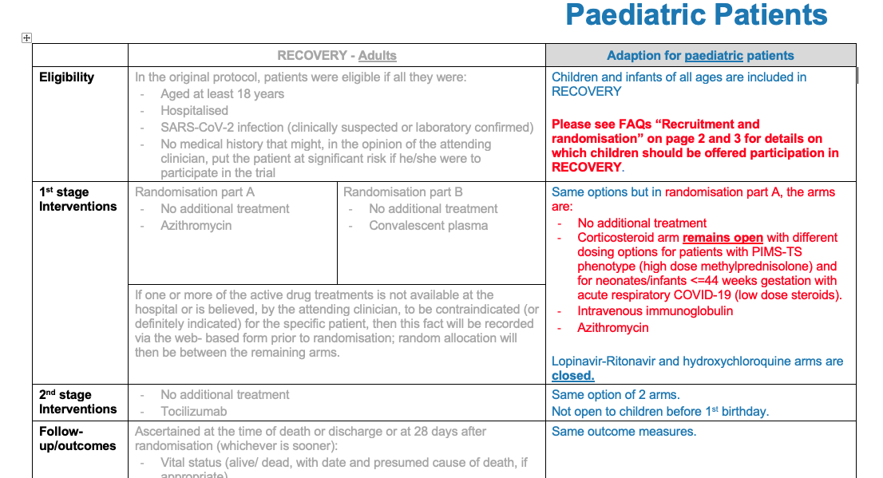

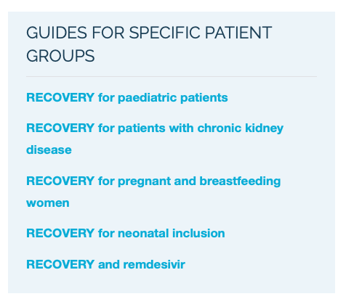
Further guidance: Frequently asked questions document

