Slide 1

Randomised Evaluation of COVID-19 Therapy: the RECOVERY trial
Quick Guide for international sites completing the 6 month follow-up form
23rd May 2022

Slide 2
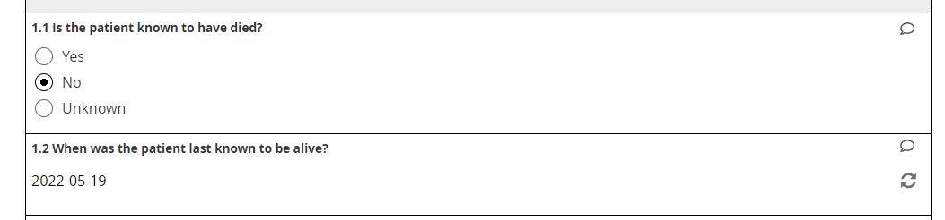
Q1 - Vital status
Record whether the patient is known to have died at the time the form is being completed
If the answer is “No”, enter the date the patient was last known to be alive:
This should be the date the patient/relative was contacted, if this was possible
If contact was not possible, use the last date they were known alive from medical records (and any other reliable sources of information)
Only select ‘Unknown’ if it was not possible to contact the patient/relative and medical records are inadequate to determine whether they were discharged alive

Slide 3
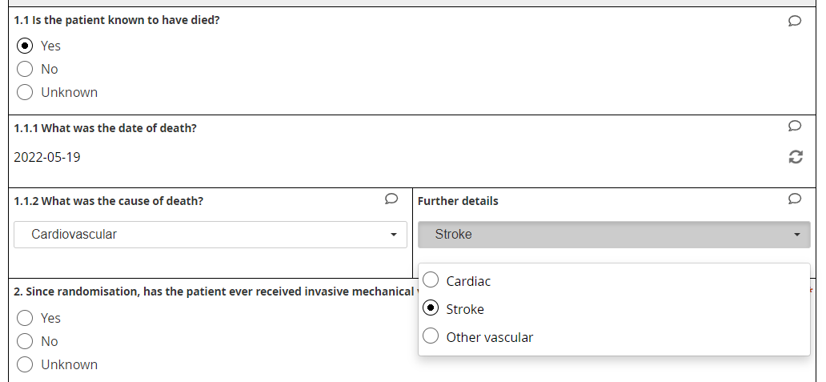
Q1 - Vital status
If the patient is known to have died, enter the date of death as accurately as possible
Note - If an option has been selected by mistake, then clicking on it again will unselect it
Select the most likely cause of death using the best information available

Slide 4
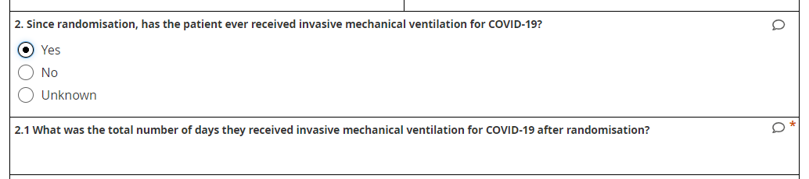
Q2 - Ventilation
Select ‘No’ if it was possible to contact the patient/relative and they have note received invasive mechanical ventilation
Select ‘Yes’ if they required invasive mechanical ventilation for COVID-19 at any time after randomisation, and record the total number of days they received it for
Only select ‘Unknown’ if it was not possible to contact the patient/relative
* Index admission = admission in which they were randomised

Slide 5
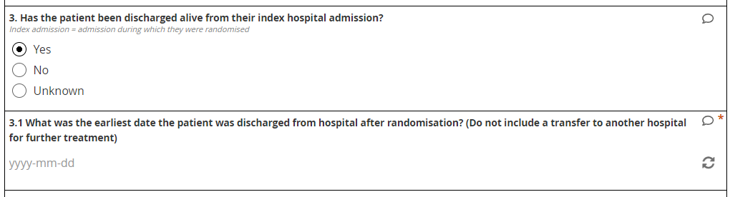
Q3 - Discharge
Select ‘Yes’ if the patient was discharged alive from their index admission, and record the discharge date as accurately as possible
If the patient was transferred for further treatment, please contact the receiving hospital to find out discharge date.
Select ‘No’ if the patient died during their index admission (or if they remain in hospital)
Only select ‘Unknown’ if it was not possible to find out discharge date

Slide 6
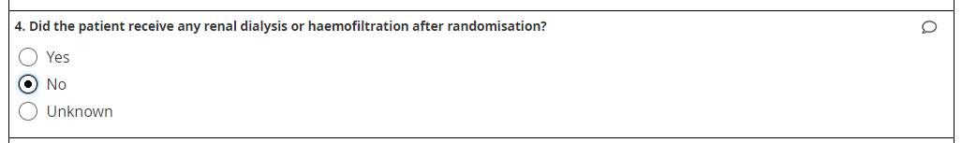
Q4 – Renal replacement
Select ‘No’ if it was possible to contact the patient/relative and they have not received renal dialysis or haemofiltration
Select ‘Yes’ if the patient received renal dialysis or haemofiltration at any time from randomisation until the date the form is completed.
Only select ‘Unknown’ if it was not possible to contact the patient/relative

Slide 7
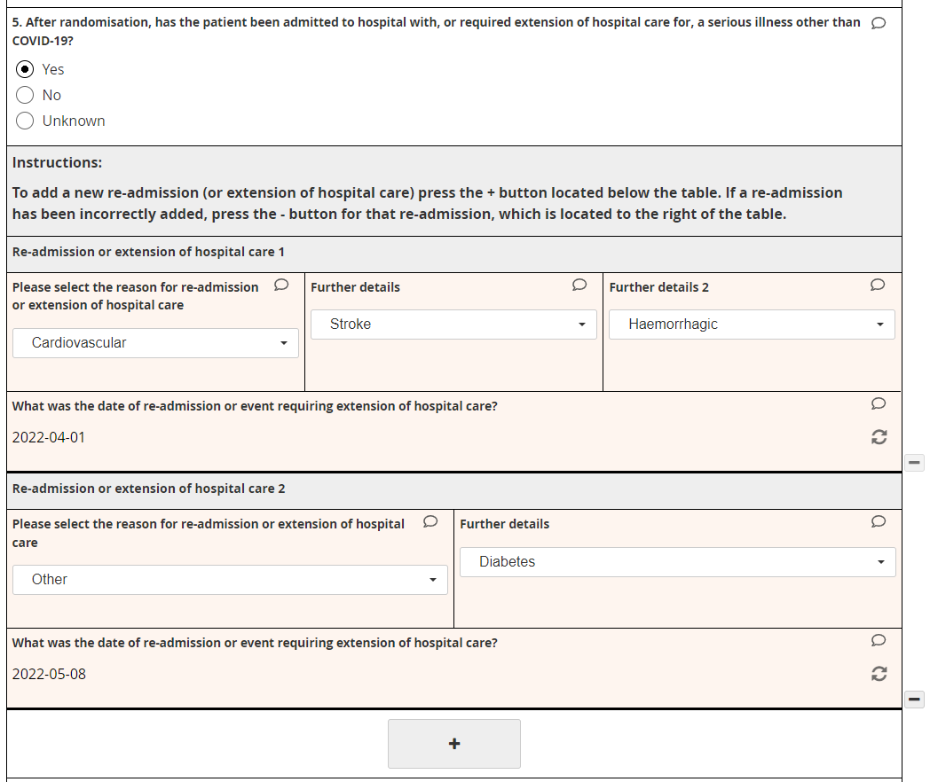
Q5 – Extended admission or re-admission
Select ‘No’ if the patient/relative has been contacted and they did not have an extension of admission or re-admission
Select ‘Yes’ if the patient developed a serious illness during their index admission that required extension of the admission
Also select ‘Yes’ if the patient is known to have required admission to hospital overnight for a serious illness after they were discharged from their index admission (do not include elective admissions)
Select ‘Unknown’ if it has not been possible to contact the patient/relative
For each event select a reason and date
Multiple events can be recorded if necessary. Click ‘+’ or ‘-’ to add or remove an event

Slide 8
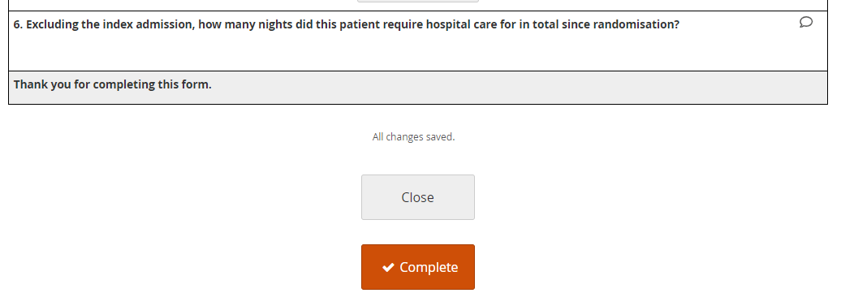
Q6 – Duration of re-admission(s)
Enter the total number of nights the patient has stayed in hospital for any serious illness since randomisation, excluding index admission.
Leave blank if it was not possible to contact the patient/relative
When the form is complete click ‘Complete’
Email recoverytrial@ndph.ox.ac.uk if you have any questions

