Slide 1
The RECOVERY trial
Trial Background and Overview
V3.0 2024-01-24

Slide 2
Background
The SARS-CoV-2 pandemic caused ~20 million deaths and global disruption, but has now moved to an endemic phase
COVID-19 treatment progressed rapidly because of the robust evaluation of potential therapies in large randomised trials
We now know more about the treatment of COVID-19 pneumonia than influenza or bacterial pneumonia
Pneumonia related to various pathogens remains a major cause of hospitalisation and death worldwide (~2.5 million deaths/year)

Slide 3
Background
RECOVERY has been by far the largest COVID-19 treatment trial, recruiting nearly 50,000 hospitalised patients
It has demonstrated the need for large, collaborative trials to identify or rule-out worthwhile treatment effects
The trial has evaluated >12 COVID-19 treatments, showing that:
Corticosteroids, IL-6 inhibitors, JAK inhibitors and neutralising monoclonal antibodies are effective (in combination reducing the risk of death by nearly half).
But, many widely used treatments had no worthwhile effect (e.g. hydroxychloroquine, lopinavir, azithromycin, andconvalescent plasma)
RECOVERY has now evolved into a platform trial evaluating treatments for other causes of pneumonia, including influenza and presumed bacterial community-acquired pneumonia

Slide 4
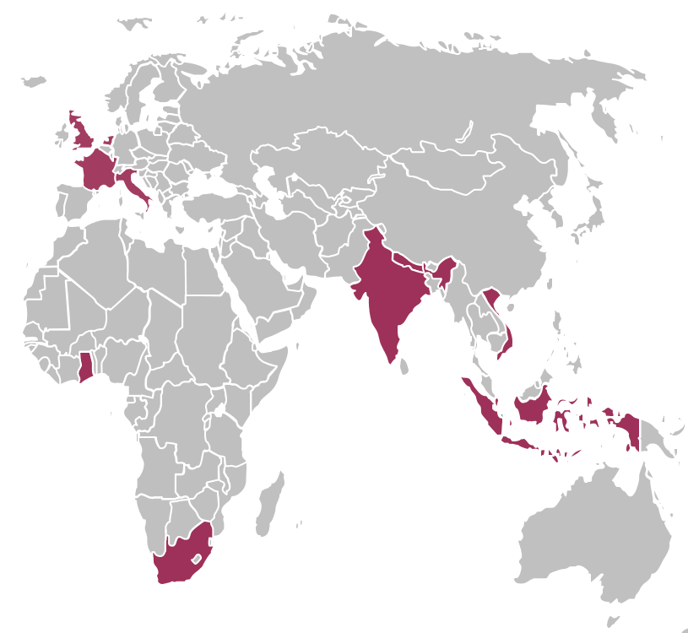
The RECOVERY Trial
Randomised, open-label, platform trial for patients hospitalised with pneumonia
Started in UK, now in 10 countries
Streamlined design - trial procedures & eligibility are simple, to reduce burden on hospital staff and allow recruitment of large numbers of patients
Primary outcome: 28-day all-cause mortality
Secondary outcomes: i) Progression to ventilation/death
ii) Time to hospital discharge
(co-primary for influenza)
www.recoverytrial.net

Slide 5
RECOVERY Core Eligibility
Hospitalised
Pneumonia syndrome, e.g.
Typical symptoms of a new respiratory tract infection (cough, shortness of breath, fever, etc); and
Objective evidence of acute lung disease (e.g. X-ray/CT/US changes, hypoxia, or clinical exam); and
Alternative causes considered unlikely or excluded (e.g. heart failure)
However, the diagnosis is a clinical one in the opinion of the managing doctor (these criteria are a guide)
One of the following diagnoses:
Confirmed SARS-CoV-2 infection (COVID-19 comparisons not open in EU)
Confirmed influenza A or B infection
Community-acquired pneumonia with planned antibiotics (without suspected COVID-19/flu/PCP/TB)
No medical history that might put the patient at risk if they were to participate
Attending clinician does not believe a specific trial treatment is indicated or contra-indicated
Outside the UK must be ≥18 years old (in the UK children are eligible for some comparisons)
Some comparisons have additional eligibility criteria - see protocol & relevant training

Slide 6
RECOVERY design (comparisons vary by region and will change over time – see current protocol on the website)
HOSPITALISED PATIENTS WITH PNEUMONIA
COVID-19 high dose corticosteroid comparison (patients on NIV or IMV)
Community-acquired pneumonia (CAP) corticosteroid comparison
ANALYSIS
Sotrovimab comparison
E
High dose dexamethasone
Usual care (standard dose corticosteroids)
J
Sotrovimab
Usual care without sotrovimab
M
Dexamethasone
Usual care without corticosteroids
or
or
or
Patients with confirmed SARS-CoV-2
Patients with CAP (without suspected SARS-CoV-2/influenza/PCP/TB)
R
Outcomes at 28 days and 6 months
Mortality
Time to discharge alive
Progression to ventilation or death
Baseline data collected, suitability determined
1:1 randomisation in each suitable comparison
Baloxavir comparison
Oseltamivir comparison
Influenza corticosteroid comparison (patients with hypoxia)
G
Baloxavir
Usual care without baloxavir
H
Oseltamivir
Usual care without oseltamivir
I
Dexamethasone
Usual care without corticosteroids
or
or
or
Patients with confirmed INFLUENZA

Slide 7
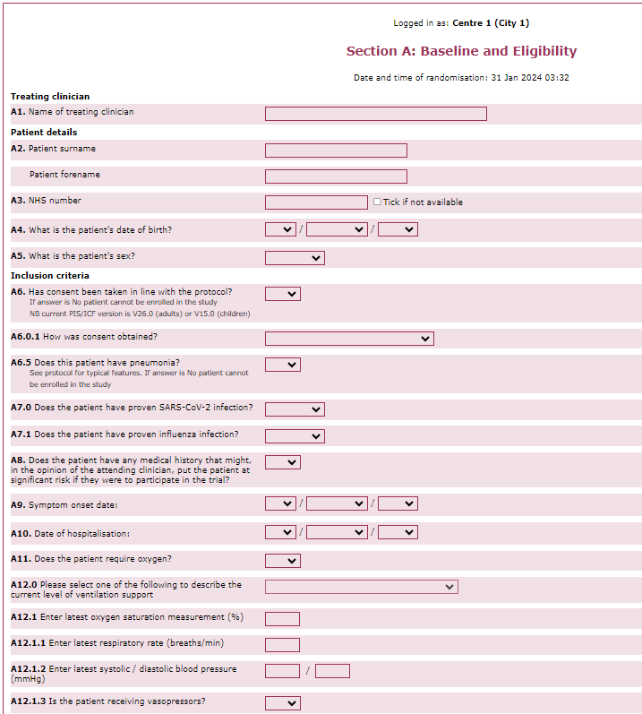
RECOVERY Trial procedures
Written consent is taken from the patient or legal representative
Baseline data entered onto randomisation website, including suitability for each treatment comparison
Patients can be entered into multiple comparisons simultaneously
If the patient is ineligible for one treatment they can still be randomised in other comparisons
Patients are allocated either to the trial treatment or to usual care without the trial treatment (other care remains the same)
Allocations are independent, so a patient can be allocated all, none or any combination of suitable treatments
Follow-up uses OpenClinica eCRF
Data from medical records, with no trial specific measurements (other than respiratory swabs for selected regions/comparisons)
Primary/secondary outcomes collected at 28 days plus treatments received & major safety outcomes (e.g. kidney/liver injury, seizure)
In some regions, follow-up at 28 days/6 months requires a phone call

Slide 8
Summary
Better treatments are needed to reduce mortality in patients hospitalised with pneumonia
RECOVERY is currently evaluating several promising treatments
As an adaptive trial, the design will continue to evolve as new treatments are added, and old treatments are removed when results are found
The RECOVERY collaboration has been a major success, involving thousands of collaborators at hundreds of hospitals
We hope to continuing welcoming new collaborators around the world!

