Slide 1
RECOVERY Trial
Corticosteroids for Community-Acquired Pneumonia (CAP)
Training
V1.0 2024-01-08

Slide 2
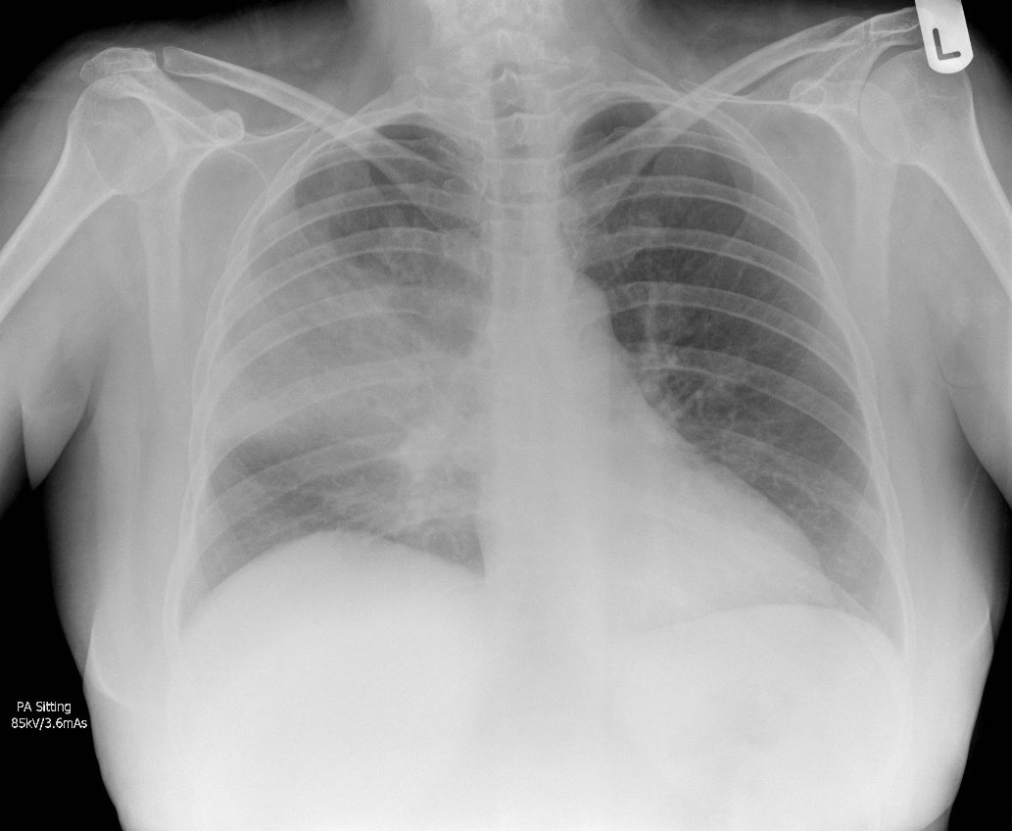
Community-acquired pneumonia
In a non-pandemic context, CAP is usually caused by bacteria from the upper respiratory tract
The causative pathogen is usually not identified, so diagnosis is based on a typical symptoms and radiology, and treatment is with empirical antibiotics and supportive care
The RECOVERY CAP comparison is recruiting these patients, with CAP related to suspected or confirmed bacterial infection
CAP is one of the commonest reasons for acute hospital admission worldwide, estimated to kill ~2,500,000 people/year
Viral pneumonia caused by SARS-CoV-2 and influenza have distinct pathologies and treatments, and can be diagnosed readily by throat swab PCR, so these are treated as separate categories of pneumonia in RECOVERY
Case courtesy of Jeremy Jones, Radiopaedia.org

Slide 3
RECOVERY Eligibility
Hospitalised
Pneumonia syndrome, e.g.
Typical symptoms of a new respiratory tract infection (cough, shortness of breath, fever, etc); and
Objective evidence of acute lung disease (e.g. X-ray/CT/US changes, hypoxia, or clinical exam); and
Alternative causes considered unlikely or excluded (e.g. heart failure)
However, the diagnosis is a clinical one in the opinion of the managing doctor (these criteria are a guide)
One of the following diagnoses:
Confirmed SARS-CoV-2 infection
Confirmed influenza A or B infection
Community-acquired pneumonia with planned antibiotics (without suspected COVID-19/flu/PCP/TB)
No medical history that might put the patient at risk if they were to participate
Attending clinician does not believe a specific trial treatment is indicated or contra-indicated

Slide 4
CAP in RECOVERY - clarifications
Patients are ineligible if they have suspected or confirmed:
SARS-COV-2 infection
Influenza infection
Pneumocystis jirovecii pneumonia (‘PCP’ or ‘PJP’)
Active pulmonary tuberculosis
Testing for these pathogens is not required for trial purposes (only if part of standard care)
Detection of viruses other than those above is not an exclusion (e.g. RSV, adenovirus, rhinovirus, etc.)
‘Community-acquired’ can be defined as in usual practice, but implies:
Pneumonia was present on admission
No recent inpatient stay in hospital or a healthcare facility (e.g. in the 10 days before admission)

Slide 5
Corticosteroids for CAP
Dexamethasone 6mg once daily reduces mortality in hypoxic COVID-19 patients by around one fifth¹
Corticosteroids are also beneficial in severe PCP²
Despite similarities with COVID-19, lung involvement is typically more focal in CAP, with less severe hypoxia, and different patterns of immune activation³
CAP is also a more heterogeneous syndrome than COVID-19, caused by a variety of pathogens
Do corticosteroids reduce mortality in patients hospitalised with CAP?
1 RECOVERY Collaborative Group. N Engl J Med. 2021 PMID32678530 2 Ewald H, et al. Cochrane Database Syst Rev. 2015 PMID25835432
3 Ibáñez-Prada ED, et alRespir Res. 2023 PMID: 36814234

Slide 6
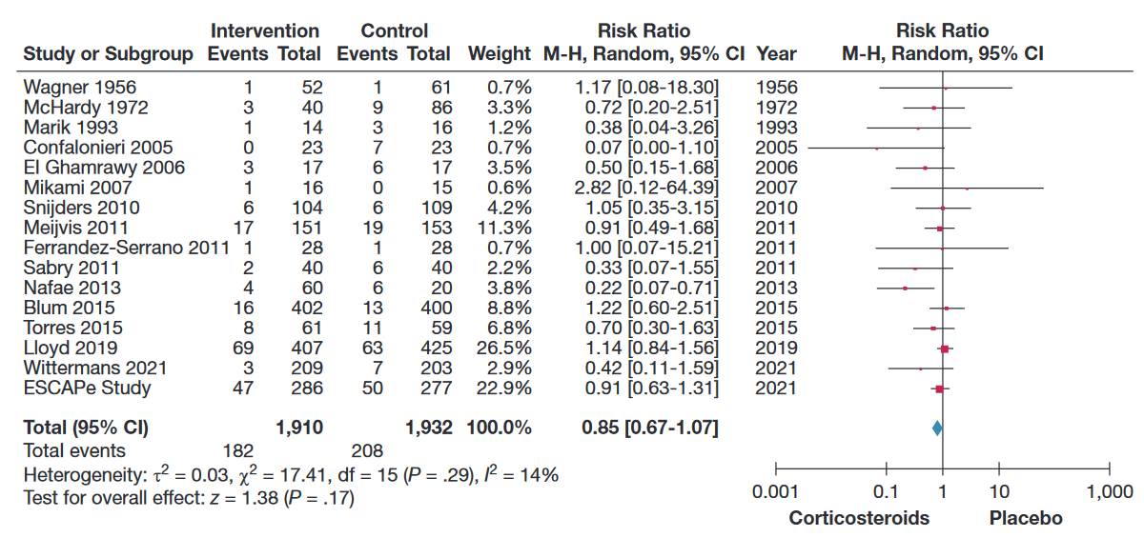
Corticosteroids for CAP
A 2023 meta-analysis found that patients with CAP receiving steroids had a 15% lower risk of death
However, the trials were too small to be conclusive, so there may be no benefit, or the benefit could be even greater (e.g. a 20-30% reduction)
Saleem N, et al. Chest. 2023. PMID36087797

Slide 7
Corticosteroids for CAP
In one subsequent trial of ICU patients (CAPE COD) the risk of death was lower with steroids (25/400 v 47/395 died)¹
However, there was no favourable result in ICU patients in the 2022 ESCAPe trial (47/286 v 50/277 died)²
Corticosteroids reduce time to discharge in CAP, but this may be a direct effect of fever/CRP reduction, rather than representing an improvement in outcomes³ (and there is some evidence that readmissions may be higher in those allocated corticosteroids⁴)
We need more randomised evidence from a wide range of patients to inform treatment of CAP
¹Dequin P, et al. N Engl J Med. 2023 PMID369427891 ²Meduri G, et al. Intensive Care Med. 2022. PMID35723686
³Joseph L, et al. Lancet 2011. PMID21907856 ⁴Saleem N, et al. Chest. 2023. PMID36087797

Slide 8
RECOVERY design: Core Protocol V27.0
HOSPITALISED PATIENTS WITH PNEUMONIA
COVID-19 high dose corticosteroid comparison (patients on NIV or IMV)
Community-acquired pneumonia (CAP) corticosteroid comparison
ANALYSIS
Sotrovimab comparison
E
High dose dexamethasone
Usual care (standard dose corticosteroids)
J
Sotrovimab
Usual care without sotrovimab
M
Dexamethasone
Usual care without corticosteroids
or
or
or
Patients with confirmed SARS-CoV-2
Patients with CAP (without suspected SARS-CoV-2/influenza/PCP/TB)
R
Outcomes at 28 days and 6 months
Mortality
Time to discharge alive
Progression to ventilation or death
Baseline data collected, suitability determined
1:1 randomisation in each suitable comparison
Baloxavir comparison
Oseltamivir comparison
Influenza corticosteroid comparison (patients with hypoxia)
G
Baloxavir
Usual care without baloxavir
H
Oseltamivir
Usual care without oseltamivir
I
Dexamethasone
Usual care without corticosteroids
or
or
or
Patients with confirmed INFLUENZA

Slide 9
RECOVERY design: CAP comparison
HOSPITALISED PATIENTS WITH PNEUMONIA
COVID-19 high dose corticosteroid comparison (patients on NIV or IMV)
Community-acquired pneumonia (CAP) corticosteroid comparison
ANALYSIS
Sotrovimab comparison
E
High dose dexamethasone
Usual care (standard dose corticosteroids)
J
Sotrovimab
Usual care without sotrovimab
M
Dexamethasone
Usual care without corticosteroids
or
or
or
Patients with confirmed SARS-CoV-2
Patients with CAP (without suspected SARS-CoV-2/influenza/PCP/TB)
R
Outcomes at 28 days and 6 months
Mortality
Time to discharge alive
Progression to ventilation or death
Baseline data collected, suitability determined
1:1 randomisation in each suitable comparison
Baloxavir comparison
Oseltamivir comparison
Influenza corticosteroid comparison (patients with hypoxia)
G
Baloxavir
Usual care without baloxavir
H
Oseltamivir
Usual care without oseltamivir
I
Dexamethasone
Usual care without corticosteroids
or
or
or
Patients with confirmed INFLUENZA

Slide 10
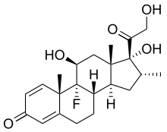
CAP Corticosteroid comparison
Open to adults ≥18 years
No requirement for hypoxia (unlike influenza corticosteroid comparison)
Pregnant & breastfeeding women are eligible (but use prednisolone/hydrocortisone instead of dexamethasone – see protocol for dosing)
Patients with liver or renal failure are eligible
Patients are not eligible if their attending doctor considers systemic corticosteroids to be indicated or contraindicated for any reason
If, after randomisation, corticosteroids become indicated in a patient allocated usual care these should be given (this should only be happening because of a change in clinical condition)

Slide 11
CAP Corticosteroid comparison
Dexamethasone is a CYP3A4 substrate, so there is a risk of increased exposure and side effects if given alongside potent CYP3A4 inhibitors, e.g.
Clarithromycin/erythromycin (but not azithromycin)
Ritonavir/cobicistat
Azole antifungals
Consider whether a potent CYP3A4 inhibitor could safely be suspended/replaced, or if increased monitoring for steroid side effects is needed
If potent CYP3A4 inhibitor cannot be avoided then it may not be appropriate to enrol the patient in the corticosteroid comparison, but this is not prohibited by the protocol, as management should be based on an assessment of individual risks/benefits

Slide 12
CAP Corticosteroid comparison
Dexamethasone 6mg once daily, oral/nasogastric or iv
Treat for 10 days or until discharged, whichever is sooner
No baseline or follow-up samples
Important side effects of corticosteroids should be considered and anticipated as in normal practice, e.g.
Risk of hyperglycaemia (consider need for increased monitoring)
Peptic ulceration (consider need for gastroprotection if high risk)
Infection (especially if other reasons for immunosuppression)
Psychiatric reactions
Fluid retention
Risk of adrenal insufficiency with sudden withdrawal in some patients, e.g. significant previous corticosteroid use, or other reasons for adrenal insufficiency (consider gradual withdrawal following normal practice)

Slide 13
Summary - CAP
CAP is a major cause of hospital admission and death worldwide
If corticosteroids reduce the risk of death even moderately (e.g. a 10-20%) it could save tens or hundreds of thousands of lives
To identify or rule out a worthwhile benefit of steroids will require far more patients to be randomised than in previous trials
Please consider RECOVERY for as many of your patients as possible

