Slide 1
Randomised Evaluation of COVID-19 Therapy: the RECOVERY trial
Collaborators’ Meeting
3/4th August 2020

Slide 2
Agenda
Introductions
Update on progress
Recruitment
Tocilizumab
Protocol V8.0
Future plans
Q&A

Slide 3
Introductions
One of the central study team will talk to the agenda
If you have questions please enter them into the “Q&A” on the right side of your screen.
Questions may be answered directly or to the whole group

Slide 4
PROGRESS update

Slide 5
Current trial design
ELIGIBLE PATIENTS
OUTCOMES
SOC + CP
SOC - CP
Tocilizumab
R
R2
No additional treatment
AZM + CP
AZM - CP
CP
vs
No CP

Slide 6
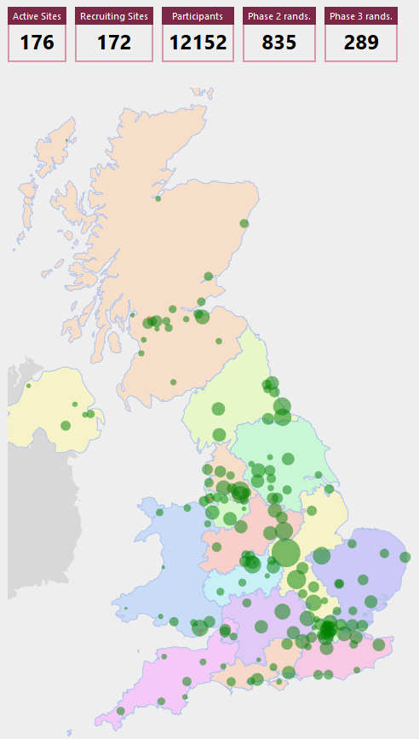
Recruitment by site and by time

Slide 7
Recruitment proportion
Proportion recruited 20 March – 30 April
Proportion recruited 30 April – 7 July
Average 17.4%
Average 12.1%

Slide 8
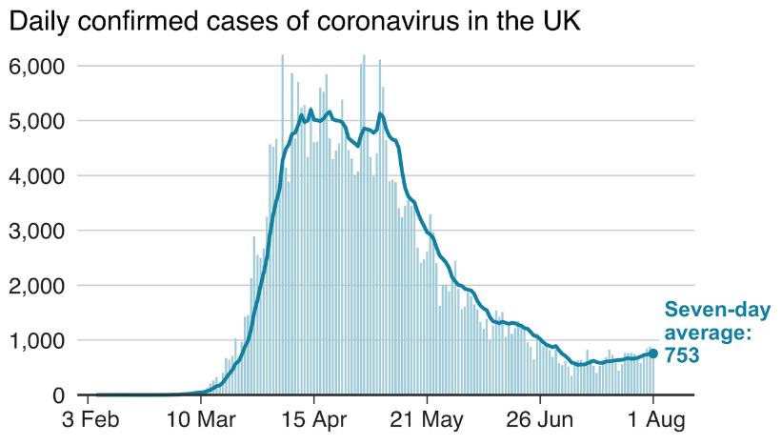
Recruitment by site and by time

Slide 9
Recruitment
Continued recruitment is essential
As local outbreaks occur, please consider discussing with your teams how to ensure that all available admissions with Covid-19 are identified and enrolled if possible
Daily catch-up with admitting teams
Links with laboratory for all positive swabs among patients to be reported

Slide 10
Tocilizumab

Slide 11
COVACTA trial
Recruited approximately 450 patients with proven Covid-19 and hypoxia and compared tocilizumab (8 mg/kg) with placebo
Primary outcome: clinical status (based on need for oxygen/ventilation) on 7-point scale
OR for improvement 1.19 (95% CI 0.81-1.76); p=0.36
OR >1 would be in favour of tocilizumab

Slide 12
COVACTA trial: secondary outcomes
Death by 28 days (secondary outcome): 19.7% tocilizumab vs 19.4% placebo
Time to discharge: 20 days tocilizumab vs 28 days placebo
Another trial (200 participants) due to report soon, with others ongoing.

Slide 13
Tocilizumab
Results of COVACTA have been reviewed by our DMC who have not recommended any change to RECOVERY, so recruitment should continue
If your site is not included yet but would like to be, please e-mail recoverytrial@ndph.ox.ac.uk

Slide 14
Protocol V8.0

Slide 15
Protocol V8.0
Two main changes:
Collection of baseline serum sample from participants in convalescent plasma comparison
Modifications to main randomisation for children with PIMS-TS

Slide 16
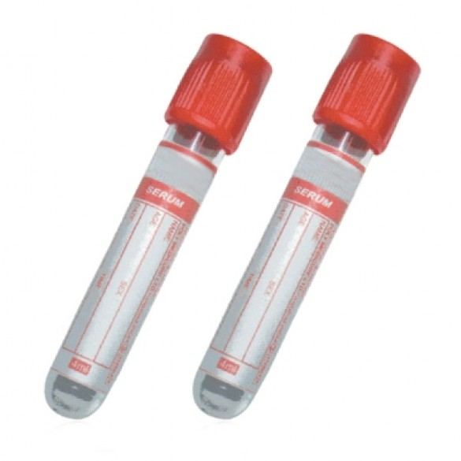
Sample collection
Adds collection of serum sample at baseline for patients entering convalescent plasma comparison
Standard serum sample (often ‘red top’) to be sent to transfusion laboratory before patient is randomised
NB it will not be possible to randomise a patient without confirming that sample has been sent
Will allow measurement of coronavirus and antibodies against it, to help assessment of effect of convalescent plasma

Slide 17
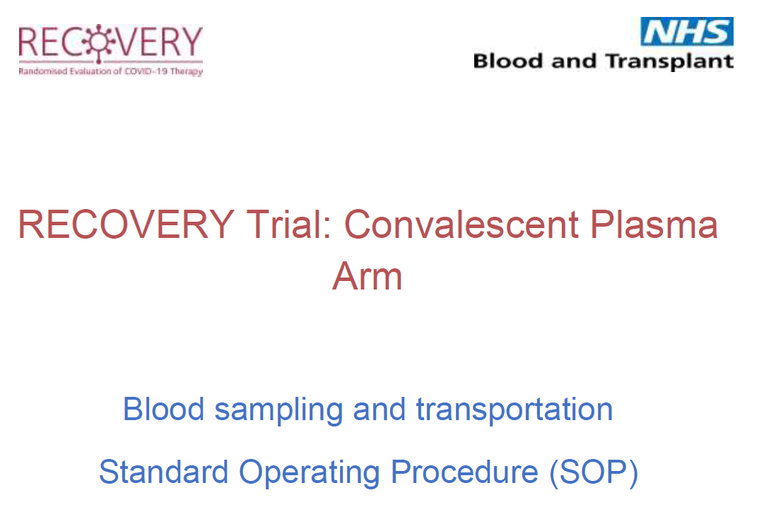
Sample collection
SOP for sample collection available on website: describes what should happen to samples
Local teams can decide who is responsible for actions
Ideally samples will be sent to local transfusion lab (so can be collected from anywhere in hospital at any time of day) and will be posted to central lab from there

Slide 18
PIMS-TS
Introduces treatments for PIMS-TS (Paediatric Multisystem Inflammatory Syndrome temporally associated with COVID-19)
Children aged >44 weeks gestational age with suspected PIMS-TS can be randomised between:
High-dose methylprednisolone vs
intravenous immunoglobulin vs
usual care

Slide 19
Follow-up

Slide 20
Completeness is key
Weekly reminders highlighting participants randomised >28 days ago without complete form and also those needing a Convalescent Plasma 72h safety form
Please do complete these as soon as possible

Slide 21
FUTURE PLANS

Slide 22
Current trial design
ELIGIBLE PATIENTS
OUTCOMES
SOC + CP
SOC - CP
Tocilizumab
R
R2
No additional treatment
AZM + CP
AZM - CP
CP
vs
No CP

Slide 23
Monitoring
On-site monitoring not possible
We would like to check consent process so will be in touch with PIs in near future about this. We hope your R&D departments may be able to assist with this.

Slide 24
Carry on recruiting!
Need to continue recruitment and collection of follow-up information to provide DMC with information about efficacy and safety of study treatments
As admission rates fall, please focus efforts on recruiting as many admitted patients as possible
Thank you!

