Slide 1
Randomised Evaluation of COVID-19 Therapy: the RECOVERY trial
Collaborators’ Meeting
18th & 19th September 2023

Slide 2
Agenda
RECOVERY Influenza comparisons
Update on COVID-19
Current COVID-19 comparisons:
Sotrovimab
High-dose corticosteroids
Trial procedures
Substantial amendment 31
Future plans for RECOVERY
Q&A
Note there are no specific obstetric or paediatric updates

Slide 3
Introductions
One of the central study team will talk to the agenda
If you have questions please enter them into the “Q&A” on the right side of your screen.
Questions may be answered directly or to the whole group

Slide 4
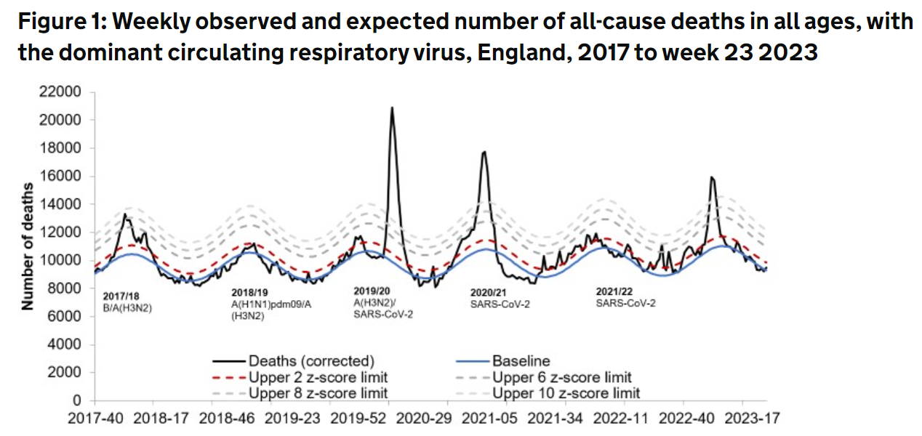
Influenza

Slide 5
Influenza
RECOVERY & other trials quickly found life-saving treatments for COVID-19 by randomising thousands of patients
Many other proposed treatments were found to be ineffective
Seasonal flu kills an estimated 400,000 people/year, but we do not have good (i.e. randomised) evidence to guide treatment

Slide 6
Influenza treatments
Oseltamivir (Tamiflu®): this antiviral is widely used in hospitalised patients but with no robust evidence of benefit
Current UKHSA guidance recommends use of oseltamivir in hospitalised patients
In January, the CMO for England clarified that they encourage enrolment of patients into randomised trials, which is in keeping with their guidance
Baloxavir: this newer antiviral works via a novel mechanism, which could be more effective than oseltamivir (or work in combination)
Dexamethasone: life-saving in COVID-19, but we don’t know if it works for flu

Slide 7


Current RECOVERY design
ELIGIBLE PATIENTS
OUTCOMES
High-dose corticosteroids
(patients requiring NIV or IMV)
Sotrovimab
Patients with
confirmed
SARS-CoV-2
COVID comparisons are currently due to end 30th November
E
High dose
steroids
or
Usual care alone
J
Sotrovimab
or
Usual care alone
Baseline data collected
Participants enter ≥1 comparisons
R
Outcomes collected at earliest of death, discharge or 28 days
Low-dose corticosteroids
(hypoxic, SARS-CoV-2 negative)
Influenza Antiviral 1
Influenza Antiviral 2
G
Baloxavir
or
Usual care alone
H
Oseltamivir
or
Usual care alone
I
Low dose
steroids
or
Usual care alone
Patients with confirmed INFLUENZA

Slide 8
Current RECOVERY design
ELIGIBLE PATIENTS
OUTCOMES
High-dose corticosteroids
(patients requiring NIV or IMV)
Sotrovimab
Patients with
confirmed
SARS-CoV-2
COVID comparisons are currently due to end 30th November
E
High dose
steroids
or
Usual care alone
J
Sotrovimab
or
Usual care alone
Baseline data collected
Participants enter ≥1 comparisons
R
Outcomes collected at earliest of death, discharge or 28 days
Low-dose corticosteroids
(hypoxic, SARS-CoV-2 negative)
Influenza Antiviral 1
Influenza Antiviral 2
G
Baloxavir
or
Usual care alone
H
Oseltamivir
or
Usual care alone
I
Low dose
steroids
or
Usual care alone
Patients with confirmed INFLUENZA

Slide 9
RECOVERY Eligibility
Hospitalised
Viral pneumonia syndrome, e.g.
Typical symptoms (e.g. influenza-like illness with fever and muscle pain, or respiratory illness with cough and shortness of breath); and
Compatible chest imaging (consolidation or ground-glass shadowing); and
Alternative causes considered unlikely or excluded (e.g. heart failure, bacteria pneumonia)
However, the diagnosis is a clinical one in the opinion of the managing doctor
Confirmed SARS-CoV-2/influenza infection
PCR (hospital or community) or in-hospital lateral flow test
No medical history that might put the patient at risk if they were to participate

Slide 10
RECOVERY Influenza
RECOVERY has philanthropic funding to extend influenza comparisons to sites across the UK
We would like to invite sites to participate in these this winter
Involvement would depend on site capacity, bearing in mind commitments to other studies (in particular REMAP-CAP)
The plan for CRN support for RECOVERY influenza comparisons is currently being discussed
These comparisons will also open soon at RECOVERY sites in Asia, Africa & the EU

Slide 11
RECOVERY Influenza
We need to randomise thousands of patients to know if these treatments work
As always, RECOVERY is designed to be as simple as possible for research & clinical teams
Unlike COVID-19 comparisons, research costs provided directly by Oxford (£400/participant)
Planned to continue for the next few flu seasons
We will email sites soon with further information
Please let us know if your site is not participating in REMAP-CAP influenza arms and might be interested in taking part in RECOVERY influenza arms

Slide 12
COVID-19 update

Slide 13
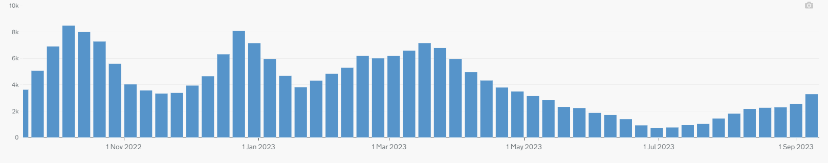
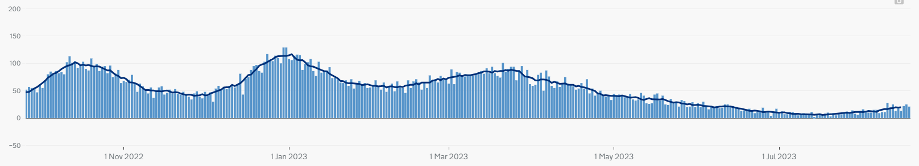
State of the pandemic
UK weekly hospital admissions with COVID-19
COVID-19 has become an endemic disease, but remains important
We will continue to see:
Severe disease in the most vulnerable
Epidemics with higher rates of hospitalisation and death
UK daily deaths caused by COVID-19

Slide 14
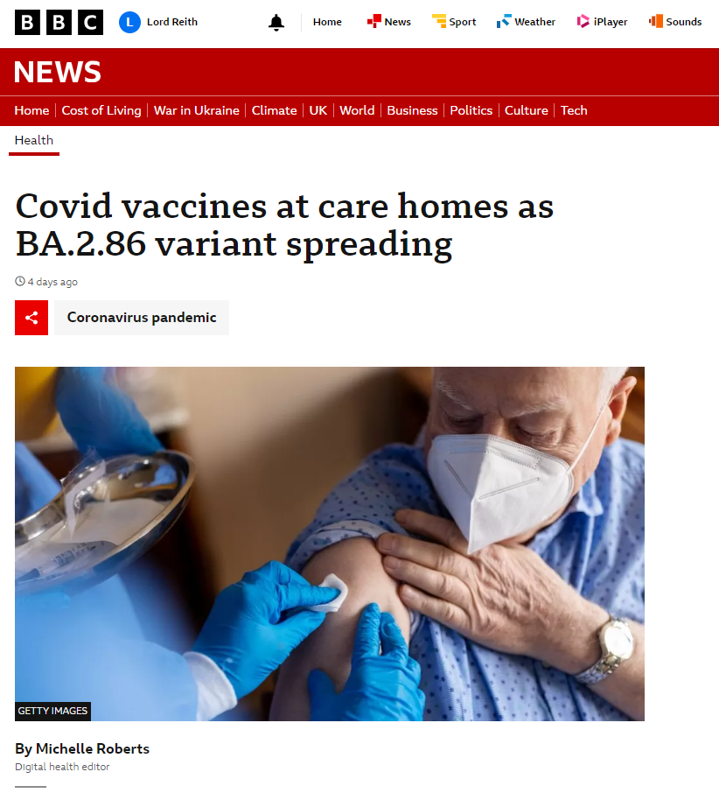
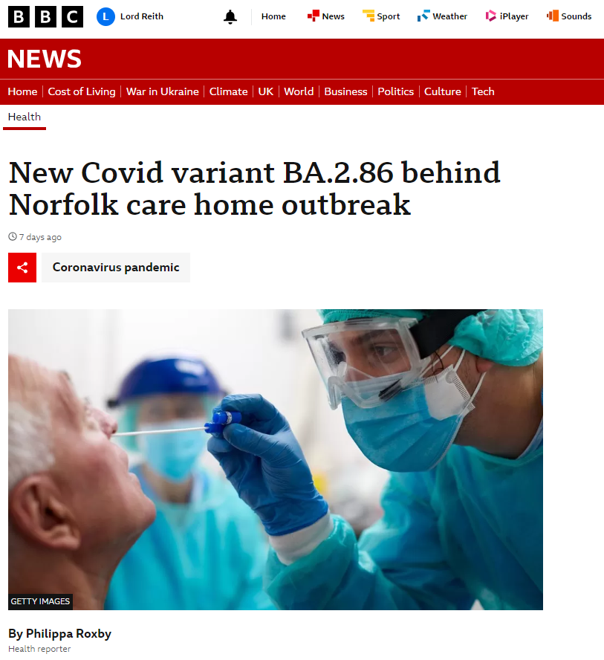
State of the pandemic
September 2023
BA.2.86 is being monitored by the UK government
It is an emerging global strain, possibly associated with immune escape
Not enough data yet to assess the risk it poses

Slide 15
RECOVERY COVID-19 comparisons
Funding for the COVID-19 comparisons is currently due to end 30th November 2023
It’s possible funding could be extended over this winter (if there is increasing concern about new variants)
Otherwise we will close recruitment to COVID-19 comparisons on the evening of 30th November

Slide 16
Sotrovimab

Slide 17
Sotrovimab
Derived from an antibody identified in a patient who had SARS-CoV-1 infection – target may be more “conserved” so less likely to mutate in future variants
Among outpatients in the COMET ICE trial, sotrovimab reduced need for hospitalisation or death by 85%
Only one small trial in hospitalised patients, so there remains uncertainty around benefits of sotrovimab for inpatients

Slide 18
Sotrovimab in RECOVERY
1628 participants to date
Blinded mortality 22%
Key importance of subgroups defined by antibody & serum antigen status
All adult participants potentially eligible, including those who have received sotrovimab previously (RECOVERY dose is 1g)
Adolescents ≥12 years old and ≥40 kg are also eligible
Pregnant or breast-feeding women are eligible after discussion with them
No exclusions around liver or kidney function

Slide 19
High-dose corticosteroids

Slide 20
High-dose corticosteroids
Now open only to adult patients on ventilatory support
This includes high-flow nasal oxygen, CPAP, BiPAP and IMV/ECMO
Results for patients not on ventilatory support now published
Usual care: should include dexamethasone 6 mg
High-dose arm: 20 mg dexamethasone once daily for 5 days, then 10 mg once daily for 5 days (stopped at discharge if sooner)

Slide 21
High-dose corticosteroids
473 participants currently in active comparison (not counting the subgroup already reported)
Recruiting in all countries in RECOVERY
Blinded mortality rate 35%

Slide 22
Trial procedures

Slide 23
Substantial Amendment 31
Substantial amendment 31 (currently under MHRA review) removes three closed comparisons: empagliflozin, Paxlovid & molnupiravir
It extends influenza comparisons to non-UK RECOVERY sites
Several other minor updates to the protocol (none require action by sites)
In the UK, SA31 introduces new PIS/ICFs – v25.0 (adults) and v15.0 (children)
Please make sure you switch to the new ICFs when the
amendment has been approved (we will contact sites)

Slide 24
Biological sampling
Samples only needed from COVID-19 participants in sotrovimab comparison
Includes those allocated usual care in sotrovimab comparison
Baseline serostatus has been crucial in understanding effects of monoclonal antibody therapy (but alternatives may now be needed)
Measuring effects on viral load may help us understand the effects of treatment & development of resistance

Slide 25
Biological sampling
 | COVID-19 |  | INFLUENZA
 | Serum sample | Nose swab | Serum sample | Nose swab
Baseline (Day 1) After consent, and before randomisation | ✓ | ✓ | ✗ | ✓
Day 3 | ✗ | ✓ | ✗ | ✗
Day 5 | ✗ | ✓ | ✗ | ✓
Full instructions are on our website (‘For Site Teams’ page)

Slide 26
Consent monitoring
We ask that a copy of every consent form is now e-mailed to RECOVERY trial
Please ensure that you write you name clearly on the consent form, so we can ensure that those taking consent have done consent training
The current version of the PIS/ICF is V24.0 (adults) and V14.0 (children)

Slide 27
Completeness of follow-up
Weekly reminders highlighting participants randomised >28 days ago without complete form
Completeness of follow-up is excellent; please keep this up!

Slide 28
Future plans
Community-acquired pneumonia
Estimated ~2,000,000 deaths/year worldwide
Common cause of admission in UK throughout the year
Initial RECOVERY comparison is low dose dexamethasone
Planned for RECOVERY sites in Asia, Africa & Europe
No current approvals to open in UK
Many other important unanswered questions in acute respiratory infection

Slide 29
Thank you!
We need better evidence for the treatment of influenza
The RECOVERY collaboration has been a remarkable success in COVID-19 treatment, and is well suited to continue providing answers for influenza
We are extremely grateful for your efforts to recruit to RECOVERY, and we hope that many of you will continue to collaborate with us in the influenza comparisons

