Slide 1
Randomised Evaluation of COVID-19 Therapy: the RECOVERY trial
Collaborators’ Meeting
4th & 5th December 2023

Slide 2
Agenda
Influenza
  Plan for collaboration with REMAP-CAP
  Oseltamivir
  Baloxavir
  Dexamethasone
COVID-19
  Funding extension
  Sotrovimab
  High-dose corticosteroids
Community-acquired pneumonia
Trial procedures
  Substantial amendments 31 & 33
Q&A
Note there are no specific obstetric or paediatric updates

Slide 3
Introductions
One of the central study team will talk to the agenda
If you have questions please enter them into the “Q&A” on the right side of your screen.
Questions may be answered directly or to the whole group

Slide 4
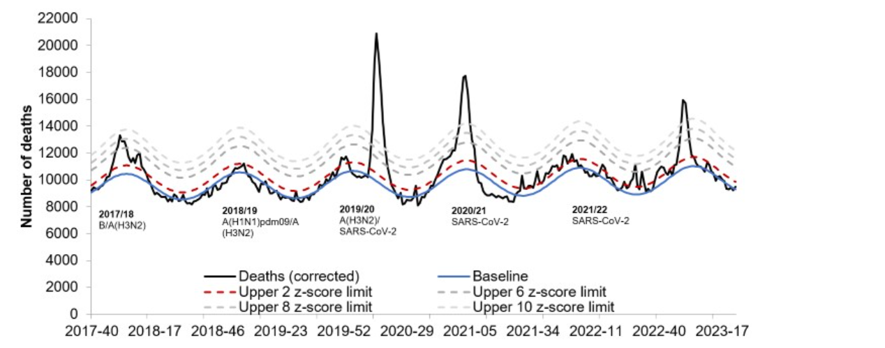
Influenza
Weekly deaths in the UK
COVID-19
Seasonal
influenza
Seasonal
influenza
2018
2019
2020
2021
2022
2023

Slide 5
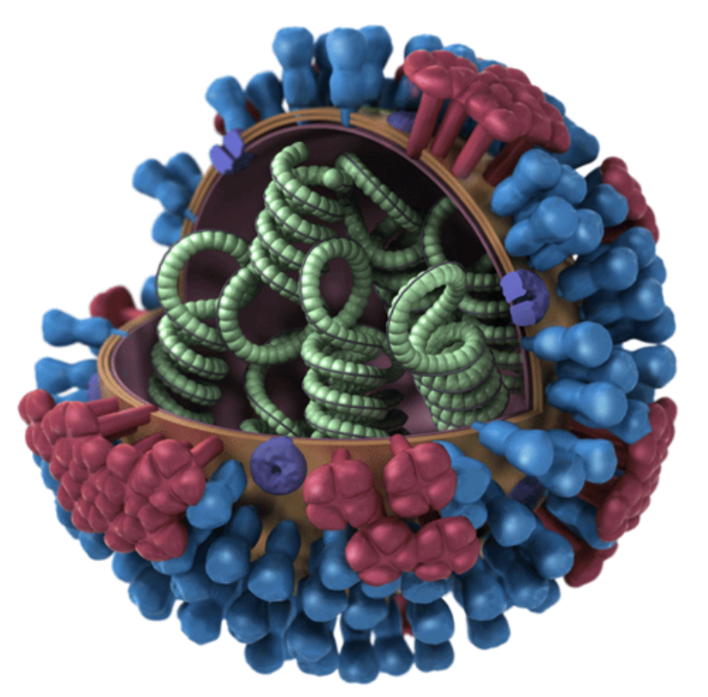
Influenza
RECOVERY & other trials quickly identified life-saving treatments for COVID-19 by randomising thousands of patients
Many other promising treatments were found to be ineffective
Seasonal flu kills ~400,000 people/year worldwide (one third aged under 65)
Unlike COVID-19, we do not have good (i.e. randomised) evidence to guide influenza treatment

Slide 6
RECOVERY & REMAP-CAP
RECOVERY & REMAP-CAP are now collaborating on influenza comparisons
Coordination of recruitment locations
  Only one trial will be open in a particular clinical area
  We aim for one trial to be open wherever there are inpatients with influenza in the NHS
Combined analysis & primary publication
  All participants recruited to either trial will contribute to the final results
The trials remain separate, with different protocols, eligibility & follow up procedures

Slide 7
RECOVERY & REMAP-CAP
If you are already running REMAP-CAP or RECOVERY flu comparisons at any locations in your trust, please continue
If you are in the process of setting up either trial at your site, please continue
If there are clinical areas where you are not yet planning to recruit patients with influenza into either trial, we would like to invite you to participate in RECOVERY
Both trials will now offer £400 per randomised participant to support trial sites with recruitment.
RECOVERY influenza & CAP comparisons are on the CRN non-commercial portfolio

Slide 8
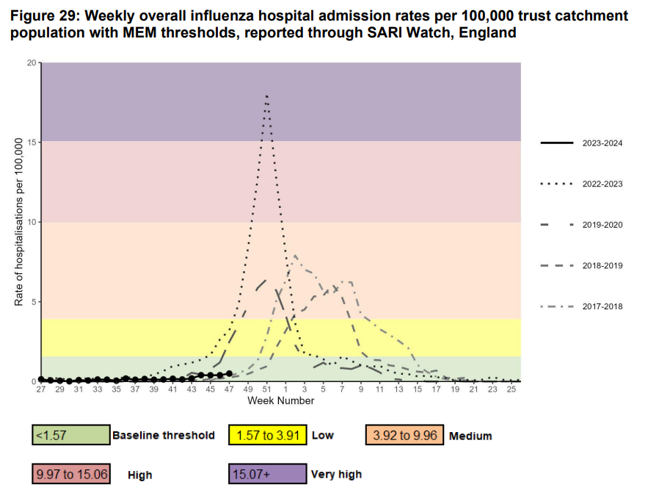
Influenza
Influenza admissions in England as of 30th November 2023

Slide 9
RECOVERY Eligibility
Hospitalised
Pneumonia syndrome, e.g.
  Typical symptoms of a new respiratory tract infection; and
  Objective evidence of acute lung disease (e.g. X-ray/CT changes, hypoxia, or clinical exam); and
  Alternative causes considered unlikely or excluded (e.g. heart failure)
  However, the diagnosis is a clinical one in the opinion of the managing doctor (these criteria are a guide)
One of the following diagnoses:
  Confirmed SARS-CoV-2 infection
  Confirmed influenza A or B infection [including those receiving antibiotics]
  Community-acquired pneumonia with planned antibiotics (without suspected COVID-19/flu/PCP/TB)
No medical history that might put the patient at risk if they were to participate
Attending clinician does not believe a specific trial treatment is indicated or contra-indicated

Slide 10


Current RECOVERY design
HOSPITALISED PATIENTS WITH PNEUMONIA
High-dose corticosteroids
(patients requiring NIV or IMV)
Low-dose corticosteroids
OUTCOMES
Sotrovimab
E
High dose
steroids
or
Usual care alone
J
Sotrovimab
or
Usual care alone
M
Low dose
steroids
or
Usual care alone
Patients with confirmed SARS-CoV-2
Patients with CAP (without suspected SARS-CoV-2/influenza/PCP/TB)
Baseline data collected
Participants enter ≥1 comparisons
R
Outcomes collected at earliest of death, discharge or 28 days
Low-dose corticosteroids
(hypoxic, SARS-CoV-2 negative)
Influenza Antiviral 1
Influenza Antiviral 2
G
Baloxavir
or
Usual care alone
H
Oseltamivir
or
Usual care alone
I
Low dose
steroids
or
Usual care alone
Patients with confirmed INFLUENZA

Slide 11
Current RECOVERY design
HOSPITALISED PATIENTS WITH PNEUMONIA
High-dose corticosteroids
(patients requiring NIV or IMV)
Low-dose corticosteroids
OUTCOMES
Sotrovimab
E
High dose
steroids
or
Usual care alone
J
Sotrovimab
or
Usual care alone
M
Low dose
steroids
or
Usual care alone
Patients with confirmed SARS-CoV-2
Patients with CAP (without suspected SARS-CoV-2/influenza/PCP/TB)
Baseline data collected
Participants enter ≥1 comparisons
R
Outcomes collected at earliest of death, discharge or 28 days
Low-dose corticosteroids
(hypoxic, SARS-CoV-2 negative)
Influenza Antiviral 1
Influenza Antiviral 2
G
Baloxavir
or
Usual care alone
H
Oseltamivir
or
Usual care alone
I
Low dose
steroids
or
Usual care alone
Patients with confirmed INFLUENZA

Slide 12
RECOVERY Influenza treatments
Oseltamivir (Tamiflu®): antiviral widely used in hospitalised patients but with no robust evidence of benefit
Baloxavir marboxil (Xofluza®): newer antiviral that works via a novel mechanism, which could be more effective than oseltamivir (or work in combination)
Dexamethasone: life-saving in COVID-19, but we don’t know if it works for flu
RECOVERY influenza comparisons planned to continue until at least 2026

Slide 13
Oseltamivir (TAMIFLU)

Slide 14
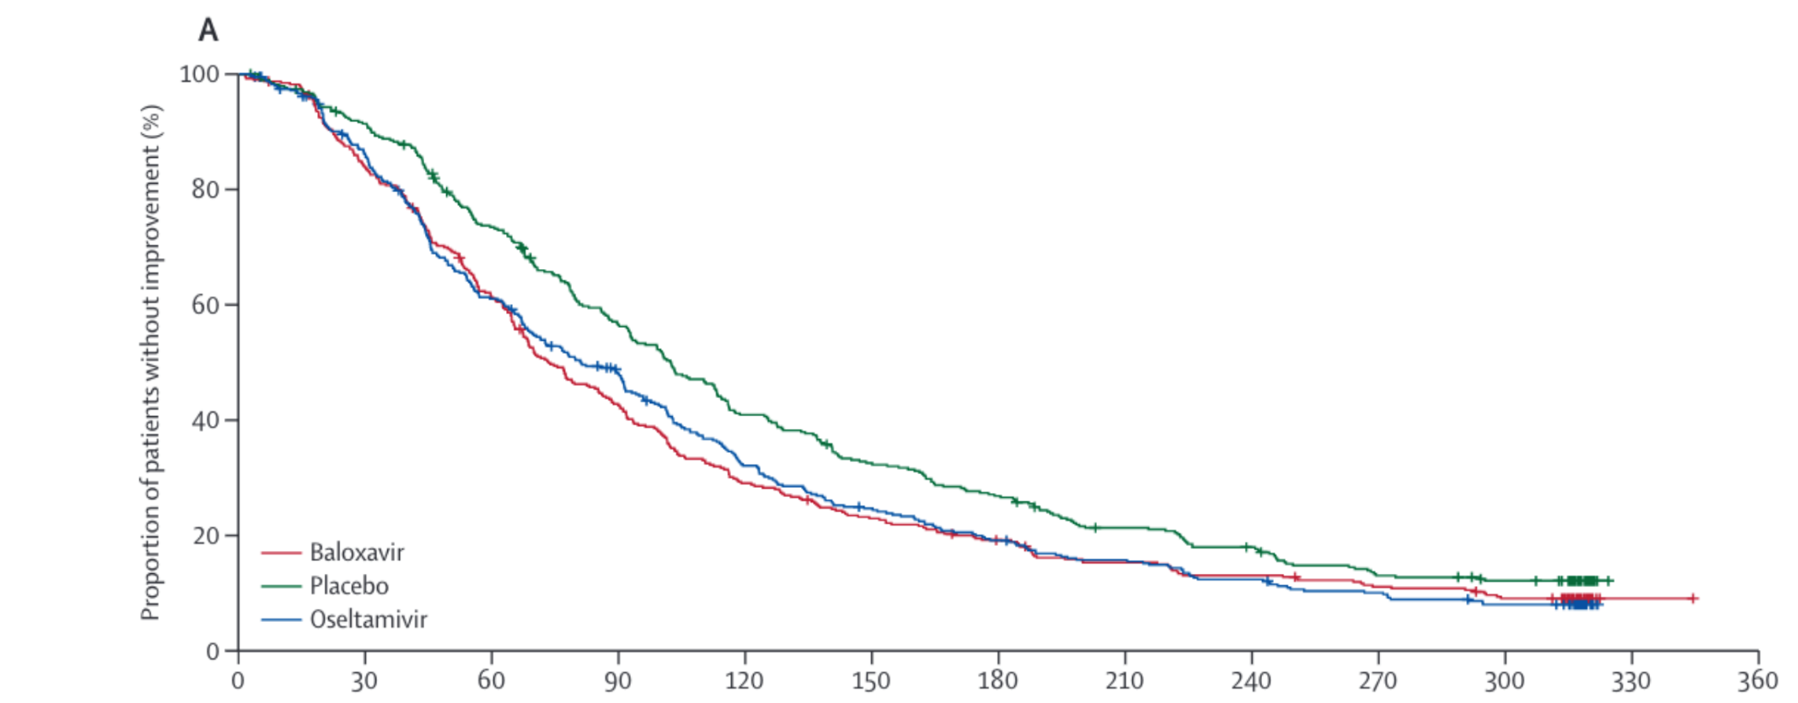
Oseltamivir (Tamiflu)
Oseltamivir is a neuraminidase inhibitor (NAI)
Neuraminidase allows the budding of virus from infected cells, so NAIs interfere with the viral replication cycle
Oseltamivir reduces the duration of flu symptoms by ~1 day in early infection
% with no symptom improvement
Baloxavir
Placebo
Oseltamivir
Time since start of treatment (h)
Ison MG et al. Lancet Infect Dis. 2020 Oct;20(10):1204-1214. PMID32526195

Slide 15
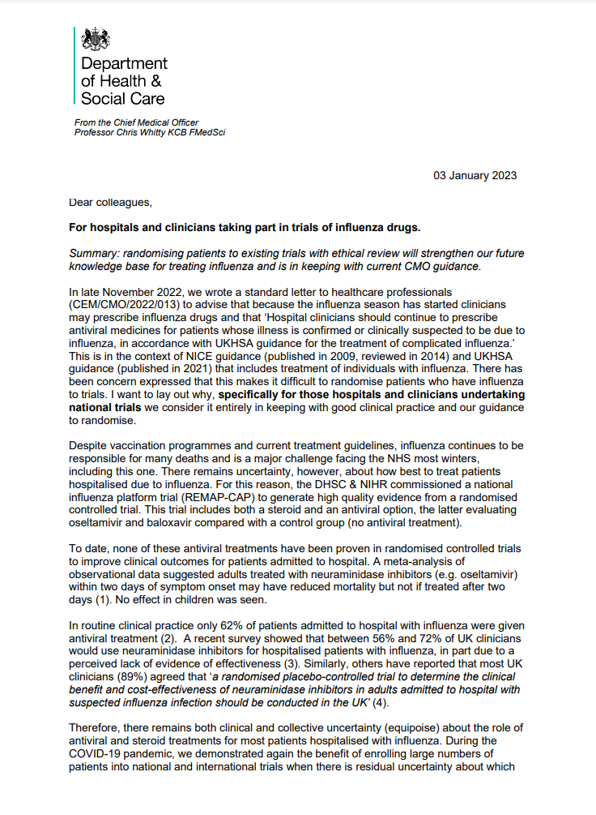
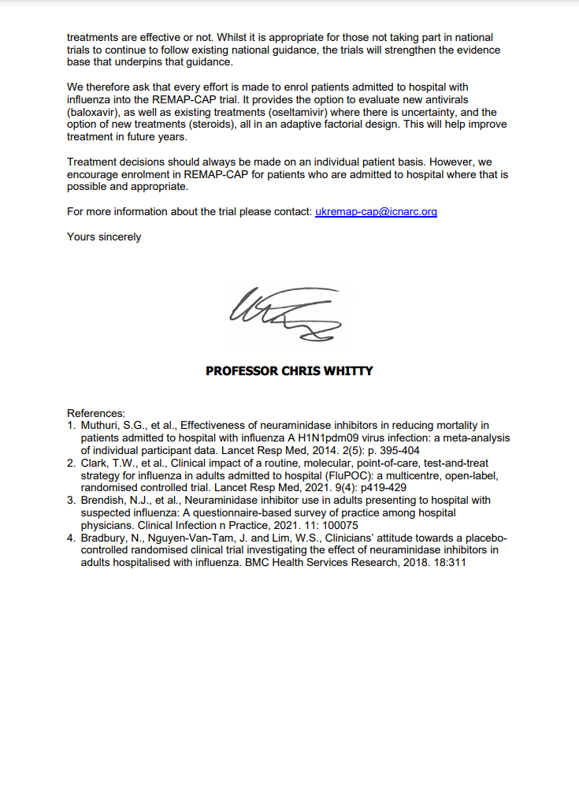
Oseltamivir (Tamiflu)
UKHSA guidance recommends NAIs for patients hospitalised with influenza (> local guidelines)
Earlier this year, the CMO for England wrote in support of trials that include a no antiviral arm
“[...] specifically for those hospitals and clinicians undertaking national trials we consider it entirely in keeping with good clinical practice and our guidance to randomise.”
“To date, none of these antiviral treatments have been proven in randomised controlled trials to improve clinical outcomes for patients admitted to hospital.”
Local discussions/communication may be needed to explain this context

Slide 16
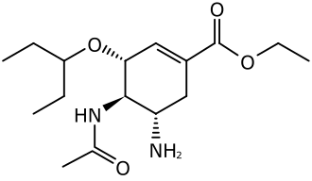
Oseltamivir (Tamiflu)
Patients with recent or planned use of an NAI for this infection are ineligible (oseltamivir or zanamivir)
Patients treated for bacterial co-infection are eligible if the clinical team think influenza may be contributing to the lung disease
Pregnant & breastfeeding women are eligible (see protocol appendix 4 for procedure)
Can be used in patients with liver & renal failure (but renal dose adjustment in RECOVERY differs from SmPC - see protocol)

Slide 17
Oseltamivir (Tamiflu)
Oral or nasogastric only (no iv route)
Treat for 5 days (10 days if immunocompromised) to be completed at home if discharged
No significant drug interactions known
Commonest side effects are headache, nausea and vomiting (<10%)

Slide 18
BALOXAVIR marboxil (XOFLUZA)

Slide 19
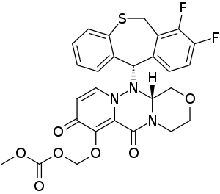
Baloxavir
Baloxavir is a cap-dependent endonuclease (CEN) inhibitor
CEN steals host mRNA cap to allow copying of the viral genome, so baloxavir interferes with viral replication
Rapidly reduces viral load, but resistance mutations can arise
Mechanism of action differs from NAIs, so combination may be better than either alone
Reduces the duration of flu symptoms by ~1 day but hasn't been properly tested in hospitalised patients

Slide 20
Baloxavir
Open to patients aged ≥12 & weighing ≥40kg
Contraindicated if recent or planned use of baloxavir for this infection
Pregnant and breastfeeding women potentially eligible (but only preclinical safety data – see protocol appendix 4)
Can be used in patients with liver or renal failure

Slide 21
Baloxavir
Oral or nasogastric only (no iv route)
Two doses only: first on day 1 and second on day 4, to be completed at home if discharged
No significant drug interactions known
No established side effects other than rare allergic reactions

Slide 22
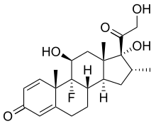
Corticosteroids for influenza
Corticosteroids are standard treatment for patients with COVID-19 pneumonia, reducing risk of death by ~1/5 in patients on oxygen
Previously proposed as a treatment for influenza pneumonia but never been properly tested in hospitalised patients
Reducing immune-mediated lung damage may improve survival in severe flu as it does in COVID-19

Slide 23
Corticosteroids for influenza
Open to patients with influenza pneumonia plus hypoxia (supplemental oxygen or SpO2 <92% on air)
Contraindicated if recent or planned use of systemic corticosteroids, or if coinfected with SARS-CoV-2
Pregnant & breastfeeding women eligible (but use prednisolone/hydrocortisone instead of dexamethasone – see protocol)
Patients with liver or renal failure are eligible
If, after randomisation, corticosteroids become indicated in a patient allocated usual care they should be given (this should only happen because of a change in clinical condition)

Slide 24
Corticosteroids for influenza
Oral or iv dexamethasone 6mg once daily
Treat for 10 days or until discharged, whichever is sooner
Common side effects of corticosteroids should be anticipated and managed as in normal practice
  E.g. consider risk of hyperglycaemia, peptic ulceration, infection
Potential for increased side effects with clarithromycin/erythromycin (& other potent CYP3A4 inhibitors) – not a contraindication but consider alternative (e.g. azithromycin)

Slide 25
COVID-19 update

Slide 26
RECOVERY COVID-19 comparisons
UKRI/NIHR funding for the COVID-19 comparisons has just been extended to 31st March 2024 because of a possible winter epidemic
We do not expect funding to be extended further
Sites not participating in influenza or CAP comparisons will close on this date

Slide 27
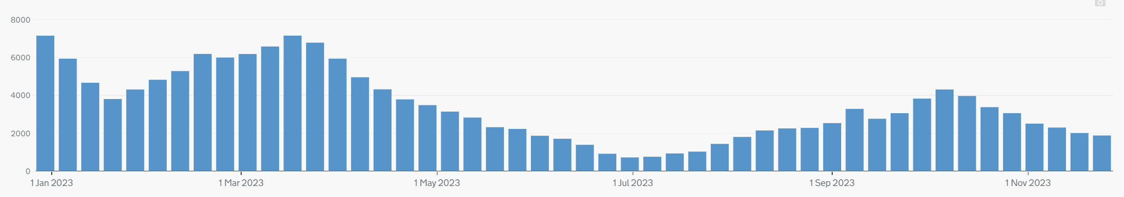
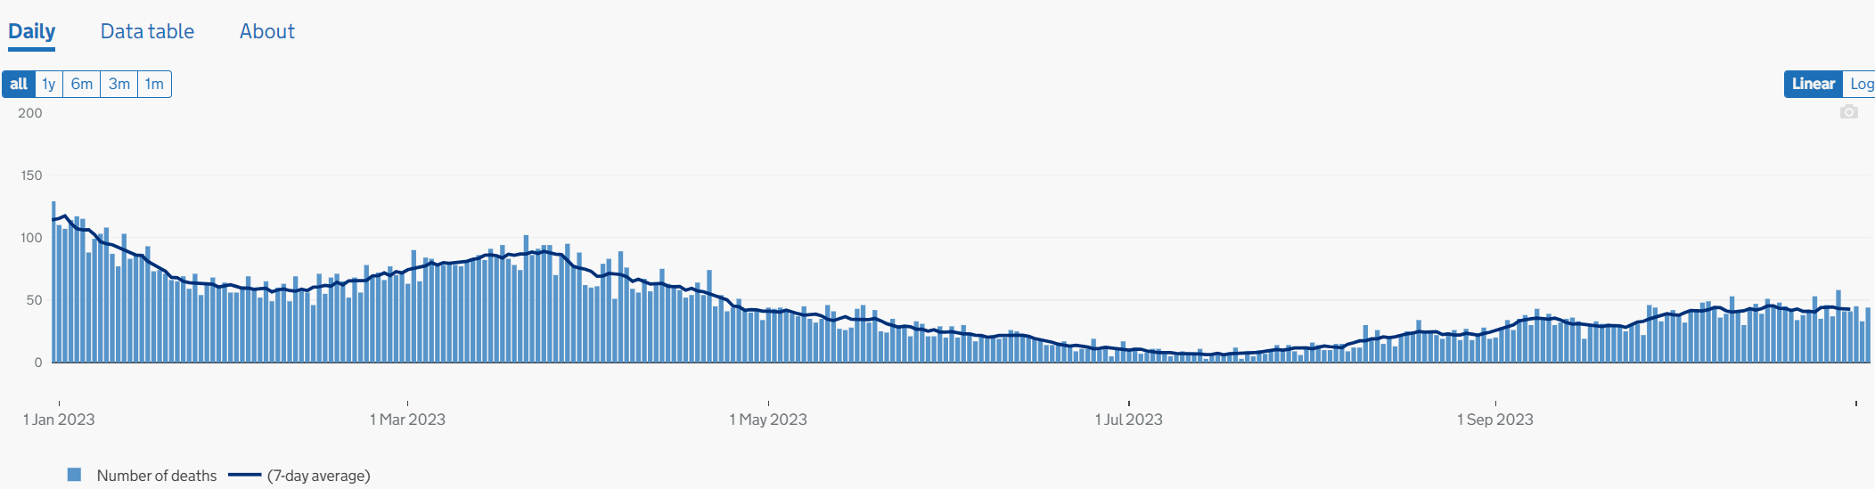
State of the pandemic
UK weekly hospital admissions with COVID-19
COVID-19 has become an endemic disease, but remains an important public health problem
We will continue to see:
Severe disease in the most vulnerable
Epidemics with higher rates of hospitalisation and death
UK daily deaths caused by COVID-19

Slide 28
Current RECOVERY design
HOSPITALISED PATIENTS WITH PNEUMONIA
High-dose corticosteroids
(patients requiring NIV or IMV)
Low-dose corticosteroids
OUTCOMES
Sotrovimab
E
High dose
steroids
or
Usual care alone
J
Sotrovimab
or
Usual care alone
M
Low dose
steroids
or
Usual care alone
Patients with confirmed SARS-CoV-2
Patients with CAP (without suspected SARS-CoV-2/influenza/PCP/TB)
Baseline data collected
Participants enter ≥1 comparisons
R
Outcomes collected at earliest of death, discharge or 28 days
Low-dose corticosteroids
(hypoxic, SARS-CoV-2 negative)
Influenza Antiviral 1
Influenza Antiviral 2
G
Baloxavir
or
Usual care alone
H
Oseltamivir
or
Usual care alone
I
Low dose
steroids
or
Usual care alone
Patients with confirmed INFLUENZA

Slide 29
Sotrovimab

Slide 30
Sotrovimab in RECOVERY
Monoclonal antibody derived from a patient with SARS-CoV-1 infection – target may be more “conserved” so less likely to mutate in future variants
~1700 participants to date, mortality 22%
Key importance of subgroups defined by antibody & serum antigen status
All adult participants potentially eligible, including those who have received sotrovimab previously (RECOVERY dose is 1g)
  Adolescents ≥12 years old and ≥40 kg are also eligible
  Pregnant or breast-feeding women are eligible after discussion with them
  No exclusions around liver or kidney function

Slide 31
High-dose corticosteroids

Slide 32
High-dose corticosteroids
Now open only to adult patients on ventilatory support
  This includes high-flow nasal oxygen, CPAP, BiPAP and IMV/ECMO
Usual care: should include dexamethasone 6 mg
High-dose arm: 20 mg dexamethasone once daily for 5 days, then 10 mg once daily for 5 days (stopped at discharge if sooner)
~500 participants currently in active comparison (not counting the subgroup already reported), mortality 35%

Slide 33
Community-acquired pneumonia

Slide 34
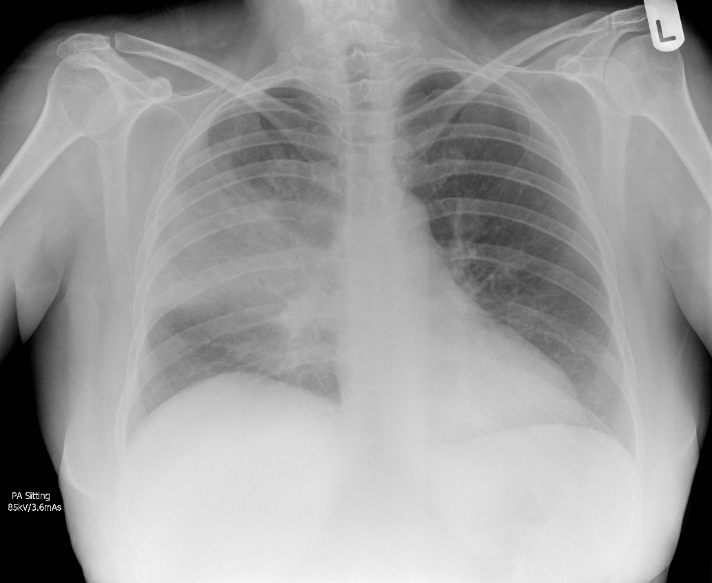
Community-acquired pneumonia
Patients admitted with pneumonia without COVID-19 or influenza infection are usually just labelled ‘community-acquired pneumonia’ (CAP)
Usually caused by bacteria in the throat, but in most cases the pathogen is never identified
Treatment is with antibiotics and supportive care
One of the commonest reasons for acute hospital admission
Estimated to kill >2,000,000 people per year worldwide
Case courtesy of Jeremy Jones, Radiopaedia.org

Slide 35
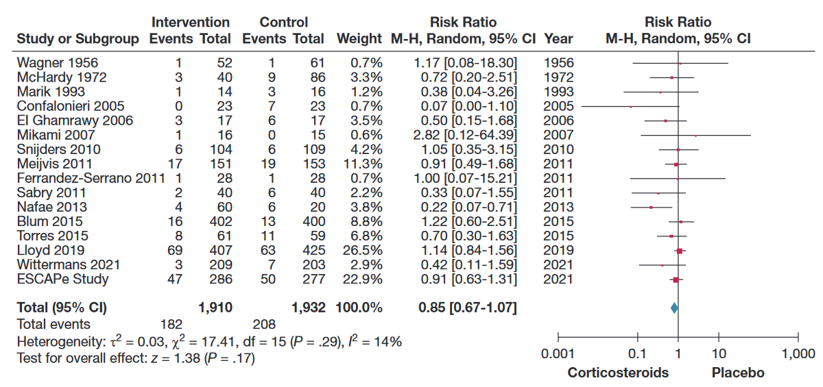
Corticosteroids for CAP
Saleem N, et al. Chest. 2023. PMID36087797

Slide 36
Corticosteroids for CAP
Favourable result for corticosteroids in ICU patients in the 2023 CAPE COD trial (25 vs 47 died)¹
However, no favourable result in ICU patients in 2022 ESCAPe trial (47 vs 50 died)²
Post-randomisation corticosteroid use avoided in the control group in CAPE COD (e.g. for septic shock), which might partly explain discrepancy³
Good evidence that corticosteroids reduce time to discharge in CAP, but this may be a direct effect of fever/CRP reduction, rather than signifying any improvement in outcome⁴
Some evidence that readmission rate may be higher in those allocated corticosteroids⁵
¹Dequin P, et al. N Engl J Med. 2023 PMID369427891 ³Friedrich JO, et al. N Engl J Med. 2023 PMID37585638
²Meduri G, et al. Intensive Care Med. 2022. PMID35723686 ⁴Joseph L, et al. Lancet 2011. PMID21907856 ⁵Saleem N, et al. Chest. 2023. PMID36087797

Slide 37
CAP in RECOVERY
To be eligible for RECOVERY CAP comparison, patients must have a diagnosis of CAP with planned antibiotic use
Patients are ineligible if they have suspected or confirmed:
  SARS-COV-2 infection
  Influenza infection
  Pneumocystis jirovecii pneumonia (‘PCP’ or ‘PJP’)
  Active pulmonary tuberculosis
However testing for these pathogens is not required for trial purposes (only needed if part of standard care)
Case courtesy of Jeremy Jones, Radiopaedia.org

Slide 38
Current RECOVERY design
HOSPITALISED PATIENTS WITH PNEUMONIA
High-dose corticosteroids
(patients requiring NIV or IMV)
Low-dose corticosteroids
OUTCOMES
Sotrovimab
E
High dose
steroids
or
Usual care alone
J
Sotrovimab
or
Usual care alone
M
Low dose
steroids
or
Usual care alone
Patients with confirmed SARS-CoV-2
Patients with CAP (without suspected SARS-CoV-2/influenza/PCP/TB)
Baseline data collected
Participants enter ≥1 comparisons
R
Outcomes collected at earliest of death, discharge or 28 days
Low-dose corticosteroids
(hypoxic, SARS-CoV-2 negative)
Influenza Antiviral 1
Influenza Antiviral 2
G
Baloxavir
or
Usual care alone
H
Oseltamivir
or
Usual care alone
I
Low dose
steroids
or
Usual care alone
Patients with confirmed INFLUENZA

Slide 39
Corticosteroids for CAP
Not eligible if attending clinician considers corticosteroids to be clearly indicated or contraindicated
No requirement for hypoxia (unlike influenza corticosteroid comparison)
Pregnant & breastfeeding women eligible (but use prednisolone/hydrocortisone instead of dexamethasone – see protocol)
Patients with liver or renal failure are eligible
If, after randomisation, corticosteroids become indicated in a patient allocated usual care they should be given (this should only happen because of a change in clinical condition)

Slide 40
Corticosteroids for CAP
Oral or iv dexamethasone 6mg once daily
Treat for 10 days or until discharged, whichever is sooner
Common side effects of corticosteroids should be anticipated and managed as in normal practice
  E.g. consider risk of hyperglycaemia, peptic ulceration, infection
Potential for increased side effects with clarithromycin/erythromycin (& other potent CYP3A4 inhibitors) – not a contraindication but consider alternative (e.g. azithromycin)

Slide 41
Trial procedures

Slide 42
Opening influenza arms
RECOVERY is on the non-commercial CRN portfolio & influenza comparisons have had national & local approval since November 2021 (SA21)
PI & relevant sites staff must have done online consent training v2 & influenza therapies module
We ask PIs to approve current delegation logs via email
Oseltamivir & baloxavir are supplied by Roche, corticosteroids from NHS supplies
We will send new sampling kits to sites – let us know if you need more
We ask sites to also sign a contract amendment confirming the recruitment fee, but please do not delay opening if this is outstanding – we can reimburse sites retrospectively

Slide 43
Substantial Amendment 31
Substantial amendment 31 removes three closed comparisons: empagliflozin, Paxlovid & molnupiravir
It extends influenza comparisons to non-UK RECOVERY sites
Several other minor updates to the protocol (none require action by sites)
SA31 updates the protocol (v26.0), adult PIS/ICFs (V25.0), and child PIS/ICF (V15.0)
We ask sites to implement SA31 by 5th December

Slide 44
Substantial Amendment 33
Substantial amendment 33 adds the CAP dexamethasone comparison
SA33 introduces new protocol (V27.0), and adult PIS/ICFs (V26.0)
We are asking sites to implement SA33 on 8th January – website documents will be updated then

Slide 45
Biological sampling
Samples only needed from COVID-19 participants in sotrovimab comparison (including those allocated usual care)
Samples needed from all patients in the influenza comparisons
No samples needed from participants in the CAP comparison

Slide 46
Biological sampling
 | COVID-19 |  | INFLUENZA
 | Serum sample | Nose swab | Serum sample | Nose swab
Baseline (Day 1) After consent, and before randomisation | ✓ | ✓ | ✗ | ✓
Day 3 | ✗ | ✓ | ✗ | ✗
Day 5 | ✗ | ✓ | ✗ | ✓
  Full instructions are on our website (‘For Site Teams’ page)

Slide 47
Consent monitoring
We still ask that a copy of every consent form is now e-mailed to RECOVERY trial
Please ensure that you write you name clearly on the consent form, so we can ensure that those taking consent have done consent training

Slide 48
Completeness of follow-up
Weekly reminders highlighting participants randomised >28 days ago without complete form
Completeness of follow-up is excellent; please keep this up!

Slide 49
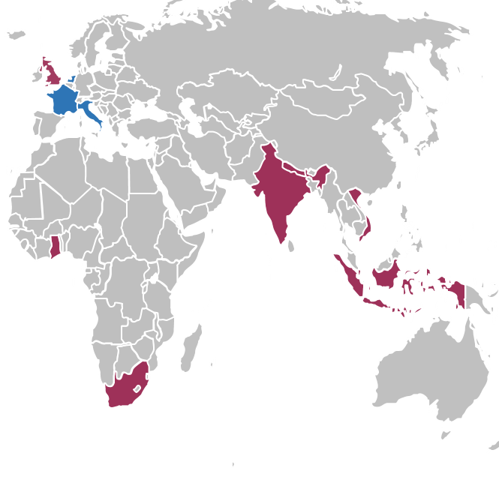
RECOVERY – international expansion
Started in UK March 2020, now open in 7 countries
Opening in Netherlands, France & Italy this winter (with aim to expand to other EU countries next year)
Possible addition of other countries in future
www.RecoveryTrial.net

Slide 50
Thank you!
We need better evidence for the treatment of COVID-19, influenza & CAP
The RECOVERY collaboration has been a remarkable success in COVID-19 treatment, and is well-suited to continue providing answers about treatment of other severe acute respiratory infections
We are extremely grateful for your efforts to recruit to RECOVERY, and we hope you will continue to collaborate us to answer these new questions

