Slide 1
The RECOVERY trial
Collaborators’ Meeting
26th & 27th February 2024

Slide 2
Agenda
Influenza
  Oseltamivir
  Baloxavir
  Dexamethasone
Community-acquired pneumonia
  Coordination with ASPECT trial
COVID-19
  Closure of comparisons
Trial procedures
  Substantial amendment 34
Q&A
Note there are no specific obstetric or paediatric updates

Slide 3
Introductions
If you have questions please enter them into the “Q&A” on the right side of your screen.
Questions may be answered directly or to the whole group

Slide 4
RECOVERY Eligibility
Hospitalised
Pneumonia syndrome
One of the following diagnoses:
  Confirmed SARS-CoV-2 infection
  Confirmed influenza A or B infection (including those bacterial co-infection)
  Community-acquired pneumonia with planned antibiotics (without suspected COVID-19/flu/PCP/TB)
No medical history that might put the patient at risk if they were to participate
Attending clinician does not believe a specific trial treatment is indicated or contra-indicated

Slide 5


Current RECOVERY design
HOSPITALISED PATIENTS WITH PNEUMONIA
COVID-19 high dose corticosteroid comparison (patients on NIV or IMV)
Community-acquired pneumonia (CAP) corticosteroid comparison
ANALYSIS
Sotrovimab comparison
E
High dose dexamethasone
Usual care (standard dose corticosteroids)
J
Sotrovimab
Usual care without sotrovimab
M
Dexamethasone
Usual care without corticosteroids
or
or
or
Patients with confirmed SARS-CoV-2
Patients with CAP (without suspected SARS-CoV-2/influenza/PCP/TB)
R
Outcomes at 28 days
Mortality
Time to discharge alive
Progression to ventilation or death
Baseline data collected, suitability determined
1:1 randomisation in each suitable comparison
Baloxavir comparison
Oseltamivir comparison
Influenza corticosteroid comparison (patients with hypoxia)
G
Baloxavir
Usual care without baloxavir
H
Oseltamivir
Usual care without oseltamivir
I
Dexamethasone
Usual care without corticosteroids
or
or
or
Patients with confirmed INFLUENZA

Slide 6
RECOVERY influenza comparisons
HOSPITALISED PATIENTS WITH PNEUMONIA
COVID-19 high dose corticosteroid comparison (patients on NIV or IMV)
Community-acquired pneumonia (CAP) corticosteroid comparison
ANALYSIS
Sotrovimab comparison
E
High dose dexamethasone
Usual care (standard dose corticosteroids)
J
Sotrovimab
Usual care without sotrovimab
M
Dexamethasone
Usual care without corticosteroids
or
or
or
Patients with confirmed SARS-CoV-2
Patients with CAP (without suspected SARS-CoV-2/influenza/PCP/TB)
R
Outcomes at 28 days
Mortality
Time to discharge alive
Progression to ventilation or death
Baseline data collected, suitability determined
1:1 randomisation in each suitable comparison
Baloxavir comparison
Oseltamivir comparison
Influenza corticosteroid comparison (patients with hypoxia)
G
Baloxavir
Usual care without baloxavir
H
Oseltamivir
Usual care without oseltamivir
I
Dexamethasone
Usual care without corticosteroids
or
or
or
Patients with confirmed INFLUENZA

Slide 7
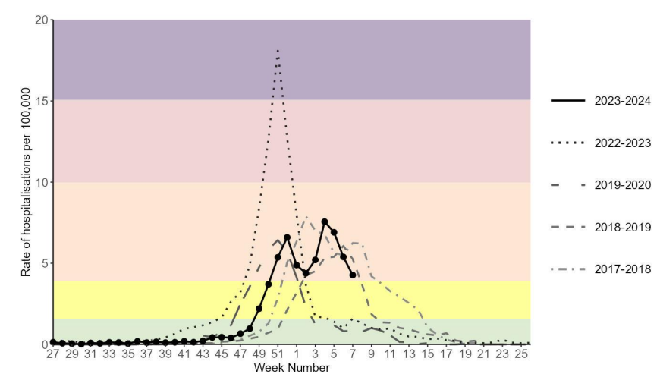
Influenza
Influenza hospitalisations in England
https://www.gov.uk/government/statistics/national-flu-and-covid-19-surveillance-reports-2023-to-2024-season

Slide 8
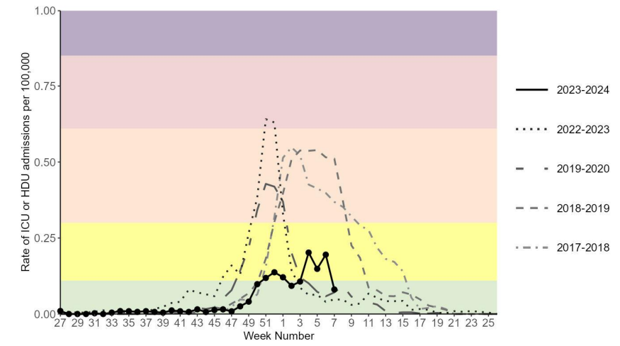
Influenza
Influenza ICU/HDU admissions in England
https://www.gov.uk/government/statistics/national-flu-and-covid-19-surveillance-reports-2023-to-2024-season

Slide 9
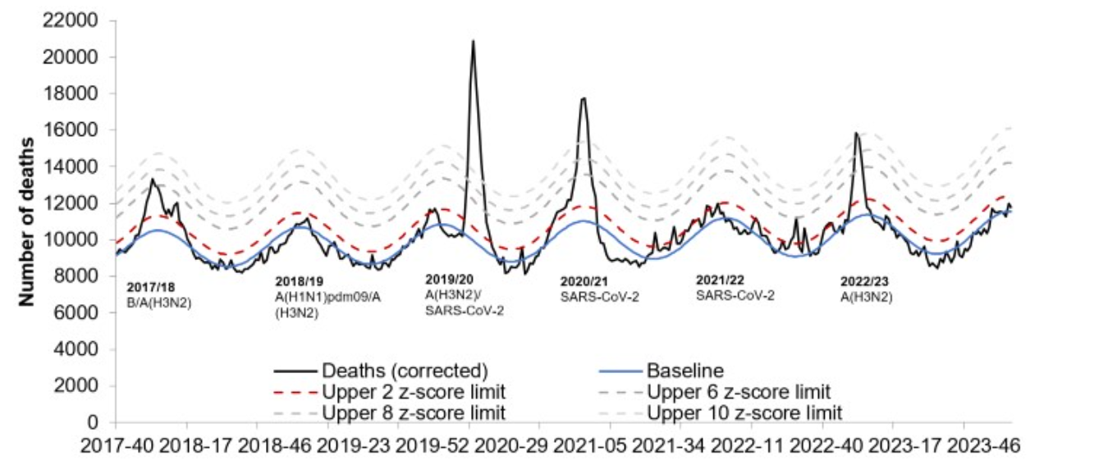
Influenza
Weekly deaths in England (to late January 2024)
https://www.gov.uk/government/statistics/weekly-all-cause-mortality-surveillance-2023-to-2024

Slide 10
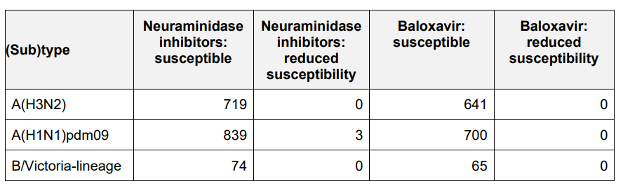
Influenza
Antiviral susceptibility of UK influenza strains - winter 2023/24
https://www.gov.uk/government/statistics/national-flu-and-covid-19-surveillance-reports-2023-to-2024-season

Slide 11
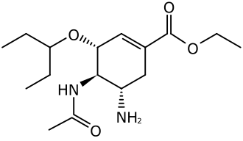
Oseltamivir (TAMIFLU)

Slide 12
Oseltamivir (Tamiflu)
NAIs reduces the duration of flu symptoms by ~1 day in early infection
Some observational studies have suggested a benefit of oseltamivir in hospitalised patients, but others have not, and evidence from randomised trials is lacking.
These observational studies are prone to biases that cannot be reliably avoided
During the pandemic, observational data was used to support COVID-19 treatments (e.g. hydroxychloroquine, convalescent plasma) that were subsequently found to be of no benefit, or even harmful, in large randomised trials
Without randomised evidence, the efficacy and safety of oseltamivir in hospitalised patients is uncertain

Slide 13
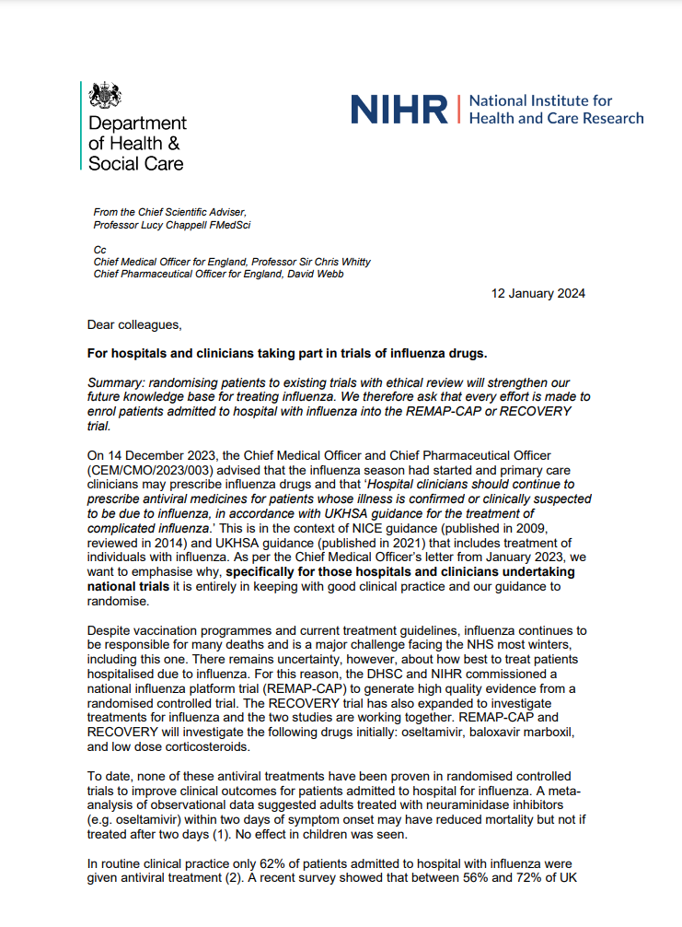
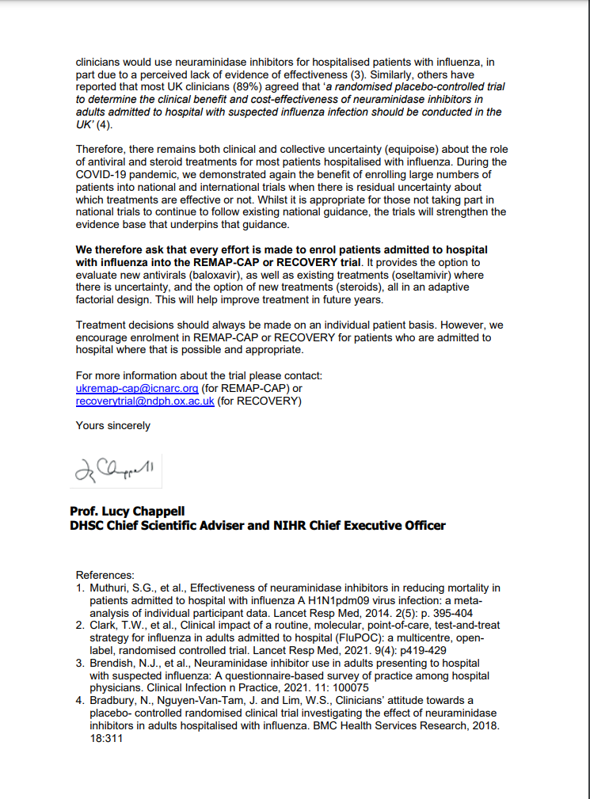
Oseltamivir (Tamiflu)
UKHSA guidance recommends NAIs for patients hospitalised with influenza (usually reflected in local guidelines)
However, DHSC & NIHR support influenza trials that include a no antiviral arm
“As per the Chief Medical Officer’s letter from January 2023, we want to emphasise why, specifically for those hospitals and clinicians undertaking national trials it is entirely in keeping with good clinical practice and our guidance to randomise.”
We therefore ask that every effort is made to enrol patients admitted to hospital with influenza into the REMAP-CAP or RECOVERY trial. It provides the option to evaluate new antivirals (baloxavir), as well as existing treatments (oseltamivir) where there is uncertainty, and the option of new treatments (steroids)”
Local discussions/communication may be needed to explain this context

Slide 14
Oseltamivir (Tamiflu)
Patients with recent or planned use of an NAI for current infection are ineligible (oseltamivir or zanamivir)
Patients treated for bacterial co-infection are eligible if clinical team think influenza is contributing to lung disease

Slide 15
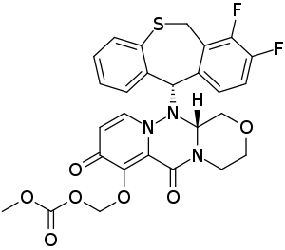
BALOXAVIR marboxil (XOFLUZA)

Slide 16
Baloxavir
Cap-dependent endonuclease (CEN) inhibitor
Rapidly reduces viral load, but resistance mutations can arise
Mechanism of action differs from NAIs, so combination may be better than either alone
Reduces the duration of flu symptoms by ~1 day but hasn't been properly tested in hospitalised patients

Slide 17
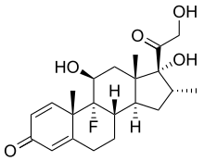
Corticosteroids for influenza

Slide 18
Corticosteroids for influenza
Corticosteroids reduce risk of death by ~1/5 in hypoxic patients with COVID-19 pneumonia
Previously proposed as a treatment for influenza pneumonia but never properly tested
Reducing immune-mediated lung damage may improve survival in severe flu as it does in COVID-19

Slide 19
Corticosteroids for influenza
Open to patients with influenza pneumonia plus hypoxia (supplemental oxygen or SpO2 <92% on air)
Contraindicated if current or planned use of systemic corticosteroids, or if coinfected with SARS-CoV-2

Slide 20
RECOVERY influenza comparisons
Influenza comparisons now open at 36 trusts
We appreciate difficulties opening this winter with Christmas break & junior doctor strikes
Current recruitment
  Baloxavir comparison - 216 participants
  Oseltamivir comparison - 43 participants
  Dexamethasone comparison - 61 participants

Slide 21
RECOVERY & REMAP-CAP
RECOVERY & REMAP-CAP are now collaborating on influenza comparisons
Coordination of recruitment locations
  Only one trial will be open in a particular clinical area
  We aim for one of the trials to be open wherever inpatients with influenza are cared for in the NHS
Combined analysis & primary publication
  All participants recruited to either trial will contribute to the final results
The trials remain separate, with different protocols, eligibility & follow up procedures

Slide 22
Planning for winter 2024/25
If there are clinical areas where you are not planning to recruit patients into either trial, we would like to invite you to participate in RECOVERY
Both trials offer £400 per influenza participant to support trial sites with recruitment.
RECOVERY influenza & CAP comparisons are on the CRN non-commercial portfolio
RECOVERY influenza comparisons planned to continue until at least 2026

Slide 23
RECOVERY CAP comparison
HOSPITALISED PATIENTS WITH PNEUMONIA
COVID-19 high dose corticosteroid comparison (patients on NIV or IMV)
Community-acquired pneumonia (CAP) corticosteroid comparison
ANALYSIS
Sotrovimab comparison
E
High dose dexamethasone
Usual care (standard dose corticosteroids)
J
Sotrovimab
Usual care without sotrovimab
M
Dexamethasone
Usual care without corticosteroids
or
or
or
Patients with confirmed SARS-CoV-2
Patients with CAP (without suspected SARS-CoV-2/influenza/PCP/TB)
R
Outcomes at 28 days
Mortality
Time to discharge alive
Progression to ventilation or death
Baseline data collected, suitability determined
1:1 randomisation in each suitable comparison
Baloxavir comparison
Oseltamivir comparison
Influenza corticosteroid comparison (patients with hypoxia)
G
Baloxavir
Usual care without baloxavir
H
Oseltamivir
Usual care without oseltamivir
I
Dexamethasone
Usual care without corticosteroids
or
or
or
Patients with confirmed INFLUENZA

Slide 24
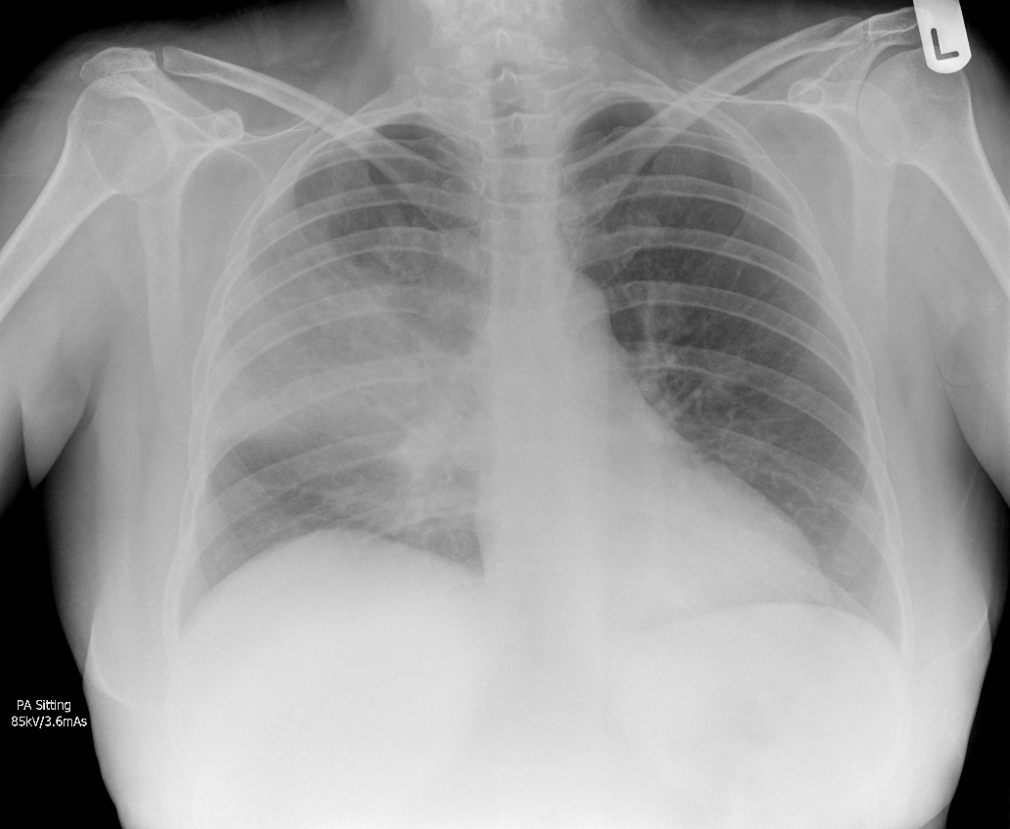
Community-acquired pneumonia
One of the commonest reasons for acute hospital admission in the UK
4th leading cause of death worldwide, estimated to kill >2,000,000 people per year
Case courtesy of Jeremy Jones, Radiopaedia.org

Slide 25
CAP in RECOVERY
To be eligible for RECOVERY CAP comparison, patients must have a diagnosis of CAP with planned antibiotic use
Patients are ineligible if they have suspected or confirmed:
  SARS-COV-2 infection
  Influenza infection
  Pneumocystis jirovecii pneumonia (‘PCP’ or ‘PJP’)
  Active pulmonary tuberculosis
However testing for these pathogens is not required for trial purposes (only if part of standard care)
Case courtesy of Jeremy Jones, Radiopaedia.org

Slide 26
Corticosteroids for CAP

Slide 27
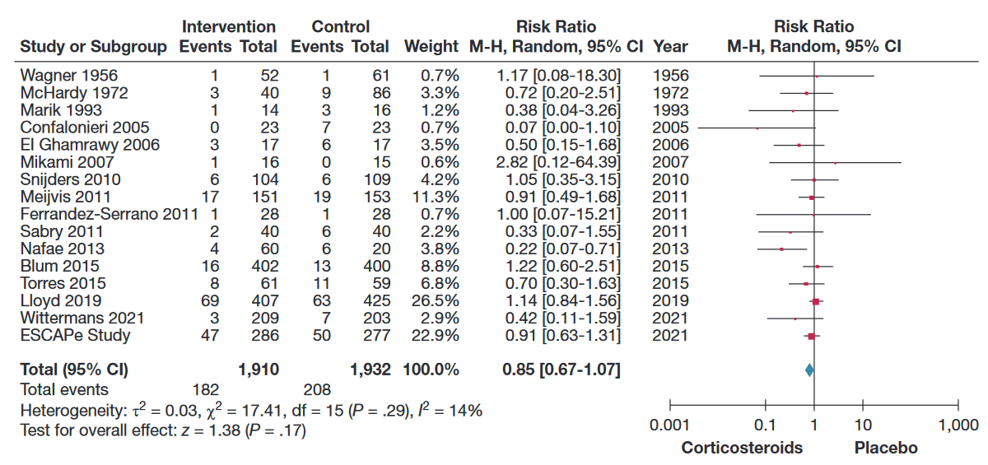
Corticosteroids for CAP
A 2023 meta-analysis found that patients with CAP receiving steroids had a 15% lower risk of death
However, the trials were too small to be conclusive, so there may be no benefit, or the benefit could be even greater (e.g. a 20-30% reduction)
Saleem N, et al. Chest. 2023. PMID36087797

Slide 28
Corticosteroids for CAP
In one subsequent trial of ICU patients (CAPE COD) the risk of death was lower with steroids (25/400 v 47/395 died)¹
However, there was no favourable result in ICU patients in the 2022 ESCAPe trial (47/286 v 50/277 died)²
Post-randomisation corticosteroid use was avoided in the control group in CAPE COD (e.g. for septic shock), which might partly explain discrepancy³
Corticosteroids reduce time to discharge in CAP, but this may be a direct effect of fever/CRP reduction, rather than representing an improvement in outcomes⁴ (and there is some evidence that readmissions may be higher in those allocated corticosteroids⁵)
We need more randomised evidence from a wide range of patients to inform treatment of CAP
¹Dequin P, et al. N Engl J Med. 2023 PMID369427891 ³Friedrich JO, et al. N Engl J Med. 2023 PMID37585638
²Meduri G, et al. Intensive Care Med. 2022. PMID35723686 ⁴Joseph L, et al. Lancet 2011. PMID21907856 ⁵Saleem N, et al. Chest. 2023. PMID36087797

Slide 29
Corticosteroids for CAP
No requirement for hypoxia (unlike influenza corticosteroid comparison)
Common side effects of corticosteroids should be anticipated and managed as in normal practice
  E.g. consider risk of hyperglycaemia, peptic ulceration, infection
Potential for increased side effects with clarithromycin/erythromycin (& other potent CYP3A4 inhibitors) – not a contraindication but consider alternative (e.g. azithromycin)

Slide 30
RECOVERY CAP comparison
Introduced into protocol January 2024, already open at 14 sites
Current recruitment 26 participants
A recruitment payment of £100 per participant has been agreed. This requires an amendment to be signed by sites, which we will send out shortly (but recruitment fees can be paid retrospectively)
Very simple comparison for sites
  No samples
  Dexamethasone from NHS stock
  Single follow-up form

Slide 31


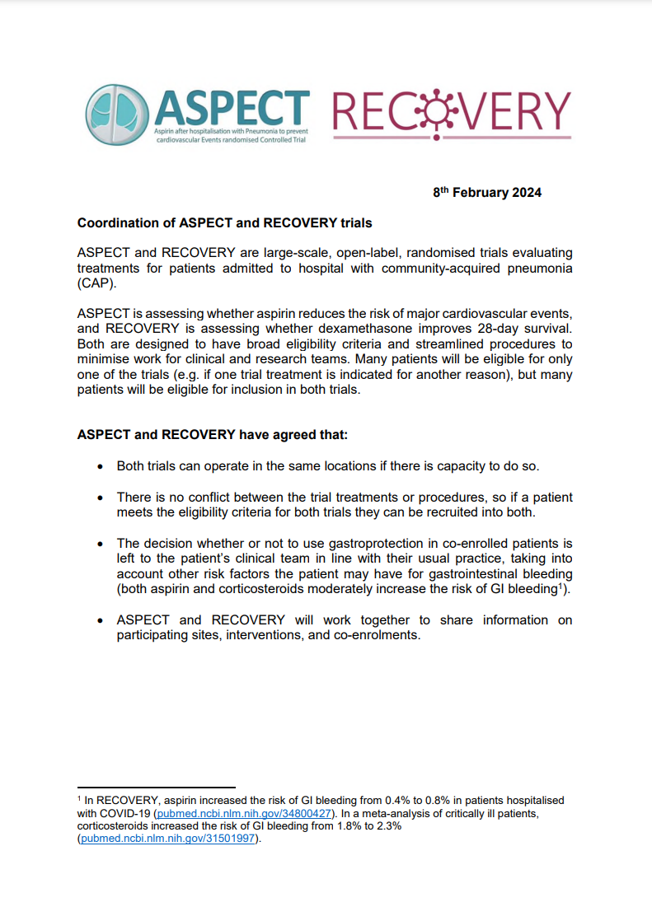
&
Risk of MI & stroke is high following admission with CAP, and ASPECT is evaluating whether 3 months of aspirin reduces this
ASPECT is another large, open-label, RCT in patients hospitalised with CAP, open at sites throughout England
Many CAP patients will be eligible for only one trial (e.g. if aspirin or systemic corticosteroids indicated for another reason)
Many CAP patients will be eligible for both trials
Download from www.recoverytrial.net/uk/for-site-staff/site-teams

Slide 32
&
Both trials can operate in the same sites if there is capacity
There’s no conflict between trial treatments/procedures, so eligible patients can be recruited into both trials
Gastroprotection in co-enrolled patients is left to the patient’s clinical team in line with usual practice (aspirin and corticosteroids moderately increase the risk of GI bleeding)
ASPECT and RECOVERY will work together to share information on participating sites, interventions, and co-enrolments
Download from www.recoverytrial.net/uk/for-site-staff/site-teams

Slide 33
&
Screening patients to both trials simultaneously may be efficient for local research teams
Please consider opening RECOVERY CAP dexamethasone comparison if you are open to ASPECT
ASPECT is also open to new sites – please contact the ASPECT team at aspect-trial@bristol.ac.uk if you are interested
ASPECT has an approaching recruitment target as it completes its pilot phase, so if there were limited capacity to co-enrol, please prioritise ASPECT recruitment in first half of 2024
Download from www.recoverytrial.net/uk/for-site-staff/site-teams

Slide 34
RECOVERY COVID-19 comparisons
HOSPITALISED PATIENTS WITH PNEUMONIA
COVID-19 high dose corticosteroid comparison (patients on NIV or IMV)
Community-acquired pneumonia (CAP) corticosteroid comparison
ANALYSIS
Sotrovimab comparison
E
High dose dexamethasone
Usual care (standard dose corticosteroids)
J
Sotrovimab
Usual care without sotrovimab
M
Dexamethasone
Usual care without corticosteroids
or
or
or
Patients with confirmed SARS-CoV-2
Patients with CAP (without suspected SARS-CoV-2/influenza/PCP/TB)
R
Outcomes at 28 days
Mortality
Time to discharge alive
Progression to ventilation or death
Baseline data collected, suitability determined
1:1 randomisation in each suitable comparison
Baloxavir comparison
Oseltamivir comparison
Influenza corticosteroid comparison (patients with hypoxia)
G
Baloxavir
Usual care without baloxavir
H
Oseltamivir
Usual care without oseltamivir
I
Dexamethasone
Usual care without corticosteroids
or
or
or
Patients with confirmed INFLUENZA

Slide 35
RECOVERY COVID-19 comparisons
The last RECOVERY COVID-19 comparisons will close on 31st March 2024
No further COVID-19 comparisons are planned (unless there is an unexpected resurgence)

Slide 36
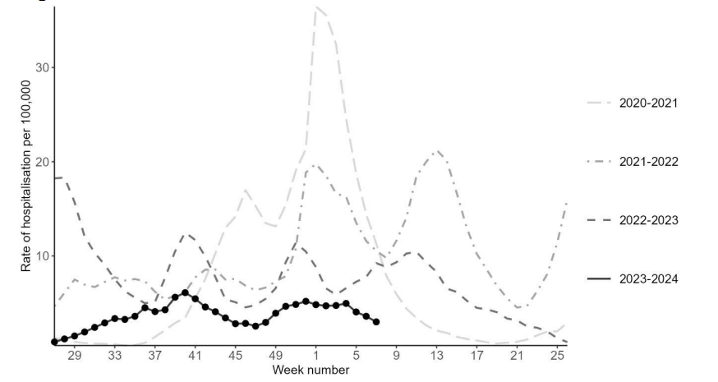
State of the pandemic
Weekly hospitalisations with COVID-19 in England

Slide 37
Sotrovimab

Slide 38
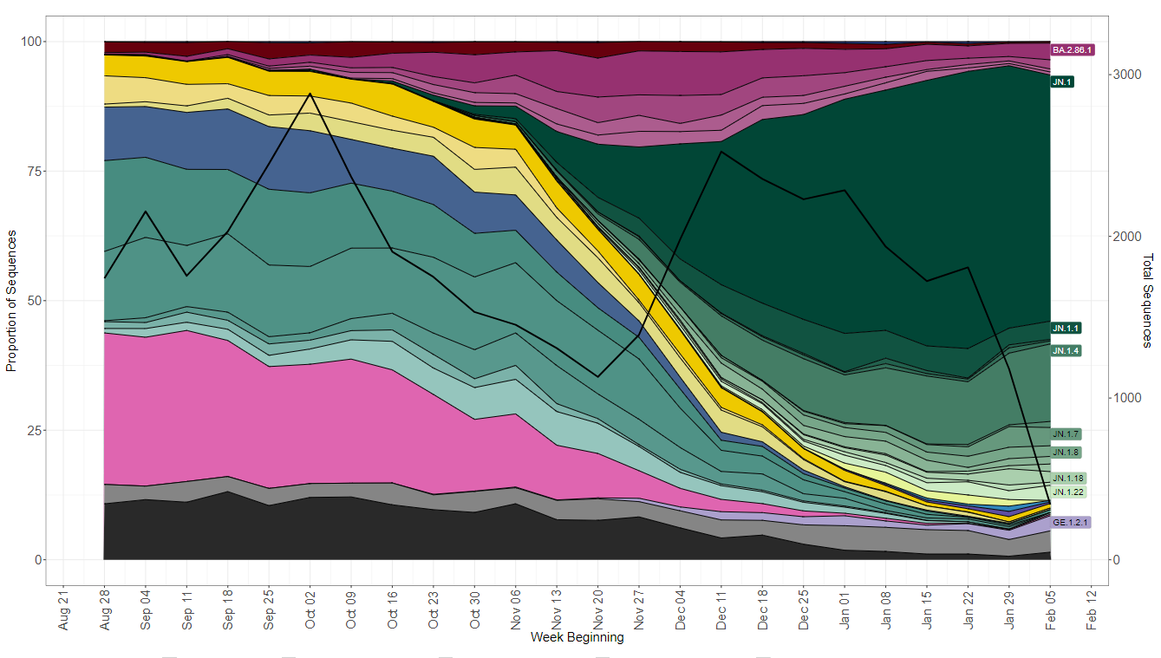
Sotrovimab in RECOVERY
Monoclonal antibody derived from a patient with SARS-CoV-1 infection – target may be more “conserved” so less likely to mutate in future variants
1720 participants recruited to date, mortality 22%
However, sotrovimab has substantially reduced activity against JN.1, the predominant SARS-CoV-2 strain now circulating in the UK & worldwide
JN.1

Slide 39
High-dose corticosteroids

Slide 40
High-dose corticosteroids
Now open only to adult patients on ventilatory support
  This includes high-flow nasal oxygen, CPAP, BiPAP and IMV/ECMO
Usual care: should include dexamethasone 6 mg
High-dose arm: 20 mg dexamethasone once daily for 5 days, then 10 mg once daily for 5 days (stopped at discharge if sooner)
481 participants currently in active comparison (not counting the subgroup already reported), mortality 35%

Slide 41
Trial procedures

Slide 42
Substantial Amendment 34
Substantial amendment 34 approves an expiry extension for sotrovimab
This is only relevant to sites holding one batch the expires at the end of February (2T8F), which will need to be relabelled for use
Documents for SA34 & relabelling are on the Pharmacy & Regulatory documents pages of the website

Slide 43
Biological sampling
Samples only needed from COVID-19 participants in sotrovimab comparison (including those allocated usual care)
Samples needed from all patients in the influenza comparisons
No samples needed from participants in the CAP comparison

Slide 44
Biological sampling
 | COVID-19 |  | INFLUENZA
 | Serum sample | Nose swab | Serum sample | Nose swab
Baseline (Day 1) After consent, and before randomisation | ✓ | ✓ | ✗ | ✓
Day 3 | ✗ | ✓ | ✗ | ✗
Day 5 | ✗ | ✓ | ✗ | ✓
  Full instructions are on our website (‘For Site Teams’ page)

Slide 45
Consent monitoring
We still ask that a copy of every consent form is now e-mailed to RECOVERY trial
Please ensure that you write you name clearly on the consent form, so we can ensure that those taking consent have done consent training (instructions on Randomisation page)

Slide 46
Completeness of follow-up
Weekly reminders highlighting participants randomised >28 days ago without complete form
Completeness of follow-up is excellent; please keep this up!

Slide 47
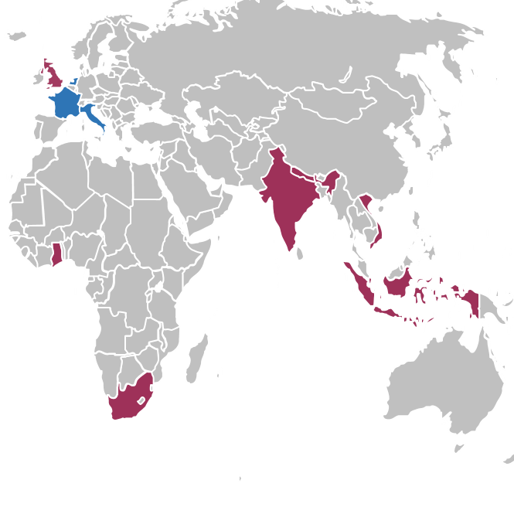
RECOVERY – international expansion
Started in UK March 2020, now open in 7 countries
Clinical trial approval granted in Netherlands, France & Italy
Aim to expand to other EU countries next year)
Possible addition of other countries in future
www.RecoveryTrial.net

Slide 48
Thank you!
The RECOVERY collaboration has been a remarkable success in COVID-19 treatment, and we need similar evidence for the treatment of influenza & CAP
We are extremely grateful for your efforts to recruit to RECOVERY
Please join RECOVERY influenza & CAP comparisons if you are not doing so already!

