Slide 1
The RECOVERY trial
Collaborators’ Meetings
14th & 15th October 2024

Slide 2
Agenda
COVID-19 results
  Sotrovimab
  High-dose dexamethasone in patients on ventilatory support
Influenza
  Oseltamivir
  Baloxavir
  Dexamethasone
Community-acquired pneumonia
  Dexamethasone
Trial procedures
Q&A
Note there are no specific obstetric or paediatric updates
(so Mon & Tue meetings cover the same material)

Slide 3
Introductions
If you have questions please enter them into the “Q&A” on the right side of your screen.
Questions may be answered directly or to the whole group
Information about the trial is on our website https://www.recoverytrial.net/uk/for-site-staff
These slides will be uploaded to the UK Site Teams page

Slide 4
SOTROVIMAB in hospitalised covid-19 patients
Please note: these slides have not been uploaded to the website as the results are unpublished

Slide 5
Higher-dose dexamethasone in hospitalised COVID-19 patients requiring ventilatory support
Results on medrxiv: https://www.medrxiv.org/content/10.1101/2024.09.04.24312992v1

Slide 6
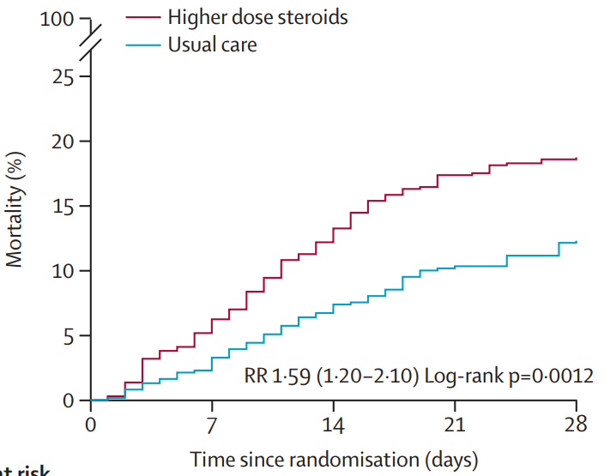
Higher-dose dexamethasone - Background
This comparison compared 20mg dexamethasone daily vs the usual 6mg daily in hypoxic patients
Randomisation of patients not needing ventilatory support (HFNO, NIV or invasive ventilation) stopped in May 2022 due to harm with higher-dose treatment (results published)
The DMC encouraged continuing recruitment of patients who did need ventilatory support
Recruitment of these patients stopped in 31st March 2024 when funding for COVID-19 comparisons ended
Effect of higher-dose dexamethasone in patients not needing ventilatory support
Lancet. 2023 May 6;401(10387):1499-1507. PMID: 37060915

Slide 7
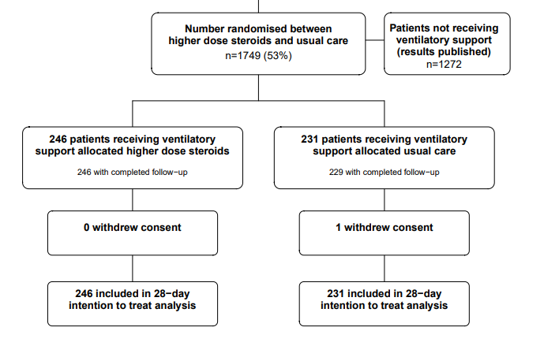
Higher-dose dexamethasone - Profile

Slide 8
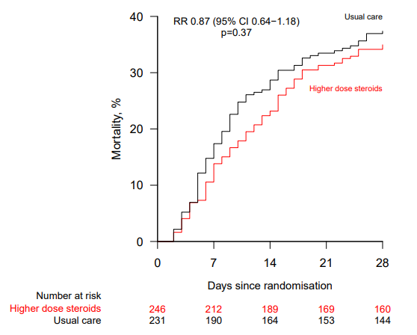
Higher-dose dexamethasone – Results & Summary
No evidence that higher-dose dexamethasone reduces mortality in patients requiring ventilatory support
Also no evidence of hazard, in contrast to patients not needing ventilatory support
No significant effect on secondary or safety outcomes
No evidence that corticosteroid doses above 6mg dexamethasone/day are beneficial, even in critically ill patients

Slide 9
Recovery – TRIAL update

Slide 10


Current comparisons
HOSPITALISED PATIENTS WITH PNEUMONIA
Community-acquired pneumonia (CAP) corticosteroid comparison
ANALYSIS
Dexamethasone
Usual care without corticosteroids
or
Patients with CAP (without suspected SARS-CoV-2/influenza/PCP/TB)
R
Outcomes at 28 days
Mortality
Time to discharge alive
Progression to ventilation or death
Baseline data collected, suitability determined
1:1 randomisation in each suitable comparison
Baloxavir comparison
Oseltamivir comparison
Influenza corticosteroid comparison (patients with hypoxia)
Baloxavir
Usual care without baloxavir
Oseltamivir
Usual care without neuraminidase inhibitor
Dexamethasone
Usual care without corticosteroids
or
or
or
Patients with confirmed INFLUENZA A or B

Slide 11
RECOVERY Eligibility
Hospitalised
Pneumonia syndrome
One of the following diagnoses:
  Confirmed influenza A or B infection (including those bacterial co-infection)
  Community-acquired pneumonia with planned antibiotics (without suspected COVID-19/flu/PCP/TB)
No medical history that might put the patient at risk if they were to participate
Attending clinician does not believe a specific trial treatment is indicated or contra-indicated

Slide 12
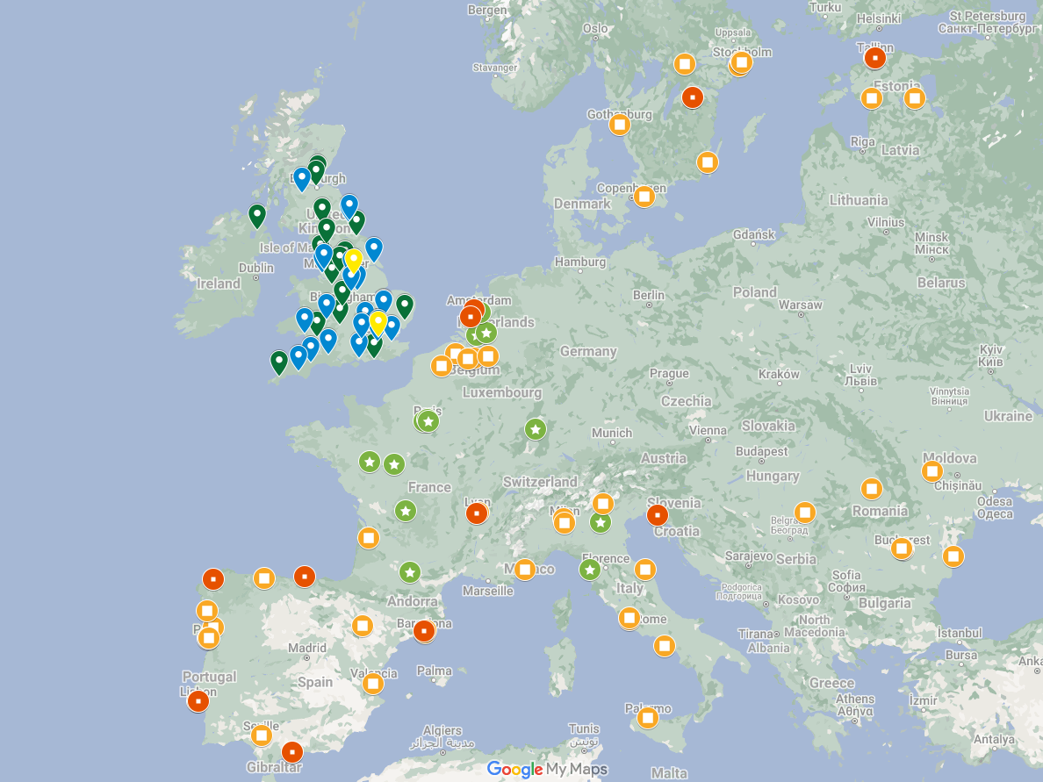
RECOVERY UK & EU sites
RECOVERY influenza & CAP comparisons
Open at 50 UK sites this winter
Active in 3 EU countries
Opening in 6 more EU countries, with EU 65 sites in total
Existing sites in Nepal, Indonesia, Vietnam, South Africa & Ghana will also be participating

Slide 13
Influenza comparisons

Slide 14
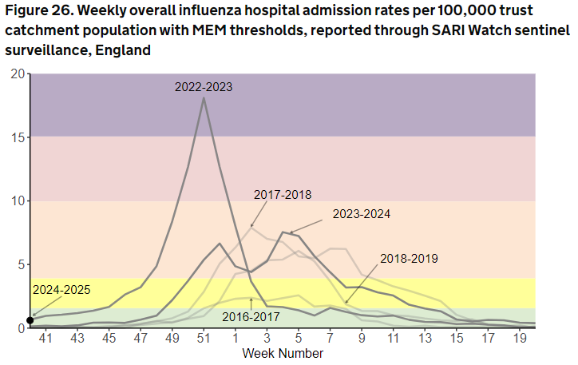
Influenza
https://www.gov.uk/government/statistics/national-flu-and-covid-19-surveillance-reports-2024-to-2025-season/

Slide 15
Oseltamivir (Tamiflu)
NAIs reduces the duration of flu symptoms by ~1 day in early infection
Some observational studies suggest a benefit of NAIs in hospitalised patients, but others don’t, and evidence from randomised trials is lacking.
These observational studies are prone to biases that cannot be reliably avoided
Observational data were used to support COVID-19 treatments (e.g. hydroxychloroquine, convalescent plasma) that were later found to be of no benefit, or even harmful, in large randomised trials
Without randomised evidence, the efficacy and safety of oseltamivir in hospitalised patients is uncertain

Slide 16
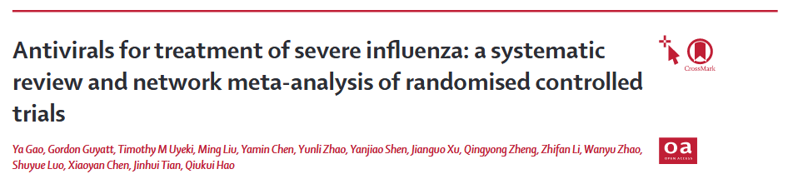

Oseltamivir (Tamiflu)
Lancet. 2024 Aug 24;404(10454):753-763. PMID: 39181595

Slide 17
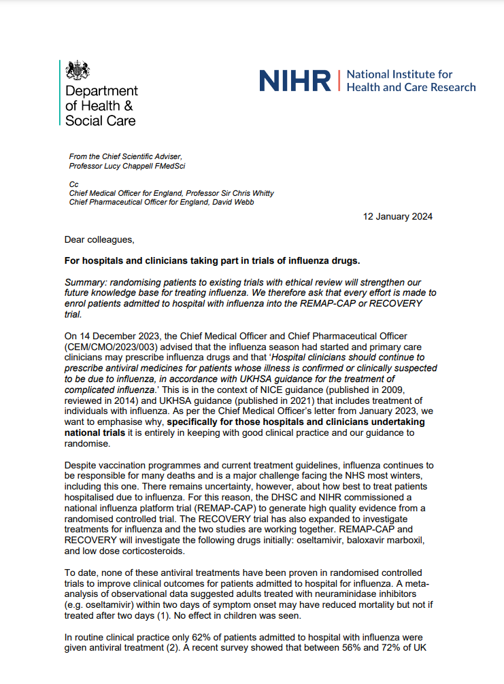
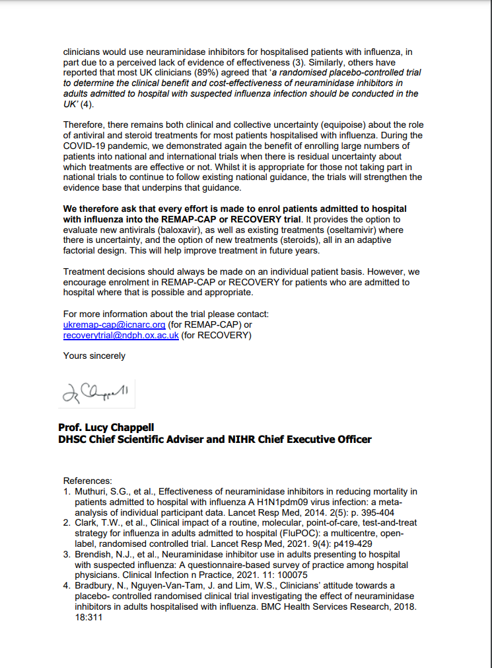
Oseltamivir (Tamiflu)
UKHSA guidance recommends NAIs for patients hospitalised with influenza (usually reflected in local guidelines)
However, DHSC & NIHR support influenza trials that include a no antiviral arm
“As per the Chief Medical Officer’s letter from January 2023, we want to emphasise why, specifically for those hospitals and clinicians undertaking national trials it is entirely in keeping with good clinical practice and our guidance to randomise.”
We therefore ask that every effort is made to enrol patients admitted to hospital with influenza into the REMAP-CAP or RECOVERY trial. It provides the option to evaluate new antivirals (baloxavir), as well as existing treatments (oseltamivir) where there is uncertainty, and the option of new treatments (steroids)”
Local discussions/communication may be needed to explain this context

Slide 18
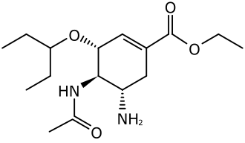
Oseltamivir (Tamiflu)
Patients with recent or planned use of an NAI for current infection are ineligible (oseltamivir or zanamivir)
Patients treated for bacterial co-infection are eligible if clinical team think influenza is contributing to lung disease
Oseltamivir supply will switch to NHS stock in November
  We will contact site teams in the coming weeks with more information

Slide 19
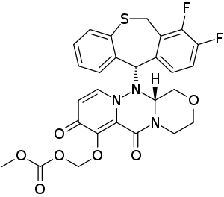
Baloxavir
Newer influenza antiviral (cap-dependent endonuclease inhibitor)
Rapidly reduces viral load, but resistance mutations can arise
Mechanism of action differs from NAIs, so combination may be better than either alone
Reduces the duration of flu symptoms by ~1 day but hasn't been properly tested in hospitalised patients

Slide 20
Baloxavir
Patients with recent or planned use of an baloxavir for current infection are ineligible
Patients treated for bacterial co-infection are eligible if clinical team think influenza is contributing to lung disease
Baloxavir distribution system and formulation will change in November
  No change in how baloxavir is used in the trial
  We will contact site teams in the coming weeks with details

Slide 21
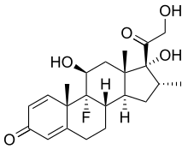
Corticosteroids for influenza
Corticosteroids reduce risk of death by ~1/5 in hypoxic patients with COVID-19 pneumonia
Previously proposed as a treatment for influenza pneumonia but never properly tested
Reducing immune-mediated lung damage may improve survival in severe flu as it does in COVID-19

Slide 22
Corticosteroids for influenza
Open to patients with influenza pneumonia plus hypoxia (supplemental oxygen or SpO2 <92% on air)
Contraindicated if current or planned use of systemic corticosteroids, or if coinfected with SARS-CoV-2
Common side effects of corticosteroids should be anticipated and managed as in normal practice
  E.g. consider risk of hyperglycaemia, peptic ulceration, infection

Slide 23
RECOVERY influenza comparisons
Influenza comparisons now open at 51 sites
Current recruitment
  Baloxavir comparison - 280 participants
  Oseltamivir comparison - 54 participants
  Dexamethasone comparison - 89 participants

Slide 24
RECOVERY & REMAP-CAP
RECOVERY & REMAP-CAP are now collaborating on influenza comparisons
Coordination of recruitment locations
  Only one trial will be open in a particular clinical area
  We aim for one of the trials to be open wherever inpatients with influenza are cared for in the NHS
Combined analysis & primary publication
  All participants recruited to either trial will contribute to the final results
The trials remain separate, with different protocols, eligibility & follow up procedures

Slide 25
Planning for winter 2024/25
If there are clinical areas where you are not planning to recruit inpatients into either trial, please consider participating in RECOVERY
Both trials offer £400 per influenza participant to support trial sites with recruitment
RECOVERY influenza & CAP comparisons are on the CRN non-commercial portfolio
RECOVERY influenza comparisons planned to continue until at least 2026

Slide 26
Community-acquired
pneumonia comparison

Slide 27
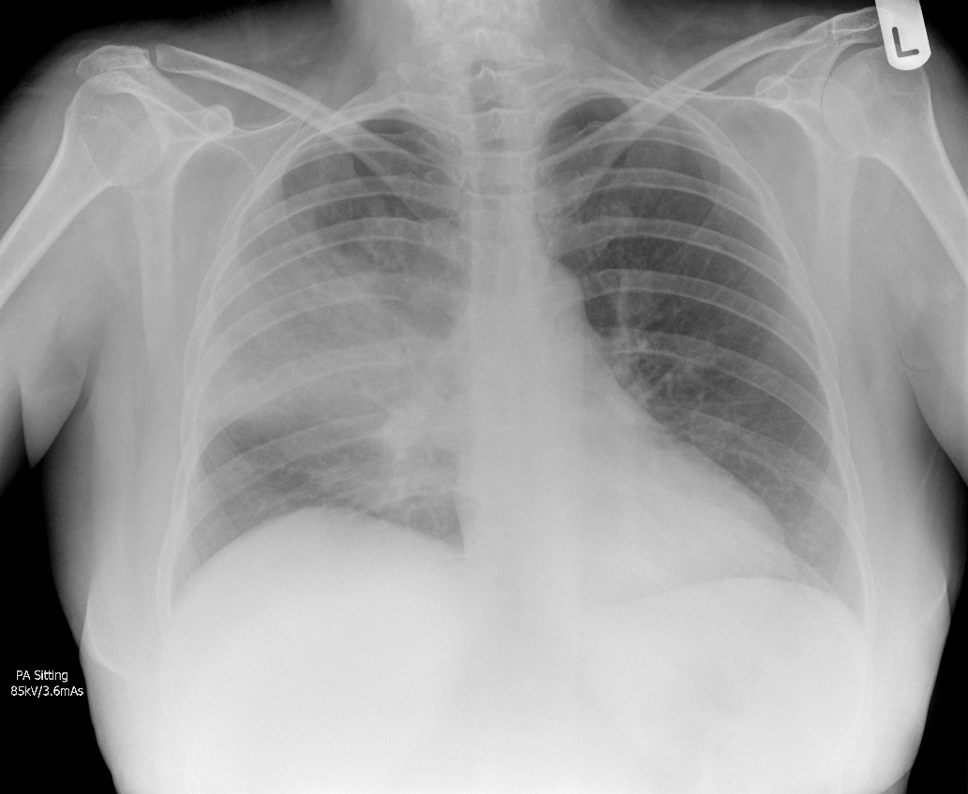
Community-acquired pneumonia
One of the commonest reasons for acute hospital admission in the UK
4th leading cause of death worldwide, estimated to kill >2,000,000 people per year
CXR courtesy of Jeremy Jones, Radiopaedia.org

Slide 28
CAP in RECOVERY - eligibility
Patients must have a diagnosis of CAP with planned antibiotic use
Patients ineligible if they have suspected or confirmed:
  SARS-COV-2 infection
  Influenza infection
  Pneumocystis jirovecii pneumonia (‘PCP’ or ‘PJP’)
  Active pulmonary tuberculosis
However testing for these pathogens is not required for trial purposes (only if part of standard care)
If an influenza test result is pending during flu season, please do not recruit until this is available

Slide 29

Corticosteroids for CAP – evidence
~20 randomised trials with 3,000-4,000 patients total (1st in 1956)
>20 meta-analyses of the same trials, with differing conclusions:
Bergmann et al. CID, 2023
Saleem et al.
Chest, 2023
Reduced time to clinical stability (p<0.001) & discharge (p=0.01) in one trial of non-severe CAP, but could just reflect fever/CRP reduction
Possible increased readmissions with corticosteroids
Concerns about side effects – hyperglycaemia, GI bleeding, secondary infection

Slide 30
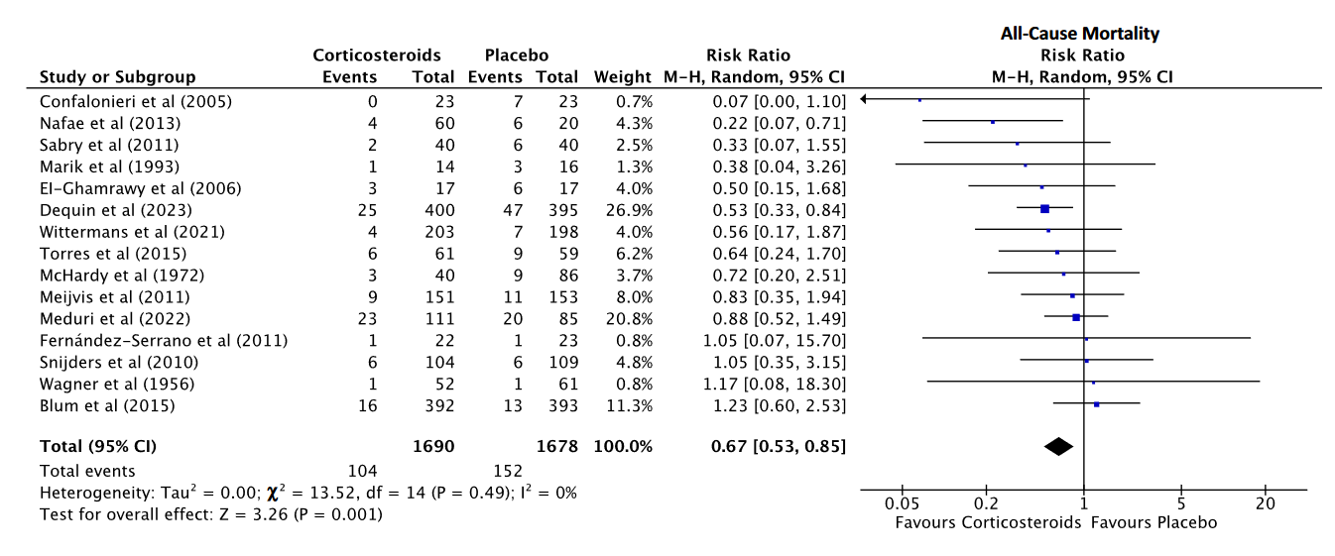
Corticosteroids for CAP – evidence
Bergmann F, et al. Clin Infect Dis. 2023 PMID 37876267

Slide 31
Corticosteroids for CAP – evidence
Bergmann F, et al. Clin Infect Dis. 2023 PMID 37876267

Slide 32
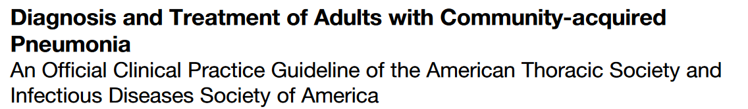
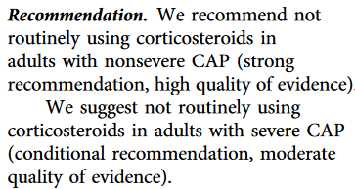

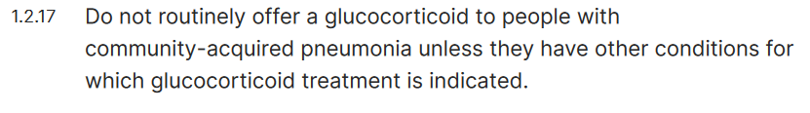
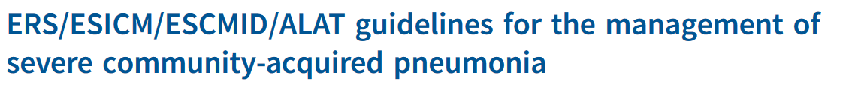
Corticosteroids for CAP - current guidance
August 2019
2014, updated 2023
June 2023
More randomised evidence is needed from a wide range of patients to inform treatment

Slide 33
Corticosteroids for CAP
No requirement for hypoxia (unlike influenza corticosteroid comparison)
Common side effects of corticosteroids should be anticipated and managed as in normal practice
  E.g. consider risk of hyperglycaemia, peptic ulceration, infection

Slide 34
RECOVERY CAP comparison
Introduced into protocol early 2024, now open at 30 sites
Current recruitment 232 participants – many sites opening for this winter
Recruitment fee £100/participant.
Very simple comparison for sites
  No samples
  Dexamethasone from NHS stock
  Single follow-up form

Slide 35


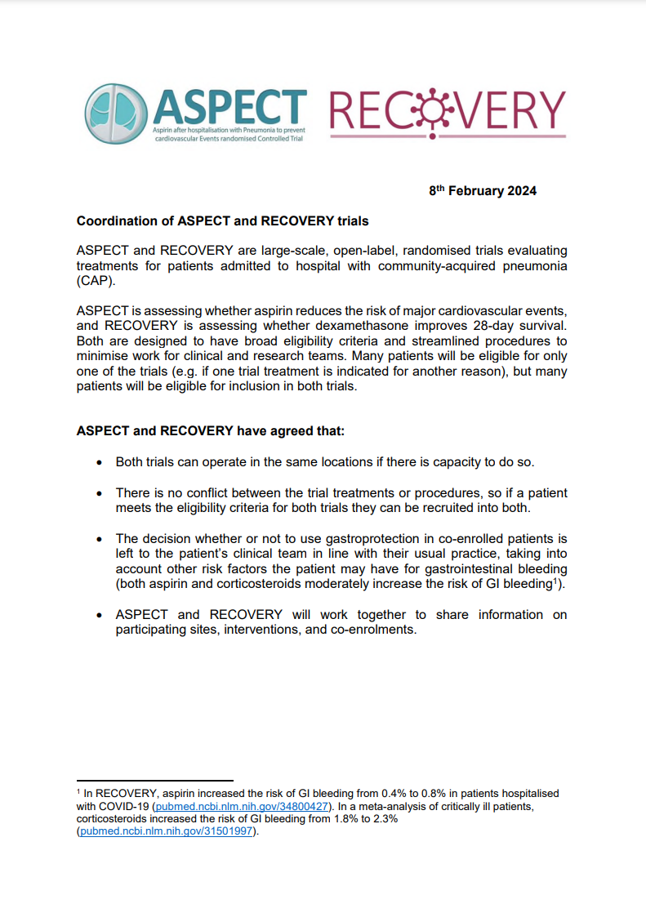
&
Risk of MI & stroke is high following admission with CAP, and ASPECT is testing if 3 months’ aspirin reduces this
Many CAP patients will be eligible for only one trial (e.g. if aspirin or systemic corticosteroids indicated for another reason) & many will be eligible for both
Both trials can operate in the same sites if there is capacity
There’s no conflict between trial treatments/procedures, so eligible patients can be recruited into both trials
Download from www.recoverytrial.net/uk/for-site-staff/site-teams

Slide 36
&
Screening patients to both trials simultaneously may be efficient for local research teams
Please consider opening RECOVERY CAP dexamethasone comparison if you are open to ASPECT
ASPECT is also open to new sites – please contact the ASPECT team at aspect-trial@bristol.ac.uk if you are interested
Download from www.recoverytrial.net/uk/for-site-staff/site-teams

Slide 37
Trial procedures

Slide 38
Opening new comparisons
Payment of influenza/CAP recruitment fees requires a simple amendment to our existing agreement
If you are in the process of opening a new comparison and this is not signed yet, then please consider chasing this on your side
If you are uncertain about the status of this, or anything else related to opening a new comparison (e.g. training, swab kits, PI confirmation), please contact us as soon as possible
recoverytrial@ndph.ox.ac.uk

Slide 39
Biological sampling
Nose swabs are needed from all patients in the influenza comparisons
  Nose swab at baseline (day 1) - after consent but before randomisation
  Nose swab at day 5
  No blood samples needed
  Email recovery trial team if you require more swab kits
No samples needed from participants in the CAP comparison
Full instructions are on the website (‘For Site Teams’ page)

Slide 40
Consent monitoring
A scanned copy of every consent form should be e-mailed to RECOVERY trial within 72 hours
Write you name clearly on the form so we can ensure those taking consent have done consent training
This should be to our nhs.net email address, which has recently changed (now pcctuoxf.recoverytrial@nhs.net)
See RECOVERY website for instructions (‘For Site Staff>Randomisation’)

Slide 41
Completeness of follow-up
Weekly reminders highlighting participants randomised >28 days ago without complete form
Completeness of follow-up has always been excellent; please keep this up!

Slide 42
Thank you!
The RECOVERY collaboration has been a huge success in COVID-19, and we hope to produce similar practice-changing evidence for the influenza & CAP
The flu season is unpredictable and usually brief, so it’s essential that teams are prepared to start recruit as soon as it arrives
We know many of you won’t have worked on RECOVERY before, so please get in touch if you have any questions about trial procedures
Thank you for being part of the RECOVERY collaboration!

