Slide 1
The RECOVERY trial
Collaborators’ Meetings
12th & 13th May 2025

Slide 2
Agenda
COVID-19 long-term follow-up results
Influenza
Baloxavir
Oseltamivir
Dexamethasone
Community-acquired pneumonia
Dexamethasone
Trial procedures
In-person collaborators’ meeting
Q&A
Monday & Tuesday meetings cover the same material (no paediatric/obstetric updates)

Slide 3
Introductions
If you have questions please enter them into the “Q&A”
Questions may be answered directly or to the whole group
Information about the trial is on our website https://www.recoverytrial.net/uk/for-site-staff
Slides & recording will be uploaded to the UK Site Teams page

Slide 4
Long-term follow-up of COVID-19 comparisons
Please note: these results are confidential until publication

Slide 5
Recovery – TRIAL update

Slide 6


Current comparisons
HOSPITALISED PATIENTS WITH PNEUMONIA
ANALYSIS
Community-acquired pneumonia (CAP) corticosteroid comparison
Dexamethasone
Usual care without corticosteroids
or
Patients with CAP
R
Outcomes at 28 days
Mortality
Time to discharge alive
Progression to ventilation or death
Baseline data collected, suitability determined
1:1 randomisation in each suitable comparison
Baloxavir comparison
Oseltamivir comparison
Influenza corticosteroid comparison (patients with hypoxia)
Baloxavir
Usual care without baloxavir
Oseltamivir
Usual care without neuraminidase inhibitor
Dexamethasone
Usual care without corticosteroids
or
or
or
Patients with confirmed INFLUENZA A or B

Slide 7
RECOVERY Eligibility
Hospitalised
Pneumonia syndrome
One of the following diagnoses:
Confirmed influenza A or B infection (including those bacterial co-infection)
Community-acquired pneumonia with planned antibiotics (without suspected COVID-19/flu/PCP/TB)
No medical history that might put the patient at risk if they were to participate
Attending clinician does not believe a specific trial treatment is indicated or contra-indicated

Slide 8
Influenza comparisons

Slide 9
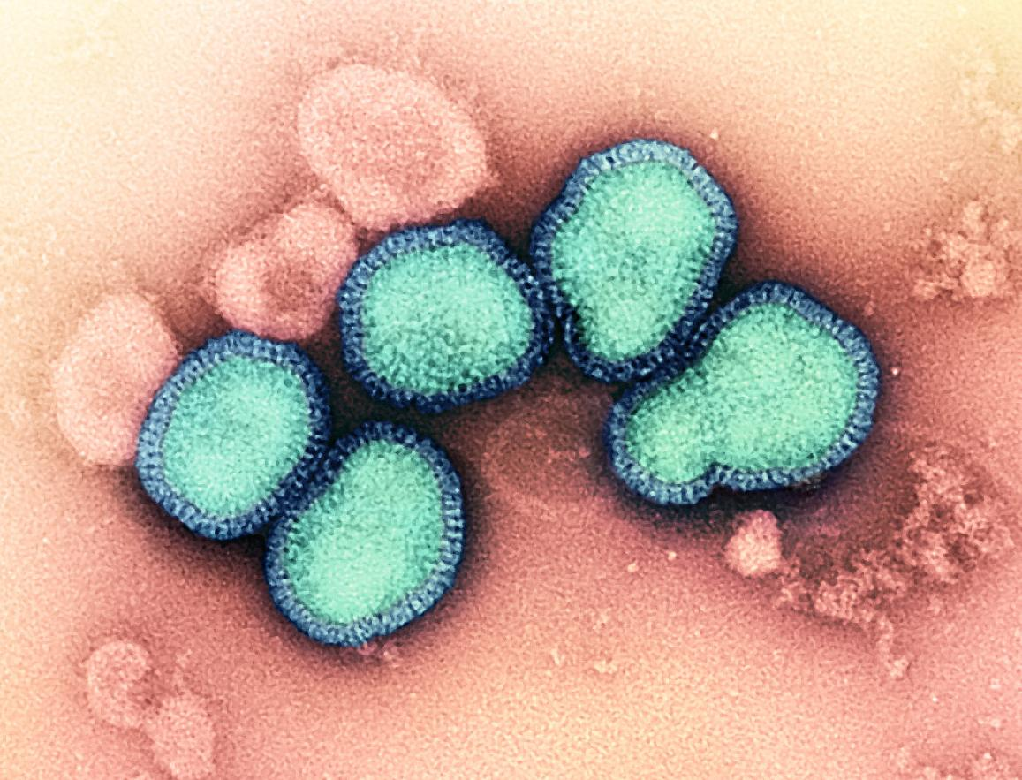
Influenza
Seasonal influenza estimated to have killed ~350,000 people in 2019
An influenza pandemic could kill tens of millions
Unlike COVID-19, we do not have good (i.e. randomised) evidence to guide treatment

Slide 10
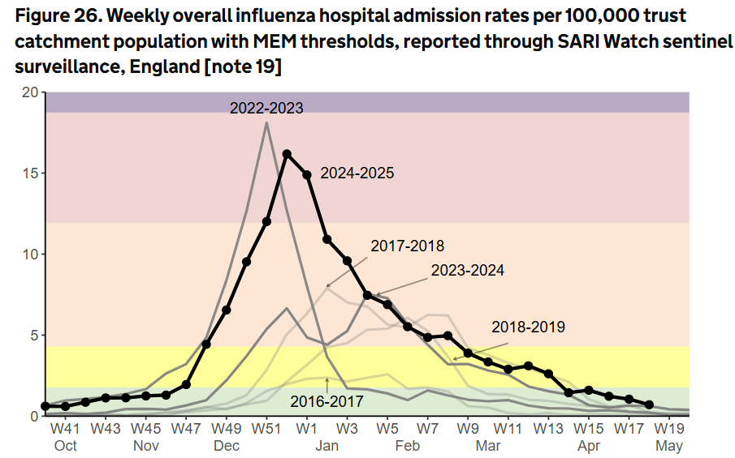
Influenza
https://www.gov.uk/government/statistics/national-flu-and-covid-19-surveillance-reports-2024-to-2025-season/

Slide 11
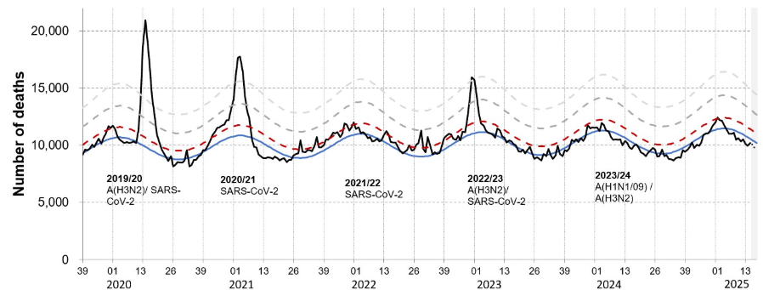
Influenza
Weekly all-cause mortality in England
https://www.gov.uk/government/statistics/weekly-all-cause-mortality-surveillance-2024-to-2025

Slide 12
BALOXAVIR

Slide 13
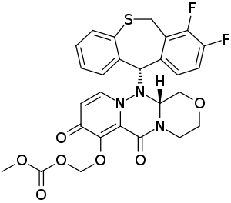
Baloxavir
Newer influenza antiviral (cap-dependent endonuclease inhibitor)
Rapidly reduces viral load, but resistance mutations can arise
Mechanism of action differs from NAIs, so combination may be better than either alone
Reduces the duration of flu symptoms by ~1 day but hasn't been properly tested in hospitalised patients

Slide 14
Baloxavir
Patients with recent or planned use of an baloxavir for current infection are ineligible
Patients treated for bacterial co-infection are eligible if clinical team think influenza is contributing to lung disease
Long half-life so two doses only – please ensure that 2nd dose is available for when patient is discharged

Slide 15
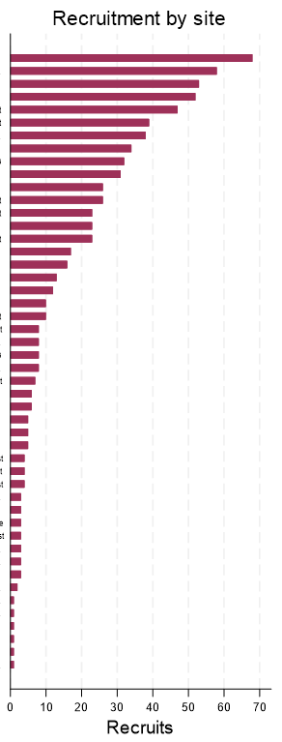
Baloxavir - recruitment
759 participant recruited to baloxavir comparison from 48 sites
Recruitment by site
Total recruitment
2023
2024
2025

Slide 16
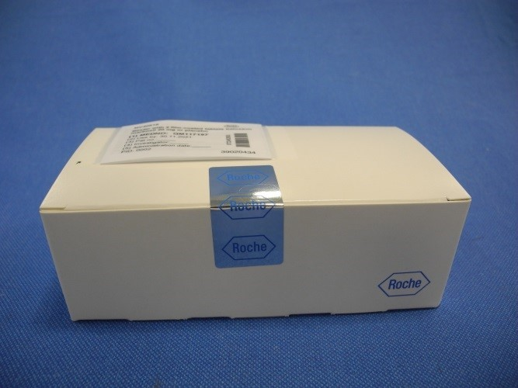
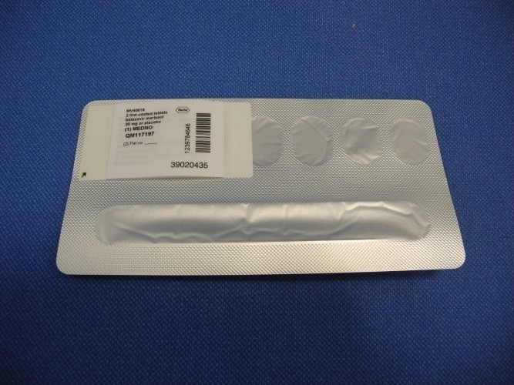
Baloxavir
Change of baloxavir supply last year – new supply has clinical trial labelling & different tablet dose
No new accountability or temperature monitoring requirements once in pharmacy – treat like other licensed medications if possible
Try to ensure that allocation in the baloxavir comparison does not affect use of routine care treatments (e.g. prescription of oseltamivir only if patient allocated usual care)

Slide 17
oseltamivir

Slide 18
Oseltamivir (Tamiflu)
NAIs reduces the duration of flu symptoms by ~1 day in early infection
Some observational studies suggest a benefit of NAIs in hospitalised patients, but others don’t, and evidence from randomised trials is lacking.
These observational studies are prone to biases that cannot be reliably avoided
Observational data were used to support COVID-19 treatments (e.g. hydroxychloroquine, convalescent plasma) that were later found to be of no benefit, or even harmful, in large randomised trials

Slide 19
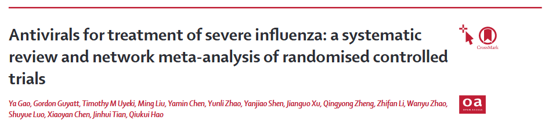

Oseltamivir
Lancet. 2024 Aug 24;404(10454):753-763. PMID: 39181595

Slide 20
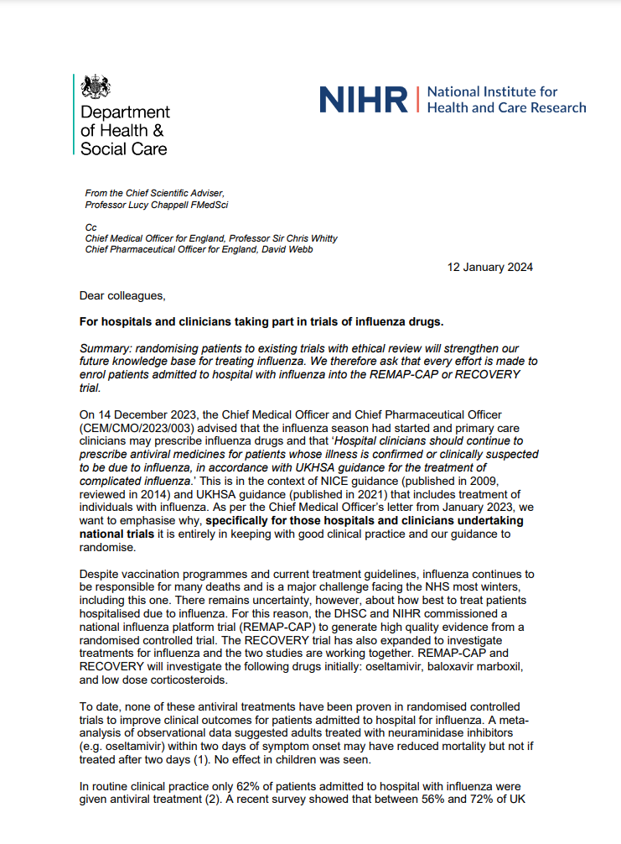
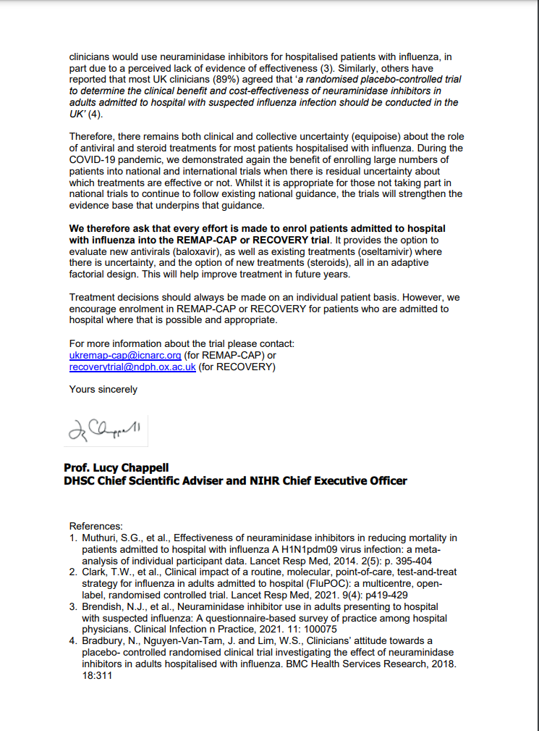
Oseltamivir
UKHSA guidance recommends NAIs for patients hospitalised with influenza (usually reflected in local guidelines)
However, DHSC & NIHR support influenza trials that include a no antiviral arm
“As per the Chief Medical Officer’s letter from January 2023, we want to emphasise why, specifically for those hospitals and clinicians undertaking national trials it is entirely in keeping with good clinical practice and our guidance to randomise.”
We therefore ask that every effort is made to enrol patients admitted to hospital with influenza into the REMAP-CAP or RECOVERY trial. It provides the option to evaluate new antivirals (baloxavir), as well as existing treatments (oseltamivir) where there is uncertainty, and the option of new treatments (steroids)”
Local discussions/communication may be needed to explain this context

Slide 21
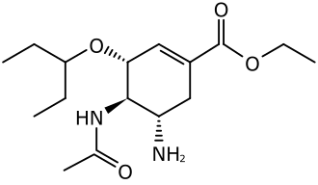
Oseltamivir
Patients with recent or planned use of an NAI for current infection are ineligible (oseltamivir or zanamivir)
Patients treated for bacterial co-infection are eligible if clinical team think influenza is contributing to lung disease

Slide 22
Oseltamivir – recruitment
Recruitment by site
218 participant recruited to oseltamivir comparison from 42 sites
Total recruitment
2023
2024
2025

Slide 23
Oseltamivir
If you were not recruiting to this comparison, please consider discussing this again before next flu season (ideally start now)
Trial oseltamivir is now from NHS stock, which should simplify recruitment
Please monitor ‘drop-in’ NAI treatment in patients allocated usual care without NAI
Try to ensure that trial participation & treatment allocation is clearly documented in notes & handed over between clinical teams

Slide 24
Corticosteroids for influenza

Slide 25
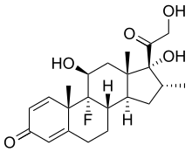
Corticosteroids (influenza)
Corticosteroids reduce risk of death by ~1/5 in hypoxic patients with COVID-19 pneumonia
Previously proposed as a treatment for influenza pneumonia but never properly tested
Reducing immune-mediated lung damage may improve survival in severe flu as it does in COVID-19

Slide 26
Corticosteroids (influenza)
Open to patients with influenza pneumonia plus hypoxia (supplemental oxygen or SpO2 <92% on air)
Contraindicated if current or planned use of systemic corticosteroids, or if coinfected with SARS-CoV-2
Common side effects of corticosteroids should be anticipated and managed as in normal practice
E.g. consider risk of hyperglycaemia, peptic ulceration, infection

Slide 27
Corticosteroids (influenza) - recruitment
Recruitment by site
296 participant recruited to influenza corticosteroid comparison from 60 sites
Total recruitment
2023
2024
2025

Slide 28
CAP CORTICOSTEROID comparison

Slide 29
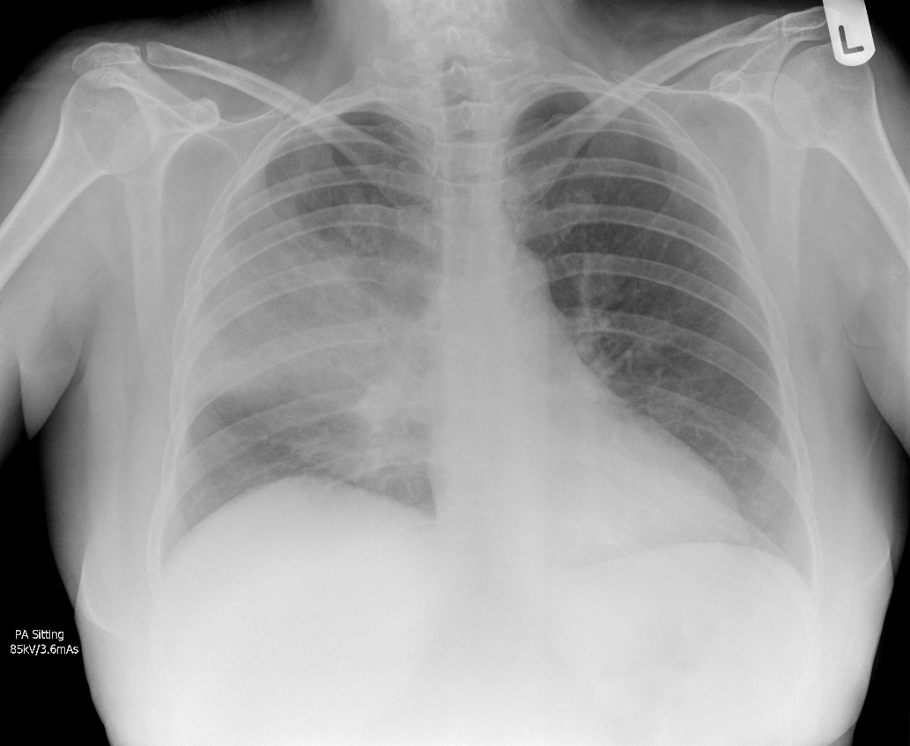
Community-acquired pneumonia
One of the commonest reasons for acute hospital admission in the UK
4th leading cause of death worldwide, estimated to kill >2,000,000 people per year

Slide 30
CAP in RECOVERY - eligibility
Patients must have a diagnosis of CAP with planned antibiotic use
Patients ineligible if they have suspected or confirmed:
SARS-COV-2 infection
Influenza infection
Pneumocystis jirovecii pneumonia (‘PCP’ or ‘PJP’)
Active pulmonary tuberculosis
However testing for these pathogens is not required for trial purposes (only if part of standard care)
If an influenza test result is pending during flu season, please do not recruit until this is available

Slide 31
Corticosteroids for CAP – evidence
~20 randomised trials with ~4,000 patients in total (1st in 1956)
>20 meta-analyses of the same trials, with differing conclusions
Reduced time to discharge in one trial (but steroids directly reduce fever & CRP)
Reduced time to resolution of septic shock in severe CAP trials
Possible increased readmission with corticosteroids
Concerns about side effects – hyperglycaemia, GI bleeding, secondary infection

Slide 32
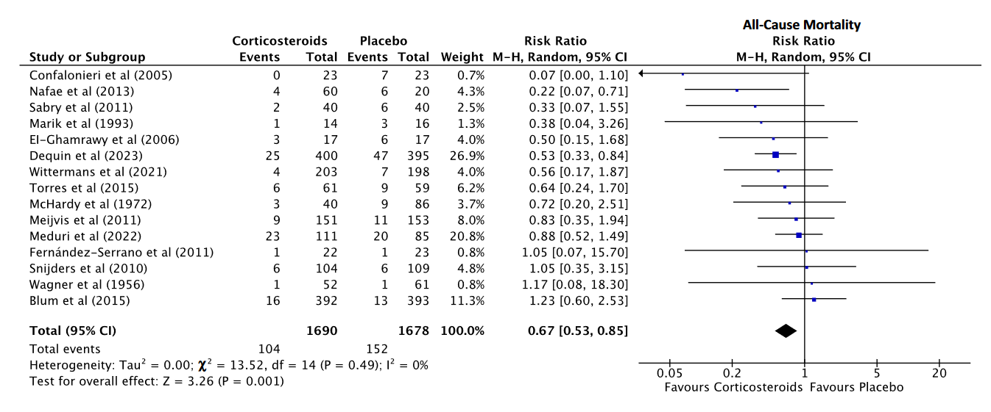
Corticosteroids for CAP – evidence
Bergmann F, et al. Clin Infect Dis. 2023 PMID 37876267

Slide 33
Corticosteroids for CAP - current guidance
Main US/UK/European CAP guidelines do not currently recommend routine use of corticosteroids
Some recent guidelines now recommend steroids in severe CAP (French, SCCM)
Last month REMAP-CAP published their CAP corticosteroid domain testing hydrocortisone for severe CAP
Stopped for futility after 455 patients randomised
Mortality 42/339 (12%) with corticosteroids versus 7/116 (6%) concurrent controls
Result consistent with harm, no benefit or reduction in mortality (OR 1.73, 95% 0.65 – 5.07)
More randomised evidence is needed from a wide range of patients to inform treatment
1 https://pubmed.ncbi.nlm.nih.gov/40261382/

Slide 34
Corticosteroids for CAP
No requirement for hypoxia (unlike influenza corticosteroid comparison)
Common side effects of corticosteroids should be anticipated and managed as in normal practice
E.g. consider risk of hyperglycaemia, peptic ulceration, infection
Simple comparison for site teams (we hope)
No biological samples
Dexamethasone from NHS stock
Single follow-up form

Slide 35
Corticosteroids (CAP) - recruitment
Recruitment by site
715 participant recruited to CAP corticosteroid comparison from 63 sites
Total recruitment
2024
2025

Slide 36


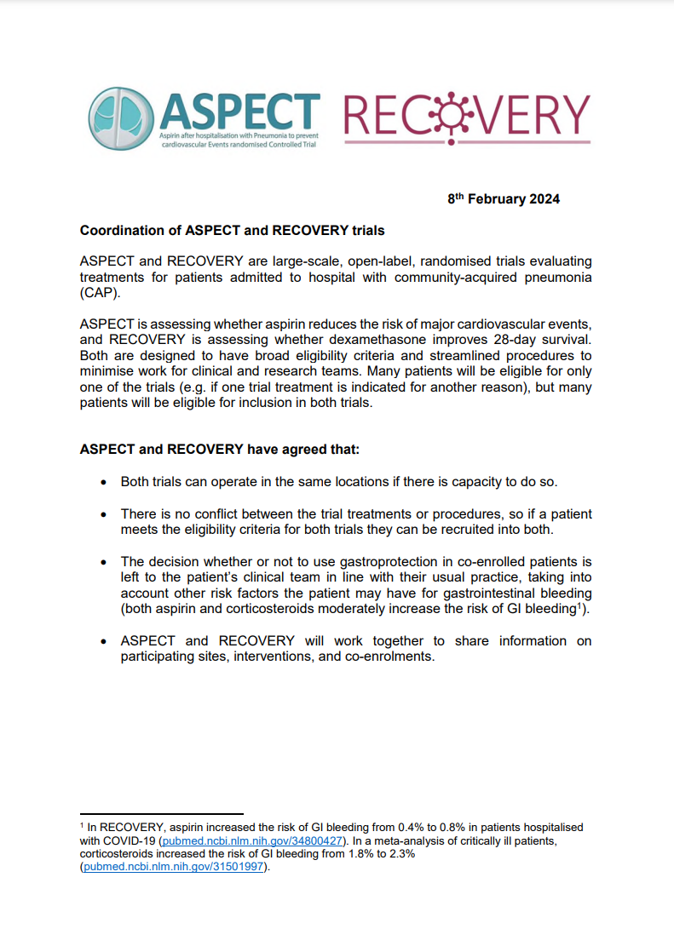
&
ASPECT is testing whether aspirin reduces risk of cardiovascular events in hospitalised CAP patients
Patients may be eligible both trials or just one
Both trials can operate in the same sites if there is capacity
There’s no conflict between trial treatments/procedures, so eligible patients can be recruited into both trials
ASPECT is open to new sites – please contact the ASPECT team at aspect-trial@bristol.ac.uk if you are interested
Download from www.recoverytrial.net/uk/for-site-staff/site-teams

Slide 37
Trial procedures

Slide 38
Substantial amendment 37
Will be submitted in the coming weeks
No new comparisons or trial procedures
Removes references to COVID-19 from protocol & consent forms, plus many other minor changes
We will email sites with a link to SA37 documents as soon as this is submitted

Slide 39
Biological sampling
Nose swabs are needed from all patients in the influenza comparisons
Nose swab at baseline (day 1) - after consent but before randomisation
Nose swab at day 5
No blood samples needed
Email recovery trial team if you require more swab kits
No samples needed from participants in the CAP comparison
Full instructions are on the website (‘For Site Teams’ page)

Slide 40
Consent monitoring
A scanned copy of every consent form should be e-mailed to RECOVERY trial within 72 hours
Write you name clearly on the form so we can ensure those taking consent have done consent training
This should be to our nhs.net email address, which has recently changed (now pcctuoxf.recoverytrial@nhs.net)
See RECOVERY website for instructions (‘For Site Staff>Randomisation’)

Slide 41
Completeness of follow-up
Weekly reminders highlighting participants randomised >28 days ago without complete form
Completeness of follow-up has always been excellent; please keep this up!

Slide 42
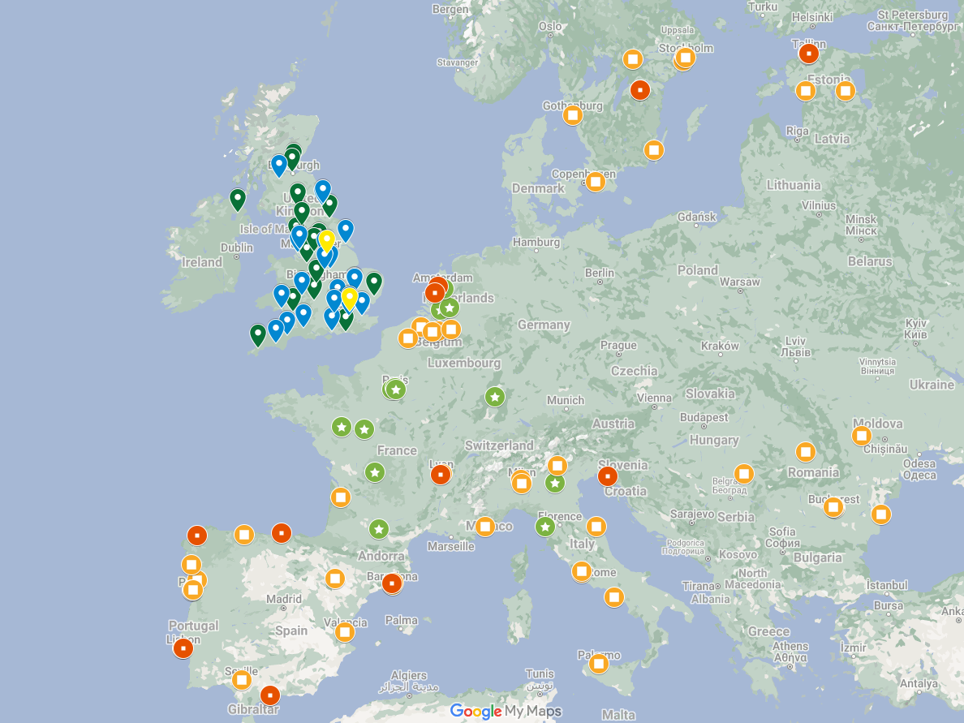
RECOVERY UK & EU sites
RECOVERY influenza & CAP comparisons
Open at 53 UK sites
Active in 7 EU countries
Opening in 2 more EU countries, with EU 65 sites in total
~20 existing sites in Nepal, Indonesia, Vietnam, South Africa & Ghana will also be participating

Slide 43
In-person collaborators’ meeting
One day meeting in Early October – date TBC soon
Thanks to those who expressed interest in attending, we will send a reminder to others this week
Will include:
Updates on RECOVERY & global influenza & CAP trials
Experience from site teams & planning for Winter 2025/26
Planning additional RDN support for influenza comparisons
Discussion of future directions for RECOVERY

Slide 44

Thank you!
The RECOVERY collaboration was a huge success in COVID-19, and we hope to produce similar practice-changing evidence for influenza & CAP
The flu season is unpredictable and usually brief, so it’s essential that teams are prepared to start recruiting as soon as it arrives
Please get in touch if you have any questions about the trial
Thank you for being part of the collaboration!

