Slide 1
The RECOVERY trial
Collaborators’ Meetings
10th and 11th November 2025

Slide 2
Agenda
Influenza
Current epidemiology
UKHSA guidelines
Oseltamivir
Baloxavir
Dexamethasone
Community-acquired pneumonia
NICE guidelines
Dexamethasone
Trial procedures
Q&A
Monday & Tuesday meetings cover the same material (no paediatric/obstetric updates)

Slide 3
Q&A
If you have questions please enter them into the “Q&A”
Questions may be answered directly or to the whole group
Information about the trial is on our website https://www.recoverytrial.net/uk/for-site-staff
Slides & recording will be uploaded to the UK Site Teams page

Slide 4

RECOVERY meeting, October 2025

Slide 5
Recovery – TRIAL update

Slide 6


Current comparisons
HOSPITALISED PATIENTS WITH PNEUMONIA
ANALYSIS
Community-acquired pneumonia (CAP) corticosteroid comparison
Dexamethasone
Usual care without corticosteroids
or
Patients with CAP
R
Outcomes at 28 days
Mortality
Time to discharge alive
Progression to ventilation or death
Baseline data collected, suitability determined
1:1 randomisation in each suitable comparison
Baloxavir comparison
Oseltamivir comparison
Influenza corticosteroid comparison (patients with hypoxia)
Baloxavir
Usual care without baloxavir
Oseltamivir
Usual care without neuraminidase inhibitor
Dexamethasone
Usual care without corticosteroids
or
or
or
Patients with confirmed INFLUENZA A or B

Slide 7
RECOVERY Eligibility
Hospitalised
Pneumonia syndrome
One of the following diagnoses:
Confirmed influenza A or B infection
Community-acquired pneumonia with planned antibiotics (without suspected COVID-19/flu/PCP/TB)
No medical history that might put the patient at risk if they were to participate
Attending clinician does not believe a specific trial treatment is indicated or contra-indicated

Slide 8
RECOVERY Eligibility: The Uncertainty Principle
Without good evidence to guide oseltamivir and steroid use, clinical practice varies widely by country, hospital and individual clinician.
Clinicians may have strong views on which kinds of patient they are willing to recruit, e.g.
Some may give steroids to all severe CAP patients
Some may give oseltamivir to all flu patients if symptoms <48h
Because of this, the protocol allows a wide range of patients to join and follows the ‘Uncertainty Principle’.

Slide 9
RECOVERY Eligibility: The Uncertainty Principle
If the responsible clinician is reasonably certain that a treatment should, or should not, be given (or if they feel they must follow guidelines that specify this) then the patient is not eligible for that comparison.
If the responsible clinician is substantially uncertain about giving a trial treatment (whether or not they would give it in normal practice) and they would be happy to follow a random allocation, the patient is potentially eligible.
The kind of patients recruited at each site will vary (as always in clinical trials)
We will explore which (if any) types of patients benefit in prespecified subgroup analyses (e.g. by severity, symptom duration, immunosuppression).

Slide 10
Influenza comparisons

Slide 11
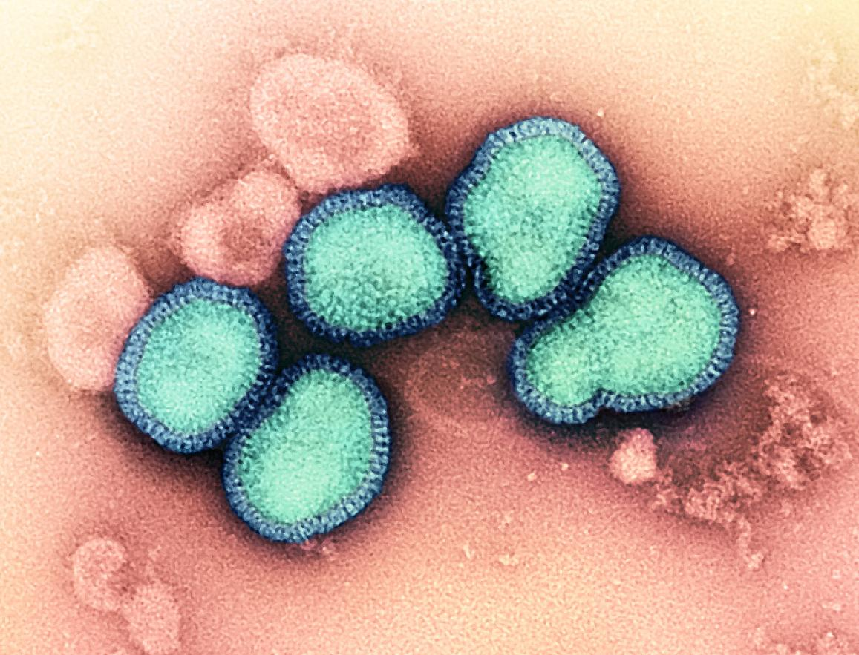
Influenza
Seasonal influenza estimated to have killed ~350,000 people in 2019
An influenza pandemic could kill tens of millions
Unlike COVID-19, we do not have good (i.e. randomised) evidence to guide treatment

Slide 12
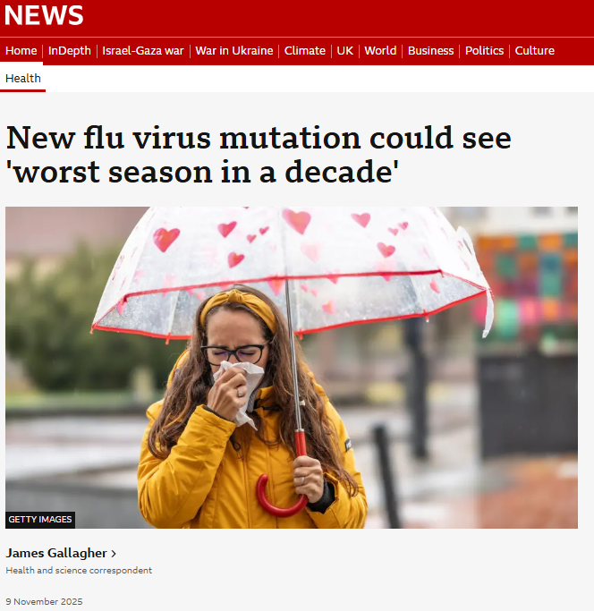
Influenza
The UK, following Japan, is seeing an unusually early start to the winter flu season
A new strain of influenza A H3N2 is circulating (subclade J.2.4.1, now known as K)
Subclade K has antigenically drifted from previous H3N2 strains, including the current vaccine strain
Most current infections are in children and young adults
If transmission or severity are high in older adults it could lead to a large wave of hospitalisations and deaths

Slide 13
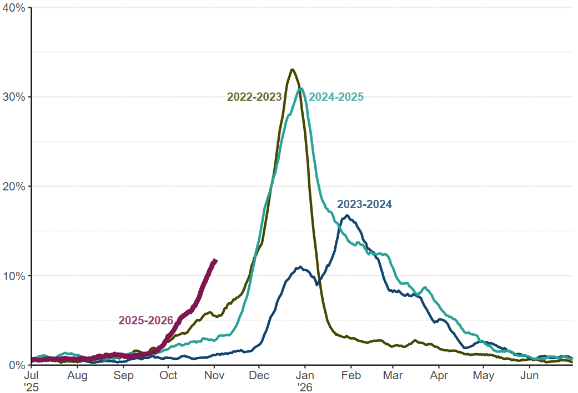
Influenza
Daily percentage of tests positive for influenza among all reported influenza tests (7-day rolling average), England
https://www.gov.uk/government/statistics/national-flu-and-covid-19-surveillance-reports-2025-to-2026-season

Slide 14
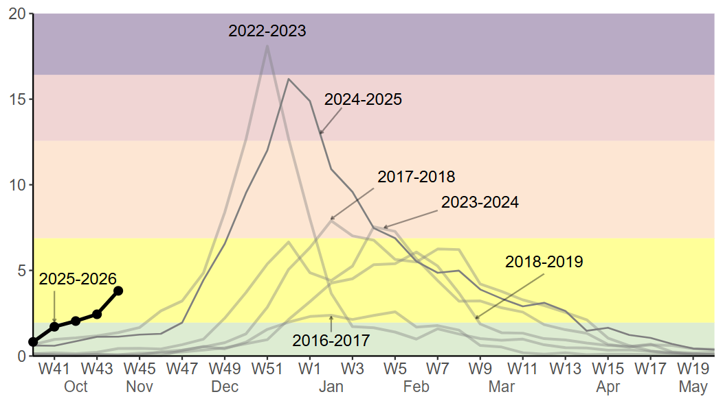
Influenza
Weekly overall influenza hospital admission rates per 100,000, England
https://www.gov.uk/government/statistics/national-flu-and-covid-19-surveillance-reports-2025-to-2026-season

Slide 15
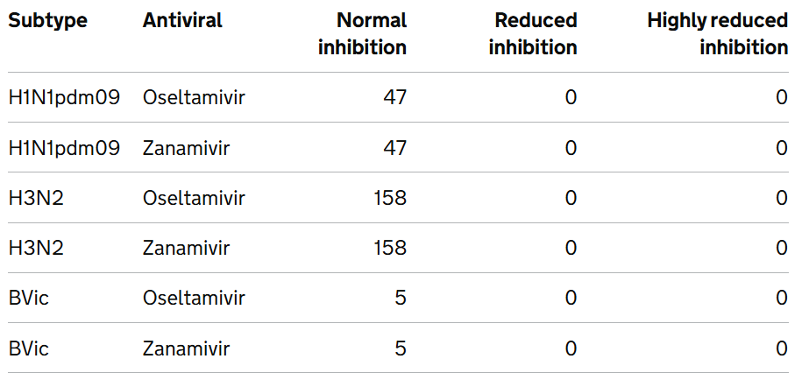
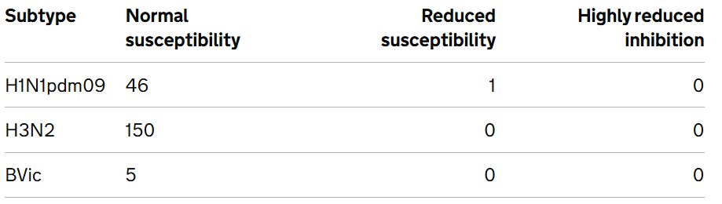
Influenza
Antiviral susceptibility in recent UK influenza samples (genome sequencing)
Rates of antiviral resistance to neuraminidase inhibitors (NAIs) and baloxavir remain low
OSELTAMIVIR
BALOXAVIR
https://www.gov.uk/government/statistics/national-flu-and-covid-19-surveillance-reports-2025-to-2026-season

Slide 16
Influenza antivirals

Slide 17
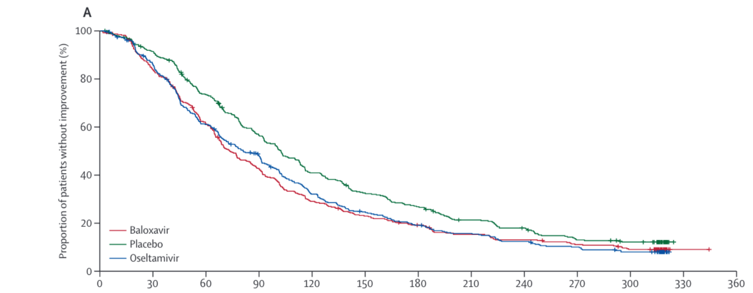
Antivirals in early infection
Oseltamivir and baloxavir have been shown to reduce the duration of uncomplicated influenza symptoms by ~1 day, if started within 48 hours of symptom onset
Neither has been properly tested in randomised trials in hospitalised patients, or those with a longer duration of symptoms
Effect of antivirals on influenza symptoms in uncomplicated infection (outpatients)
% with no symptom improvement
Baloxavir
Placebo
Oseltamivir
Ison MG et al. Lancet Infect Dis. 2020 Oct;20(10):1204-1214. PMID32526195
Time since start of treatment (h)

Slide 18
Oseltamivir in hospitalised patients
Some observational studies suggest a benefit of NAIs in hospitalised patients, but others don’t, and evidence from randomised trials is lacking.
Observational studies are prone to biases that cannot be reliably avoided
Observational data were used to support COVID-19 treatments (e.g. hydroxychloroquine, convalescent plasma) that were later found to be of no benefit, or even harmful, in large randomised trials

Slide 19


Oseltamivir
Lancet. 2024 Aug 24;404(10454):753-763. PMID: 39181595

Slide 20
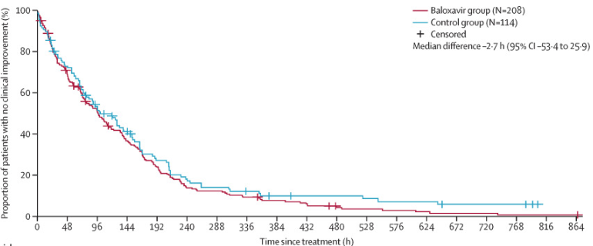
Baloxavir in hospitalised patients
Randomised evidence in hospitalised patients is limited to the FLAGSTONE trial in 366 patients, comparing baloxavir plus oseltamivir with oseltamivir monotherapy.
There was no significant reduction in time to clinical improvement, but was underpowered to rule out important benefits
Kumar, Deepali et al. Lancet Infect Dis. 2022 May;22(5):718-730. doi: 10.1016/S1473-3099(21)00469-2

Slide 21
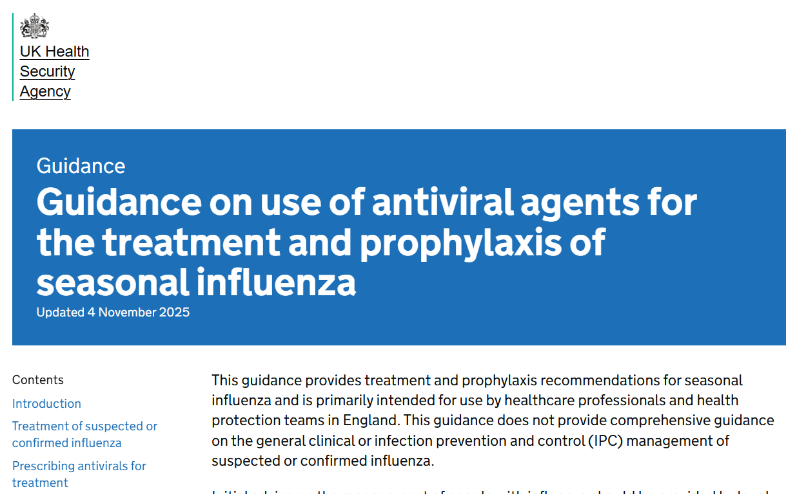
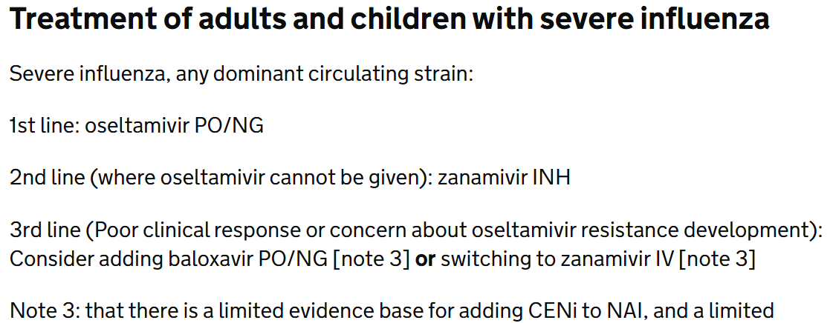
UK clinical guidelines
UKHSA influenza antiviral guidelines updated last week
These continue to recommend antiviral treatment for patients with severe influenza (i.e. requiring hospitalisation)
UKHSA guidance is usually replicated in local guidelines
https://www.gov.uk/government/publications/influenza-treatment-and-prophylaxis-using-anti-viral-agents/guidance-on-use-of-antiviral-agents-for-the-treatment-and-prophylaxis-of-seasonal-influenza

Slide 22
UK influenza treatment trials
The guidelines also support recruitment into randomised trials:
“There remains a need to strengthen the evidence base for the relative effectiveness of different approaches to managing influenza. Considering patients for ethically approved randomised controlled trials will strengthen the knowledge base and is a decision for clinicians and their consenting patients.”
https://www.gov.uk/government/publications/influenza-treatment-and-prophylaxis-using-anti-viral-agents/guidance-on-use-of-antiviral-agents-for-the-treatment-and-prophylaxis-of-seasonal-influenza

Slide 23
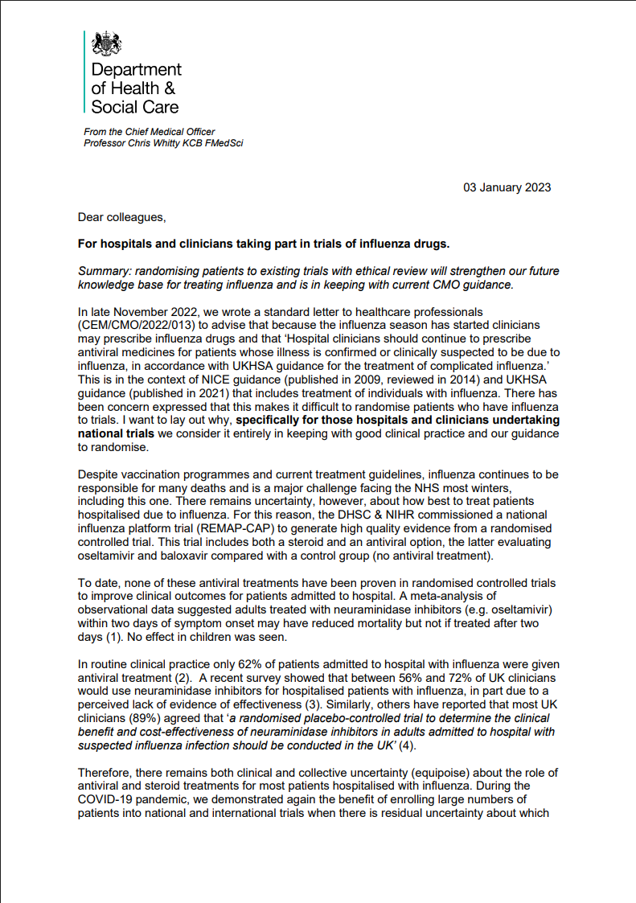
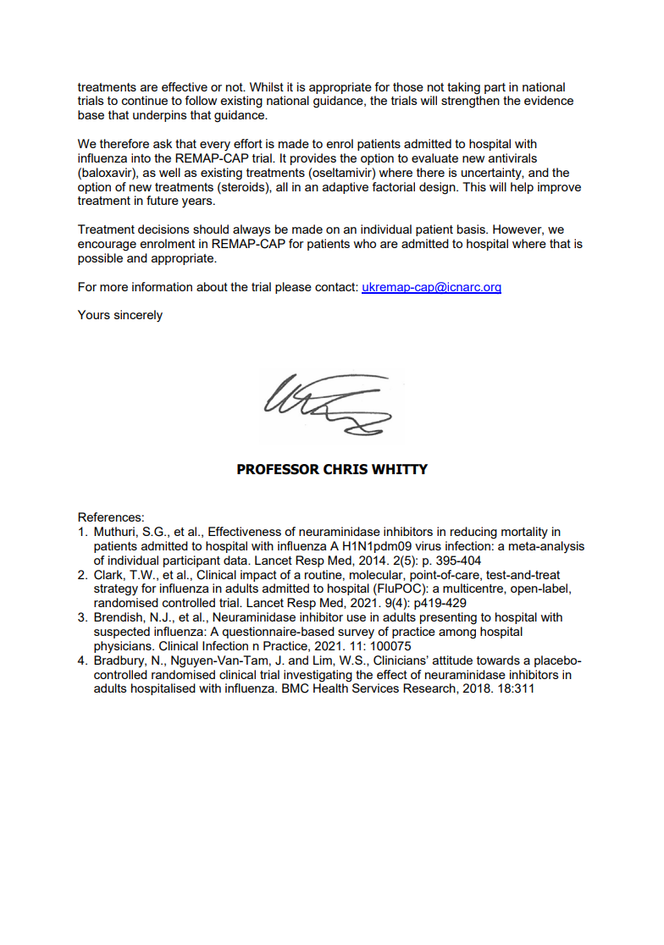
UK influenza treatment trials
The DHSC supports influenza trials that include a no antiviral arm
“[…] there remains both clinical and collective uncertainty (equipoise) about the role of antiviral and steroid treatments for most patients hospitalised with influenza.
[…] Whilst it is appropriate for those not taking part in national trials to continue to follow existing national guidance, the trials will strengthen the evidence base that underpins that guidance.”
2023 CMO letter for hospitals and clinicians taking part in trials of influenza treatments

Slide 24
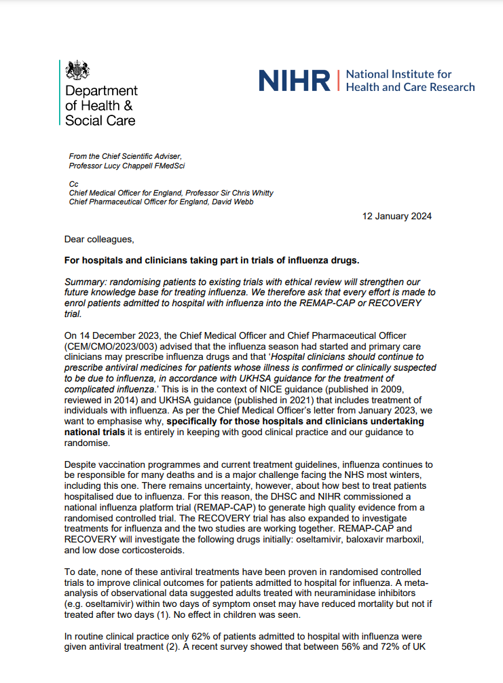
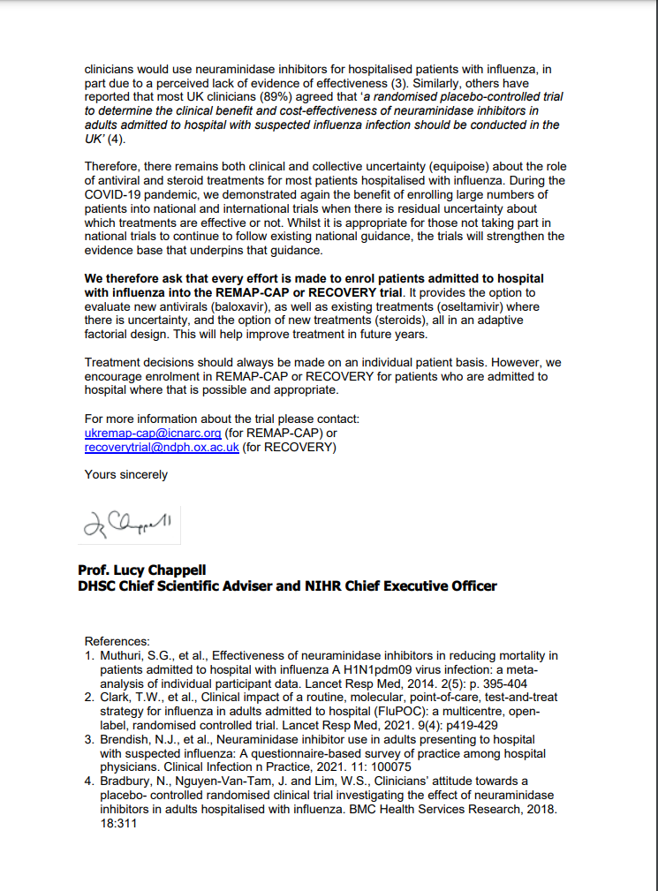
UK influenza treatment trials
“[…] we want to emphasise why, specifically for those hospitals and clinicians undertaking national trials it is entirely in keeping with good clinical practice and our guidance to randomise.”
We therefore ask that every effort is made to enrol patients admitted to hospital with influenza into the REMAP-CAP or RECOVERY trial. It provides the option to evaluate new antivirals (baloxavir), as well as existing treatments (oseltamivir) where there is uncertainty, and the option of new treatments (steroids)”
2024 letter from DHSC Chief Scientific Advisor

Slide 25
UK influenza treatment trials
The availability of NAIs in routine care complicates recruitment to the oseltamivir comparison
Local discussion with relevant clinicians may be needed to agree which types of patients (if any) can be approached about the oseltamivir comparison, e.g.
Early (<48h) vs late (>48h)symptoms
ICU vs non-ICU
Immunosuppressed vs not
Patients treated with routine care NAI can still join baloxavir and corticosteroid comparisons

Slide 26
Oseltamivir comparison

Slide 27
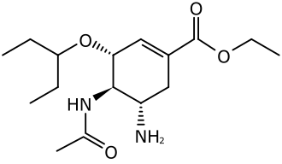
Oseltamivir
Patients with recent or planned use of an NAI for current infection are ineligible (oseltamivir or zanamivir)
Patients treated for bacterial co-infection are eligible if clinical team think influenza is contributing to lung disease

Slide 28
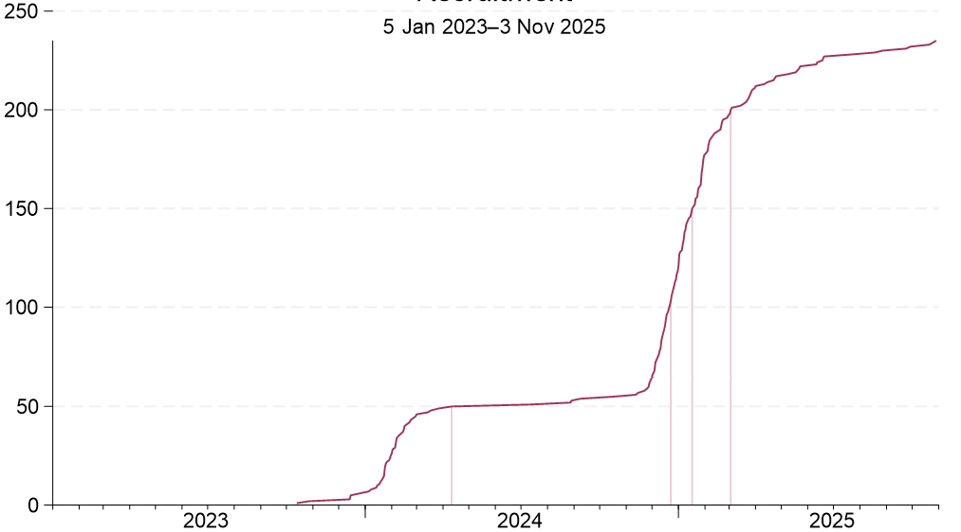
Oseltamivir – recruitment
Recruitment by site
240 participant recruited to oseltamivir comparison from 98 sites
Total recruitment

Slide 29
Oseltamivir
Trial oseltamivir is from NHS stock, which should simplify recruitment
Please monitor ‘drop-in’ NAI treatment in patients allocated usual care without NAI
Ensure trial participation & treatment allocation is clearly documented in notes & handed over between clinical teams

Slide 30
BALOXAVIR

Slide 31
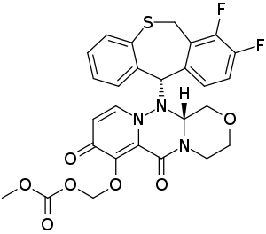
Baloxavir
Newer antiviral class (cap-dependent endonuclease inhibitor, CENi)
Reduces viral load more rapidly than NAI, but resistance mutations may arise more commonly on treatment
Mechanism of action differs from NAIs, so combination may be better than either alone

Slide 32
Baloxavir
Patients with recent or planned use of an baloxavir for current infection are ineligible
Patients treated for bacterial co-infection are eligible if clinical team think influenza is contributing to lung disease
Long half-life so two doses only – please ensure that 2nd dose is available when patient is discharged

Slide 33
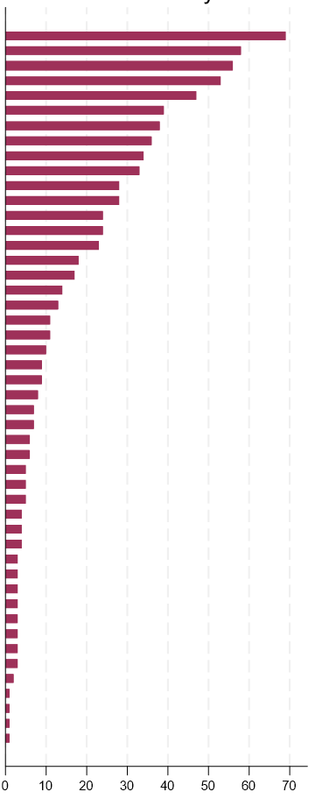
Baloxavir - recruitment
809 participant recruited to baloxavir comparison from 58 sites
Recruitment by site
Total recruitment
2023
2024
2025

Slide 34
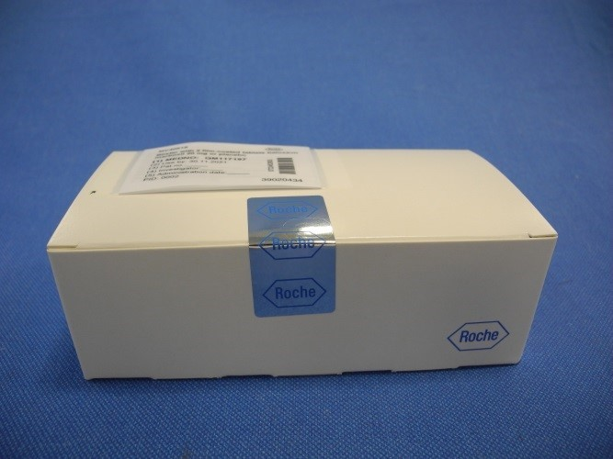
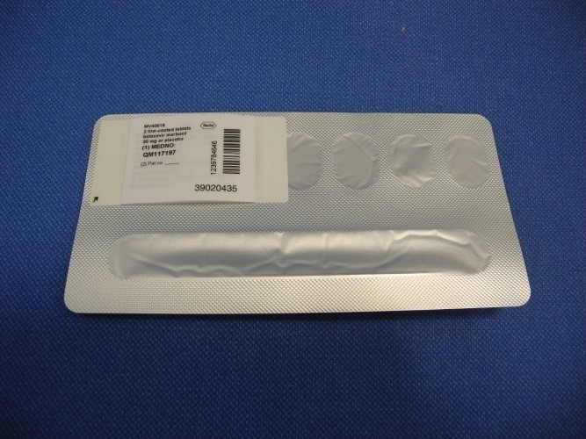
Baloxavir
Change of baloxavir supply last winter – new supply has clinical trial labelling
No new accountability or monitoring requirements once in pharmacy – treat like other licensed medications if possible
Aim to start treatment within 6h of randomisation
Ensure that allocation in baloxavir comparison does not affect use of routine care antivirals (e.g. prescription of oseltamivir only if patient allocated usual care)

Slide 35
Corticosteroids for influenza

Slide 36
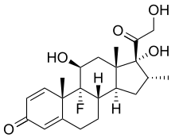
Corticosteroids (influenza)
Corticosteroids reduce risk of death by ~1/5 in hypoxic patients with COVID-19 pneumonia
Previously proposed as a treatment for influenza pneumonia but never properly tested
Reducing immune-mediated lung damage may improve survival in severe flu as it does in COVID-19
“Adjunctive corticosteroid therapy has been associated with an increased risk of mortality in observational studies, however there is a strong possibility of confounding by indication in these studies and further evidence from clinical trials is needed”
2025 UKHSA influenza treatment guidelines

Slide 37
Corticosteroids (influenza)
Open to patients with influenza pneumonia plus hypoxia (supplemental oxygen or SpO2 <92% on air)
Contraindicated if current or planned use of systemic corticosteroids, or if coinfected with SARS-CoV-2
Common side effects of corticosteroids should be anticipated and managed as in normal practice
E.g. consider risk of hyperglycaemia, peptic ulceration, infection

Slide 38
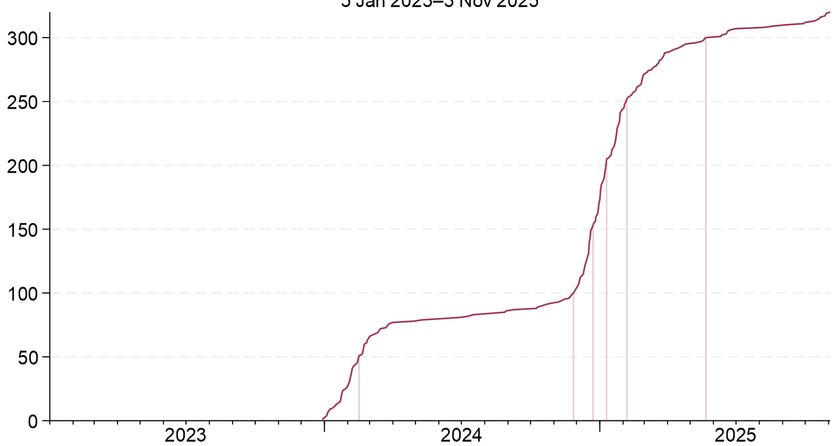
Corticosteroids (influenza) - recruitment
Recruitment by site
325 participant recruited to influenza corticosteroid comparison from 109 sites
Total recruitment

Slide 39
CAP CORTICOSTEROID comparison

Slide 40
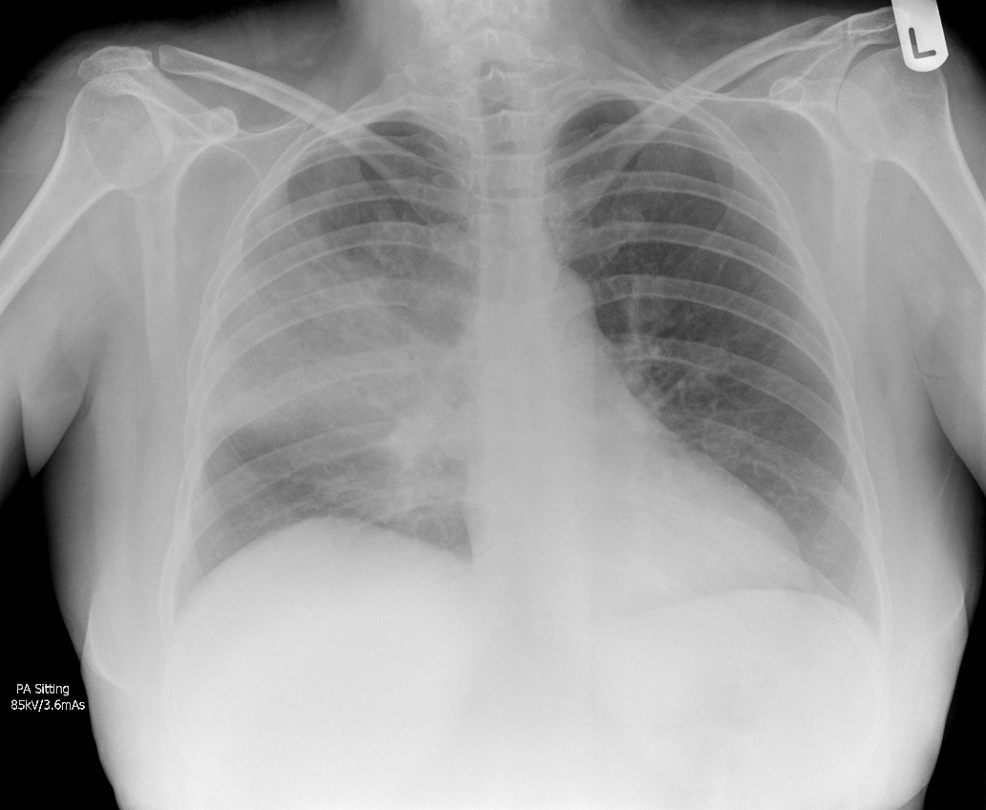
Community-acquired pneumonia
One of the commonest reasons for acute hospital admission in the UK
4th leading cause of death worldwide, estimated to kill >2,000,000 people per year

Slide 41
CAP in RECOVERY - eligibility
Patients must have a diagnosis of CAP with planned antibiotic use
Patients ineligible if they have suspected or confirmed:
SARS-COV-2 infection
Influenza infection
Pneumocystis jirovecii pneumonia (‘PCP’ or ‘PJP’)
Active pulmonary tuberculosis
However testing for these pathogens is not required for trial purposes (only if part of standard care)
If an influenza test result is pending, please do not recruit until this is available

Slide 42
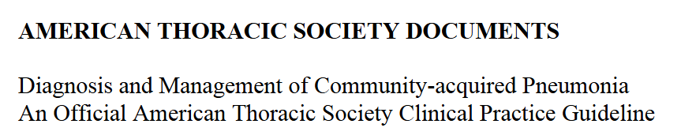
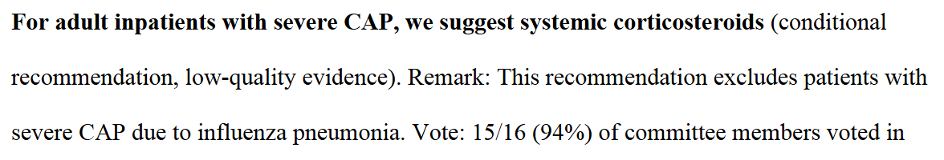
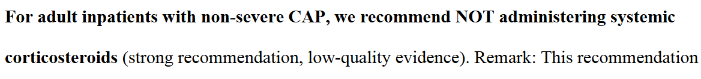
CAP – Guidelines
ATS
2025

Slide 43
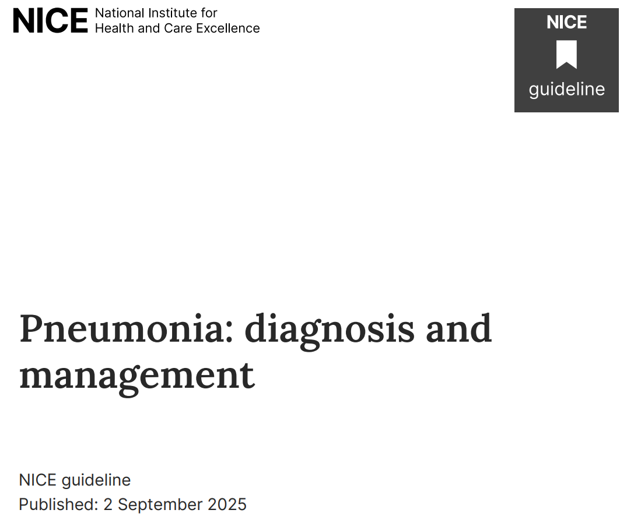
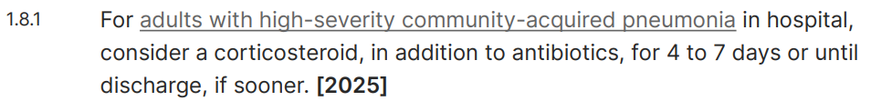
CAP – Guidelines
UK NICE
2025

Slide 44
CAP – Corticosteroids
We still don’t have high-quality randomised evidence to inform treatment of patients hospitalised with CAP
Interpretation of the current evidence varies, with widespread heterogeneity in practice
Most evidence supporting corticosteroids is in ICU patients (especially those with septic shock)
There is much less evidence for the ~95% of patients who are not on ICU
More randomised evidence is needed from a wide range of patients to properly inform treatment of CAP

Slide 45
CAP corticosteroid comparison
No requirement for hypoxia (unlike influenza corticosteroid comparison)
Common side effects of corticosteroids should be anticipated and managed as in normal practice
E.g. consider risk of hyperglycaemia, peptic ulceration, infection
Simple comparison for site teams (we hope)
No biological samples
Dexamethasone from NHS stock
Single follow-up form

Slide 46
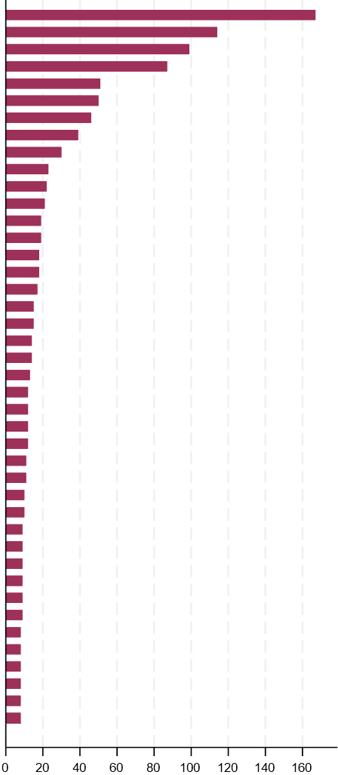
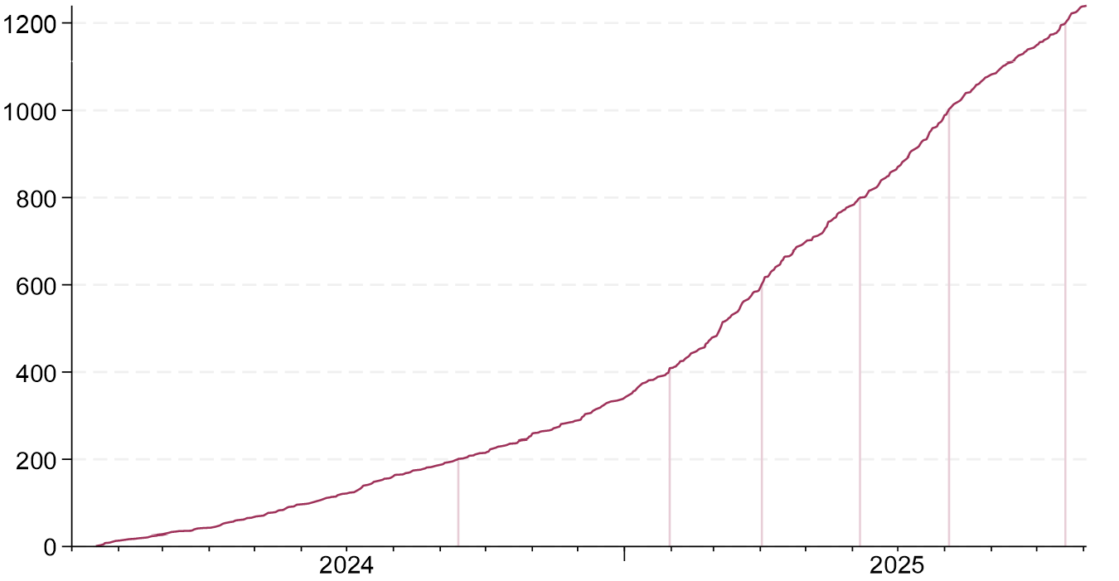
CAP corticosteroid comparison
Recruitment by site
1263 participant recruited to CAP corticosteroid comparison from 95 sites
Total recruitment

Slide 47
Trial procedures

Slide 48
Preparing for influenza
Please ensure your site is ready to respond to an imminent rise in hospitalisations
Define roles and ensure staff have done relevant online training (UK > Site Staff > Training)
Engage local clinicians who will be admitting and treating flu patients
No trial requirement for the person taking consent to be a doctor
2) Discuss study support with your RRDN or equivalent
Contact details are in the email sent last week
3) Ensure your pharmacy is stocked with baloxavir
We ask sites to hold 30 boxes
Ordering instructions are in the Pharmacy Briefing (UK > Site Staff > Pharmacy)

Slide 49
Trial procedures
Substantial amendment 37
Removes outdated references to COVID-19
No new trial treatments/procedures
Ensure you are using the new version of the protocol (V28.0) and ICFs(adult V27.0, child V16.0)
Training & delegation logs
Updated versions will be sent to PIs by next week
If correct, these can be confirmed or corrected by return of email
PI does not need to update Oxford with subsequent changes to the site team
A new system will be introduced after the flu season, linked to individual access to the randomisation system

Slide 50
Biological sampling
Nose swabs are needed from all patients in the influenza comparisons
Nose swab at baseline (day 1) - after consent but before randomisation
Nose swab at day 5
No blood samples needed
Email recovery trial team if you require more swab kits
No samples needed from participants in the CAP comparison
Full instructions are on the website (‘For Site Teams’ page)

Slide 51
Consent monitoring
A scanned copy of every consent form should be e-mailed to RECOVERY trial within 72 hours
Write you name clearly on the form so we can ensure those taking consent have done consent training
This should be to our nhs.net email address, which has recently changed (now pcctuoxf.recoverytrial@nhs.net)
See RECOVERY website for instructions (‘For Site Staff>Randomisation’)

Slide 52
Completeness of follow-up
Weekly reminders highlighting participants randomised >28 days ago without complete form
Completeness of follow-up has always been excellent; please keep this up!

Slide 53
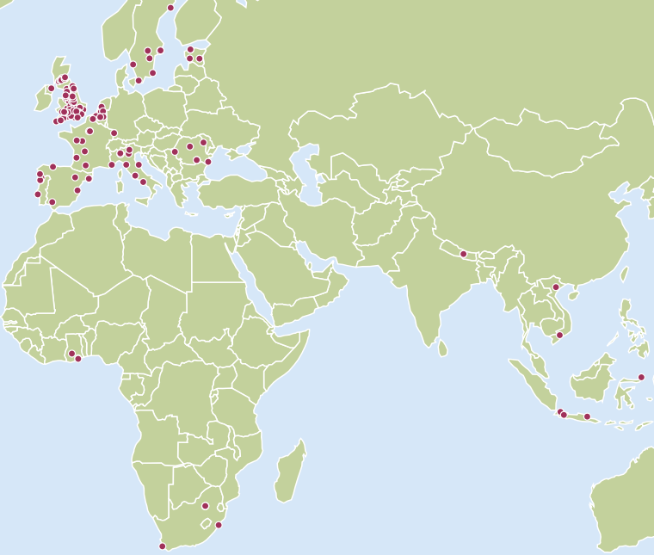
RECOVERY
RECOVERY is now open in 14 countries
64 UK sites
53 non-UK sites

Slide 54

Thank you!
The RECOVERY collaboration was a huge success in COVID-19, and we hope to produce similar practice-changing evidence for influenza & CAP
The flu season is upon us, so it’s essential that teams are prepared to start recruiting as soon as possible
Please get in touch if you have any questions about the trial
Thank you for being part of the collaboration!

