Slide 1
The RECOVERY trial
EU Informed Consent Training
V1.0 2024-01-24

Slide 2
Informed consent
Written informed consent is required for all patients prior to any trial-specific procedures (i.e. there is no deferred consent)
There are three types of consent:
Direct from the patient - if the patient has capacity and can sign the form themselves
Witnessed - if a patient has capacity but is unable to sign the form, a witness can sign on their behalf
Legal representative - if patient lacks capacity, consent may be obtained from a legal representative (note if the participant subsequently regains capacity, they must also provide written consent to continue)
The criteria for determining capacity should be the same as for routine medical care in your country

Slide 3
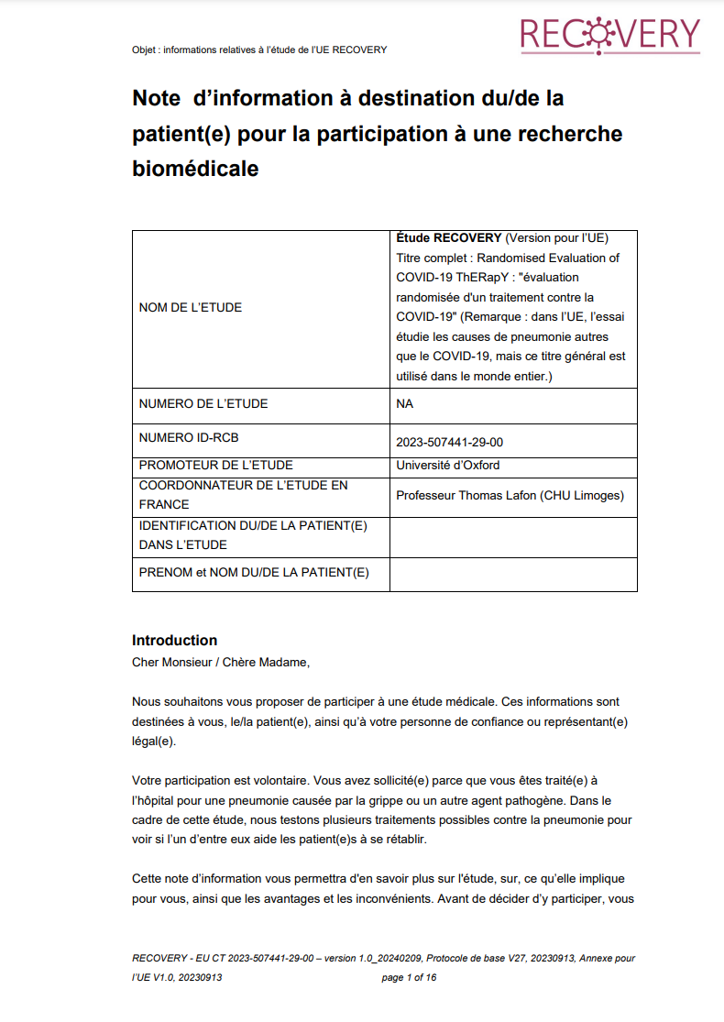
Informed consent
The patient (or legal representative) should be provided with the Participant Information Sheet, and be allowed to read it and ask any questions
If they prefer to discuss the trial in person rather than read the form, this is fine (but it may require a longer discussion to cover the points in the form)

Slide 4
Informed consent
Key points to cover in discussion:
Ensure the patient has had time to ask any questions.
Participation is voluntary, if they do not join they will still receive the best care available.
If they do join, they can change their mind and withdraw at any time.
All treatments can have side-effects, and they will be monitored for these.
Some of their data will be shared with the trial team outside the hospital (and possibly officials who check the trial is being done properly)
This data will only be linked to them via a code, not anything identifiable, and anyone who sees it is bound by confidentiality rules.
The trial team will collect data about them from their hospital medical records for 6 months, and may contact them or their relative (no need to mention this if you know local records at your site will be sufficient to complete the follow-up form without contacting the patient).
Their data will be kept secure, and will stored for at least 25 years. De-identified data may be shared with researchers studying pneumonia or other infectious diseases.
These are listed on the consent form itself, so use this as your guide.

Slide 5
Informed consent: speakers of other languages
If the consenter does not also speak the language, process should be supported by an impartial translator (i.e. not a member of research team), which could be telephone translation service
Please document in the notes how consent was obtained in such situations

Slide 6
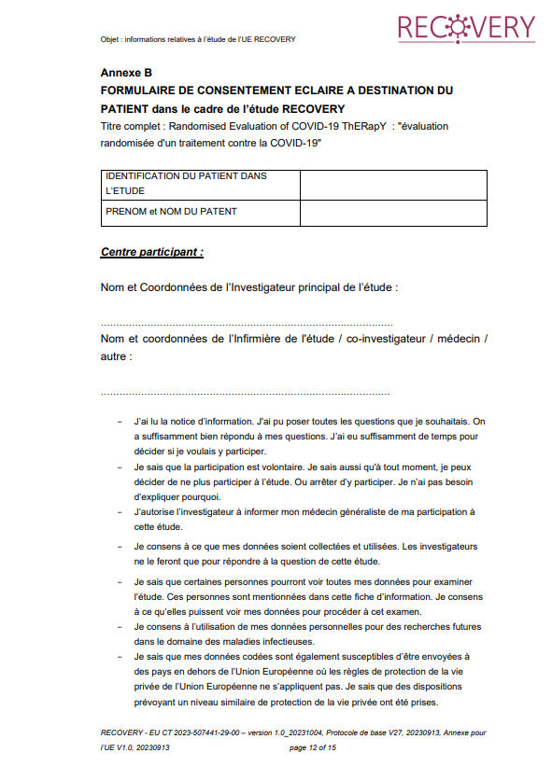
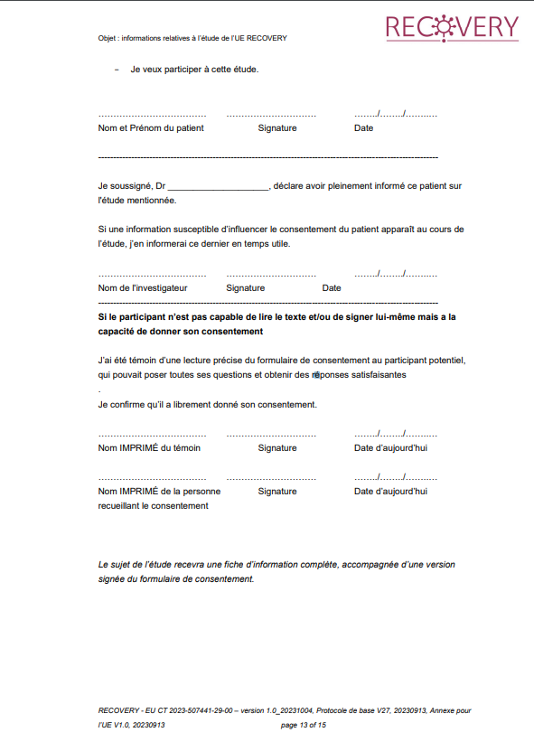
Informed consent: Direct from patient
If the patient has capacity and can sign, they should write their name, signature & date on the form
The person taking consent should then do the same, and complete the other details on the consent form (study number will be assigned at randomisation)
Make copies:
1 for site file (original)
1 for participant
1 for medical notes
In some countries it may not be permissible to scan/photocopy the consent form, in which case 3 forms should be signed
Completed by person
GIVING consent
Completed by person
TAKING consent

Slide 7
Informed consent: Witnessed
If the patient has capacity to consent but is physically unable to sign, then an impartial witness (i.e. not a member of the research team) should complete the form
The person taking consent should then do the same, and complete the other details on the consent form (study number will be assigned at randomisation)
Make copies:
1 for site file (original)
1 for participant
1 for medical notes
In some countries it may not be permissible to scan/photocopy the consent form, in which case 3 forms should be signed
Completed by person
WITNESSING consent
Completed by person
TAKING consent

Slide 8
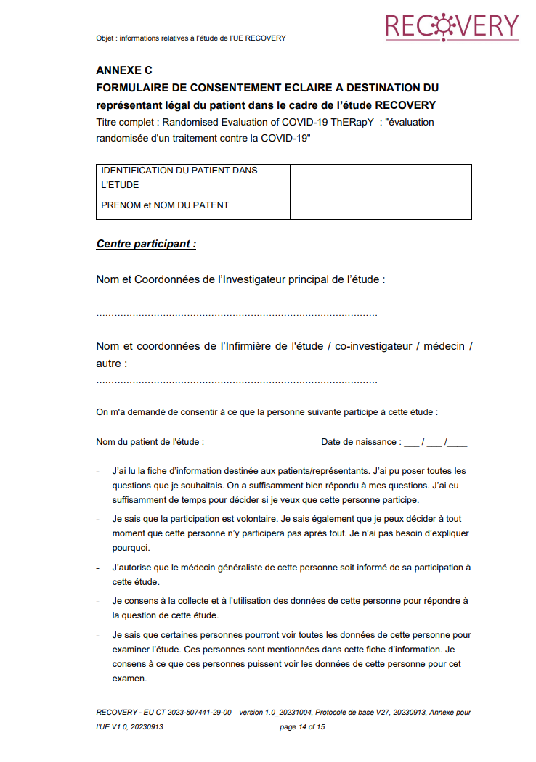
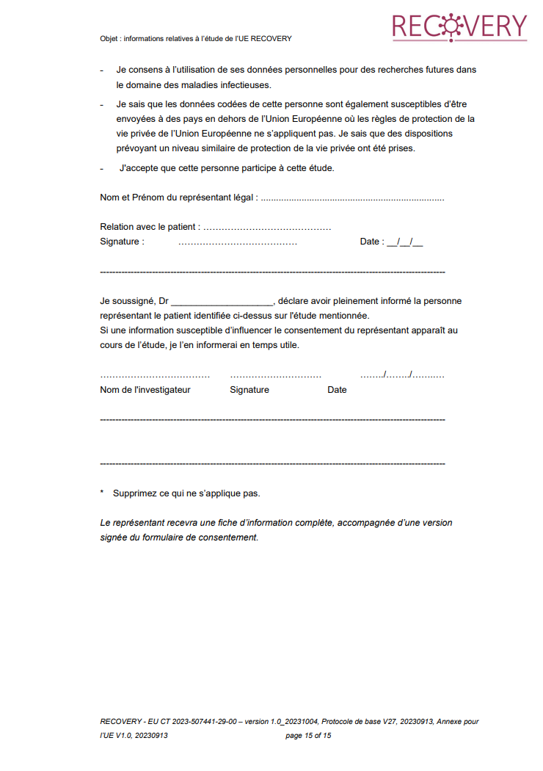
Informed consent: Legal representative
Completed by legal
representative
GIVING consent
If the patient lacks capacity because of the current illness or a pre-existing impairment, then consent must be obtained from a legal representative, who should sign the consent form
The acceptable legal representative is determined by national laws (see EU protocol appendix section 3.3 for clarification)
The person taking consent should then do the same, and complete the other details on the consent form (study number will be assigned at randomisation)
Make copies:
1 for site file (original)
1 for participant
1 for medical notes
In some countries it may not be permissible to scan/photocopy the consent form, in which case 3 forms should be signed
Completed by person
TAKING consent

Slide 9
Informed consent: Legal representative
Legal representatives must be available in person to complete their section of consent form, this cannot be done over the telephone
If participant regains capacity prior to discharge, they should be provided with information about the trial, and must provide consent in order to continue in the trial
This should follow the usual process for informed consent
It is important to establish a system for approaching participants who may have regained capacity within a reasonable time (e.g. 1-2 working days)
During the COVID-19 pandemic there were cases where re-consent did not happen, and this was a critical inspection finding
Note that if the patient continues in the trial they should have two signed consent forms

Slide 10
Withdrawal
If the patient or legal representative asks to withdraw, clarify what they want:
They want to stop study treatment but are happy to continue follow-up
Action: Stop study treatment (this will be captured on the follow-up form). This is not a withdrawal.
They do not want further contact with the trial team, but are happy with follow-up from medical records [this only applies to sites that contact patients for follow-up]
Action: Ensure the trial team do not contact the patient/relatives again. Complete follow-up as much as possible from medical records. This is not a withdrawal.
They want do not want any further contact or access to medical records
Action: This is a withdrawal. Inform Ecraid or CRA and document in medical record. Stop study treatment & ensure the trial team do not contact the patient/relatives again.
If a patient is approached after regaining capacity and does not provide consent to continue in the trial, this is a withdrawal and should be treated as point 3 above
Avoid withdrawing patients from the trial unless this is definitely what they want
Data collected up to the point of withdrawal will still be used for analysis
None of the above scenarios are protocol deviations

Slide 11
Informed consent: Summary
Consent can be given in several ways in RECOVERY:
By patient themselves (directly, or using a witness if necessary)
By legal representative, if they lack capacity
If a patient regains capacity, they must be approached and asked to consent for their on-going involvement in the trial
Thank you for help with this vital aspect of RECOVERY

