Slide 1
The RECOVERY trial
Training for EU Principal Investigators
V1.0 2024-01-24

Slide 2
Topics
Role of local principal investigator
Training and delegation
Identification and invitation of potential participants
Informed consent
Randomisation
Follow-up
Safety reporting
Protocol violations
Investigator Site File

Slide 3
RECOVERY Trial Structure
IMP supplier
(for IMPs not
supplied by LCC)
Research Governance, Ethics & Assurance
(Sponsor’s office)
Trial Steering Committee
Independent
Data Monitoring Committee
Central Coordinating Office (CCO)
University of Oxford
Regional Coordinating Centre
(RCC, one per region)
EU RCC = Ecraid
RCC
RCC
RCC
Local Clinical Centre (LCC, ‘site’)
LCC
LCC
LCC
LCC
LCC

Slide 4
Role of Local Clinical Centre PI
Needs to be qualified by education, training and experience to assume responsibility for the proper conduct of the trial
Is responsible for conduct of the trial in compliance with the protocol at their site, including oversight of other members of trial team
Should be aware of, and comply with, good clinical practice and applicable regulations (in the EU: Clinical Trials Regulation (Regulation (EU) No 536/2014)
As specified in the protocol, RECOVERY is being conducted in accordance with the principles of ICH-GCP

Slide 5
Principles of ICH-GCP
Clinical trials should be conducted in accordance with the ethical principles that have their origin in the Declaration of Helsinki, and that are consistent with GCP and the applicable regulatory requirement(s).
Before a trial is initiated, foreseeable risks and inconveniences should be weighed against the anticipated benefit for the individual trial subject and society. A trial should be initiated and continued only if the anticipated benefits justify the risks.
The rights, safety, and well-being of the trial subjects are the most important considerations and should prevail over interests of science and society.
The available nonclinical and clinical information on an investigational product should be adequate to support the proposed clinical trial.
Clinical trials should be scientifically sound, and described in a clear, detailed protocol.
A trial should be conducted in compliance with the protocol that has received prior institutional review board (IRB)/independent ethics committee (IEC) approval/favourable opinion.
The medical care given to, and medical decisions made on behalf of, subjects should always be the responsibility of a qualified physician or, when appropriate, of a qualified dentist.
Each individual involved in conducting a trial should be qualified by education, training, and experience to perform his or her respective task(s).
Freely given informed consent should be obtained from every subject prior to clinical trial participation.
All clinical trial information should be recorded, handled, and stored in a way that allows its accurate reporting, interpretation and verification. This principle applies to all records referenced in this guideline, irrespective of the type of media used.
The confidentiality of records that could identify subjects should be protected, respecting the privacy and confidentiality rules in accordance with the applicable regulatory requirement(s).
Investigational products should be manufactured, handled, and stored in accordance with applicable good manufacturing practice (GMP). They should be used in accordance with the approved protocol.
Systems with procedures that assure the quality of every aspect of the trial should be implemented. Aspects of the trial that are essential to ensure human subject protection and reliability of trial results should be the focus of such systems.

Slide 6
Training and delegation
PI is required to be trained in relevant aspects of GCP
In addition to this PI training, PIs are required to complete training on the following topics:
Background and rationale of trial
Obtaining informed consent
Randomisation
IMP-specific training modules (in the EU: Influenza Treatment and CAP Treatment)
Although the PI is responsible for all trial-related activities at his/her site, they do not have to deliver all such activities

Slide 7
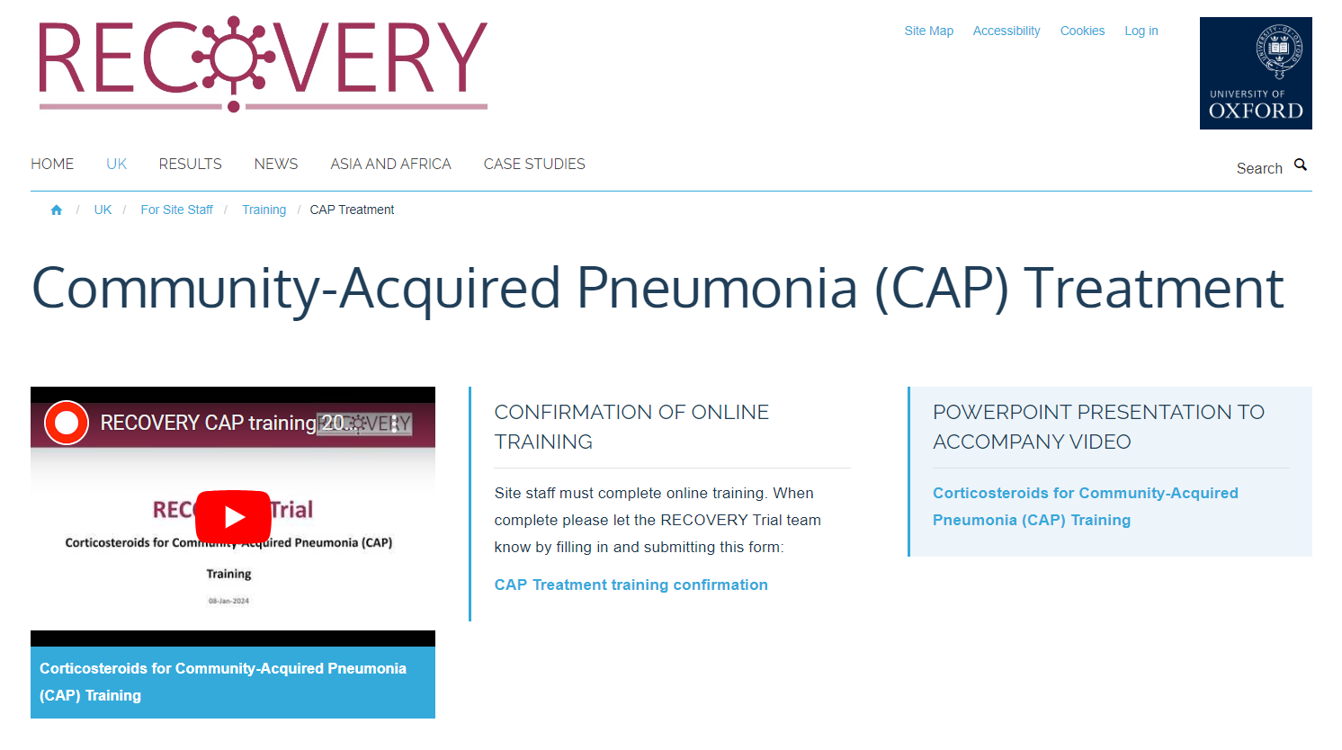
Training records
Training modules may be delivered at a Site Initiation Visit, or by viewing training materials on the trial website
In either case, the staff member must document this by completing the relevant confirmation of training form on the website
A record of training is then emailed to the staff member and their PI
This is also recorded on the trial administration system, which can be used to create a training log for each site
Training logs will be sent to PIs periodically, and can also be sent on request

Slide 8
Delegation log
PI is responsible for ensuring that members of his/her research team have completed training relevant to their role
Delegated duties should be recorded in the delegation of duties log, kept in the ISF
6 duties are defined, each with specific training modules required:
Eligibility - assess patient eligibility for the trial (in discussion with the patient’s attending doctor) 1) Eligibility for influenza comparisons needs Influenza Treatment training 2) Eligibility for CAP comparison needs CAP Treatment training | Consent – Explain the trial, answer questions, and complete the informed consent form with the participant or their representative 3) Consent for influenza comparisons needs Background, Consent and Influenza Treatment training 4) Consent for CAP comparison needs Background, Consent and CAP Treatment training | 5) Randomisation - Enter participant details into the randomisation system and randomise the participant. Needs Randomisation training 6) Follow-up – Complete eCRF follow-up forms and adverse event forms. Needs Follow-up training

Slide 9
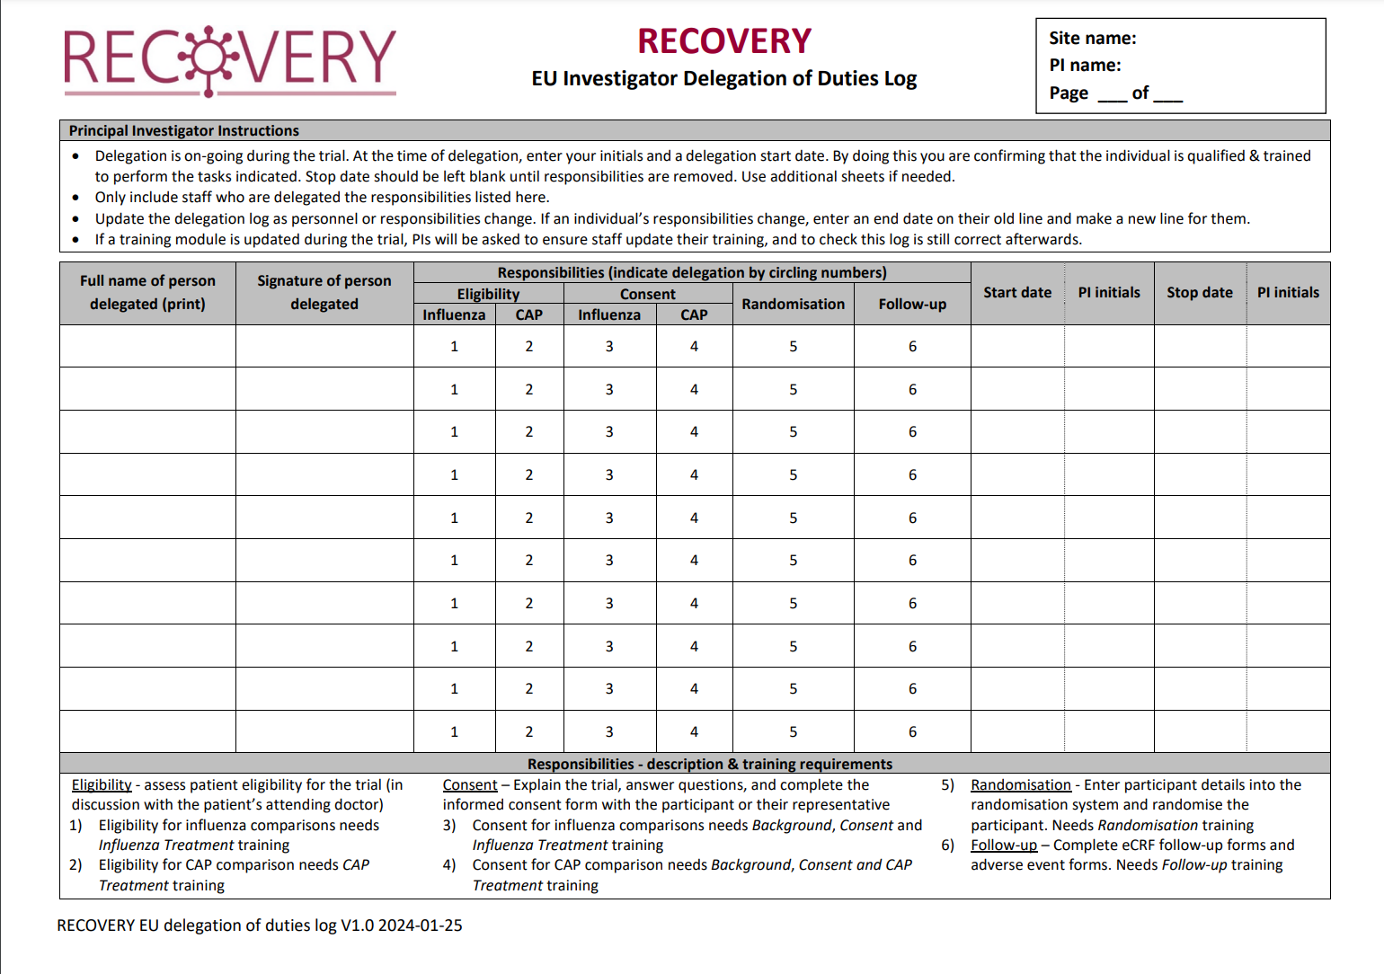
Delegation log
Staff should be added to the delegation log before performing the relevant duties
A copy should be shared with Ecraid before site activation, and the log will be reviewed at monitoring visits
After site initiation, Ecraid do not need to be informed of changes to the log or to be sent updated versions

Slide 10
Identification and invitation
The PI should ensure that there is a process at their site to identify potential participants
For example, regular review of medical admissions with CAP or influenza, or link with microbiology laboratory influenza testing
Maintaining recruitment is good way to ensure quality at sites, as staff familiarity with procedures will improve and errors will be reduced

Slide 11
Informed consent
Written informed consent is required for all patients prior to any trial-specific procedures
The consent form may be signed by
The patient
A witness (if the patient has capacity but cannot physically sign), or
A legal representative (if the patient does not have capacity)
Details are provided in the EU Informed Consent Training module

Slide 12
Randomisation
Eligibility assessment should be made by medically-qualified person with appropriate training and knowledge of IMPs (and contraindications).
This assessment should be made in discussion with the patient’s attending doctor and documented in the medical records.
Randomisation may be conducted by member of research team (not necessarily the person who obtained consent or assessed eligibility).
The individual who completes the randomisation form must have completed the trial-specific training on this topic and confirm that consent has been obtained.
A reliable method of informing the participant’s treating clinicians of the randomised allocation(s) must be developed

Slide 13
Follow-up
The PI must nominate individuals with appropriate training (including trial-specific training on this topic) who will be provided with accounts on OpenClinica to complete follow-up case report forms
The PI is responsible for ensuring site staff have access to relevant medical records when completing such forms

Slide 14
Safety reporting
The RECOVERY protocol requires that Serious Adverse Events (SAEs) believed by the PI to be related “with reasonable probability” to study treatment(s) should be reported
Other SAEs do not require reporting
Definition of “serious” adverse event:
Fatal or life-threatening
Requires or prolongs hospitalisation
Results in persistent or significant disability or incapacity
Results in congenital anomaly or birth defect
Other important medical event in opinion of the PI

Slide 15
Safety reporting
For an adverse event to be considered an adverse reaction requires (according to ‘CT-3’ guidance from European Commission) “a reasonable possibility of a causal relationship between the event and the IMP. This means that there are facts (evidence) or arguments to suggest a causal relationship.”
SAEs believed to be related to study treatment (suspected serious adverse reactions, SSARs) should be reported within 24 hours of PI becoming aware
It may be helpful to discuss adverse event with the CCO/RCC to ensure sufficient information is provided to support onward reporting (to regulators, ethics committee etc.)

Slide 16
Safety reporting
The CCO will assess ‘expectedness’ of event against reference safety information for the IMP(s)
If ‘unexpected’, CCO will report SUSAR
All information on SUSARs in RECOVERY is made available to PIs on the trial website (updated every quarter)

Slide 17
Protocol violations
PI may become aware of potential protocol violation or the Regional Coordinating Centre (RCC) may identify them from information received from site
All potential protocol violations should be reported to the RCC (e-mail recovery@ecraid.eu) where they will be recorded and reviewed to determine further actions
PI may be asked to complete a file note to document protocol violation and any corrective and preventative actions

Slide 18
Investigator Site File
The RECOVERY EU ISF Index should be used to organise the ISF
Most trial documents are available on the website, and these do not need to be duplicated in the paper ISF
Other documents will either be held in paper ISF, or can be held in other clearly documented secure locations
If ISF documents are stored electronically they must be accessible whenever needed, and the document version history must be clear (if applicable)

Slide 19
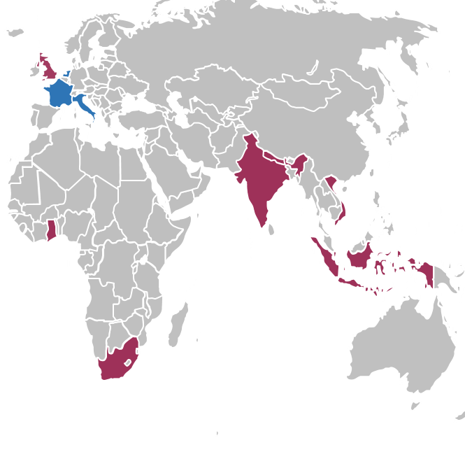
Thank you!
Thank you for being part of the RECOVERY collaboration!

