Slide 1
The RECOVERY trial
EU Randomisation Training
V1.0 2024-01-30

Slide 2
Randomisation
Randomisation does not have to be done by the person who took consent
Randomisation must be done online and can be accessed via the relevant country page at www.recoverytrial.net
Follow links for “Randomisation” and log in to the system
The Participant Information Leaflet and Consent Form can also be downloaded from the country page if needed

Slide 3
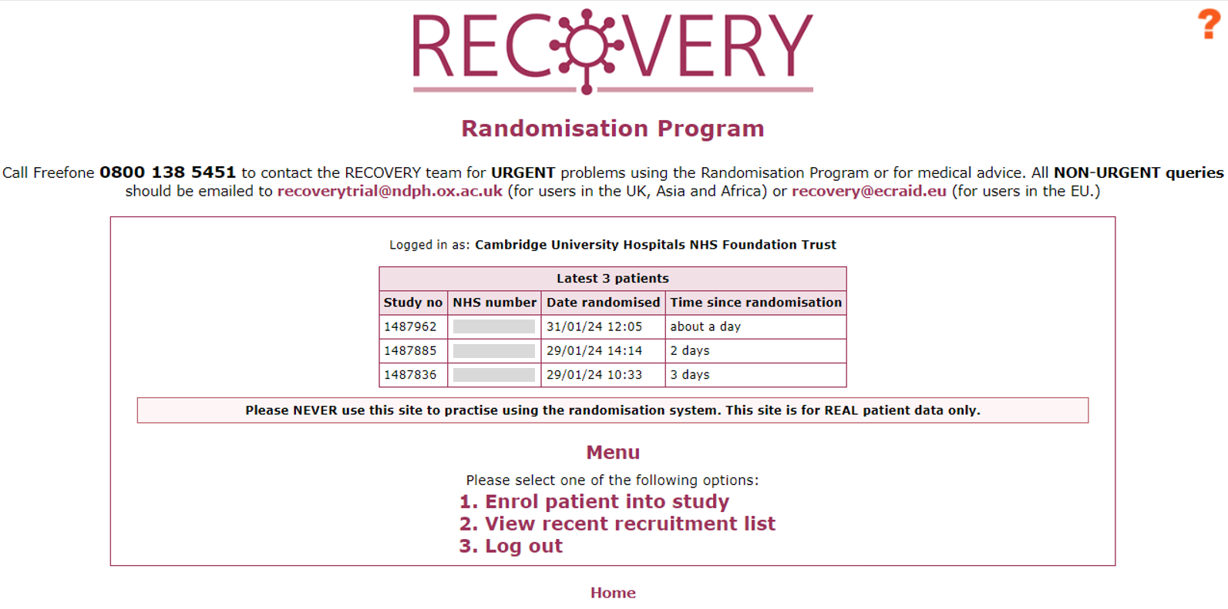
Randomisation
To enter a new participant, click ‘Enrol patient into study’
From the home page you can also access a recruitment list for you site

Slide 4
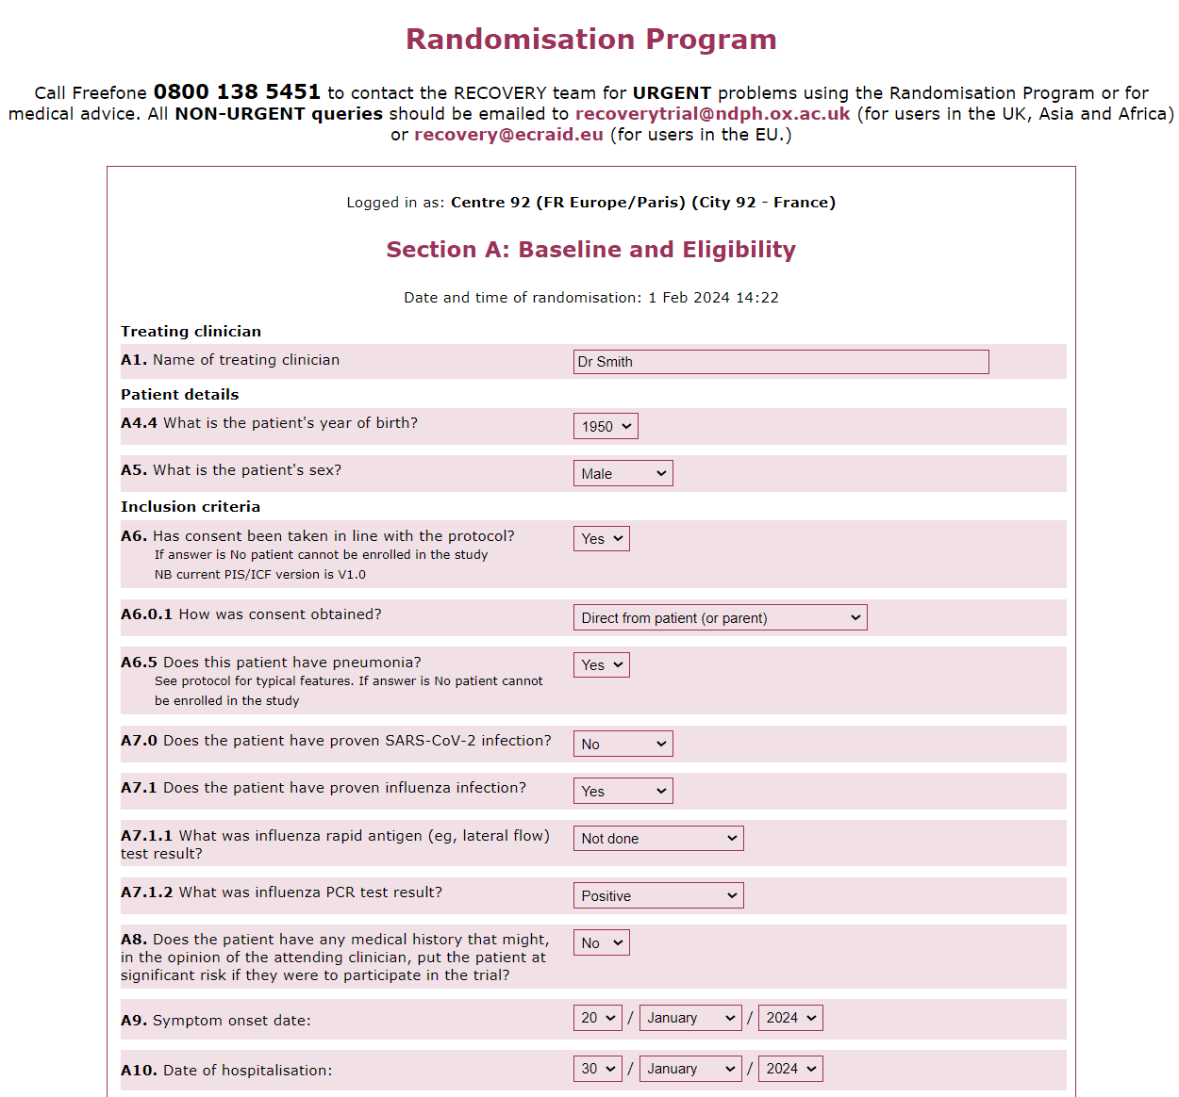
Randomisation
Patient’s attending doctor
Eligibility criteria are confirmed on the form

Slide 5
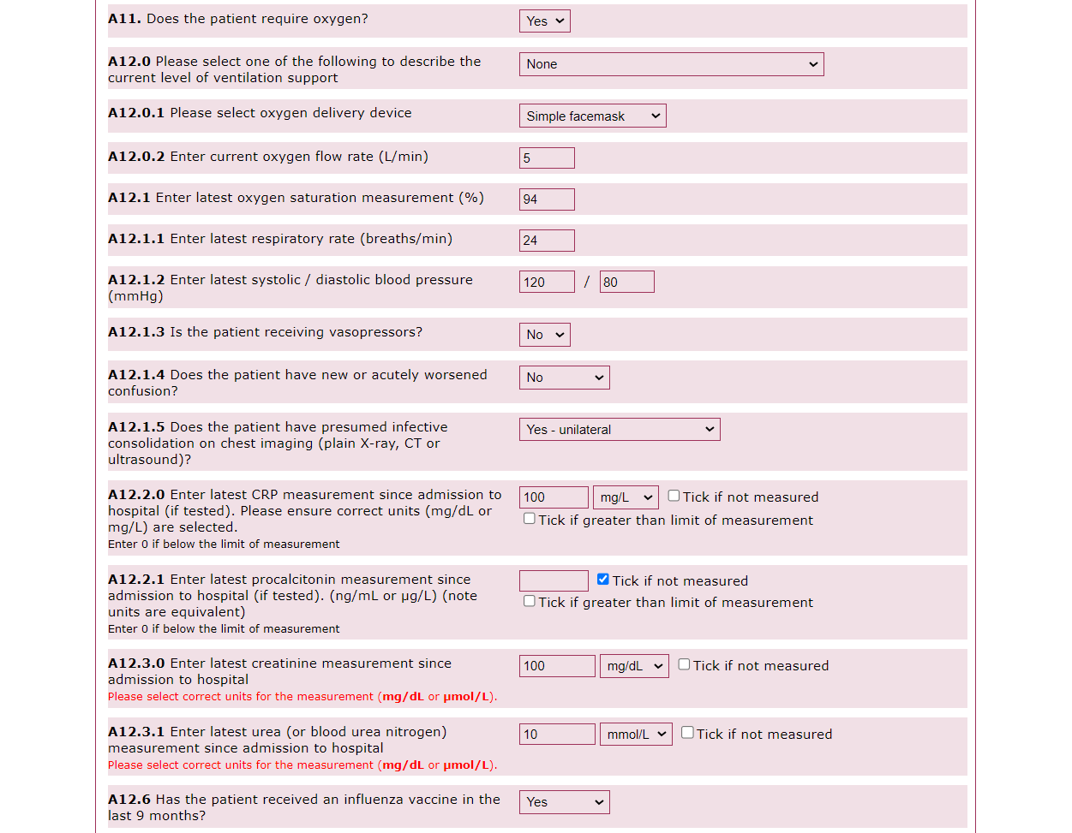
Randomisation
Most recent clinical observations taken as part of routine care
Results from investigations done for routine care (these are not performed for the trial, so if they were not done just click ‘not measured/not taken’)
Pay attention to the units for laboratory results, as these vary between sites

Slide 6
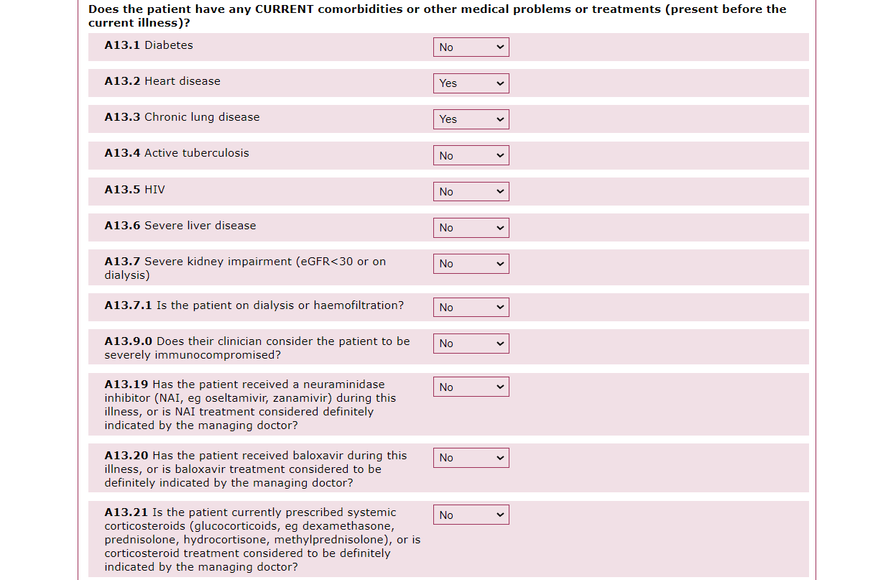
Randomisation
Requiring ongoing specialist care
If any treatment is considered to be indicated the patient cannot enter the relevant comparison

Slide 7
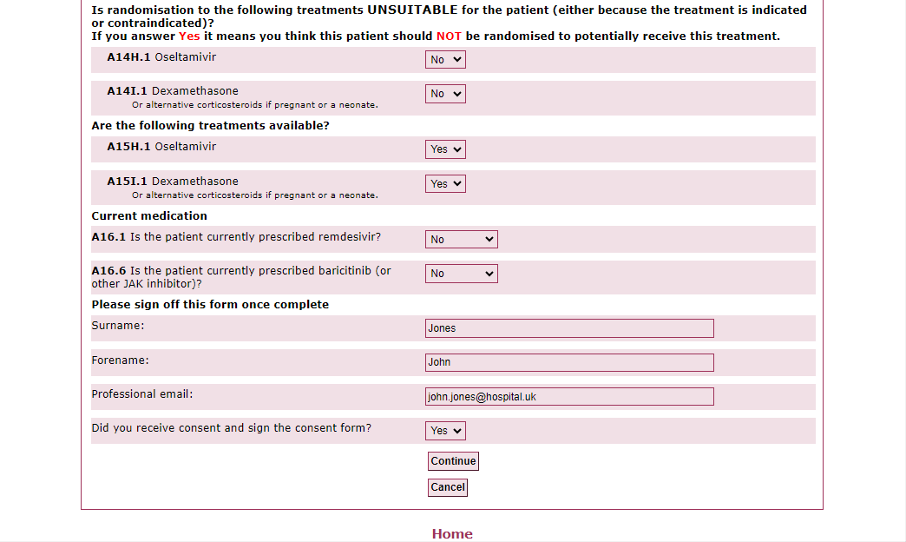
Randomisation
Suitability for each comparison. Please read the wording carefully:
- If the patient is NOT suitable for the comparison the answer should be ‘Yes’
- If the patient IS suitable for the comparison the answer should be ‘No’
Availability of study treatment at your site (only select ‘No’ if you’ve heard that a specific treatment is unavailable)
If you did not sign the consent form, provide the name of the person who did
When the form is complete click ‘Continue’

Slide 8
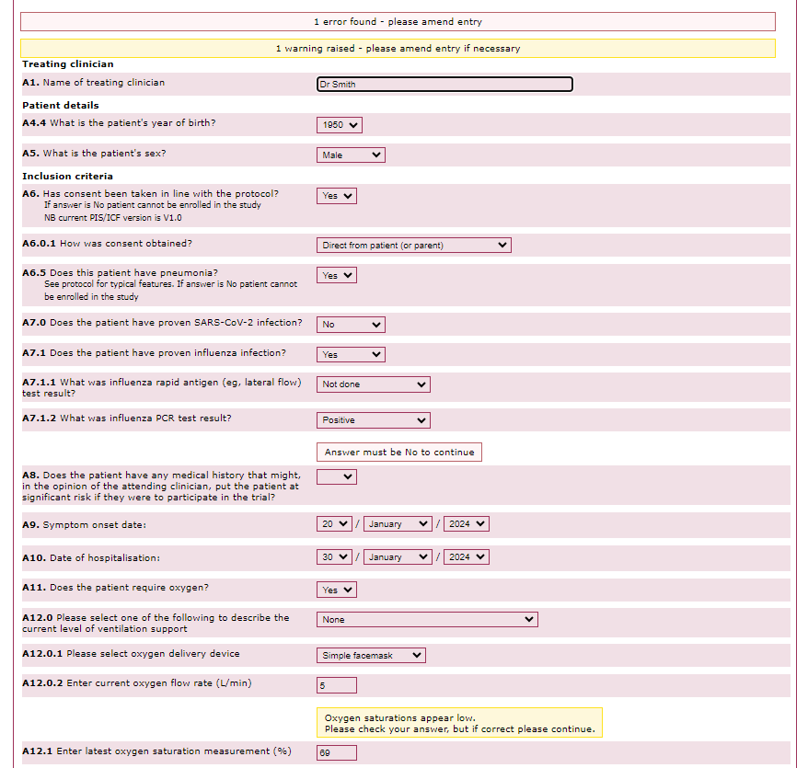
Randomisation
After clicking ‘Continue’, errors or warnings may be highlighted - review these and amend as needed
Errors flag answers or missing data that mean the patient cannot be randomised
Warnings flag unexpected answers - these can be amended or left unchanged if correct

Slide 9
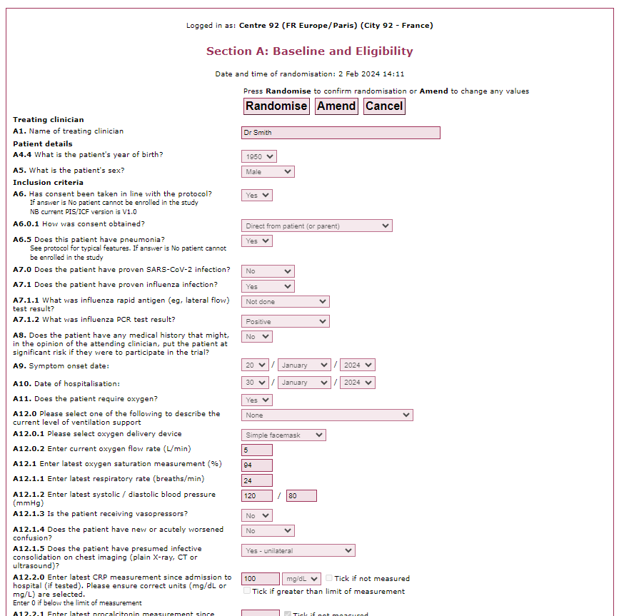
Randomisation
After any errors/warnings have been reviewed, you can review the data entered before proceeding
If you need to correct anything click ‘Amend’
If all is correct click ‘Randomise’

Slide 10
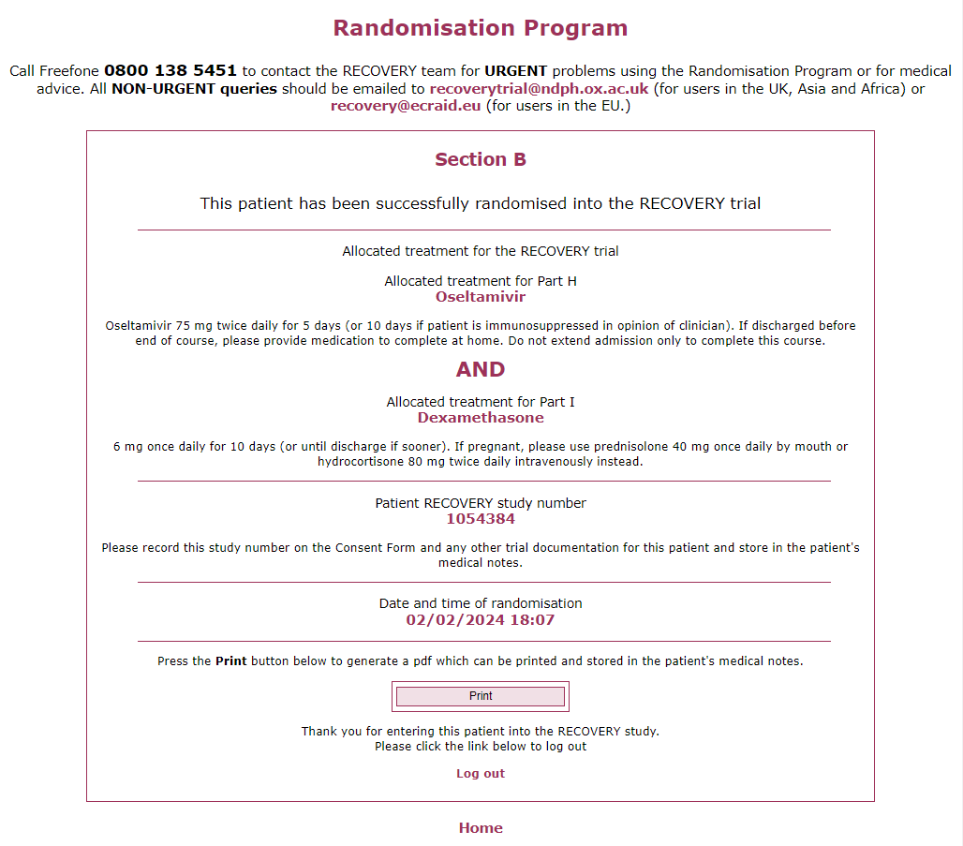
Randomisation
For each comparison, the allocation will either be the trial treatment or usual care (without the trial treatment)
If the patient is allocated a trial treatment, ensure this is prescribed (as a normal inpatient prescription by a one of the patient’s medical team)
Record the study number in the medical record and on the consent form
A copy of the treatment allocation, study number, and data in the randomisation form can be saved or printed as a pdf

Slide 11
Problems
If you have any questions about the process or run into problems with the website please do one of the following:
Review our Frequently Asked Questions on the study website www.recoverytrial.net
E-mail the study team at recovery@ecraid.eu (in English)
Telephone the study team on +44 800 138 5451 (in English - urgent calls only please)

