Slide 1

Randomised Evaluation of COVID-19 Therapy: the RECOVERY trial
Participant follow-up data collection

Slide 2
Follow-up data collection
There are two follow-up data collection points in RECOVERY
  28 days after randomisation
  6 months after randomisation
Data for each timepoint is recorded in a single online form, using the OpenClinica system
Sample follow-up and adverse event forms are on the ‘Follow-up’ webpage (www.recovery.net)
If you expect that follow up can be reliably completed from your medical records alone, then you can do this without contacting the participant/relative
  Note this requires reliable information on death and readmission to hospital (so your records must cover the expected hospital(s) the patient might be admitted to)
If you cannot reliably complete the forms using your medical records alone, the participant/relative should be contacted to gain more information
  In this case, they should have been told to expect contact from the research team
  After speaking to the participant/relative (or repeated failed efforts), complete the form as best you can

Slide 3
OpenClinica
OpenClinica is a clinical data management system used to collect follow-up data in RECOVERY
  Access is via a web browser (Chrome, Firefox & Internet Explorer supported)
Participant records are created in OpenClinica automatically when a patient is randomised (so OpenClinica does not need to be used until a follow-up form is due)

Slide 4
OpenClinica Definitions
Study - this refers to the trial, in this case RECOVERY
Participant - this is a patient within the study
Event or Study Event - refers to a data collection point such as randomisation, follow-up or adverse events
CRF - Case Report Form, is a form used to collect and contain data for a study event
Queries - are queries or annotations for data items where a value that has been entered is not as expected (created by the site team or co-ordinating centre). Some are generated automatically if a result requires checking.

Slide 5
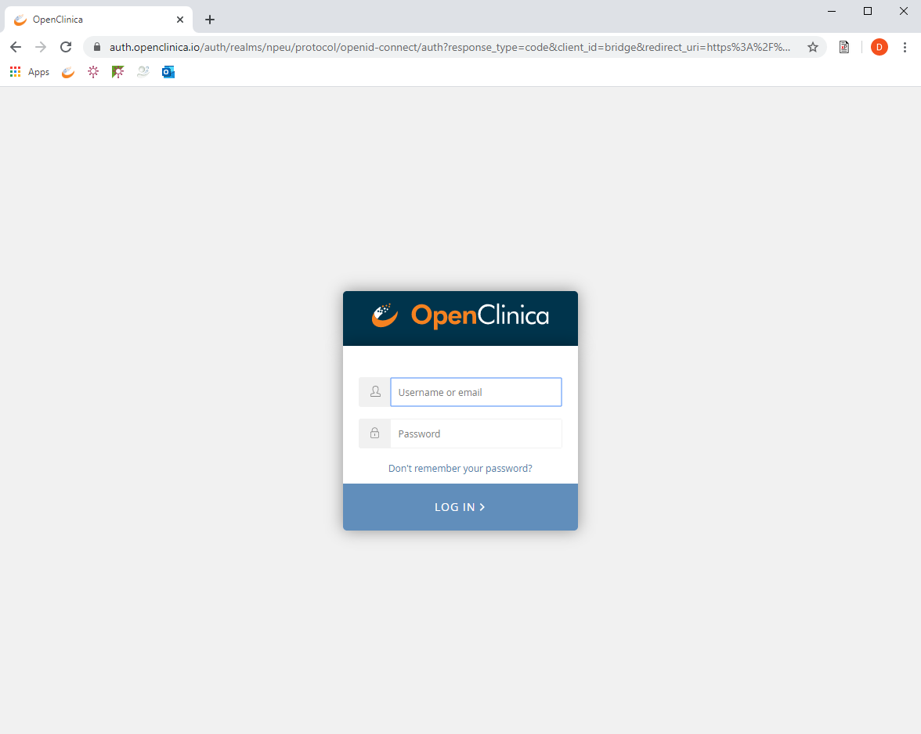
Log-in page
URL: https://npeu.openclinica.io
An invitation email will be sent to you, which will include your log-in credentials

Slide 6
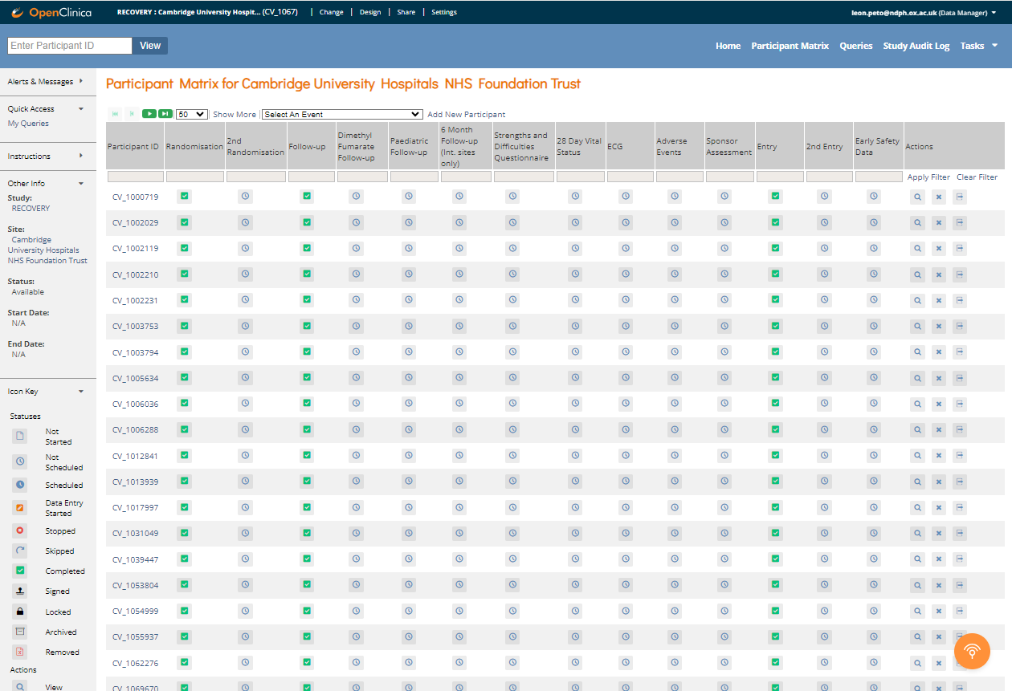
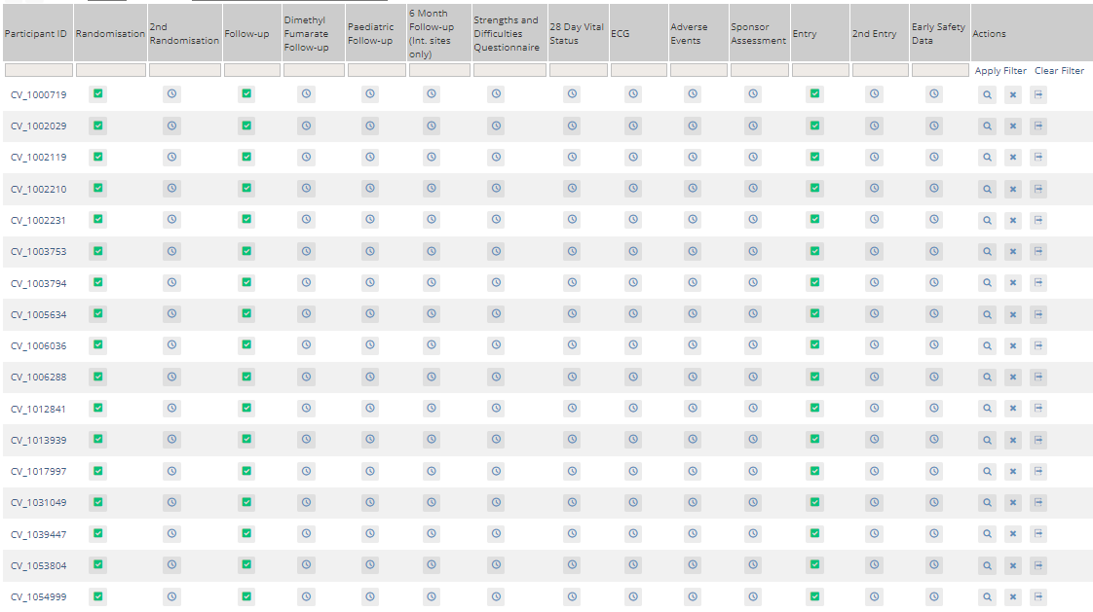
Participant Matrix
Navigate using the navigation bar
  Home takes you to your site home page (not used)
  Participant matrix displays a table of all participants at your site
  Queries displays a table of all queries at your site
When a patient is randomised, their baseline data is automatically added to two CRFs:
  A ‘Randomisation’ form (which can potentially be modified if an error was made), and also
  An ‘Entry’ form (a locked version of the entry data that cannot be modified)
You never need to add a new participant yourself in OpenClinica, so please do not use this button
  Contact the trial team if you cannot find a participant you expect to see

Slide 7
Participant Matrix
Each row is one participant, with Participant ID (study number) in the first column with a ‘CV_’ prefix
Subsequent columns contain CRFs
The CRFs used for data entry are:
  ‘Follow-up’: The main follow-up form, completed on (or soon after) day 28
  ‘6 Month Follow-up’: 6-month follow-up form
  Adverse Events: For use if reporting a Suspected Serious Adverse Reaction
‘Sponsor Assessment’, ‘28 Day Vital Status’ and any other CRFs that appear in this matrix are not used for data entry

Slide 8

Data entry statuses
The icons in the table indicate the status of data entry of CRFs:
Data entry completed
Data entry started but not marked as complete
‘Scheduled event’
‘Non-scheduled event’
However, in RECOVERY please ignore the ‘scheduled’ and ‘non-scheduled’ distinction, and complete follow-up forms when they are due, at 28 days and 6 months

Slide 9
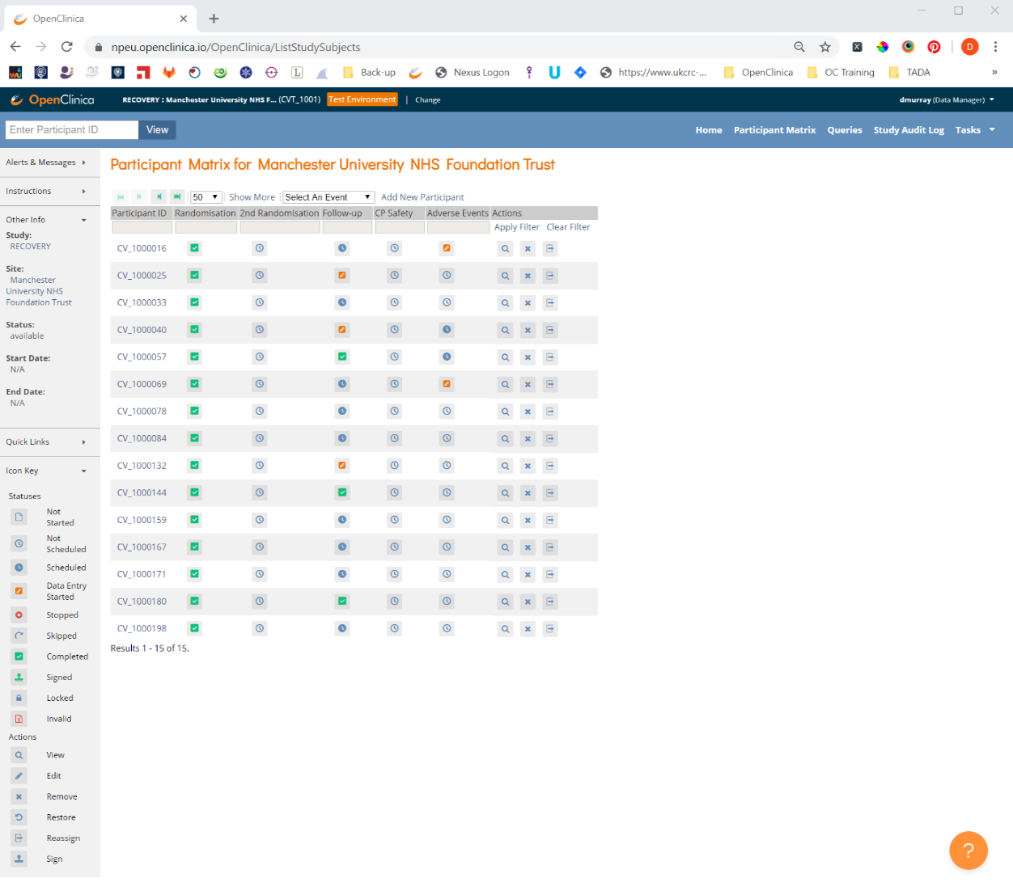
Finding a participant
Find a participant by entering their ID using the box in the top left corner, or Participant ID box
Open their record by clicking on their ID, or on the View button
Although CRFs can be accessed directly from the matrix, please open the participant record first to reduce ID errors

Slide 10
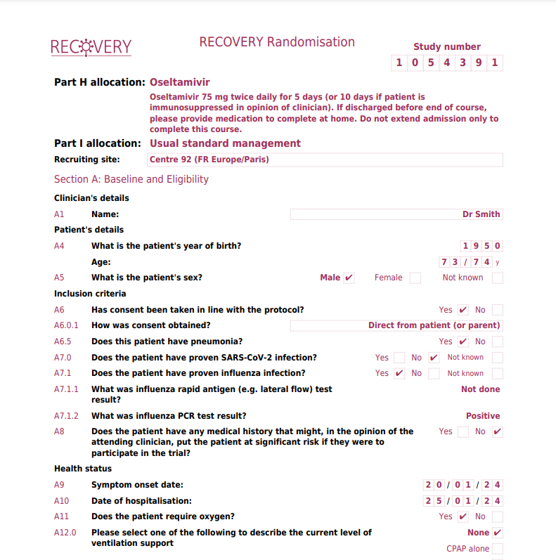
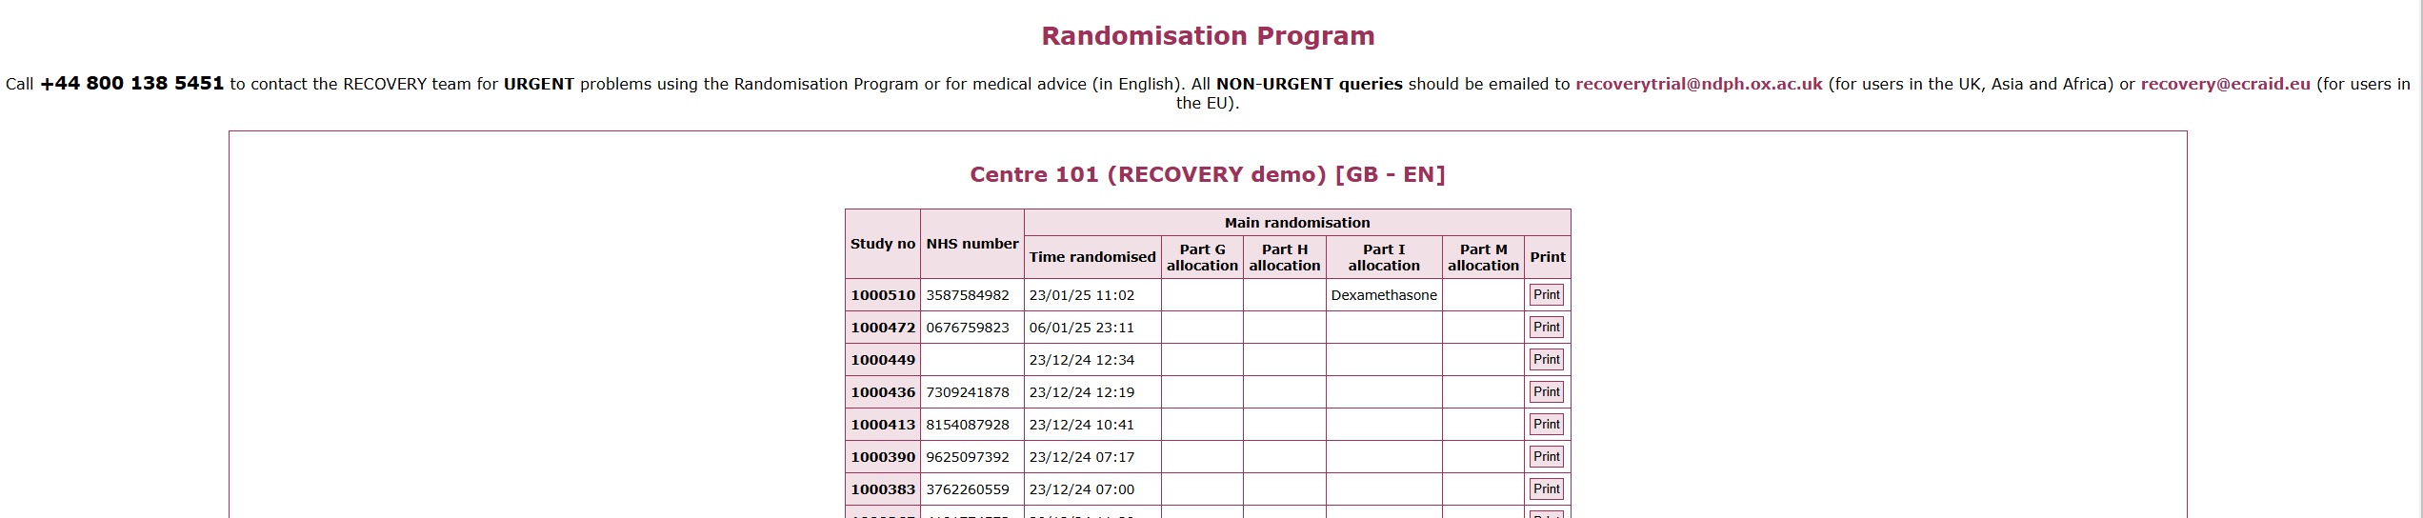
Identifying the participant
Use participant’s NHS or equivalent National ID number to correctly identify the participant and obtain their study number
Confirm study number by either using a print out of the randomisation details OR log into the randomisation website and click View recent recruitment list
Print out of randomisation details
Recent recruitment list in randomisation website

Slide 11
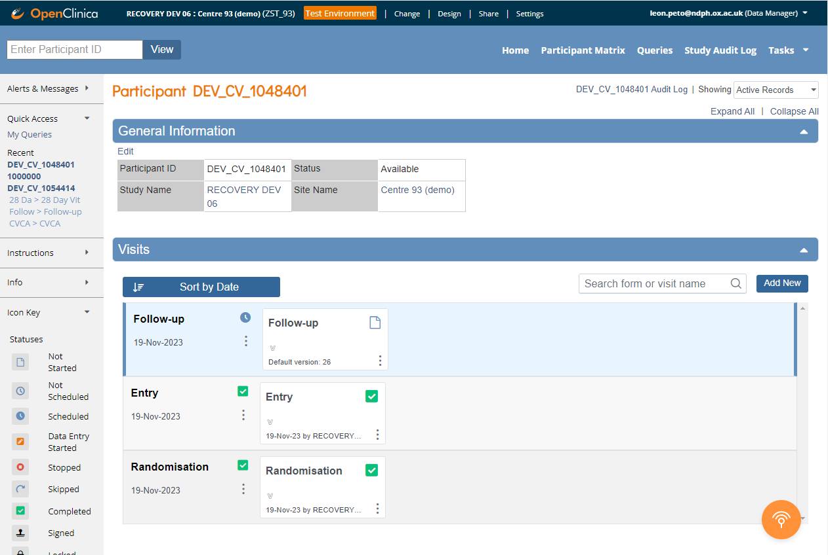
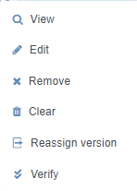
Participant’s Record
In the participant’s record you will see a list of CRFs that have been created
A blank Follow-up form is created as soon as the participant is randomised, but should not be completed until day 28
To View or Edit a CRF, click on the dots and select the relevant icon (to avoid accidental changes, use ‘View’ unless you intend to edit)

Slide 12
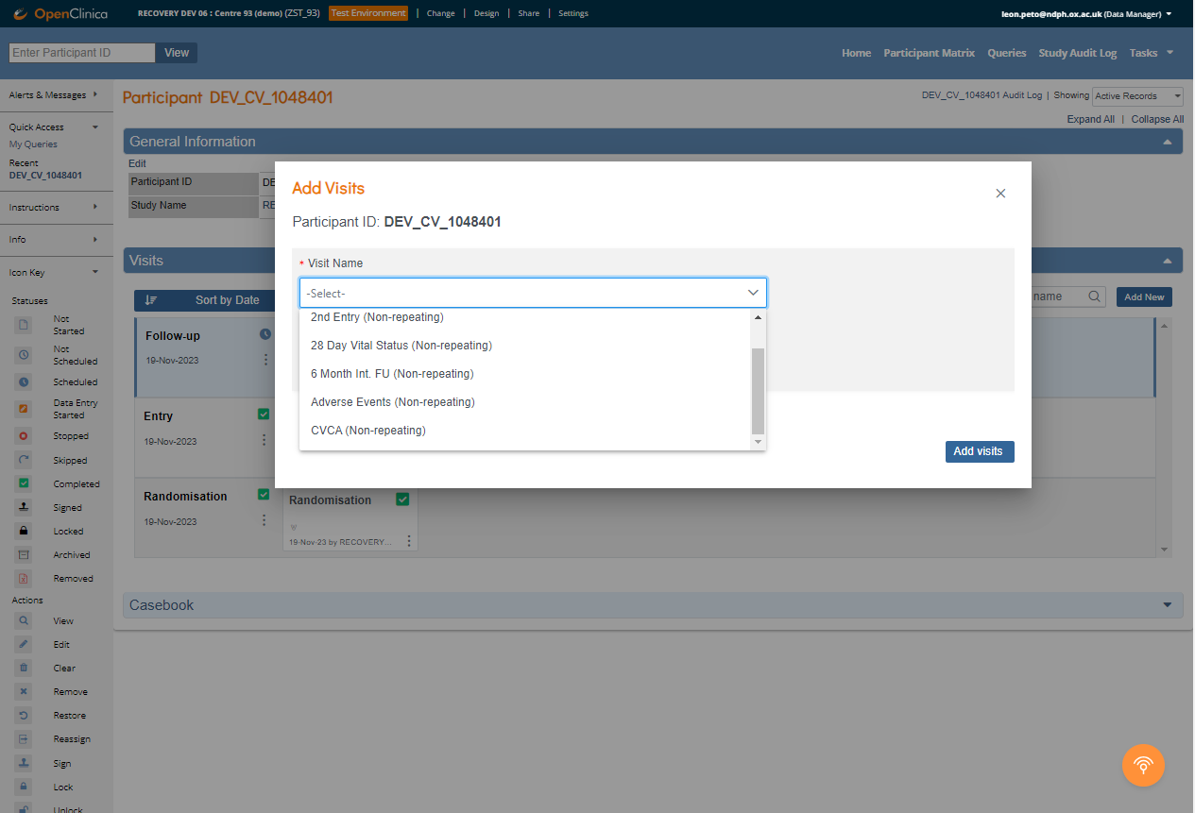
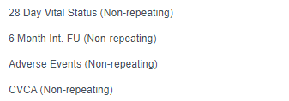
Participant’s Record
To create a new blank CRF (6-month or Adverse Event), click ‘Add New’
Then select the relevant form and date of CRF completion (‘Start Date’), and click ‘Add visits’

Slide 13
Completion of CRFs
All questions on the Follow-up and 6 Month CRFs refer to the post randomisation period of the participant’s hospitalisation

Slide 14
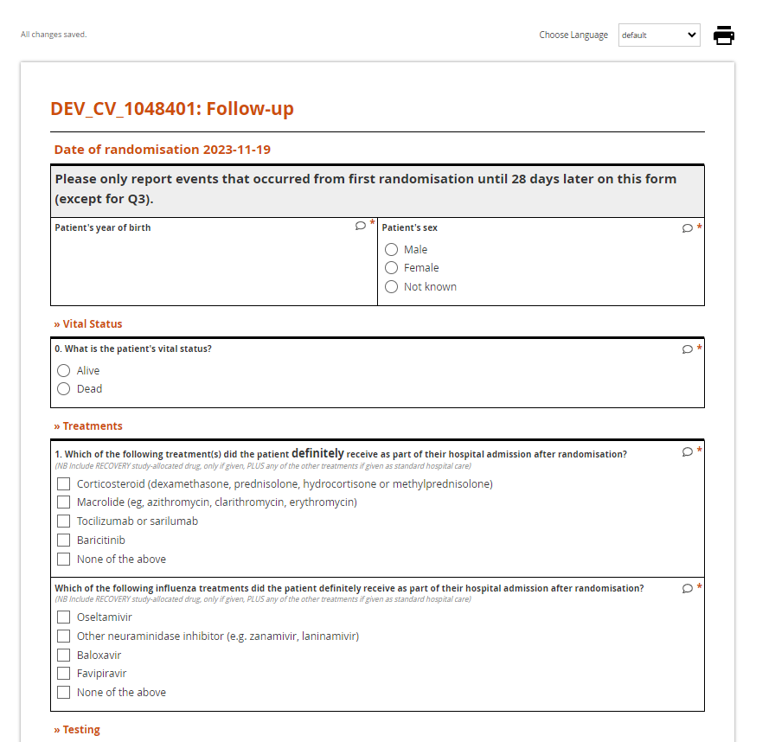
Completion of CRFs
Remember 28-day follow-up is completed using the ‘Follow-up form’ form (not 28-day Vital Status form)
Enter data by selecting an option or typing data in to the appropriate box
If entering a date, you can use the calendar widget or type in the format YYYY-MM-DD

Slide 15
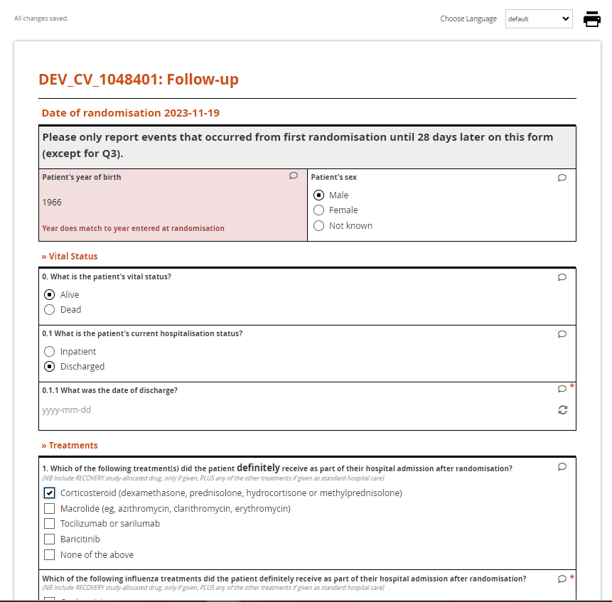
Warning messages
Warning messages appear if the value entered fails a validation check
In this example, the year of birth does not match the date entered at randomisation (year of birth and sex are collected to prevent data accidentally being entered for the wrong participant)

Slide 16
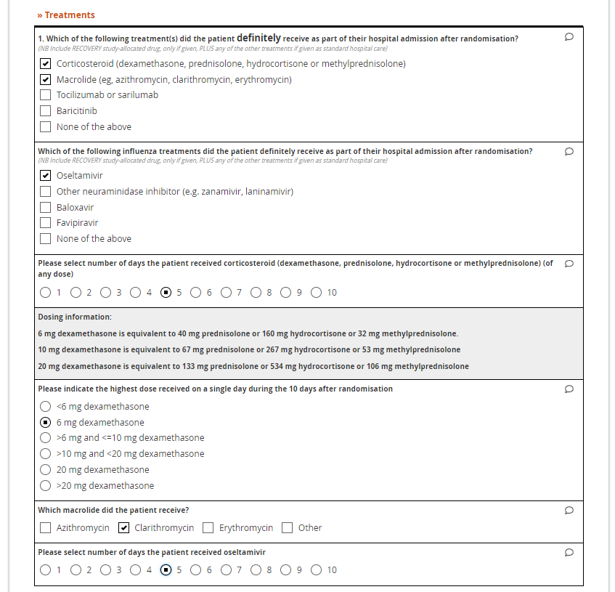
Completion of CRFs
In the Follow-up CRF, select all listed treatments the patient received (for the trial or as part of routine care)
Only include the allocated RECOVERY study treatment if it was actually given to the patient
Ensure you record any non-trial use of treatments (e.g. oseltamivir) in participants who were not allocated that treatment

Slide 17
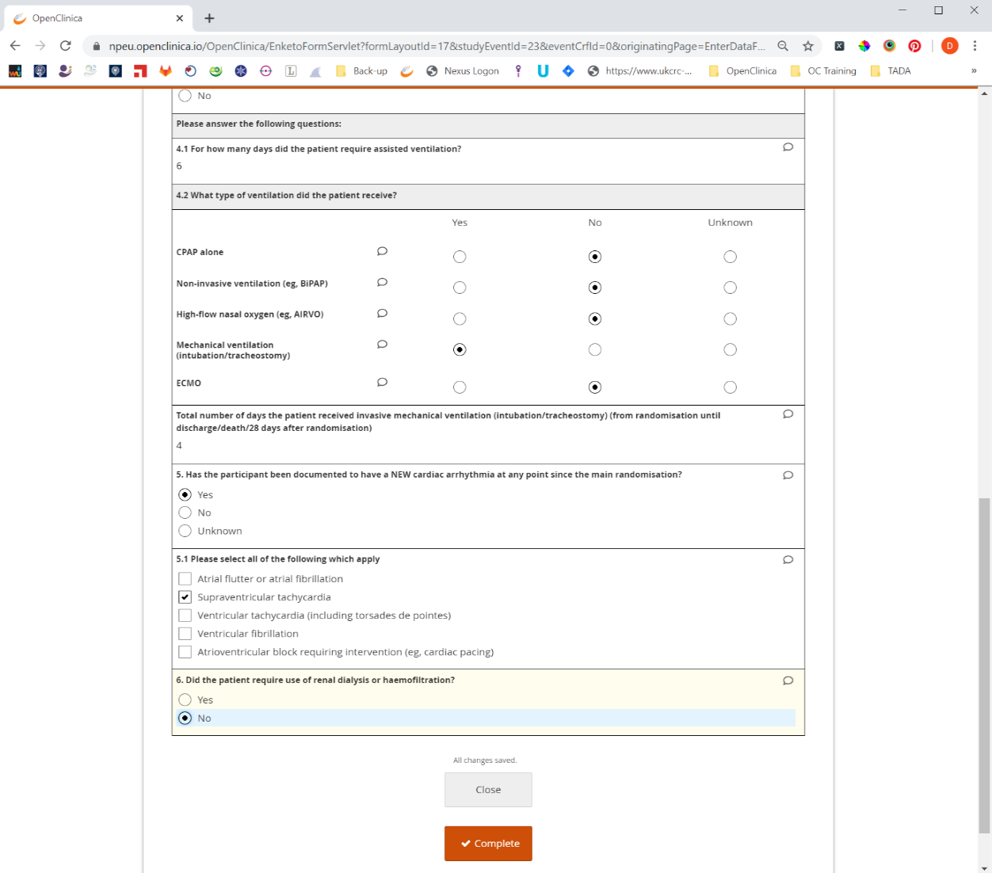
Complete data entry
To complete data entry in a CRF press the Complete button
Then Confirm

Slide 18
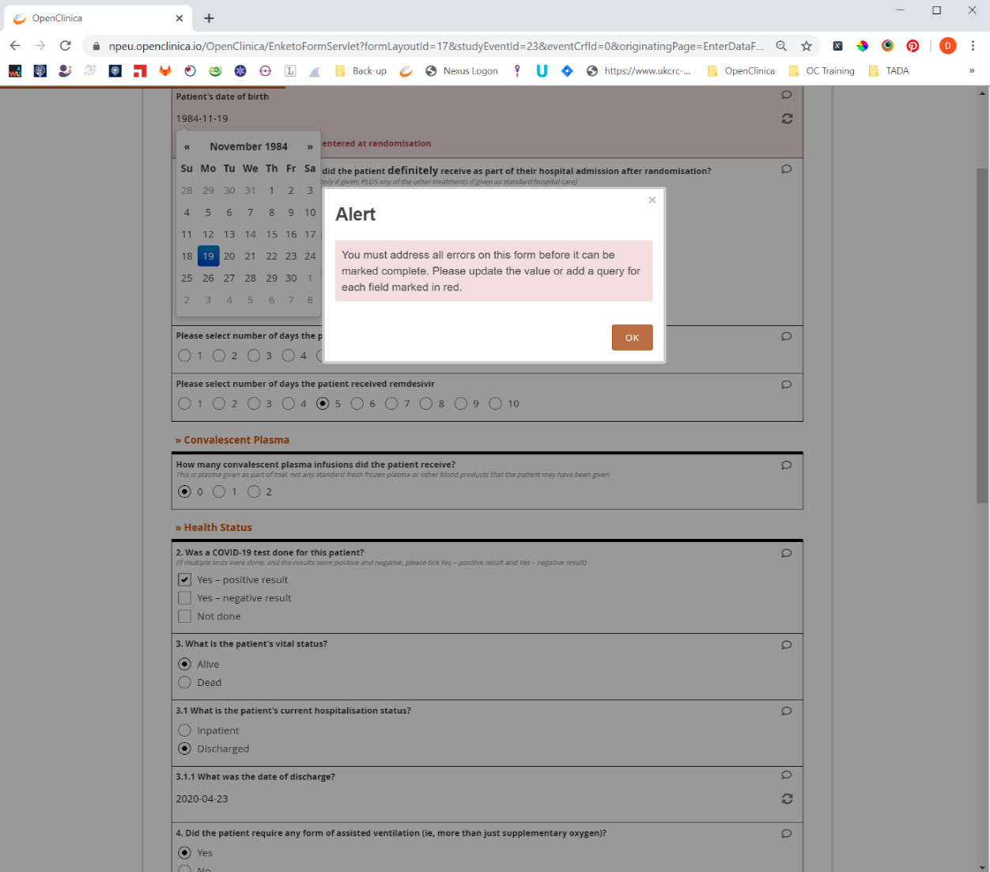
Error message
If an alert message appears, this is because of an error with the data entered.
If the data entered has no errors, this message will not appear. To resolve the error, click ok.

Slide 19
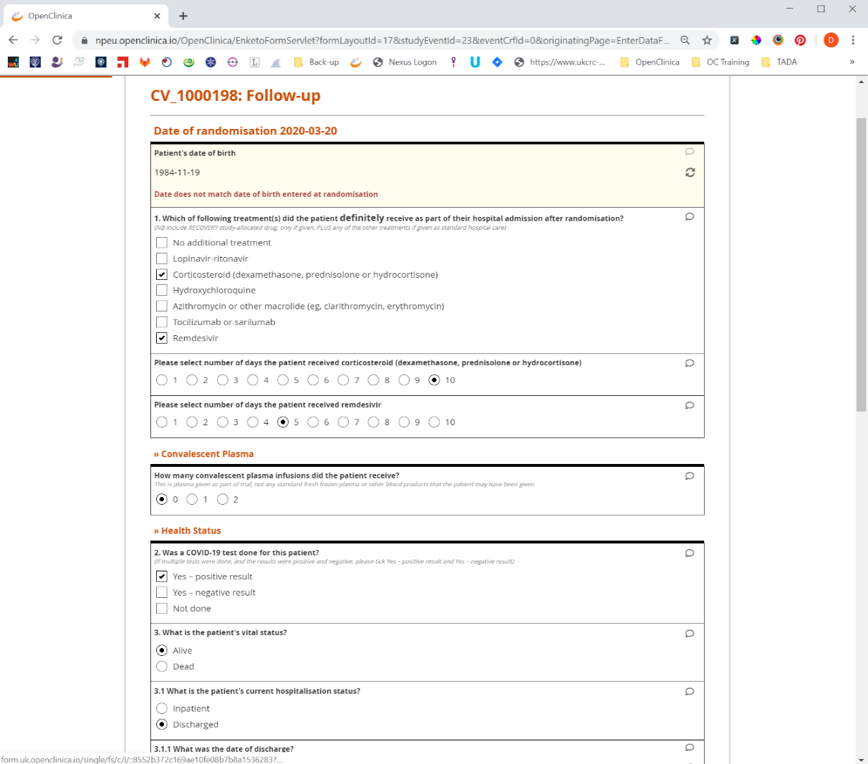
Resolving an error
If the data was incorrectly entered edit the value entered.
If the value is correct, you need to raise a query, to do this click on the small speech bubble.

Slide 20
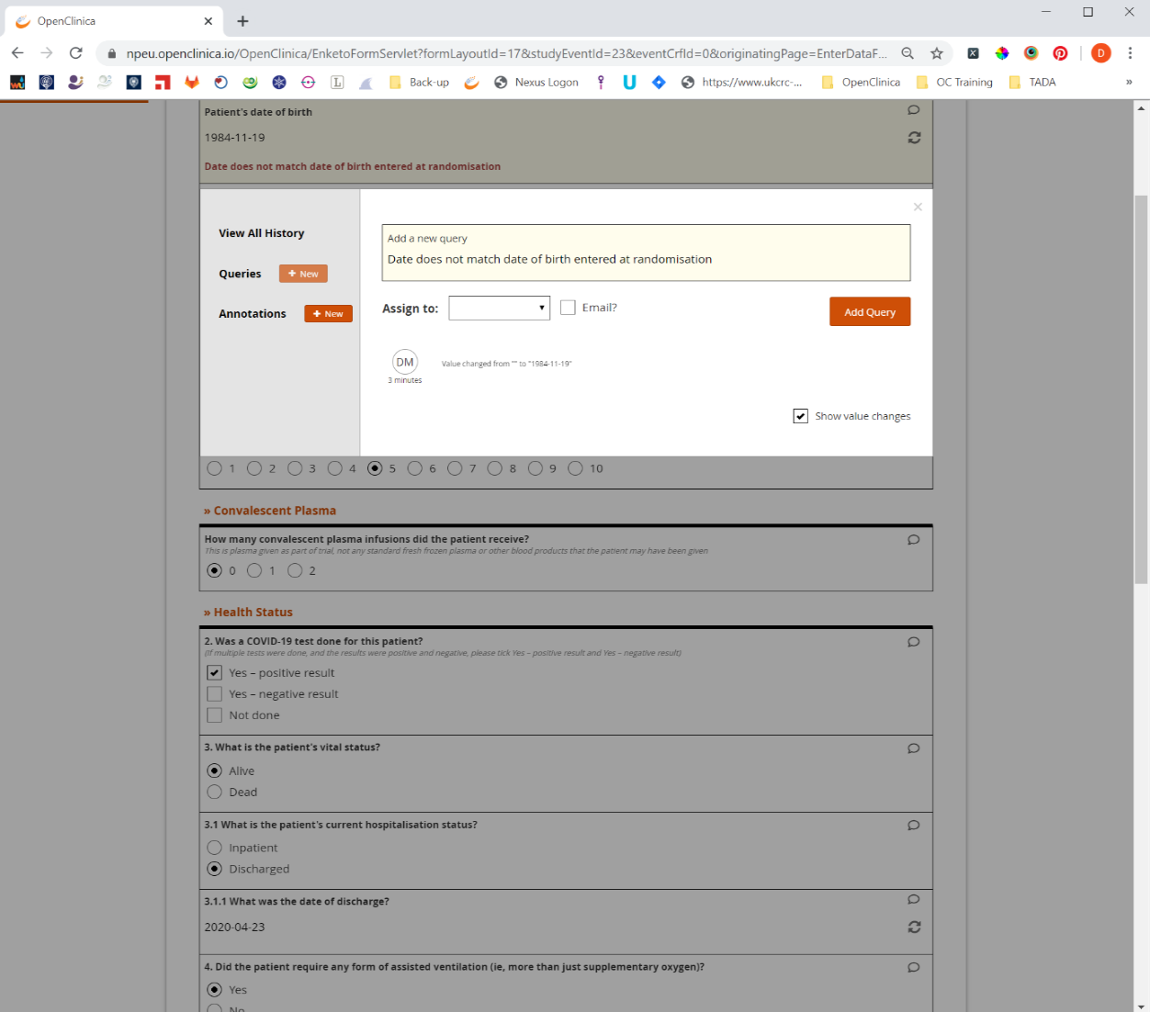
Adding a query
Press the New button next to Queries, then in the text box provide some information.
To save the query, click Add Query.

Slide 21
Administrative editing
If you some reason you need to change the data after the data entry is complete, you can do this by opening the CRF in Edit mode.

Slide 22
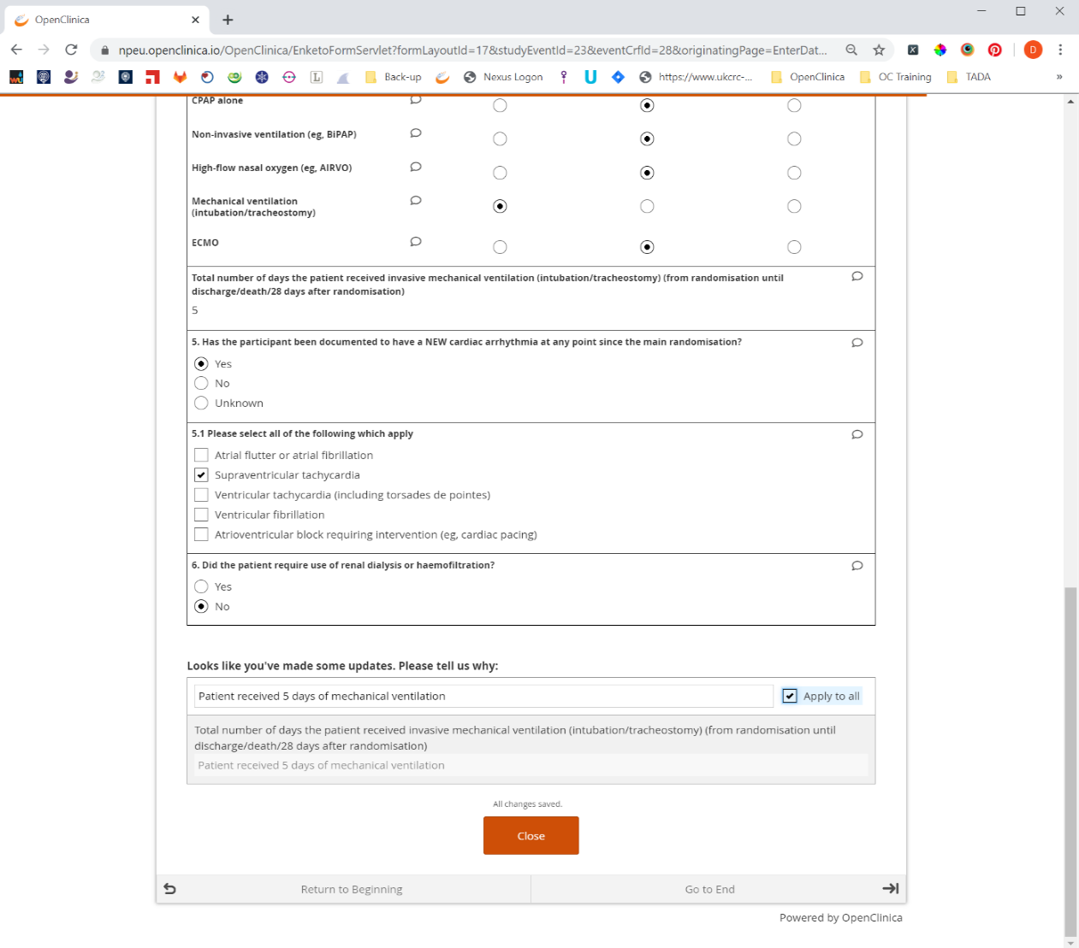
Reason for change
Clicking the Edit button will open the form and allow you to change the data.
If you do change the data, you will be required to provide a reason for change.

Slide 23
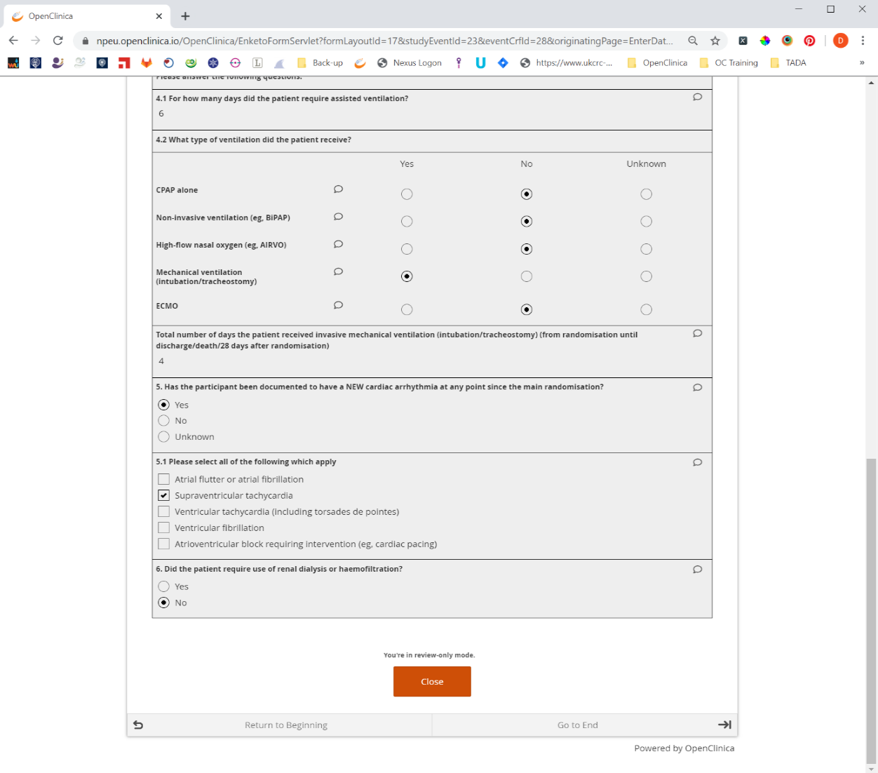
View data
If you want to view the data that has been entered, click on the View button
This will open the CRF in read only mode.

Slide 24
Adverse event reporting
The Principal Investigator must ensure that they are made aware of any Suspected Serious Adverse Reactions (SSARs) related to a study treatment
Only SSARs need to be reported in RECOVERY, that is adverse events that are both:
  Believed with reasonable probability to be related to a study treatment, AND
  Serious, i.e. i) life-threatening, ii) requiring hospitalisation or prolongation of hospitalisation, iii) resulting in persistent or significant disability or incapacity, iv) resulting in congenital anomaly or birth defect, or v) important events that may jeopardise the participant or require intervention to prevent one of the outcomes listed above
Other events do not require reporting, even if related to study treatment
The Principal Investigator determines if an event is reportable (if they will be unavailable, they should nominate another doctor to assess possible SSARs in their absence)
More information on the criteria for SSAR reporting is in core protocol section 4

Slide 25
Adverse event reporting
If a SSAR is identified, the Central Coordinating Office (CCO) should be notified in by email (recoverytrial@ndph.ox.ac.uk) or telephone (+44 800 138 5451) within 24 hours of the investigator becoming aware
An Adverse Event form should also be created in OpenClinica, which collects essential data for evaluation and possible further reporting by the CCO
Please contact the CCO at the email address above if you have any questions about the process of reporting

