Slide 1
Randomised Evaluation of COVID-19 Therapy: the RECOVERY trial
Paxlovid Training
17-Mar-2022

Slide 2
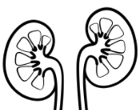
Current comparisons for adults with COVID-19
ELIGIBLE PATIENTS
OUTCOMES
High-dose corticosteroids
(hypoxic)
SGLT-2i comparison
E
High dose
steroids
or
Usual care alone
F
Empagliflozin
or
Usual care alone
Baseline data collected
Participants enter ≥1 comparisons
R
Outcomes collected at earliest of death, discharge or 28 days
Antiviral 1
Antiviral 2
Antiviral 3
J
Sotrovimab
or
Usual care alone
K
Molnupiravir
or
Usual care alone
L
Paxlovid
or
Usual care alone

Slide 3
Paxlovid
Paxlovid is a combination of nirmatrelvir (PF-07321332) and ritonavir
Nirmatrelvir is an inhibitor of the SARS-CoV-2 main protease, and stops viral replication by preventing cleavage of the viral polypeptide
Ritonavir inhibits CYP3A mediated metabolism, resulting in higher concentrations of nirmatrelvir
The viral protease is a conserved target, so Paxlovid retains activity against Omicron (and hopefully future variants)
Because Paxlovid, molnupiravir and sotrovimab have distinct viral targets, they may have additive antiviral effects

Slide 4
Efficacy of Paxlovid
Paxlovid is approved for use in early COVID-19, but there is no data from hospitalised patients
In the EPIC-HR trial, 2,085 patients with COVID-19 symptoms starting in the past 5 days were given Paxlovid or placebo
Hospitalisation or death occurred in 8/1037 (1%) allocated Paxlovid versus 66/1046 (6%) allocated placebo (a reduction of 88%)
Adverse effects included altered taste (6%) and diarrhoea (3%). Treatment was discontinued doe to adverse events in 2% allocated Paxlovid and 4% allocated placebo

Slide 5
Eligibility for Paxlovid
Contraindications
Patients aged < 18 years
Severe liver impairment (Child-Pugh class C)
Severe renal impairment (eGFR <30 mL/min/1.73m²)
Concomitant medication that may have dangerous interactions with ritonavir (if this cannot be withheld)
Inability to swallow tablets (no NG or IV formulations are available)
Patients who have received Paxlovid during the current illness
First trimester of pregnancy (<12 weeks)
Pregnant women in the 2nd & 3rd trimester, and breast-feeding women are potentially eligible after individualised discussion of risks & benefits - see protocol appendix for more information.

Slide 6
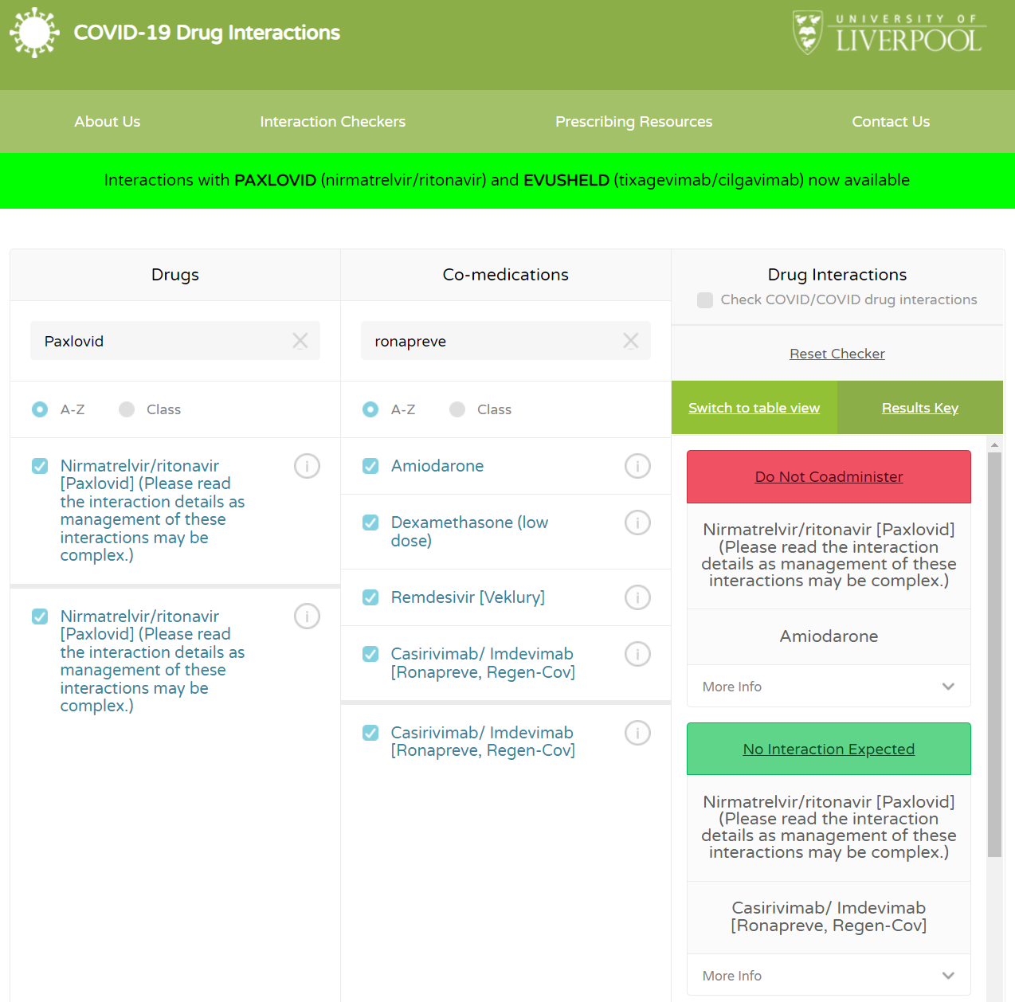
Paxlovid drug interactions
Ritonavir interacts with many drugs, including statins, anticoagulants, antiarrhythmics, antipsychotics, benzodiazepines, immunosuppressants
The Liverpool COVID-19 therapies interaction checker incudes Paxlovid (www.covid19-druginteractions.org)
Contraindicated medications are listed in the protocol appendix
Dexamethasone levels are increased, so patients cannot also be randomised to the high-dose dexamethasone comparison
No significant interaction with standard dose (6mg) dexamethasone, tocilizumab, baricitinib, remdesivir, Ronapreve, sotrovimab, molnupiravir, or empagliflozin

Slide 7
Paxlovid in RECOVERY
Dose is Paxlovid 300/100 twice daily for 5 days (two nirmatrelvir 150mg tablets plus one ritonavir 100mg tablet)
Reduce dose to 150/100 twice daily in moderate renal impairment (eGFR 30-59 mL/min/1.73m²).
The course should be completed at home if participants are discharged before it is finished
Please try to ensure that provision of drug to take home does not delay discharge
May affect combined oral contraceptives, so women of child-bearing potential should use an effective alternative for one complete menstrual cycle after stopping
Biological sampling will be crucial to assessments

Slide 8
Biological sampling in RECOVERY
 | Serum sample | Nose swabs
Baseline (Day 1 - after consent, before randomisation) | ✓ | ✓
Day 3 | ✗ | ✓
Day 5 | ✗ | ✓
Serum samples are used to measure antibody levels and viral antigen
Swabs are used to measure viral load and presence of resistance mutations
From April 2022, those discharged before day 5 should self-swab & post kits if possible
Print instructions from our website: For Site Staff>Site Teams>Self-swabbing instructions

