Slide 1


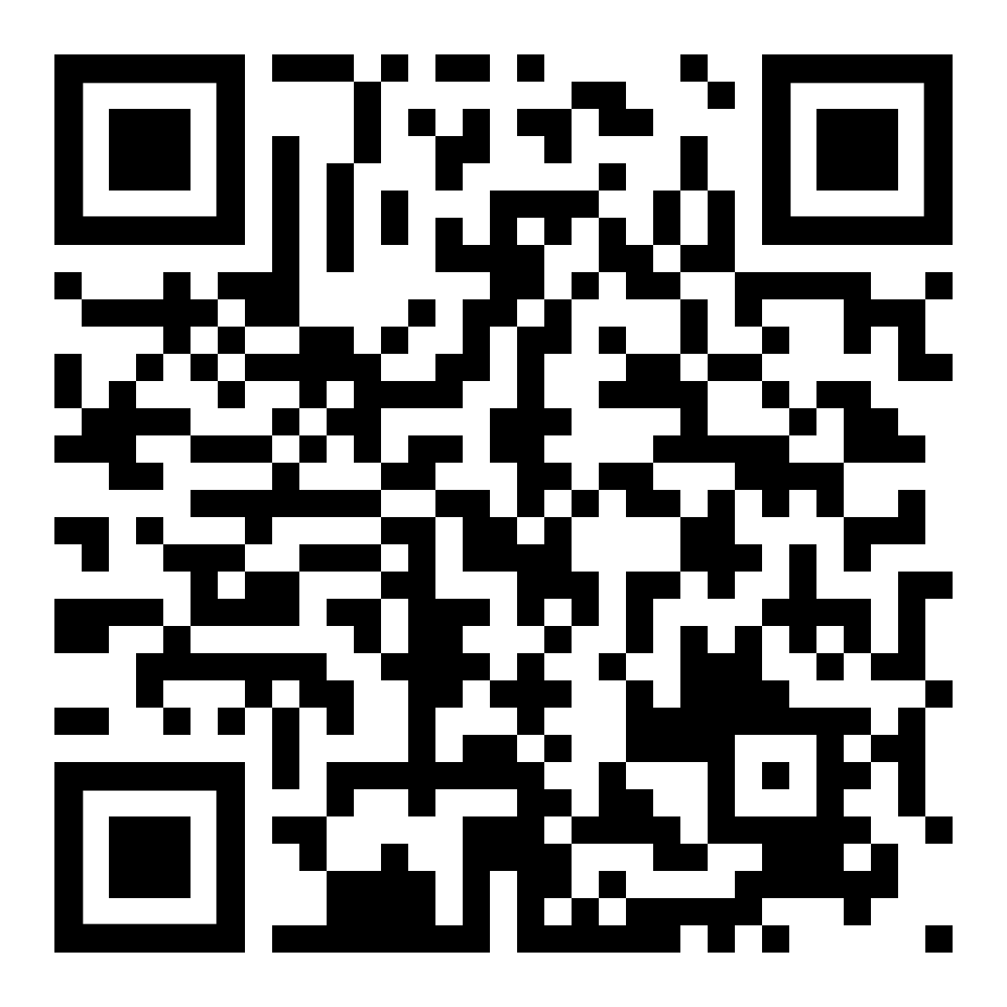
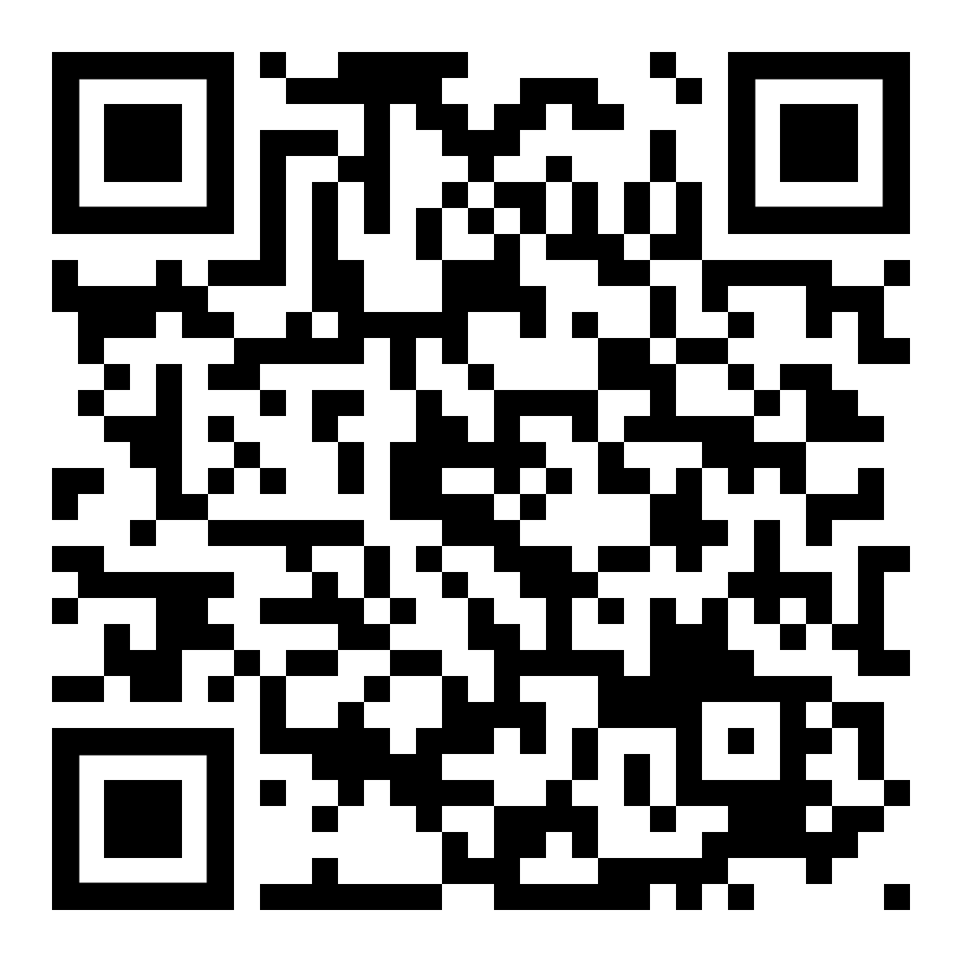
RECOVERY is an open-label platform trial evaluating corticosteroids in
patients with presumed bacterial community-acquired pneumonia (CAP)
Are you looking after a patient with CAP?
Might they be eligible
for RECOVERY?
If so, please contact the trial team and help
us improve the treatment of CAP!
ELIGIBILITY
1. Hospitalised (planned overnight stay) with a pneumonia syndrome, defined as
  a) typical symptoms of new respiratory infection, and
  b) objective evidence of acute lung disease (e.g. compatible CXR, CT or US, clinical exam, or new hypoxia), and
  c) alternative causes considered unlikely (e.g. heart failure)
2. Corticosteroids are not considered definitely indicated or contraindicated by the responsible clinician*
3. Diagnosis of CAP with planned antibiotic treatment (without suspected SARS-CoV-2, influenza, active pulmonary
tuberculosis or Pneumocystis pneumonia†)
Eligible patients
1:1 randomisation:
Dexamethasone (6 mg od)
OR
Usual care without systemic corticosteroids
To refer potential patients, or for questions, contact the trial team:
Email [local research team email]
If urgent tel [local team tel]
Principal Investigator:
[local PI]
Associate PI/main contacts:
[names of API(s)/contacts, if any]
For more information on each treatment comparison
see the Intervention Sheets here ->
* Patients who have been receiving systemic corticosteroids during the current illness are not eligible (glucocorticoid equivalent of ≥10mg prednisolone for >24h)
If corticosteroids are considered definitely indicated by the responsible clinician then the patient is not eligible. This could include treatment for COPD, asthma, septic shock, or CAP itself (2025 NICE pneumonia guidelines recommend considering a corticosteroid in adults with high-severity CAP).
† Testing for these pathogens is not required for trial purposes, and should only be done if indicated for routine care (if done, please await results before randomising)
For protocol, training materials, and DHSC letters supporting influenza trials see here ->
Trial website: www.recoverytrial.net
RECOVERY poster (CAP-only sites) V2.0 2025-11-04

