Slide 1

Randomised Evaluation of COVID-19 Therapy: the RECOVERY trial
Aspirin, Baricitinib and Colchicine
Research Team Training Material

Slide 2



Current design
ELIGIBLE PATIENTS
early immunomodulation - 1
antibody-based therapy
OUTCOMES
A
Colchicine + usual care
or
Usual care alone
B
REGN-COV2 mAb
Usual care alone
or
R
Outcomes collected at earliest of death, discharge or 28 days
Participants enter ≥1 randomisation A-D
anti-thromboembolic therapy
early immunomodulation - 2
C
Aspirin + usual care
or
Usual care alone
D
Baricitinib + usual care
or
Usual care alone

Slide 3
Aspirin
Commonly used antiplatelet agent with anti-inflammatory properties
Dose in RECOVERY is 150 mg once daily for duration of admission
Contraindications: known hypersensitivity; recent major bleeding or bleeding risk considered too high
Side-effects: bleeding

Slide 4
Aspirin FAQs
Q Why 150 mg?
A Potential risk of underdosing larger patients with 75 mg and bleeding risk little different
Q Should we give a PPI with aspirin?
A Gastroprotection can be used at the discretion of the treating physician
Q What about other VTE prophylaxis?
A Other VTE prophylaxis (e.g. heparin) should not be modified by allocation to aspirin or control

Slide 5
Baricitinib
Baricitinib is a licensed treatment for rheumatoid arthritis
Inhibits JAK-1/2 which is part of signalling mechanism for many cytokines
Also inhibits tyrosine kinase which has similar function
Tyrosine kinase activity identified as marker for severe COVID, so inhibition may be good

Slide 6
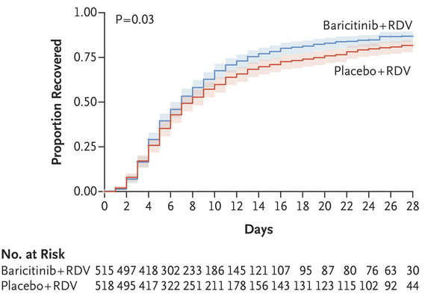
Baricitinib
Baricitinib was tested in ACTT-2 trial of 1033 people hospitalised with COVID-19
Randomised between baricitinib plus remdesivir or placebo plus remdesivir
Outcome | Rate ratio (95% CI)
Mortality | 0.65 (0.39-1.09)
Death or IMV | 0.69 (0.50-0.95)
IMV | 0.64 (0.44-0.93)
Safety:
SAEs in 16.0% vs 21.0% (p=0.03)
Median time to recovery 7 vs 8 days

Slide 7
Baricitinib
Contraindications:
Pregnancy
eGFR <15 mL/min/1.73m² (including those on dialysis/haemofiltration)
Neutrophil count <0.5 x10⁹/L
Active TB infection
Cautions:
Dose reduction for kidney impairment
eGFR ≥30 <60 mL/min/1.73m²: 2 mg once daily
eGFR ≥15 <30 mL/min/1.73m²: 2 mg alternate days
Dose should be halved if taking probenecid
Co-administration with tocilizumab is allowed according to clinician’s discretion

Slide 8
Baricitinib
Adverse effects:
Infections
Abdominal symptoms, uncommonly diverticulitis
Headache
Rarely neutropaenia, LFT disturbance
Supplies:
NHS stocks can be used
Blueteq form required for each participant (but kept very simple)

Slide 9
Colchicine
Colchicine inhibits spindle formation in neutrophils and NRPL3 inflammasome activation
Used routinely as an anti-inflammatory for gout and pericarditis
Increasing evidence of its benefits in cardiovascular disease e.g. post-myocardial infarction or chronic coronary artery disease

Slide 10
Colchicine
Dose in RECOVERY is:
1 mg after randomisation
500 mcg 12 hours later
500 mcg twice daily thereafter for a total of 10 days (or until discharge if sooner)
Colchicine can rarely cause cytopaenia so full blood count monitoring is recommended (frequency at clinician discretion e.g. 3 and 7 days after randomisation)

Slide 11
Colchicine: Contraindications
Colchicine is teratogenic in animals so pregnancy test is required for women of child-bearing potential
Colchicine is also contraindicated in presence of:
Severe hepatic impairment
Significant cytopaenia (neutrophil count <1; platelet count <50; reticulocyte count <20 [if measured])
Concomitant use of strong CYP3A4 or P-gp inhibitors
Hypersensitivity to lactose

Slide 12
Colchicine: Cautions
Colchicine can be used in the following conditions, but dose frequency could be reduced (i.e. 500 mcg daily rather than twice daily)
Moderate CYP3A4 inhibitor
Reduced kidney function (eGFR <30 mL/min/1.73m²)
Estimated body weight <70 kg
If >1 of these present, investigator should consider excluding colchicine from randomisation (i.e. mark as “unsuitable”)

Slide 13
Colchicine: Adverse effects
Main adverse effect is diarrhoea which may limit tolerability
Cytopaenias are rare

Slide 14
Other RECOVERY treatments
For training on REGN-COV2 monoclonal antibody cocktail or dimethyl fumarate comparisons, please see their individual training modules

