Slide 1

Randomised Evaluation of COVID-19 Therapy: the RECOVERY trial
Baricitinib
Research Team Training Material

Slide 2



Current design (adults)
ELIGIBLE PATIENTS
early immunomodulation - 1
OUTCOMES
A
Dimethyl fumarate
or
Usual care alone
R
Outcomes collected at earliest of death, discharge or 28 days
Participants enter ≥1 randomisation A, D or E
For hypoxic patients only:
corticosteroids
early immunomodulation - 2
E
High-dose corticosteroids
Usual care alone
D
Baricitinib
Usual care alone
or
or
Infliximab
or
UK only

Slide 3
Baricitinib
Baricitinib is a licensed treatment for rheumatoid arthritis
Inhibits JAK-1/2 which is part of signalling mechanism for many cytokines
Also inhibits tyrosine kinase which has similar function
Tyrosine kinase activity identified as marker for severe COVID, so inhibition may be good

Slide 4
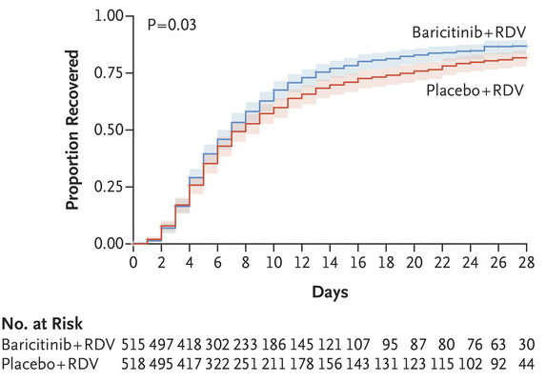
Baricitinib
Baricitinib was tested in ACTT-2 trial of 1033 people hospitalised with COVID-19
Randomised between baricitinib plus remdesivir or placebo plus remdesivir
Outcome | Rate ratio (95% CI)
Mortality | 0.65 (0.39-1.09)
Death or IMV | 0.69 (0.50-0.95)
IMV | 0.64 (0.44-0.93)
Safety:
SAEs in 16.0% vs 21.0% (p=0.03)
Median time to recovery 7 vs 8 days

Slide 5
Baricitinib
Contraindications:
Pregnancy
eGFR <15 mL/min/1.73m² (including those on dialysis/haemofiltration)
Neutrophil count <0.5 x10⁹/L
Active TB infection
Cautions:
Dose reduction for kidney impairment
eGFR ≥30 <60 mL/min/1.73m²: 2 mg once daily
eGFR ≥15 <30 mL/min/1.73m²: 2 mg alternate days
Dose should be halved if taking probenecid
Co-administration with tocilizumab is allowed according to clinician’s discretion

Slide 6
Baricitinib
Adverse effects:
Infections
Abdominal symptoms, uncommonly diverticulitis
Headache
Rarely neutropaenia, LFT disturbance
Supplies:
NHS stocks can be used
Blueteq form required for each participant (but kept very simple)

Slide 7
Other RECOVERY treatments
For training on the other comparisons e.g. dimethyl fumarate, please see individual training modules

