Slide 1

Randomised Evaluation of COVID-19 Therapy: the RECOVERY trial
Dimethyl fumarate (DMF): Early Phase Assessment
Research Team Training Material

Slide 2



Design including Dimethyl fumarate (DMF)
ELIGIBLE PATIENTS
early immunomodulation - 1
antibody-based therapy
OUTCOMES
A
or
Usual care alone
B
REGN-COV2 mAb
Usual care alone
Colchicine + usual care
or
DMF + usual care
or
or
R
Outcomes collected at earliest of death, discharge or 28 days
Participants enter ≥1 randomisation A-D
anti-thromboembolic therapy
early immunomodulation - 2
C
Aspirin + usual care
or
Usual care alone
D
Baricitinib + usual care
or
Usual care alone

Slide 3
Dimethyl fumarate
Proposed modes of action: inhibition of NLRP3 inflammasome activation + anti-viral effect against SARS-CoV-2 in vitro
Licensed for long-term oral immunomodulatory therapy in relapsing-remitting multiple sclerosis and plaque psoriasis
Immunomodulatory agents have produced best therapeutic results for patients with COVID-19 so far
Limited current clinical evidence with DMF in COVID-19: no other clinical trials worldwide

Slide 4
Dimethyl fumarate
Adults ≥18 years old, those on ECMO excluded
Dosing:
  By mouth: 120mg every 12 hours for 4 doses followed by 240mg every 12 hours for 8 days (10 days total or until discharge if sooner)
Contraindications
  Pregnancy and breast-feeding (negative pregnancy test result required in women of child-bearing age)
  Known hypersensitivity to excipients in any oral therapy
Side Effects:
  Diarrhoea and flushing side effects commonly reported but usually mild
  Incidence of side effects and DMF discontinuation will be recorded
  Dose can be reduced for these symptoms if problematic: 240mg BD -> 120mg BD -> 120mg OD

Slide 5
Early Phase assessment
UK CTAP request for RECOVERY to perform early phase assessment of DMF
Additional information is required before considering large-scale assessment of impact on mortality
Estimated to need 400 participants
Review results for decision as to whether to include in main trial

Slide 6
Early Phase assessment
Many study procedures as for main trial:
  Eligibility criteria
  Consent process and Patient Information Sheet (updated to include DMF information)
  Randomisation website – DMF included in Part A randomisation for selected sites
  SSAR reporting
Specific outcome measures and follow-up form
  Primary outcome:
    Non-invasive, bedside measure of patient oxygenation: the S/F₉₄ ratio
    Similarities to PaO₂:FiO₂ ratio but not requiring arterial blood gases
  Other outcome measures:
    Simple ordinal scale clinical progression score
    Laboratory results: CRP, Creatinine, ALT/AST
    Incidence of adverse side effects and treatment adherence

Slide 7
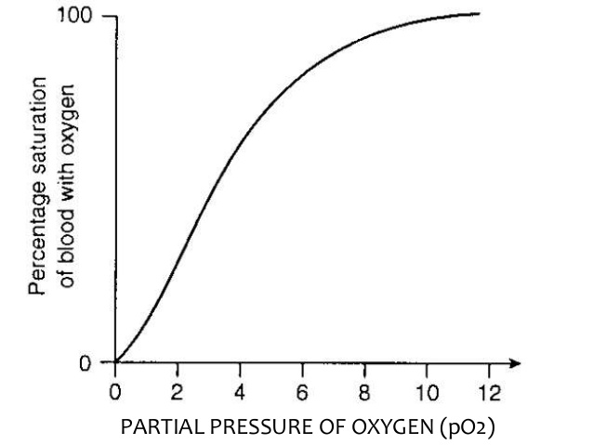
S/F₉₄ Ratio
Measure of patient oxygenation
Defined as the ratio of oxygen saturations to percentage fraction of inspired oxygen when the oxygen saturations are <94%
Improves accuracy compared with O₂ sats ≥94%
Bedside testing performed by research team ~10-30 minutes duration
Measured before randomisation and on days 3, 5 and 10

Slide 8
S/F₉₄ Ratio
  Participant resting in bed with head of bed at 30º for at least 5 minutes
  Oxygen delivery mode switched to one that measures FiO₂ accurately
  Oxygen reduced until sats on pulse oximeter are <94% or the patient is breathing air
  Short periods of hypoxia (e.g. SpO2 of 80%) are not considered harmful
  Monitor participant for signs of distress throughout
  Revert patient to previous oxygen therapy on completion
Please see SOP for full details

Slide 9
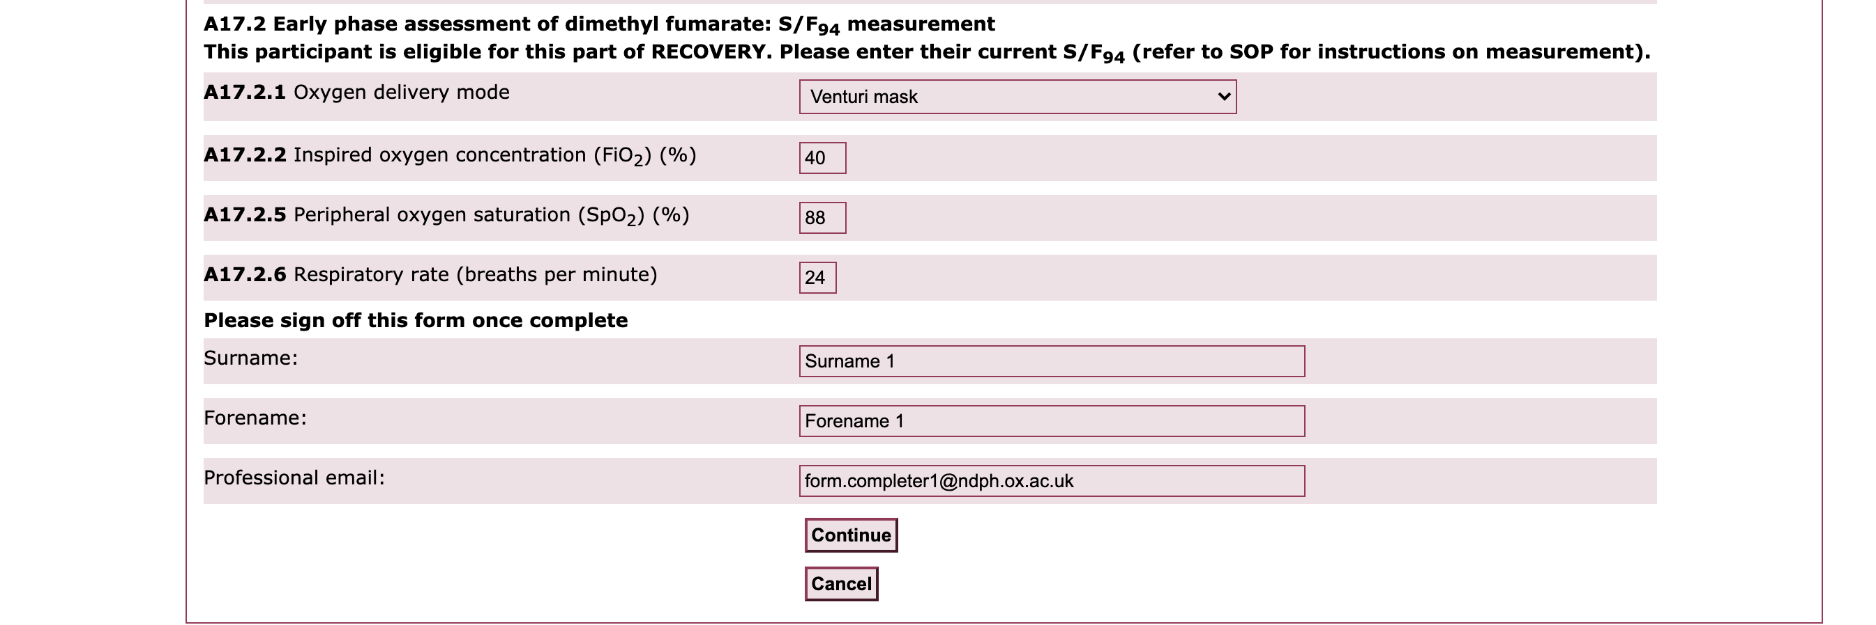
S/F₉₄ Ratio Randomisation form

Slide 10
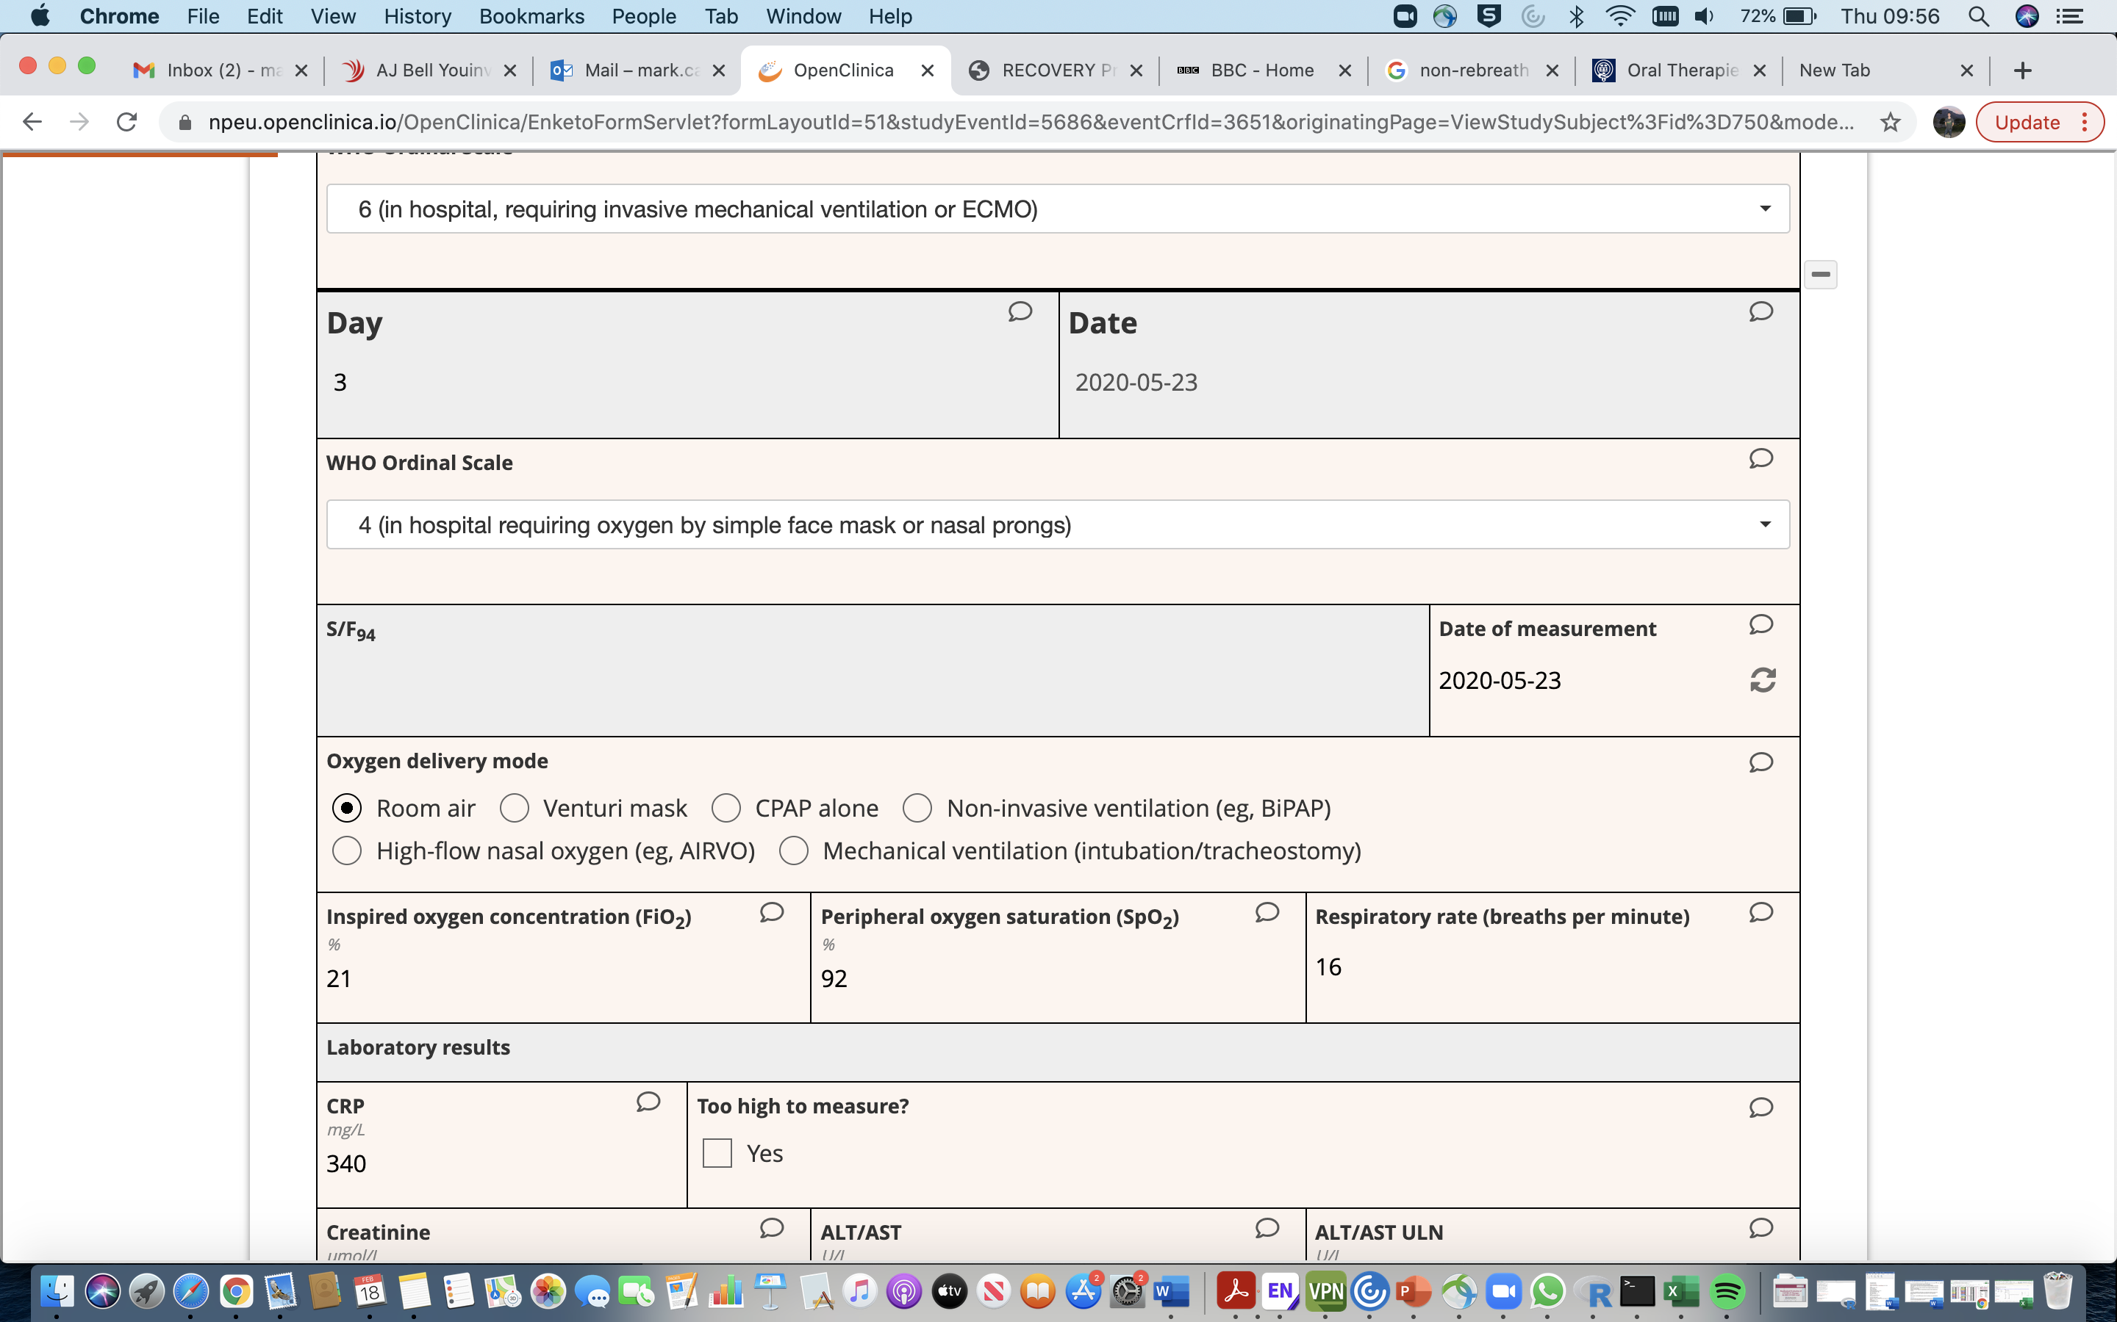
S/F₉₄ Ratio Follow-up form

Slide 11
Ordinal Scale Score
Measured daily at ~12:00pm from medical records from study day 2 until day 10 or discharge
Score | Descriptor
1 | Discharged (alive)
2 | In hospital, not requiring oxygen, not requiring medical care
3 | In hospital, not requiring oxygen, requiring medical care
4 | In hospital requiring oxygen by simple face mask or nasal prongs
5 | In hospital requiring high flow nasal oxygen, CPAP or NIV
6 | In hospital, requiring invasive mechanical ventilation or ECMO
7 | Death

Slide 12
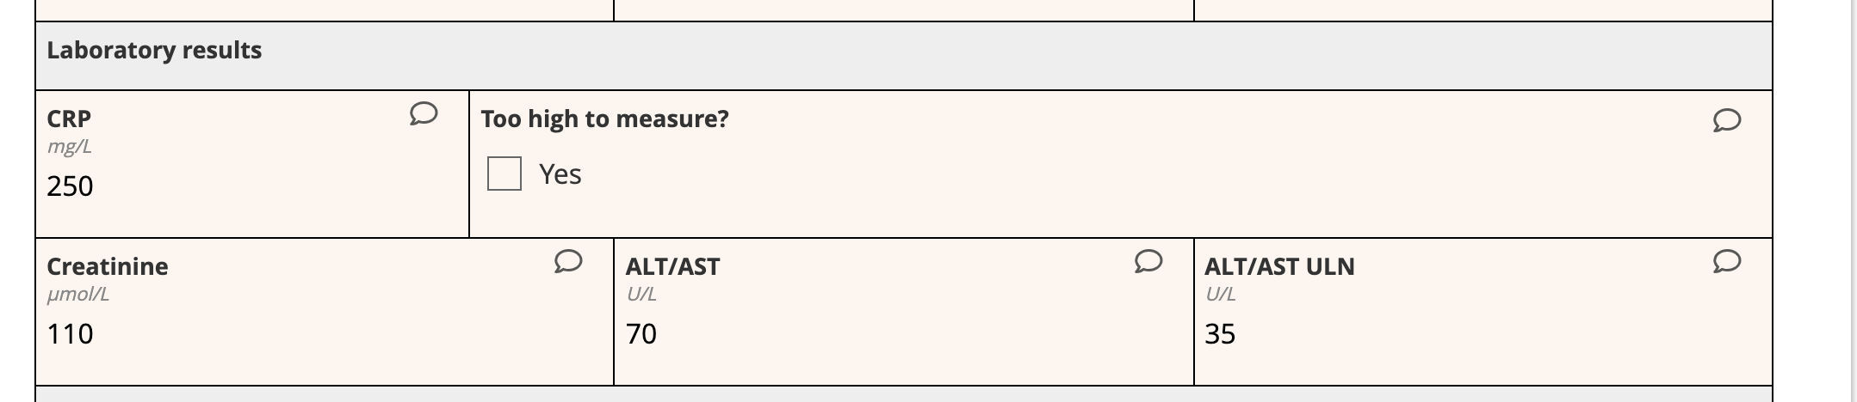
Lab Results
Measure blood CRP, creatinine and ALT/AST on days 3, 5 and 10
Use routine clinical care blood test results or perform blood test on patient for routine analysis

Slide 13
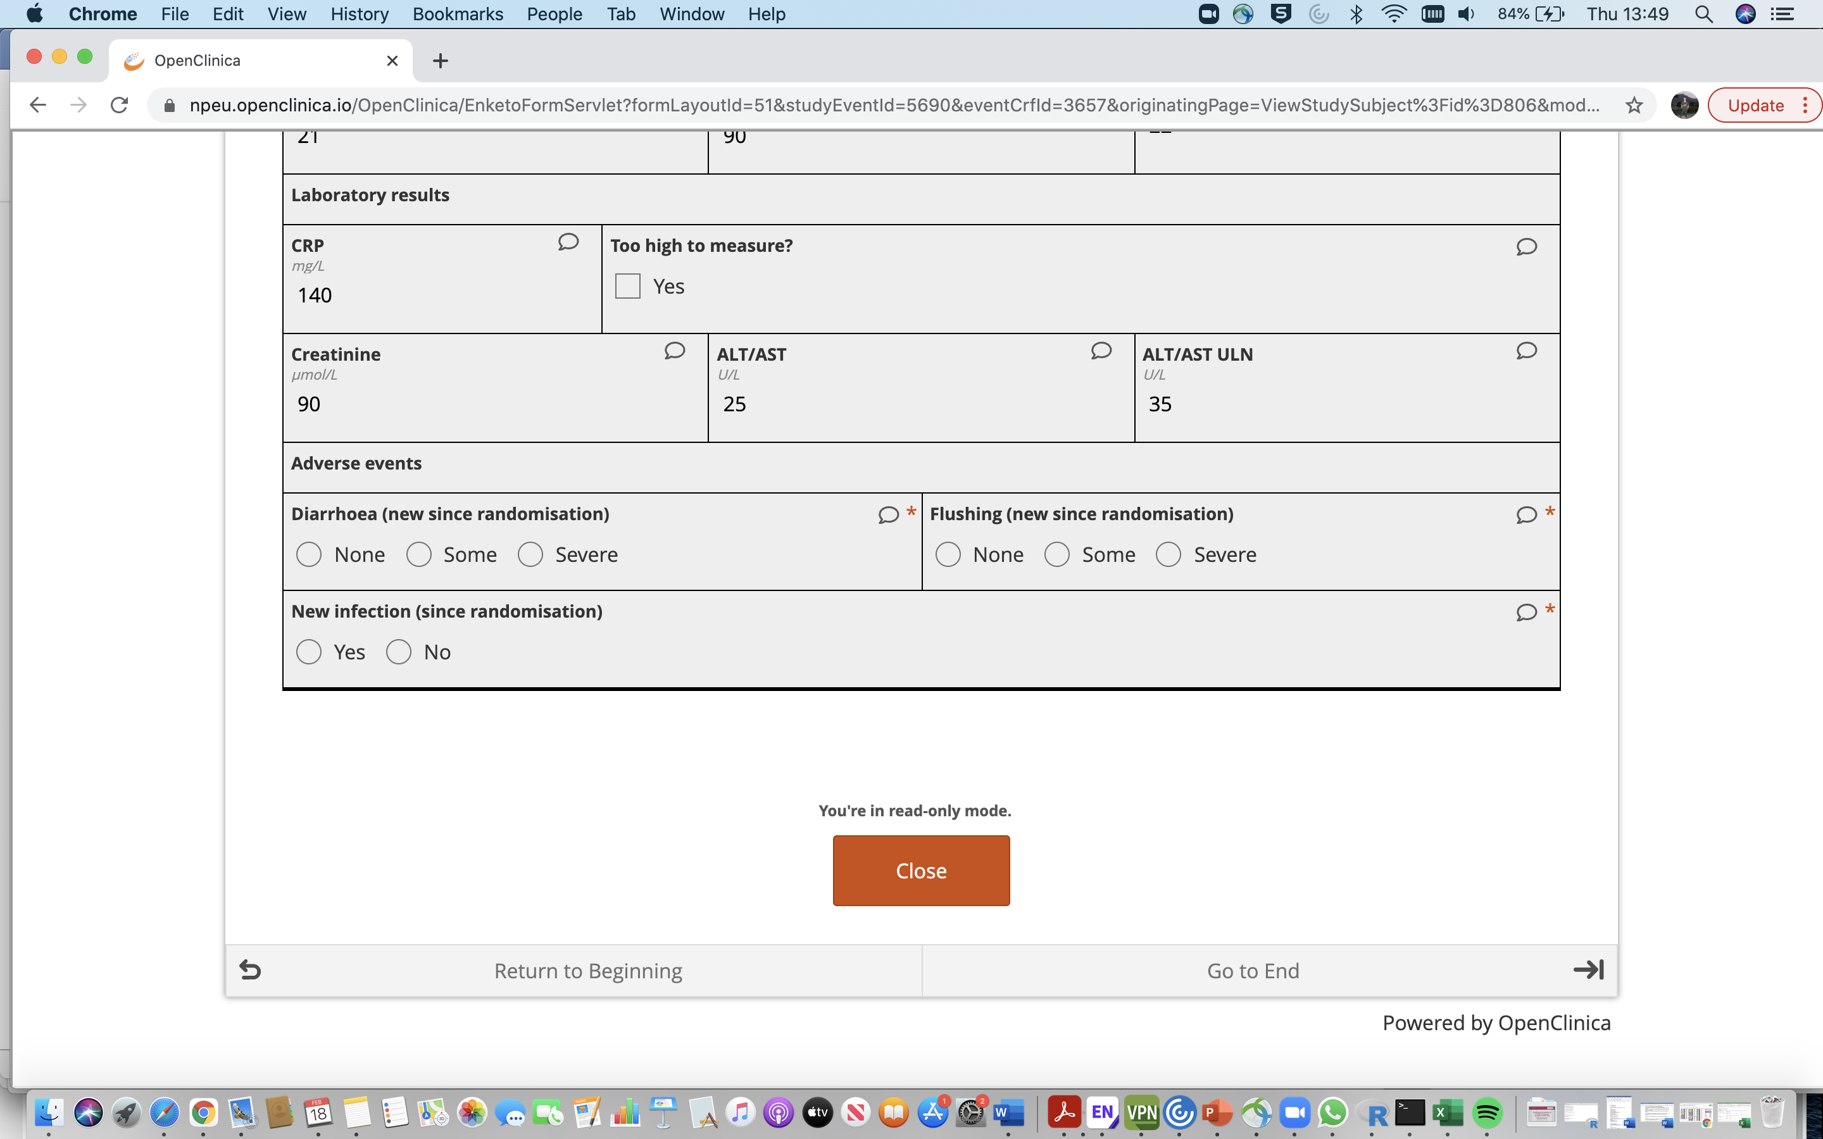
DMF Adverse Events and Adherence
Adverse Events
  Presence of new diarrhoea or flushing
  Participant-rated severity (or clinician if patient unable to give answer)
Adherence
  DMF dose in last 24 hours
  Reason for discontinuation (if applicable)
  Total days DMF taken for on day 10

Slide 14
Summary of timing of outcome measures
Outcome measure | Day 1 | Day 2 | Day 3 | Day 4 | Day 5 | Day 6 | Day 7 | Day 8 | Day 9 | Day 10
S/F₉₄ | [ ] |  | [ ] |  | [ ] |  |  |  |  | [ ]
Ordinal Scale |  | [ ] | [ ] | [ ] | [ ] | [ ] | [ ] | [ ] | [ ] | [ ]
Laboratory results (CRP, creatinine, ALT/AST) |  |  | [ ] |  | [ ] |  |  |  |  | [ ]
Adverse events |  |  | [ ] |  | [ ] |  |  |  |  | [ ]
Adherence |  |  | [ ] |  | [ ] |  |  |  |  | [ ]
Day 1 = Day of randomisation. S/F₉₄ measurement at day 1 collected as part of the randomisation form
Outcome measurement stops at day 10 (or discharge if sooner)

