Slide 1

Randomised Evaluation of COVID-19 Therapy: the RECOVERY trial
Second Randomisation

Slide 2
IL-6 and Tocilizumab
NORMAL
IN PRESENCE OF TOCILIZUMAB
IL-6 binds surface receptor
IL-6 binds soluble receptor
Tocilizumab binds surface receptor
Tocilizumab binds soluble receptor
IL-6/IL-6R complex binds gp130 on cell surface
IL-6 cannot bind either surface or soluble receptor
IL-6/IL-6R/gp130 complex activates JAK1/2-STAT1/3 signalling
IL-6/IL-6R complexes cannot bind to gp130 so no activation of JAK1/2-STAT1/3 pathway
Inflammatory processes
(CRP production, B cell stimulation, T cell differentiation)
Reduced inflammation

Slide 3
Tocilizumab
Humanized monoclonal antibody against IL-6 receptor
Licensed for treatment in:
Rheumatoid arthritis
Cytokine release syndrome (CRS) after CAR-T cell therapy (new treatment for haematological malignancy)
Also being tested in REMAP-CAP and COVACTA trials

Slide 4
RECOVERY trial design
No additional treatment
ELIGIBLE PATIENTS
Admitted to hospital
Proven or suspected SARS-CoV-2 infection
OUTCOMES
Primary: all-cause death
Secondary:
Duration of hospitalisation
Need for ventilation
Need for renal replacement therapy
Lopinavir-ritonavir
400/100 mg bd PO for 10 days
R
Dexamethasone
6 mg od PO/IV for 10 days
Hydroxychloroquine
See protocol for dosing
Azithromycin
500 mg od PO/IV for 10 days

Slide 5
RECOVERY second randomisation
No additional treatment
SECOND RANDOMISATION ELIGIBILITY CRITERIA
Tocilizumab
OUTCOMES
Mortality at 28 days
Need for ventilation; admission duration
R
Control
Lopinavir-ritonavir
400/100 mg bd PO for 10 days
Tocilizumab
R
Control
Tocilizumab
Dexamethasone
6 mg od PO/IV for 10 days
Tocilizumab
R
vs
Control
Control
Hydroxychloroquine
See protocol for dosing
Tocilizumab
R
Control
Azithromycin
500 mg od PO/IV for 10 days
Tocilizumab
R
Control

Slide 6
Second randomisation
Will not be conducted at all study sites due to limited drug supply
Sufficient for 4000 participants to be randomised between tocilizumab and control
May be done at any time from immediately after first randomisation until 21 days later
Consent included in main PIS/ICF (V4.1)
For participants recruited using earlier PIS/ICF may be included without re-consent

Slide 7
Second randomisation: eligibility
Eligibility criteria:
Receiving oxygen or oxygen saturations <92% on air
CRP ≥75 mg/L
No medical history that might, in the opinion of the attending clinician, put the patient at significant risk if s/he were to participate in this aspect of the RECOVERY trial
e.g. clear evidence of secondary bacterial infection causing deterioration

Slide 8
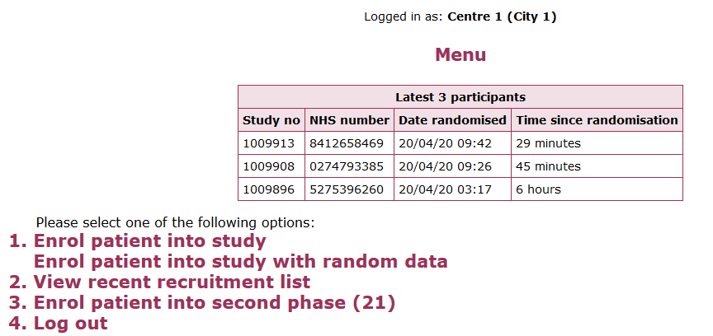
Second randomisation: access
Access (i) via main randomisation system:

Slide 9
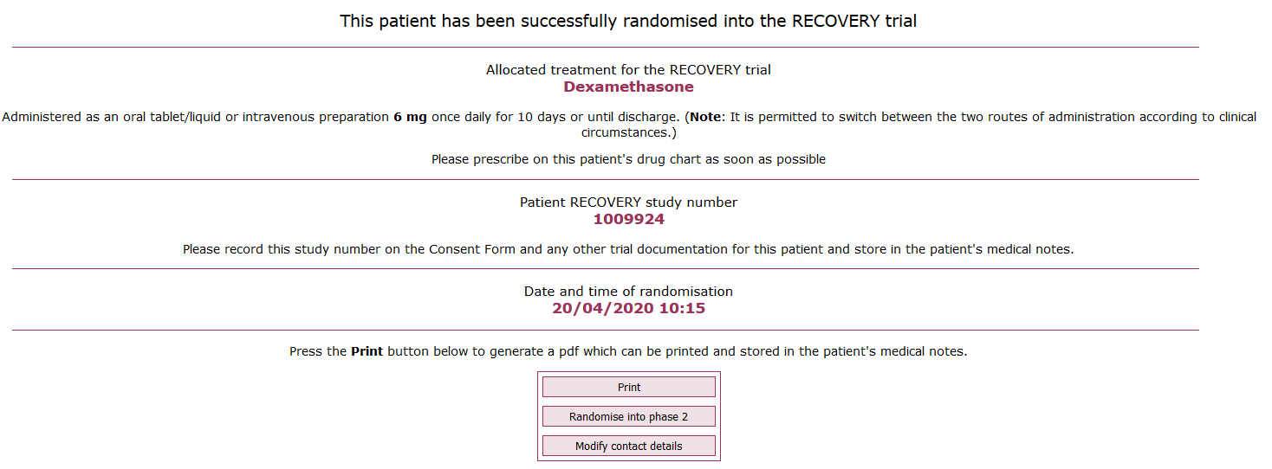
Second randomisation: access
Or (ii) access at end of main randomisation:

Slide 10
Second randomisation: process
Check that correct participant has been selected
Drop-down:
CPAP
NIV
High-flow nasal O₂
IMV
ECMO
Yes/No

Slide 11
Second randomisation: process
Either enter result (“0” if below limit); or tick box if
not measured; or
Above limit (e.g. >250)
Yes/No
Yes/No

Slide 12
Tocilizumab prescribing
Weight-based dose
Can use estimated weight if measurement not available/possible
If weight ≤40 kg, prescribe 8 mg/kg
Single intravenous infusion over 60 minutes in 100 mL 0.9% sodium chloride
Second dose can be given ≥12 <24 hours later if – in clinician’s opinion – the patient’s condition has not improved
Weight | Dose
>40 and ≤65 kg | 400 mg
>65 and ≤90 kg | 600 mg
>90 kg | 800 mg

Slide 13
Tocilizumab stock
Available via ImmForms/Movianto system
Sites will be able to order sufficient for 20 patients initially; please contact coordinating centre once 10 patients treated
Further information available at www.recoverytrial.net

