Slide 1
Randomised Evaluation of COVID-19 Therapy: the RECOVERY trial
Convalescent Plasma
Research Team Training

Slide 2
Trial design
No additional treatment
ELIGIBLE PATIENTS
OUTCOMES
Lopinavir-ritonavir
400/100 mg bd PO for 10 days
Tocilizumab
R
Dexamethasone
6 mg od PO/IV for 10 days
R2
No additional treatment
Hydroxychloroquine
See protocol for dosing
Azithromycin
500 mg od PO/IV for 10 days

Slide 3
Adding convalescent plasma in factorial design
ELIGIBLE PATIENTS
OUTCOMES
Convalescent Plasma
1 unit on day 1 & 2
Tocilizumab
R
R2
No additional treatment
No additional treatment

Slide 4
Adding convalescent plasma in factorial design
ELIGIBLE PATIENTS
OUTCOMES
SOC + CP
SOC - CP
LOP + CP
LOP - CP
Tocilizumab
R
R2
DEX + CP
DEX - CP
No additional treatment
HCQ + CP
HCQ - CP
AZM + CP
AZM - CP
CP
vs
No CP

Slide 5
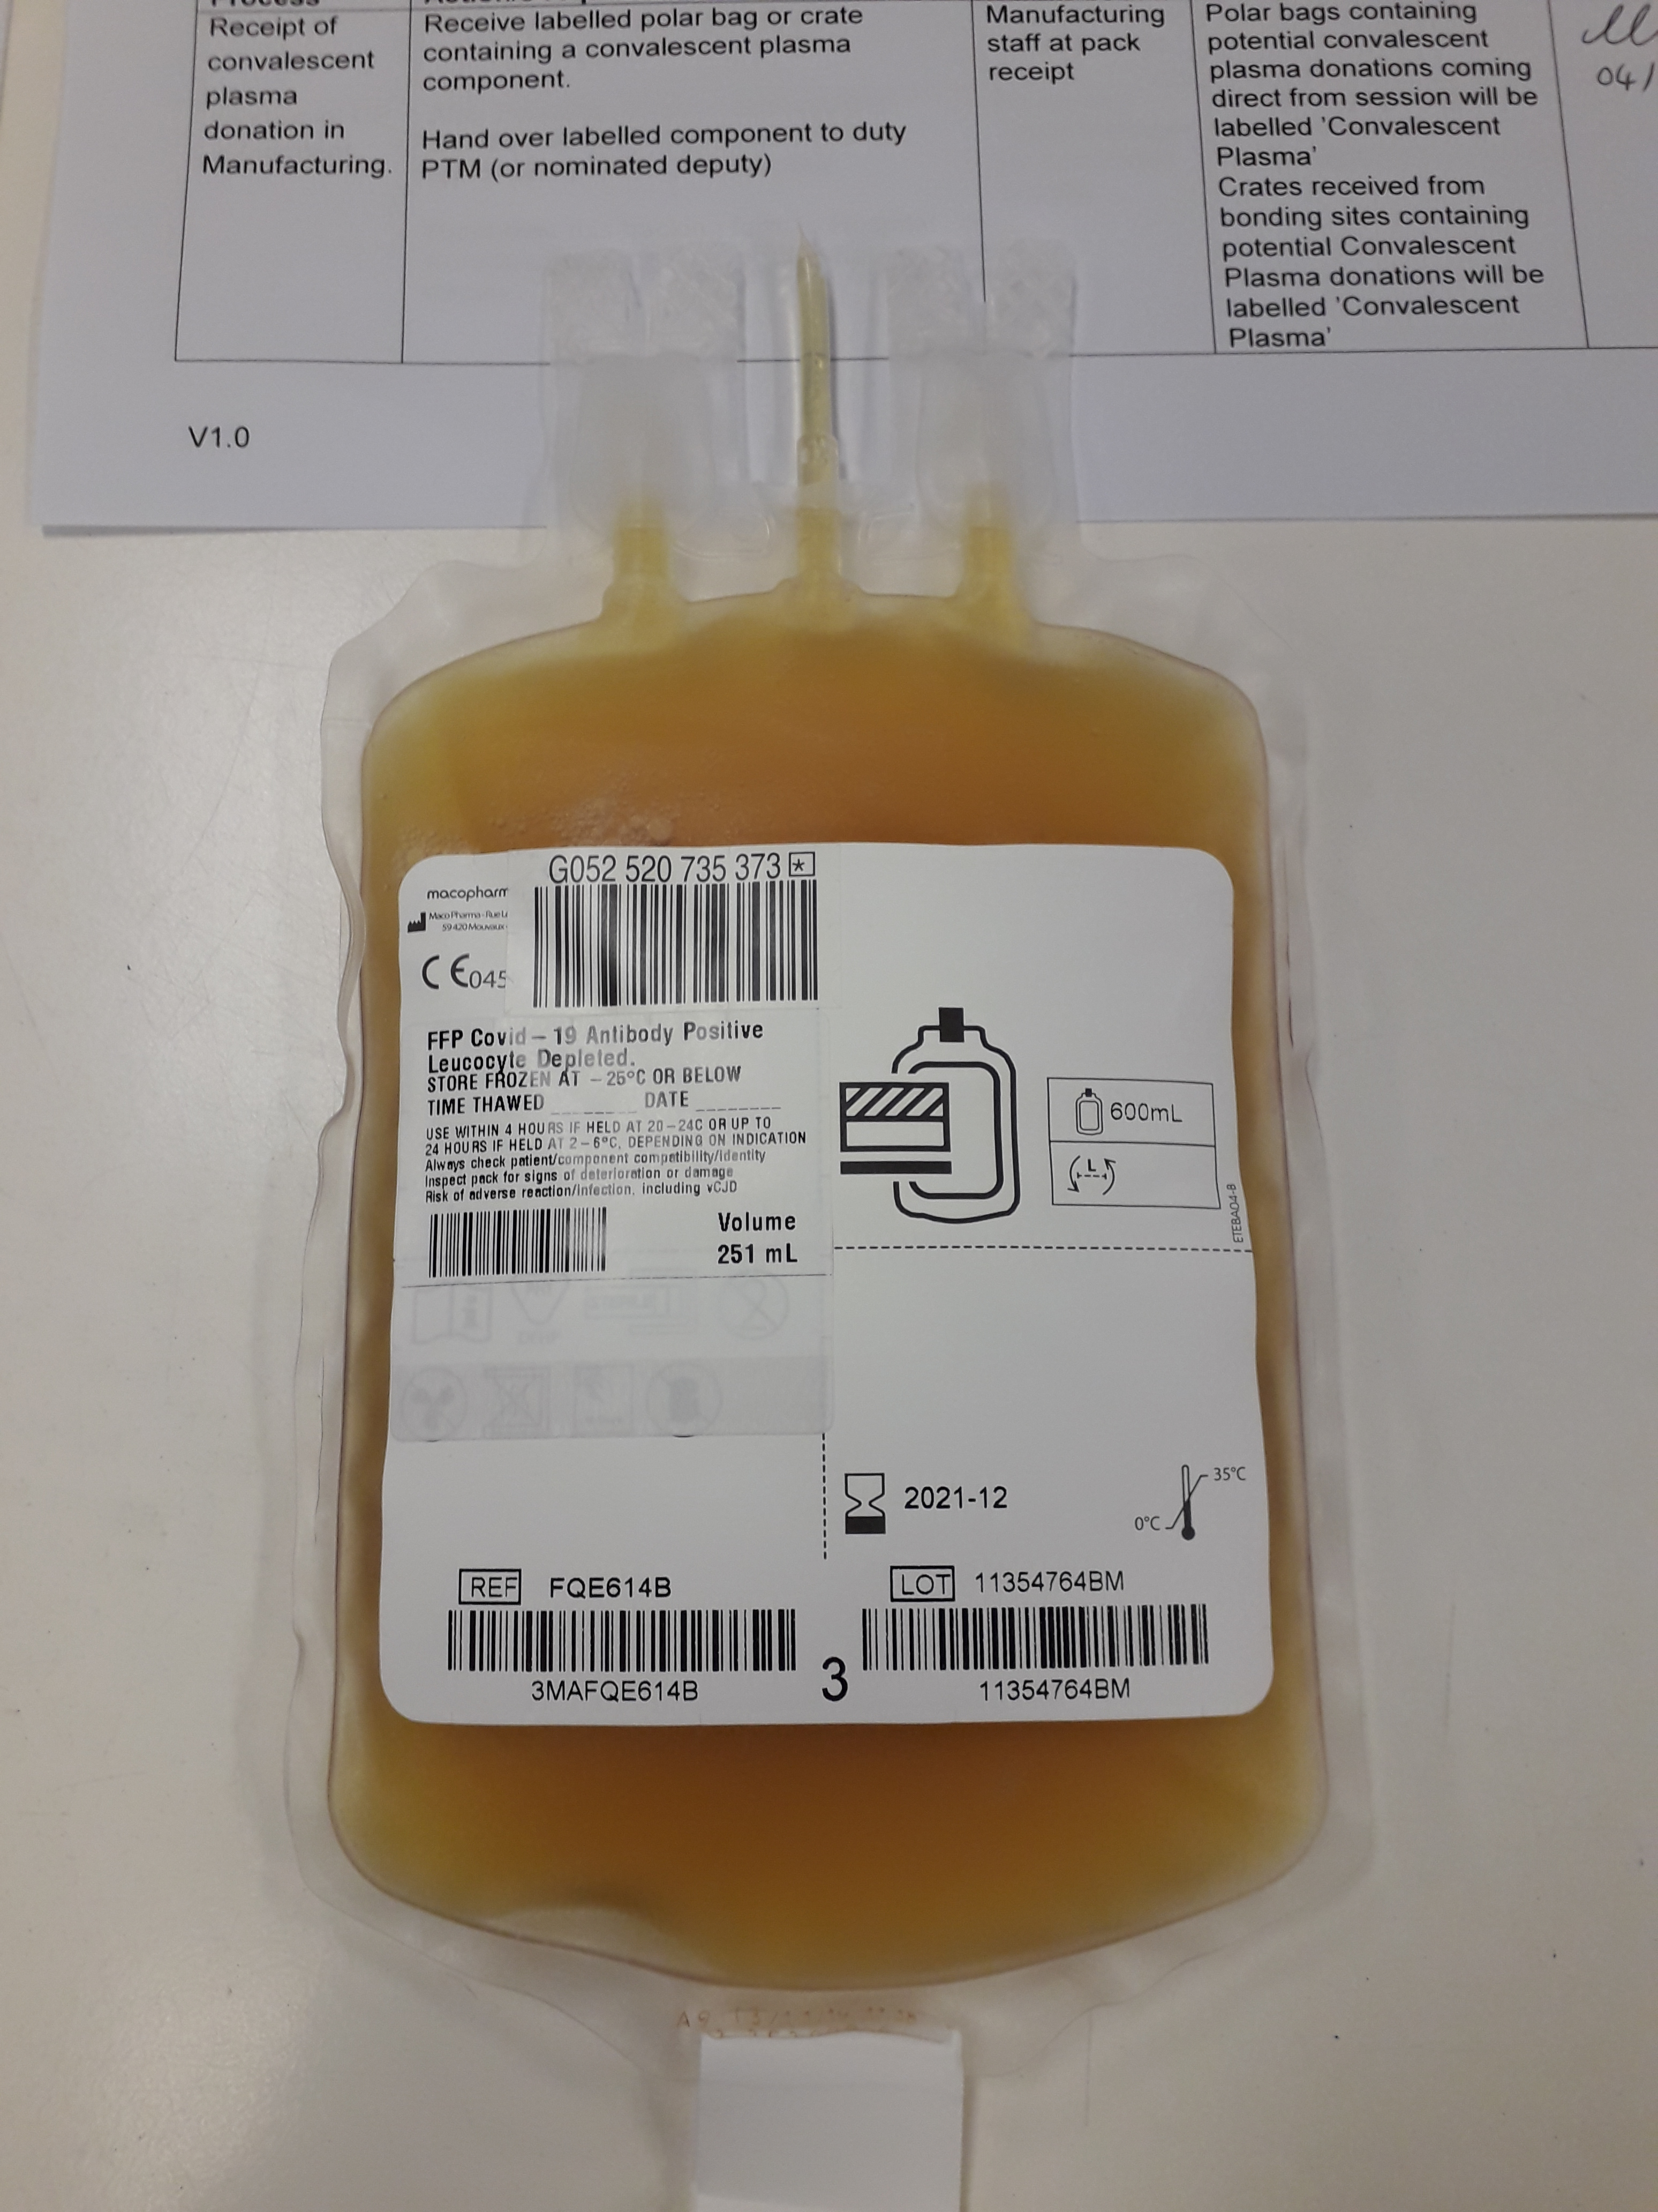
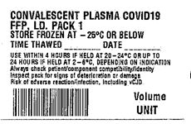

Convalescent plasma
Convalescent plasma COVID-19 FFP (CP) is plasma donated from patients who have recovered from COVID-19 and contains antibodies which may neutralise SARS-CoV-2 virus.
Some low quality data to suggest it may be effective in viral pneumonia
Need robust data from larger RCTs so has been included in RECOVERY and REMAP-CAP protocols
Notes:
Add better picture when available

Slide 6
Consent and Randomisation
RECOVERY PIS+ICF V5.0 has information on CP and extra line on consent form:
Randomisation form has questions on:
  Participant’s willingness to receive CP (i.e. the answer above)
  Participant’s suitability for CP
  Availability of CP

Slide 7
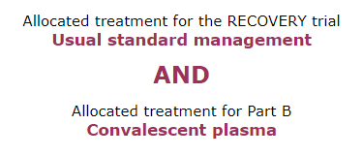
Allocation and access to CP
Allocations will be displayed:
BEFORE convalescent plasma can be supplied by transfusion lab:
  Two Group & Screen samples must have been sent to laboratory (taken at separate times)
BEFORE administering convalescent plasma:
  Assess for potential transfusion associated circulatory overload

Slide 8
Potential hazards of CP
Antibody-dependent enhancement
  Theoretically antibodies may promote viral entry into cells and accelerate disease
  No clear evidence of this in humans
Transfusion-associated circulatory overload (TACO)
  Assess patient’s volume status and risk of circulatory overload before prescribing CP
Hypersensitivity reaction to plasma

Slide 9
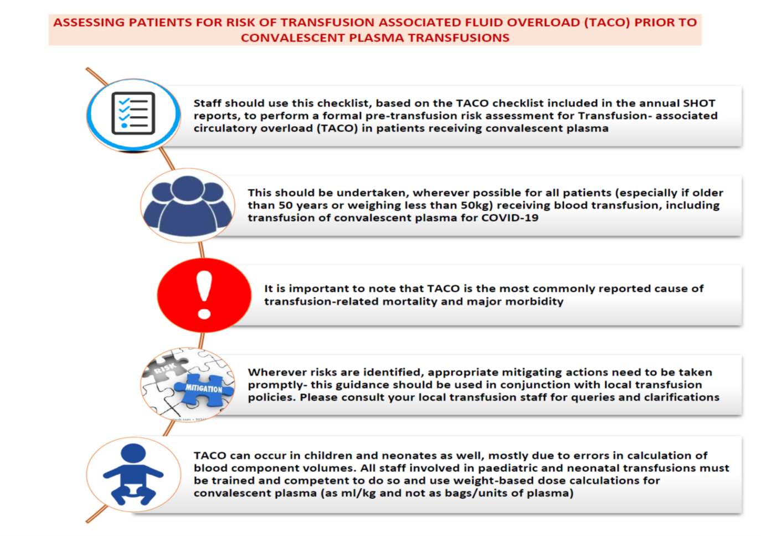
Transfusion-associated circulatory overload
Most important cause of morbidity with transfusions
Consider:
  Cardiac status
  Pulmonary risk
  Fluid balance
Actions could include:
  Delay CP transfusion
  Give at slower rate
  Give with diuretic
TACO checklist: available on study website

Slide 10
Prescription of CP
Adult dose: One unit (275 ± 75 mL) on days 1 and 2
  At least 12 hours apart
Paediatric dose = 5 mL/kg
  See protocol for neonatal details
Administer as soon as possible and within 4 hours of defrosting if at room temperature or up to 24 hours if refrigerated between 2 - 6ºC

Slide 11
Administration of CP
All standard administration checks as per local policy should be completed and documented
If any adverse reactions are suspected, inform:
  Managing medical team
  Transfusion laboratory/practitioner who will complete Serious Hazard of Transfusion (SHOT) reporting as required
  If with first unit, re-consider before giving second unit
  Document in medical records

Slide 12
Additional early safety data collection for first 200 CP recipients/controls
In first 72 hours after randomisation, has the participant had:
  Sudden worsening in respiratory status
  Severe allergic reaction
  Temperature >39ºC or ≥2ºC rise above baseline
  Sudden hypotension (defined as either (i) sudden drop in systolic blood pressure of ≥30 mmHg with systolic blood pressure ≤80 mmHg; or (ii) requiring urgent medical attention)
  Clinical haemolysis (defined as fall in haemoglobin plus one or more of the following: rise in lactate dehydrogenase (LDH), rise in bilirubin, positive direct antiglobulin test (DAT), or positive crossmatch)
How many units of CP were given and were any stopped early
This information will be collected on additional OpenClinica form
Standard SHOT reporting will also be used for all participants receiving CP

Slide 13
Summary
Convalescent plasma (CP) is being offered in a factorial randomisation at entry into RECOVERY
Participant may opt out of this part of the trial but still participate in the rest
Ensure all participants are considered for the risk of transfusion-associated circulatory overload (TACO) before administering CP
CP should be given according to local policy for blood products
First 200 participants in this randomisation will have extra safety information collected

