Slide 1

Randomised Evaluation of COVID-19 Therapy: the RECOVERY trial
Participant follow-up data collection

Slide 2
What is OpenClinica?
Clinical data management system
Electronic data capture
Data management
Accessed via web browser
Chrome, Firefox, IE supported

Slide 3
Definitions
Study - this refers to the trial, in this case RECOVERY
Participant - this is a patient within the study
Event or Study Event - refers to a data collection point such as randomisation, follow-up or adverse events
CRF - stands for Case Report Form and is a form used to collect and contain data for a study event
Queries - are queries or annotations for data items where a value that has been entered is not as expected

Slide 4
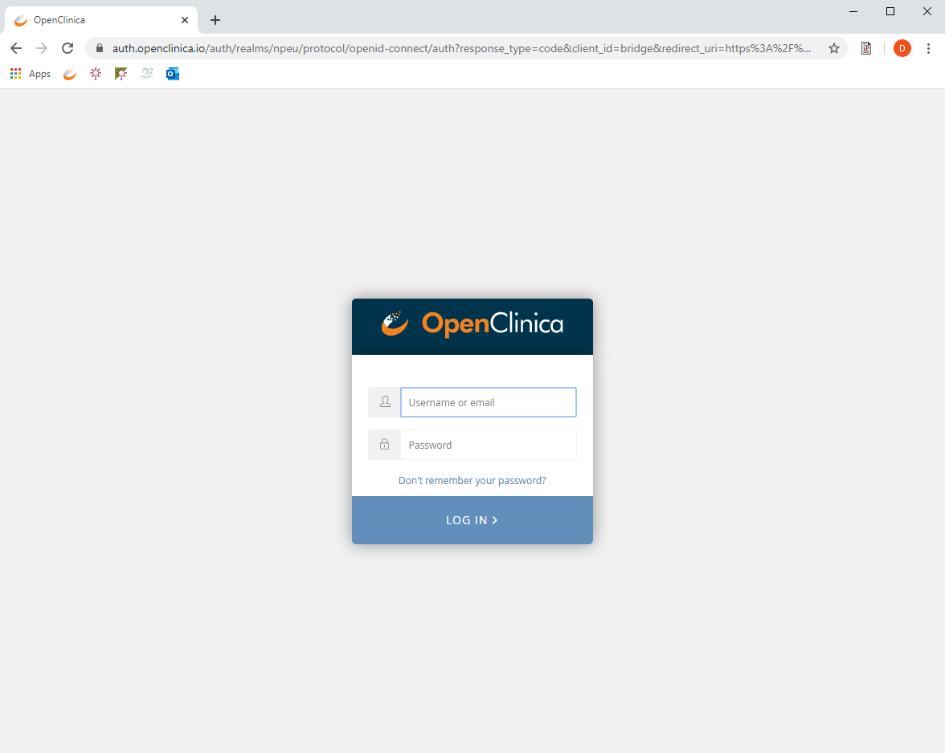
Log-in page
URL: https://npeu.openclinica.io
An invitation email will be sent to you, which will include your log-in credentials

Slide 5
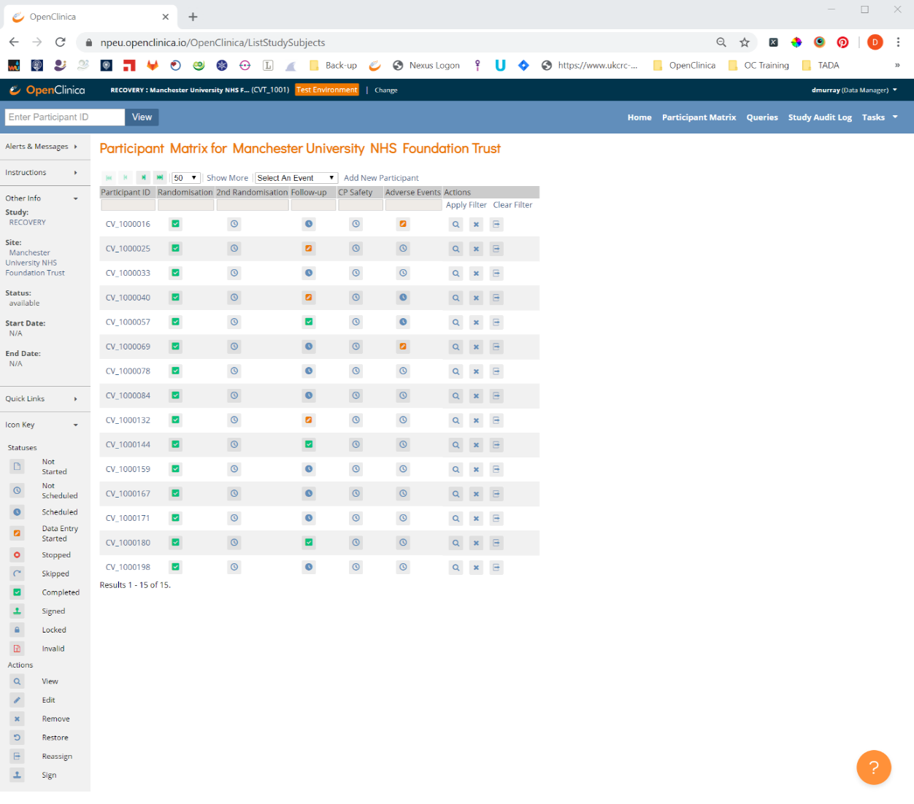
Participant Matrix
The Participant Matrix is a table with event information for all participants recruited at your site.
This is where you can view, enter and edit data for participants and their events in the study.

Slide 6
Participant Matrix
Each row represents a participant. The first column contains the study Participant ID also known as the study number.
All of the subsequent columns contain the study events for the data collection points in the study.
As you can see here, the study events are, Randomisation, Follow-up and Adverse Events.

Slide 7
Filtering the participant matrix
Filter the participant matrix using the grey box under the study Participant ID or in the text box in the top left corner

Slide 8
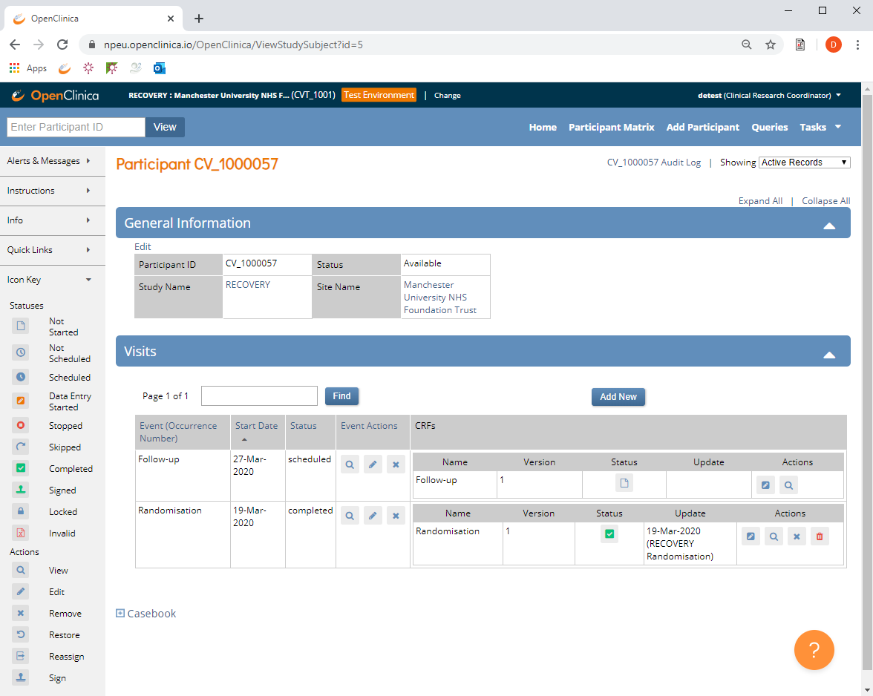
Participant’s Record
Click the View button to open the participant’s record page.
Here you will see a list of CRFs that have been completed or are scheduled for a participant

Slide 9
Data entry statuses
Data entry completed
Data entry started but not marked as complete
Scheduled event, events where data are expected

Slide 10
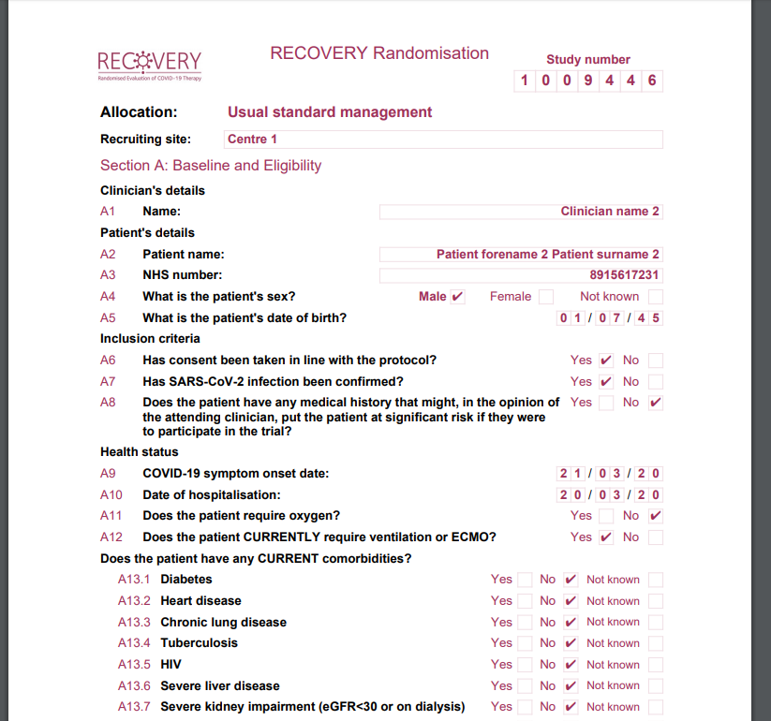
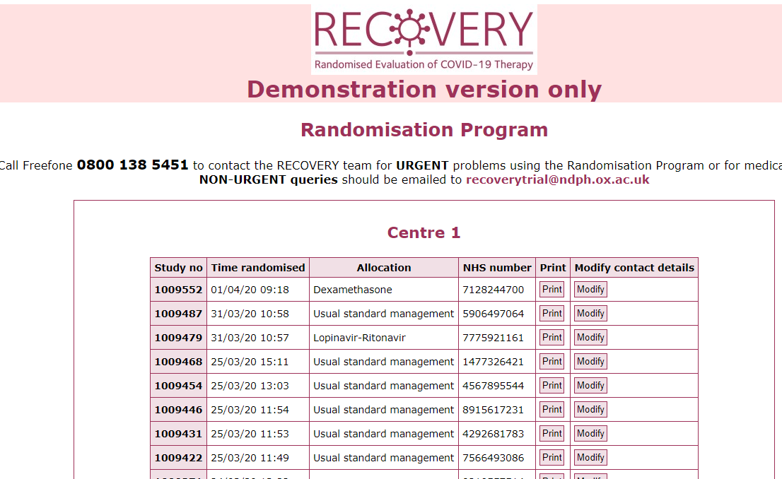
Identifying the participant
Use participant’s NHS or equivalent National ID number to correctly identify the participant and obtain their study number
Confirm study number by either using a print out of the randomisation details OR log into the randomisation website and click View recent recruitment list
Print out of randomisation details
Recent recruitment list in randomisation website

Slide 11
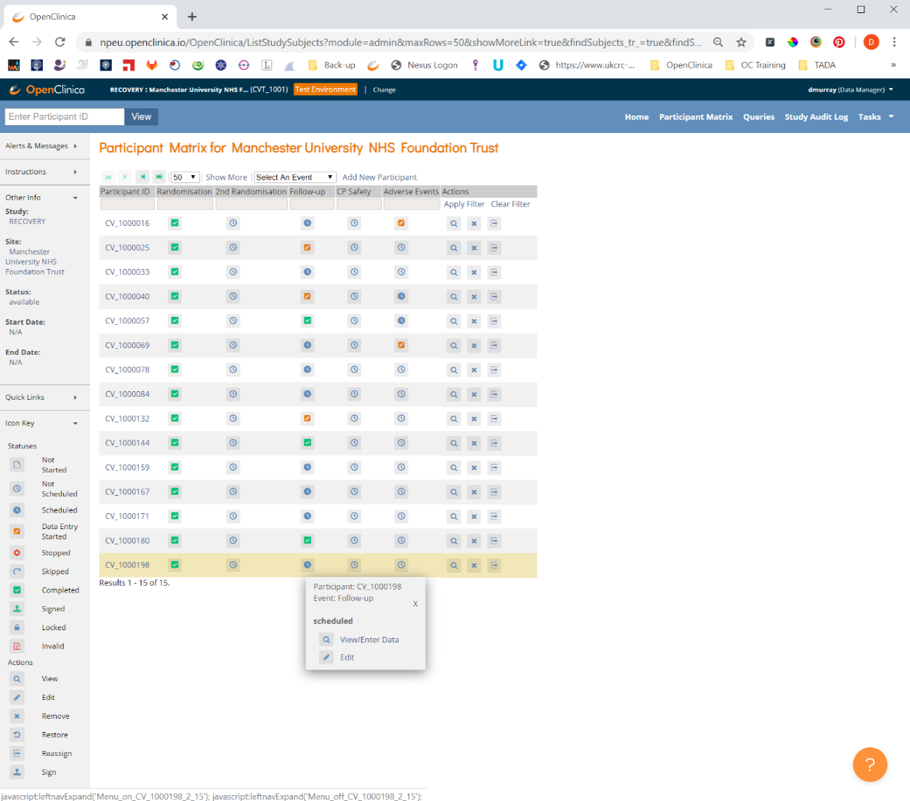
Entering data
Click the scheduled icon and then click View/Enter Data in the yellow pop-up window

Slide 12
Entering data
All questions on the Follow-up refer to the post randomisation period of the participant’s hospitalisation

Slide 13
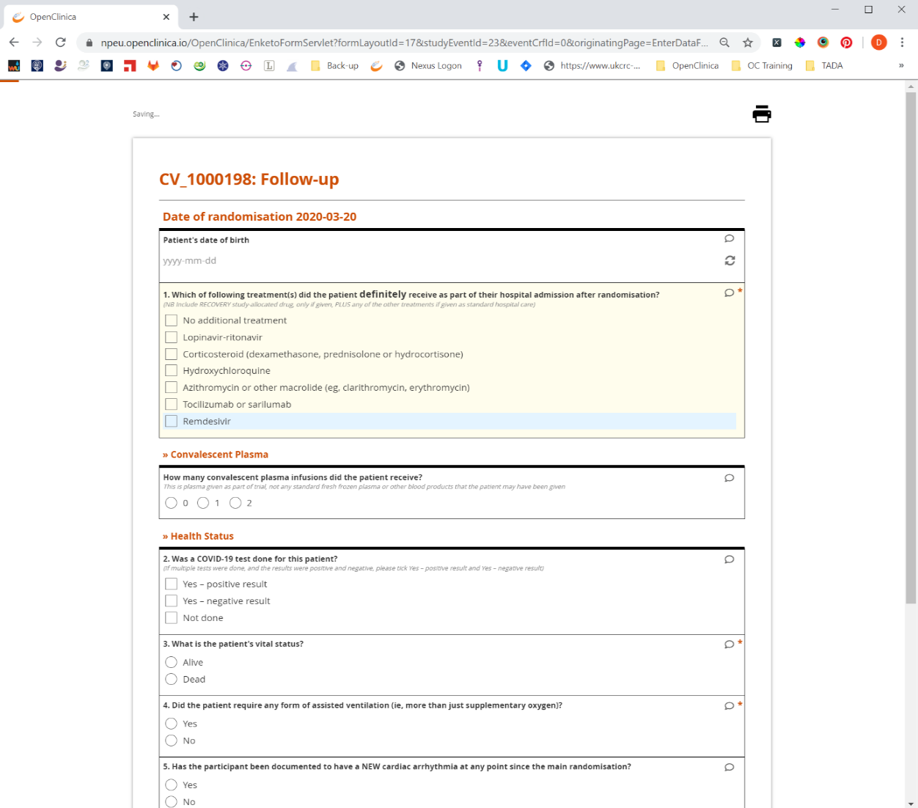
Entering data
Enter data by selecting an option or typing data in to the appropriate text box.
If entering a date, you can use the calendar widget, or type in the data in the format, YYYY-MM-DD

Slide 14
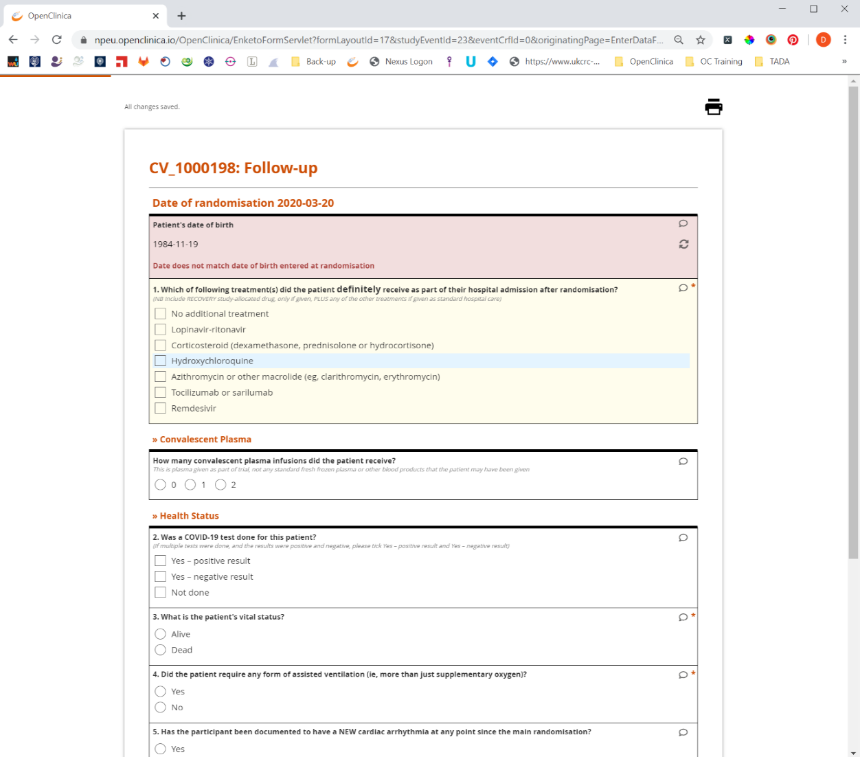
Warning messages
Warning messages appear if the value entered fails a validation check.
In this example, the date of birth does not match the date entered at randomisation

Slide 15
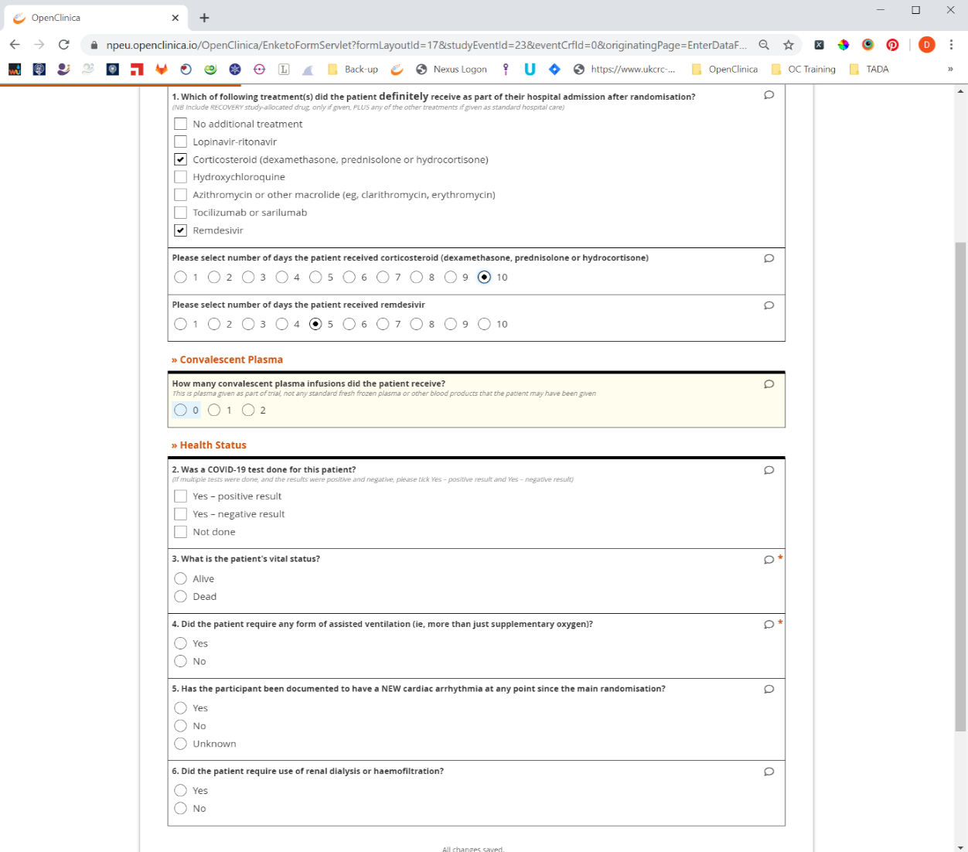
Question 1
Please select all treatments the patient received as standard care and select the number of days the patient received the treatment
Only include the allocated RECOVERY study treatment if it was given to the patient.

Slide 16
Convalescent Plasma
If the patient was allocated convalescent plasma please confirm the number of infusions the patient received. This is plasma given as part of trial, not any standard fresh frozen plasma or other blood products that the patient may have been given.
If the patient did receive convalescent plasma confirm if any infusions were stopped. If Yes, please confirm how many were stopped.

Slide 17
Question 2
Confirm if the patient was tested for COVID-19
If multiple tests were done, and the results were positive and negative, please tick Yes – positive result and Yes – negative result

Slide 18
Question 3
If the answer is Alive, you will be asked the participant’s current hospitalisation status.
If they where Discharged, please give the date of discharge
OR
If they are an In-patient, please give the today’s date
If the answer is Died, please enter
  Date of death
  Cause of death

Slide 19
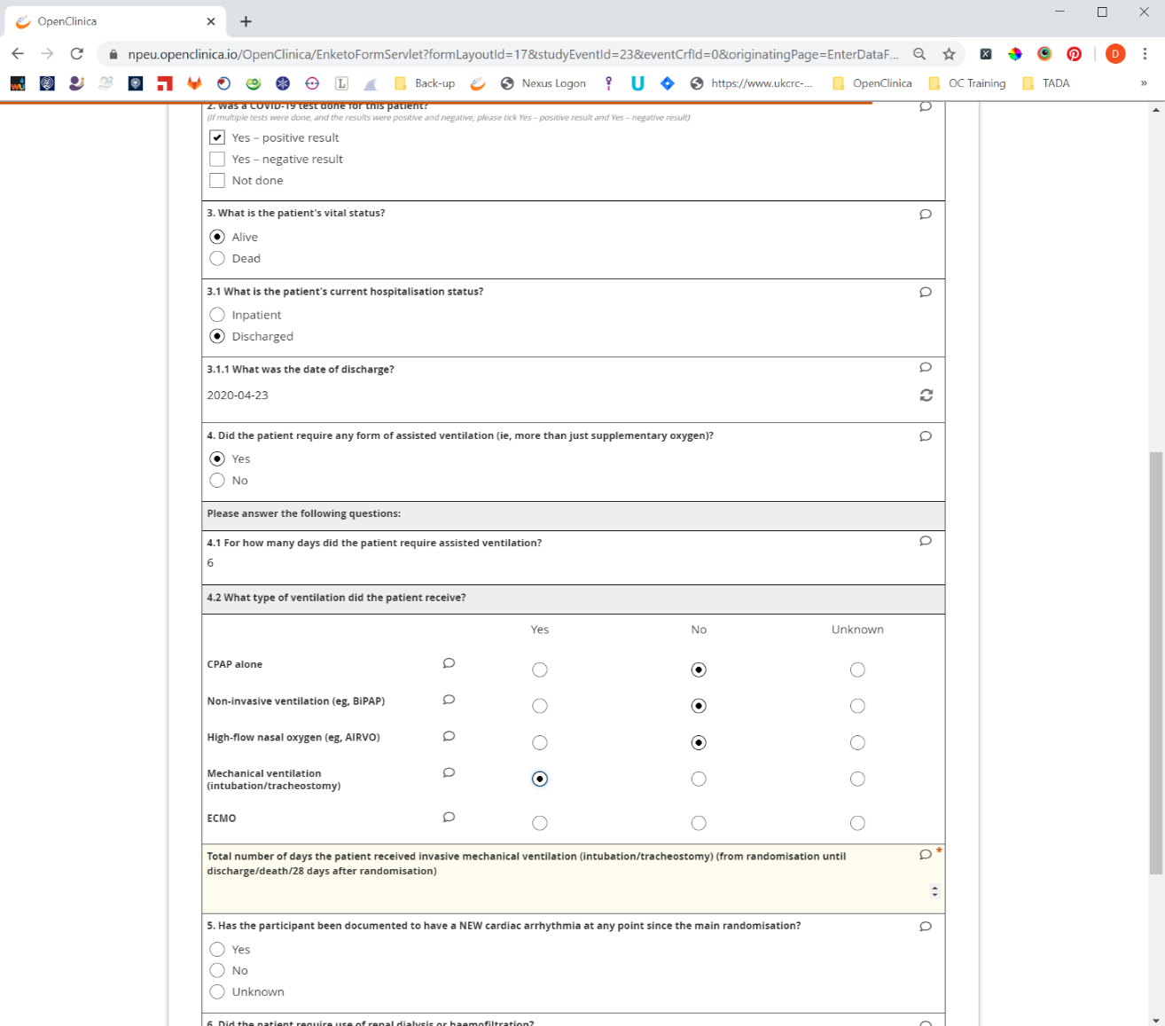
Question 4
If the answer to question 4 is Yes, you will be prompted to ask two further: 4.1 and 4.2.
If the patient received Intubation/tracheostomy and mechanical ventilation, you’ll then be asked to enter the number of days they received invasive mechanical ventilation.

Slide 20
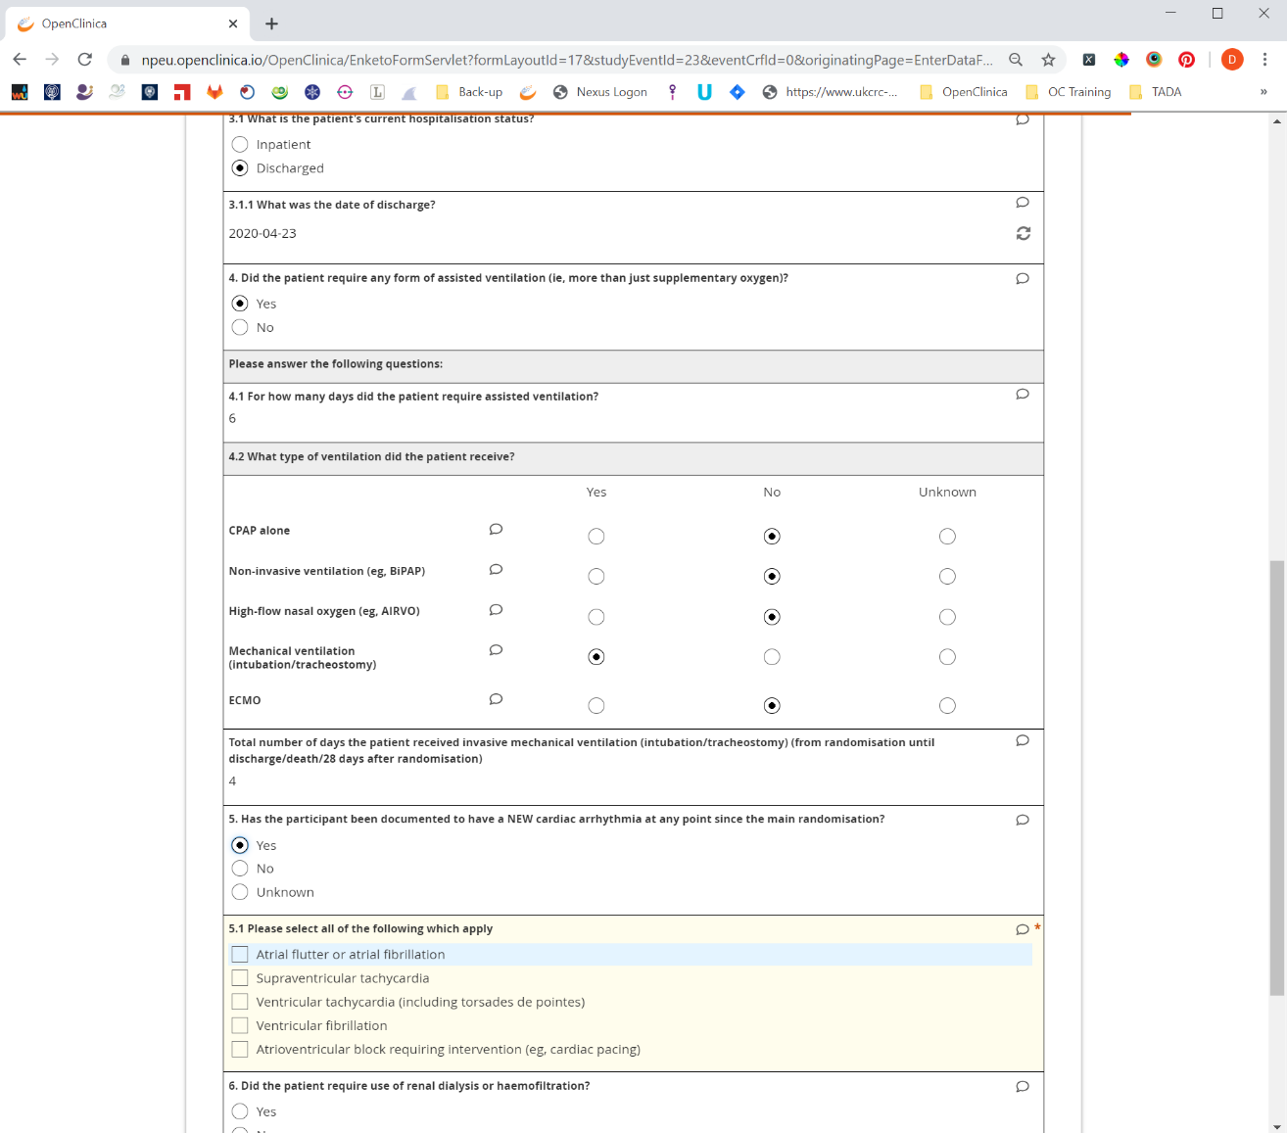
Question 5
If the answer to question 5 is Yes, please select all the options that apply in question 5.1

Slide 21
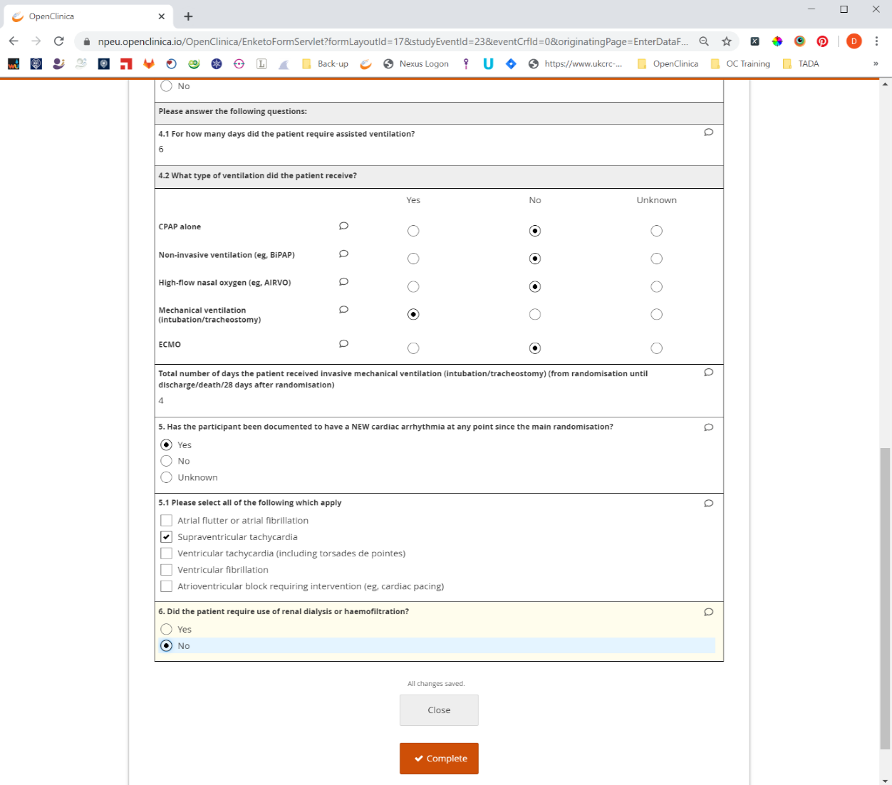
Complete data entry
To complete data entry press the Complete button
Then Confirm

Slide 22
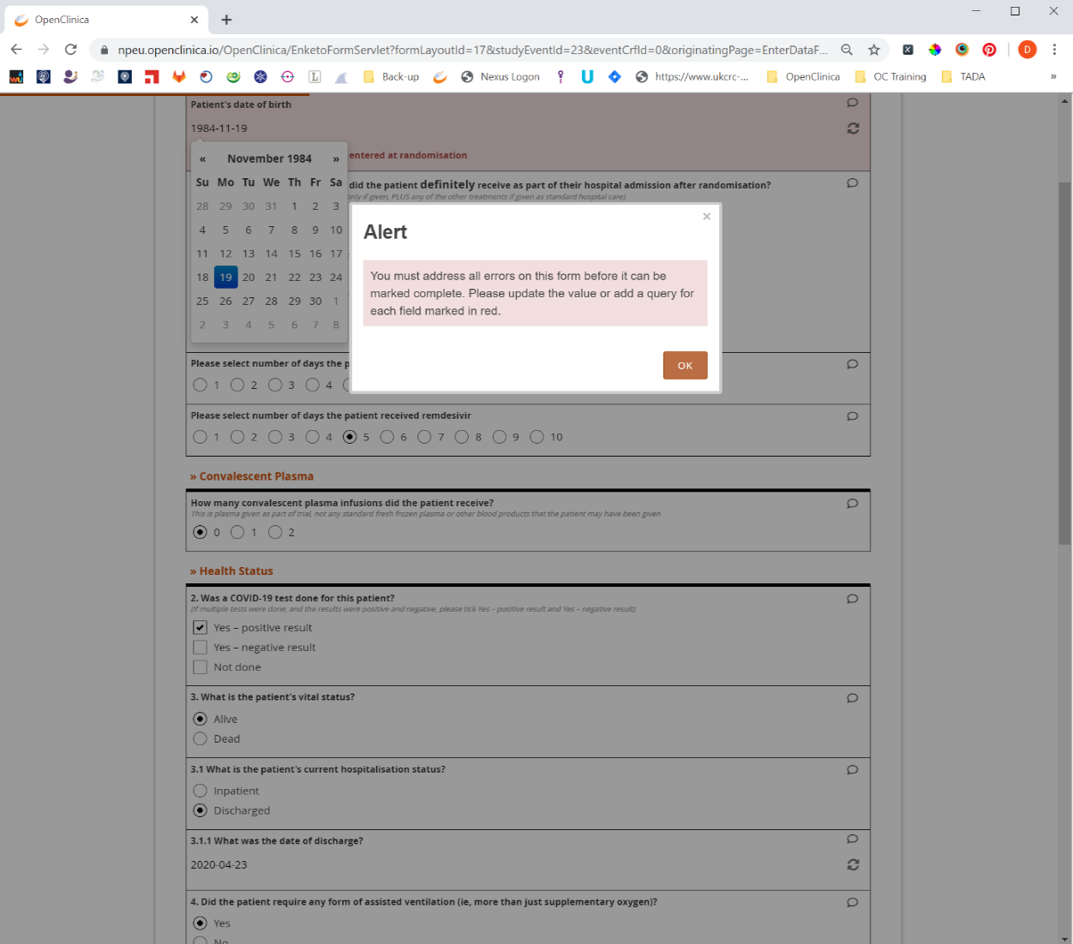
Error message
If an alert message appears, this is because of an error with the data entered.
If the data entered has no errors, this message will not appear. To resolve the error, click ok.

Slide 23
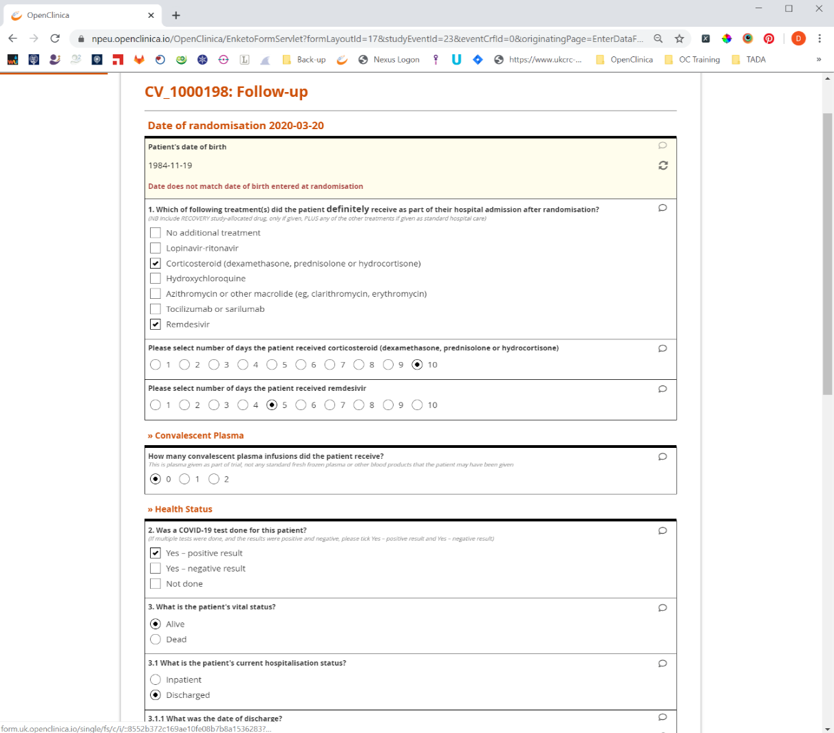
Resolving an error
If the data was incorrectly entered edit the value entered.
If the value is correct, you need to raise a query, to do this click on the small speech bubble.

Slide 24
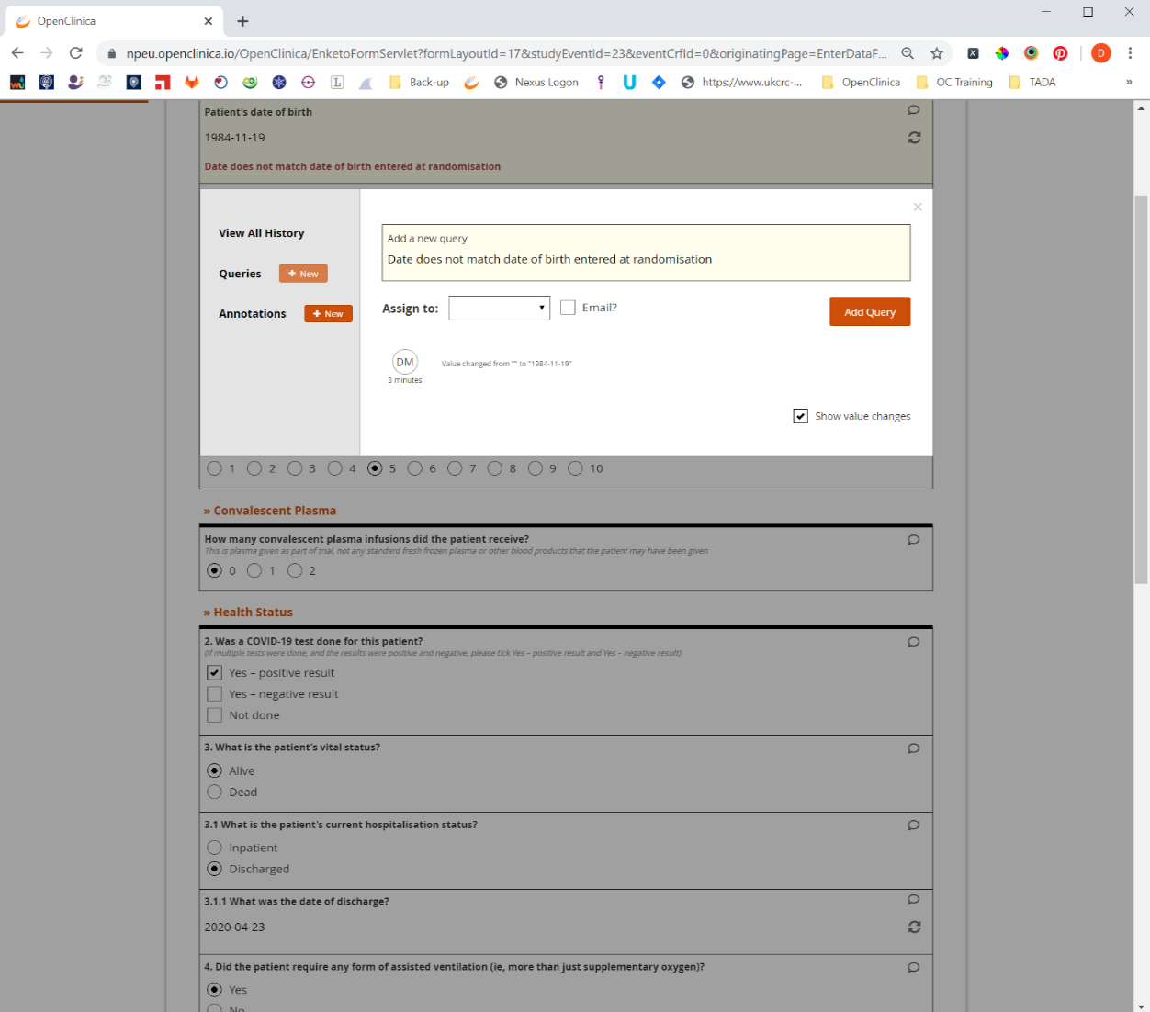
Adding a query
Press the New button next to Queries, then in the text box provide some information.
To save the query, click Add Query.

Slide 25
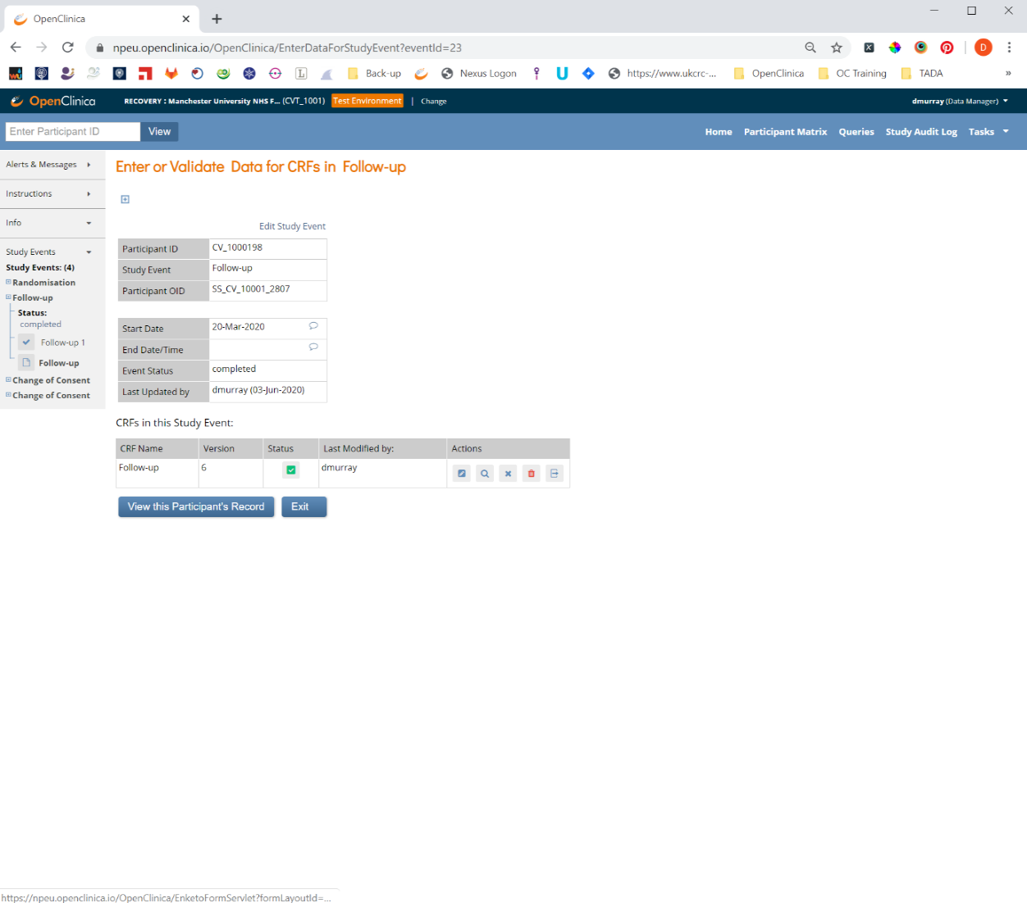
Administrative editing
If you some reason you need to change the data after the data entry is complete, you can do this by opening the CRF in Administrative Editing mode.
You do this by clicking the Administrative Editing button.

Slide 26
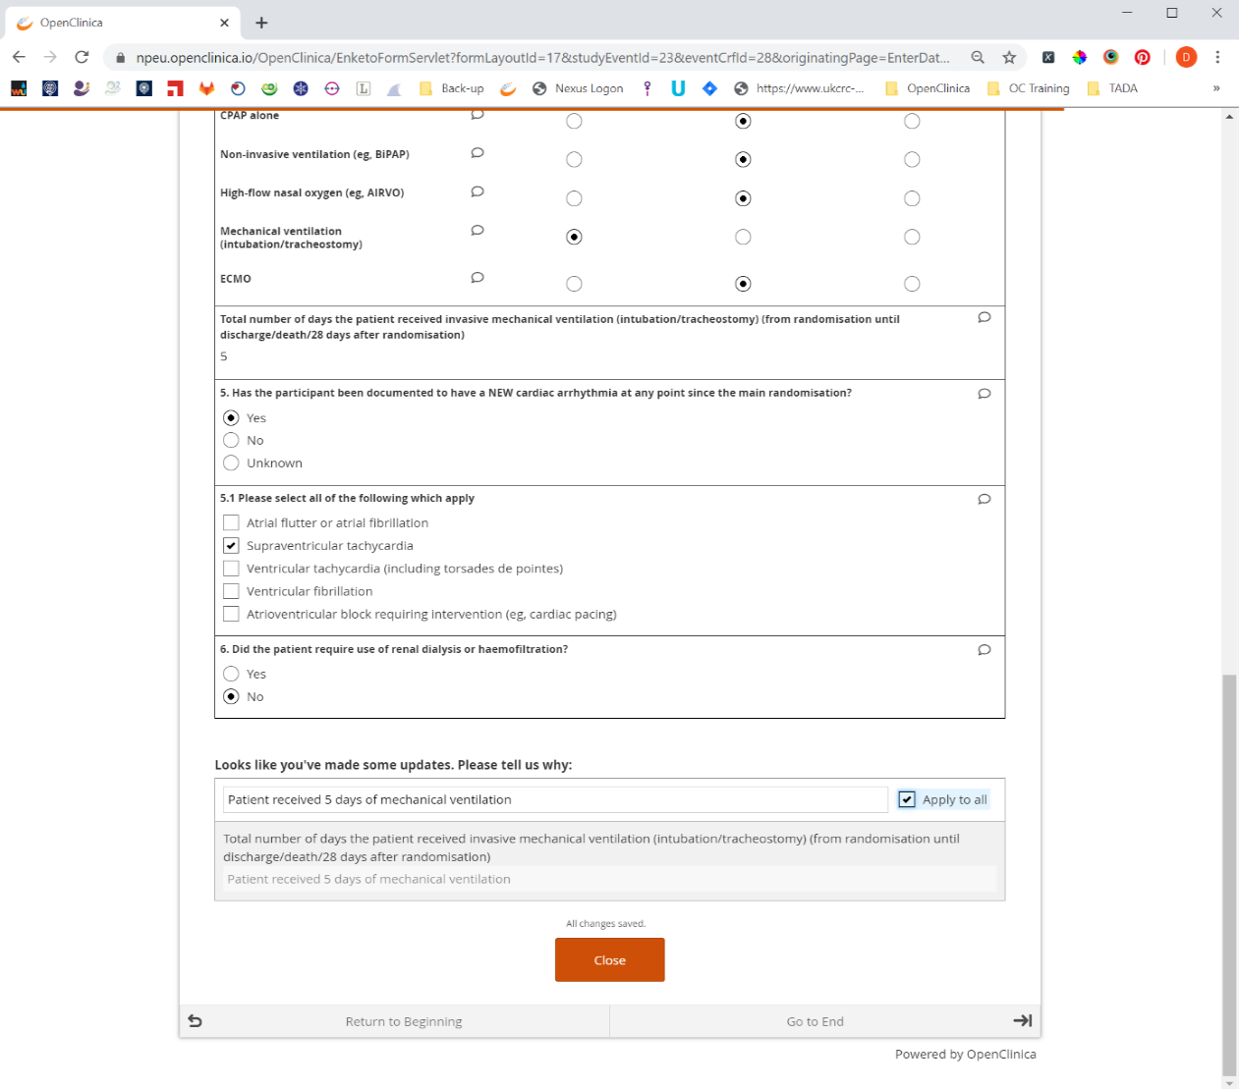
Reason for change
Clicking the Administrative Editing button will open the form and allow you to change the data.
If you do change the data, you will be required to provide a reason for change.

Slide 27
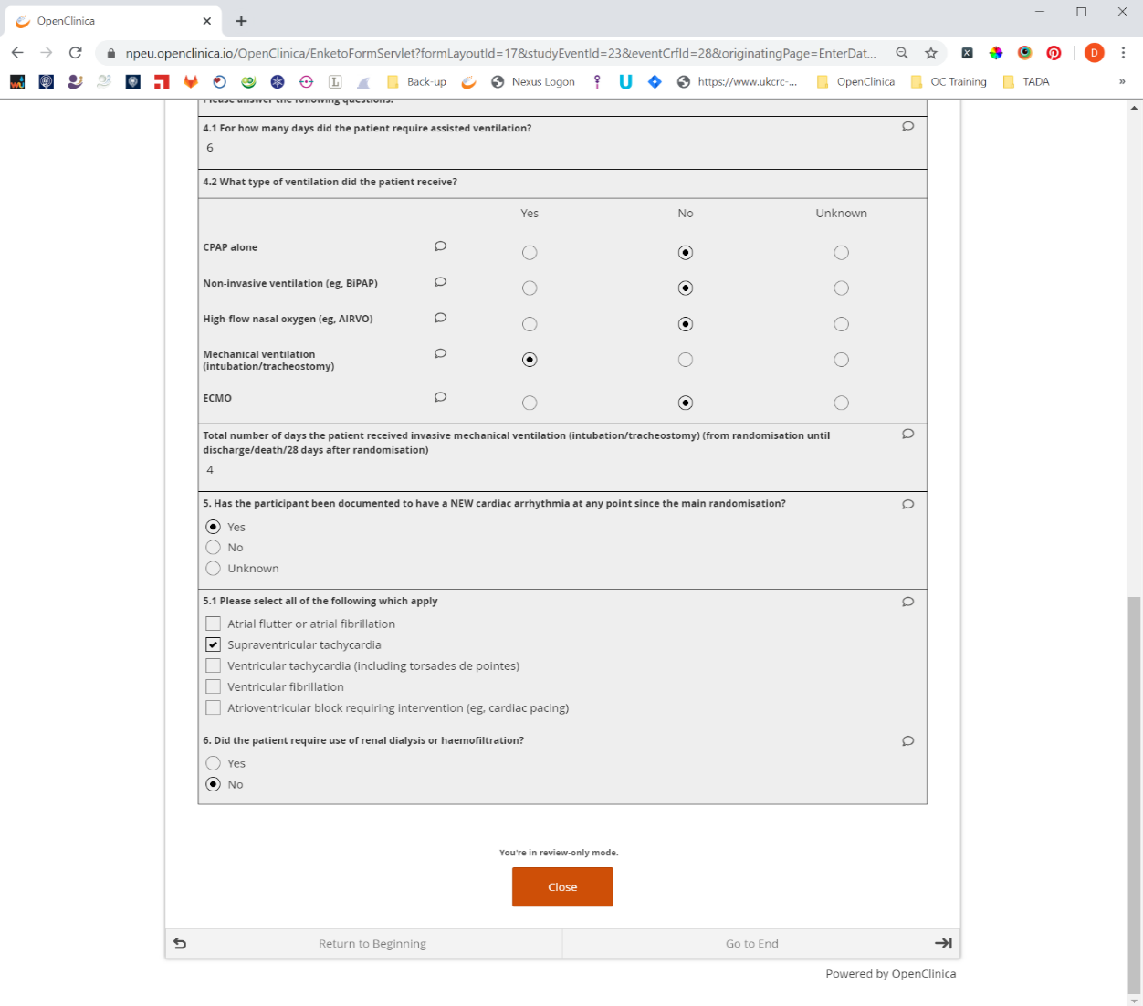
View data
If you want to view the data that has been entered, click on the View button
This will open the CRF in read only mode.

