Slide 1
Randomised Evaluation of COVID-19 Therapy: the RECOVERY trial
Sotrovimab Training
14-Jan-2022

Slide 2
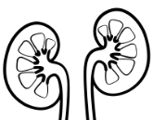
Current comparisons for adults with COVID-19
ELIGIBLE PATIENTS
OUTCOMES
High-dose corticosteroids
(hypoxic)
SGLT-2i comparison
E
High dose
steroids
or
Usual care alone
F
Empagliflozin
or
Usual care alone
Baseline data collected
Participants enter ≥1 comparisons
R
Outcomes collected at earliest of death, discharge or 28 days
Antiviral 1
Antiviral 2
J
Sotrovimab
or
Usual care alone
K
Molnupiravir
or
Usual care alone

Slide 3
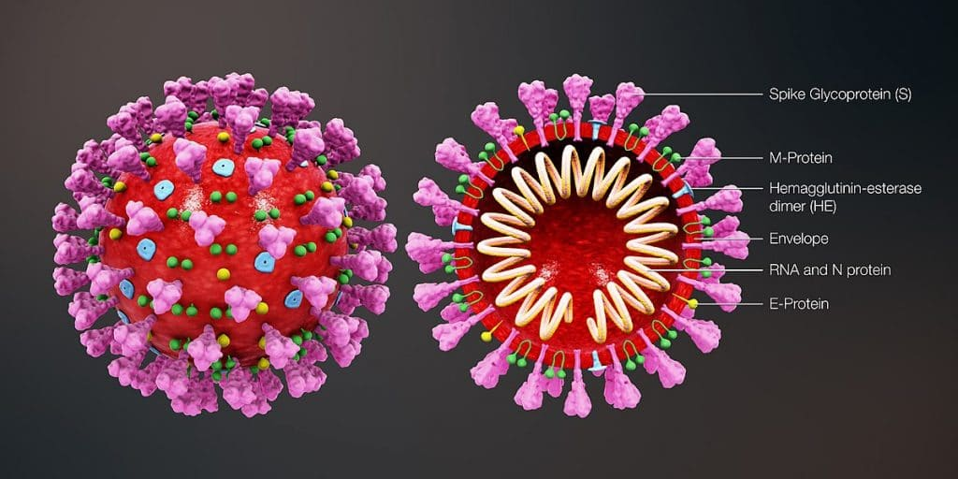
Monoclonal antibodies
Several different monoclonal antibody treatments have been developed that target the SARS-CoV-2 spike protein

Slide 4
Monoclonal antibodies can improve clinical outcome

Slide 5
Variants and monoclonal antibodies
Because each monoclonal antibody binds to its own specific part of the spike protein, mutations in the binding site can alter the potency of these treatments
Ronapreve is highly effective against previous variants, but has very little activity against Omicron
Sotrovimab has preserved efficacy against Omicron

Slide 6
Sotrovimab
Derived from an antibody identified in a patient who had SARS-CoV-1 infection
Thought to bind to part of the spike protein which is more “conserved” so may be less likely to mutate in future variants
Is fully human, but has had Fc portion modified to increase its half-life after infusion

Slide 7
Efficacy of sotrovimab
Among outpatients in the COMET ICE trial, sotrovimab reduced need for hospitalisation or death by 85%
Assessed in NIH ACTIV-3-TICO trial among inpatients, but abandoned for futility
However, pre-specified analysis did not take into account serostatus, so effects like that seen with Ronapreve in RECOVERY would have been missed
There remains uncertainty around benefits of sotrovimab for inpatients

Slide 8
Sotrovimab in RECOVERY
All adult participants are potentially eligible, including those who have received sotrovimab previously
Adolescents ≥12 years old and ≥40 kg are also eligible
Pregnant or breast-feeding women are eligible after discussion with them
No exclusions around liver or kidney function
Dose is 1000 mg in 100 mL 0.9% saline or 5% dextrose given over 1 hour given as soon as possible after randomisation
Biological sampling will be crucial to assessments

Slide 9
Biological sampling in RECOVERY
 | Serum sample | Nose swabs
Baseline (Day 1 - after consent, before randomisation) | ✓ | ✓
Day 3 | ✗ | ✓
Day 5 | ✗ | ✓
Serum samples used to measure antibody levels and possibly viral antigen
Swabs used to measure viral load and presence of resistance markers

Slide 10
Safety of sotrovimab
Largest trial to date is COMET-ICE which compared sotrovimab with placebo among outpatients
Infusion reactions will be recorded on trial follow-up form so please ensure they are recorded in medical records
Event | Sotrovimab (n=430) | Placebo (n=438)
Any adverse event | 73 (17%) | 85 (19%)
Any serious adverse event | 7 (2%) | 26 (6%)
Any infusion-related reaction | 6 (1%) | 5 (1%)

Slide 11
Safety of sotrovimab
Infusion reactions will be recorded, including:
Severity
Mild (no treatment required)
Moderate (antihistamine, bronchodilator or other simple treatment required)
Severe (adrenaline required)
Completion of infusion

Slide 12
Sotrovimab supply
RECOVERY has its own supply of sotrovimab
As part of site set-up process, sites must provide address(es) to which they would like sotrovimab to be sent to RECOVERY team
RECOVERY team will monitor use and re-supply automatically, but do contact team if concerned
Should be stored at 2-8C; no additional monitoring or accountability records required beyond standard care

