Slide 1
RECOVERY Background training
Trial Overview
Updated 10-Nov-2025

Slide 2
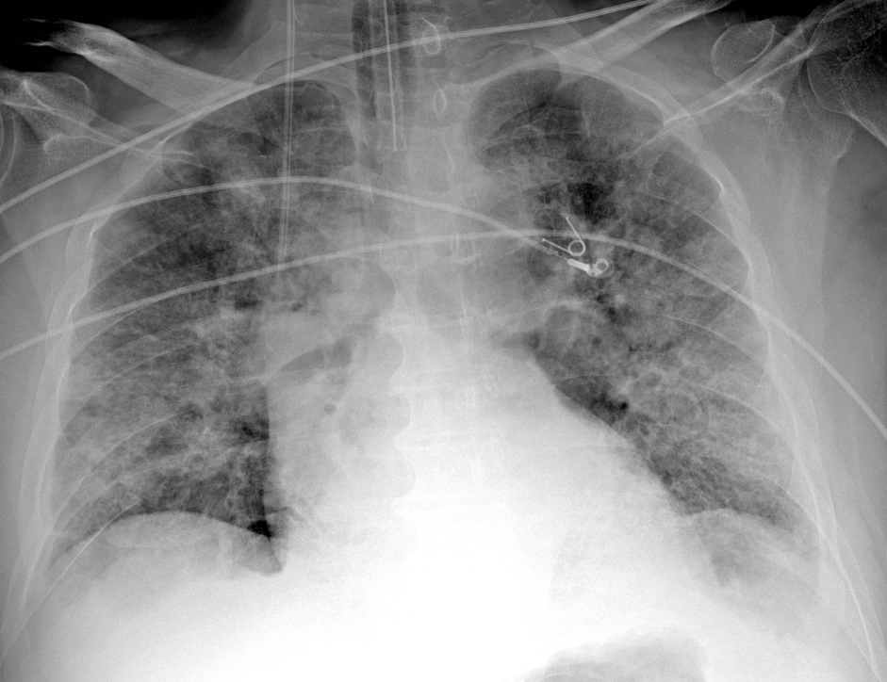
RECOVERY after COVID-19
COVID-19 pneumonia killed ~20 million in 2020‑22, but is now uncommon
Final RECOVERY COVID-19 comparisons closed in 2024
We now have better evidence guiding treatment of COVID-19 pneumonia than influenza or bacterial pneumonia
Other causes of pneumonia are still a major cause of hospitalisation and death worldwide

Slide 3
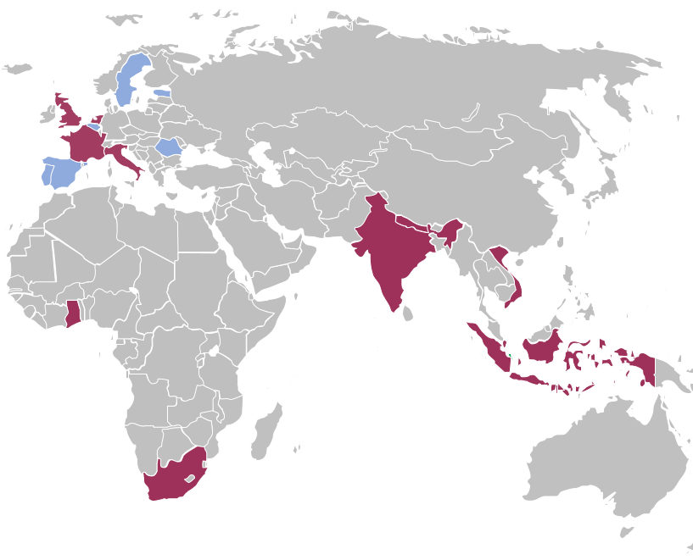
RECOVERY overview
Randomised, open-label, platform trial for patients hospitalised with pneumonia
Started as COVID-19 treatment trial in UK, now includes flu & non-flu CAP
Now open in 10 countries & expanding in EU (~120 sites in 2025)
Streamlined design - trial procedures &
eligibility as simple as possible
1° outcome: 28-day all-cause mortality
2° outcomes: i) Progression to ventilation/death
ii) Time to hospital discharge
(co-primary for influenza)
www.recoverytrial.net

Slide 4
RECOVERY Core Eligibility
Hospitalised
Pneumonia syndrome
  Typical symptoms of a new respiratory infection; and
  Objective evidence of acute lung disease (e.g. X-ray or CT, hypoxia, or compatible clinical examination); and
  Alternative causes are considered unlikely or excluded (e.g. heart failure)
  However, the diagnosis remains a clinical one based on the opinion of the managing doctor
Either:
  Confirmed influenza A or B (including hospital-acquired)
  Diagnosis of community-acquired pneumonia with planned antibiotic treatment
  (without suspected influenza/COVID-19/PCP/TB)
No medical history that might put patient at significant risk if they participated
Trial treatment is not considered indicated or contra-indicated by the responsible doctor
Aged 18+ years
Individual comparisons can have additional criteria (e.g. for the influenza dexamethasone comparison patients must be hypoxic, and must not have SARS-CoV-2 infection)

Slide 5


Current comparisons
HOSPITALISED PATIENTS WITH PNEUMONIA
Community-acquired pneumonia (CAP) corticosteroid comparison
ANALYSIS
Dexamethasone
(6mg daily)
Usual care without corticosteroids
or
Patients with CAP (without suspected SARS-CoV-2/influenza/PCP/TB)
R
Outcomes at 28 days
Mortality
Time to discharge alive
Progression to ventilation or death
Baseline data collected, suitability determined
1:1 randomisation in each suitable comparison
Baloxavir comparison
Oseltamivir comparison
Influenza corticosteroid comparison (patients with hypoxia)
Baloxavir
Usual care without baloxavir
Oseltamivir
Usual care without neuraminidase inhibitor
Dexamethasone
(6mg daily)
Usual care without corticosteroids
or
or
or
Patients with confirmed INFLUENZA A or B

Slide 6
Randomisation
After informed consent is taken, randomisation is done via a web interface. Baseline data is collected here including the suitability of each treatment comparison
Patients can be entered into multiple comparisons simultaneously, i.e. all those where the treatment is available and not considered to be indicated or contraindicated by the clinical team
If the patient is ineligible for a particular arm they can still be randomised to others
Patients will be allocated either to the additional treatment or to no additional treatment, with other care remaining the same
Allocations are independent, so a patient may end up being allocated all, none or any combination of the suitable treatments

Slide 7
Summary
Better treatments are needed to reduce mortality in patients hospitalised with CAP or influenza
RECOVERY is now evaluating promising treatments for both types of infections
The exact design of the trial will continue to change as new arms are added and old ones removed – details of the current treatments can be found in the protocol and in specific training materials

