Slide 1
Randomised Evaluation of COVID-19 Therapy: the RECOVERY trial
Empagliflozin
Research Team Training Material

Slide 2

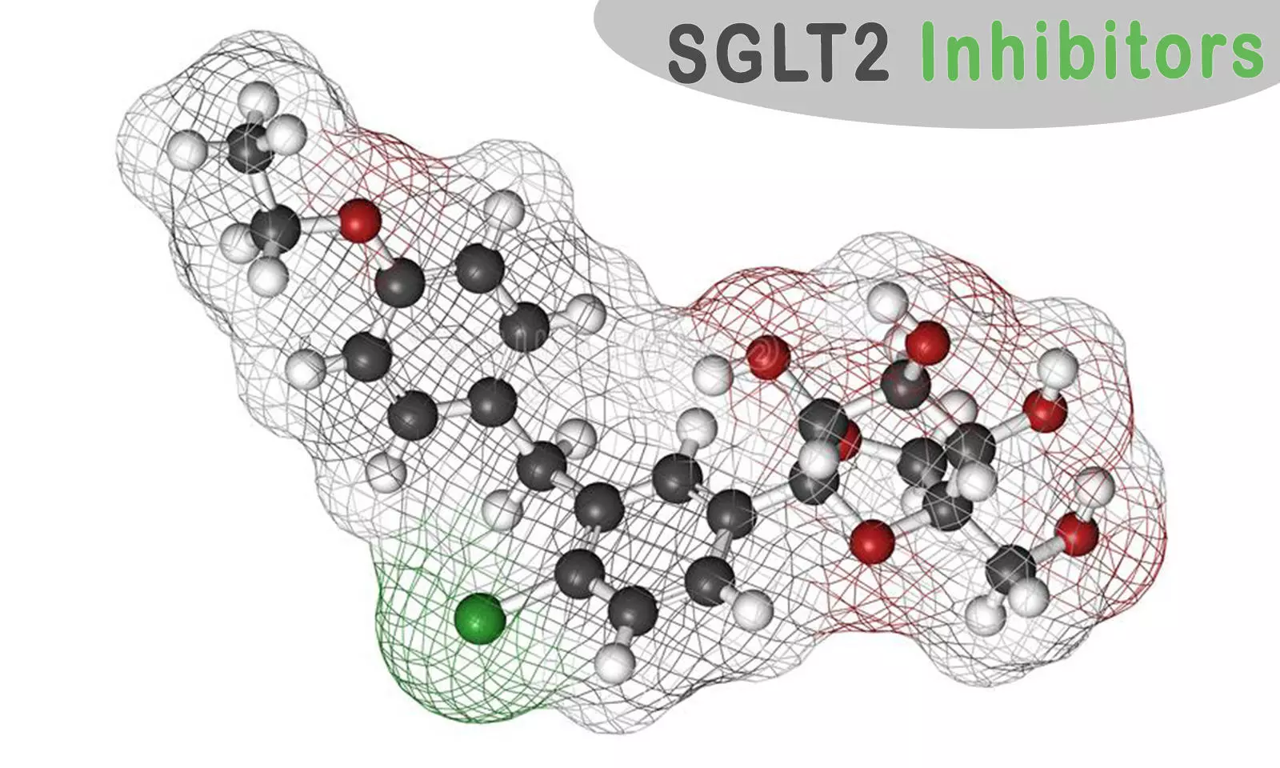

Planned design (adults)
ELIGIBLE PATIENTS
early immunomodulation - 1
SGLT-2i comparison
OUTCOMES
A
Dimethyl fumarate
or
Usual care alone
F
Empagliflozin
Usual care alone
or
R
Outcomes collected at earliest of death, discharge or 28 days
Participants enter ≥1 randomisation A, D, E or F
For hypoxic patients only:
corticosteroids
early immunomodulation - 2
E
High-dose corticosteroids
Usual care alone
D
Baricitinib
Usual care alone
or
or

Slide 3
SGLT-2 inhibitors and Empagliflozin (empa)
Empagliflozin is an SGLT-2 inhibitor (SGLT-2i)
SGLT-2 = sodium-glucose co-transporter 2 and is the main process by which glucose filtered into the urine is reabsorbed by the kidney
SGLT-2i were developed as treatments for diabetes because they can lower blood sugar
In addition to lowering blood sugar they have also been found to reduce the risk of:
Atherosclerotic cardiovascular events (eg, myocardial infarction) in people with type 2 diabetes
Cardiovascular death in people with heart failure
Progression of chronic kidney disease in people with diabetes and CKD

Slide 4
SGLT-2i in COVID-19
SGLT-2i may have beneficial effects in COVID-19
Shift in energy metabolism from glucose (which SARS-CoV-2 may rely on) to lipids
Improve endothelial function
Anti-inflammatory effects
DARE-19 trial compared dapagliflozin with placebo among 1250 patients hospitalised for COVID-19 with another ‘risk factor’ (eg, diabetes, cardiovascular disease)
Primary outcome = time to organ failure or death
HR 0.80 (95% CI 0.58 – 1.10; p=0.168)

Slide 5
Empagliflozin in RECOVERY
Available in all countries
Separate factorial randomisation to others (so can be given in addition to other study treatment allocations)
Dose: 10 mg once daily for up to 28 days (stopped at discharge if sooner)
Exclusions:
Type 1 diabetes mellitus
Pregnancy or breast-feeding
(No exclusions around kidney or liver function)

Slide 6
Adverse effects of SGLT-2i
Mycotic genital infection (eg, vulvovaginal candidiasis or candidal balanitis)
Commonest adverse effect
Easily treated with topical antifungal eg, clotrimazole cream
Ketoacidosis
Rare (<1% of people with type 2 diabetes mellitus)
Risk increased with starvation so withhold empagliflozin if patient not being fed
NB ketoacidosis with SGLT-2i may have relatively normal blood glucose so check ketones if suspicious

Slide 7
Adverse effects of SGLT-2i
Hypoglycaemia
SGLT-2i do not cause hypoglycaemia unless given with insulin or insulin secretagogue (eg, sulphonylurea such as gliclazide)
Volume depletion
SGLT-2i cause natriuresis and osmotic diuresis so care required with fluid balance

Slide 8
Additional outcomes to be collected
Ketoacidosis
Severe hypoglycaemia i.e. hypoglycaemia causing a reduced conscious level requiring another person to recover
Hyperglycaemia requiring new insulin or with hyperosmolar state
Peak creatinine during admission

Slide 9
Summary
Empagliflozin may provide additional benefits to patients hospitalized with COVID-19
RECOVERY is testing 10 mg once daily for up to 28 days
Patients with type 1 diabetes mellitus or who are pregnant or breast-feeding are not eligible
Main risk is ketoacidosis so care required if patient not being fed

