Slide 1
Randomised Evaluation of COVID-19 Therapy: the RECOVERY trial
Empagliflozin
Research Team Training Material
V2.0 2021-08-07

Slide 2

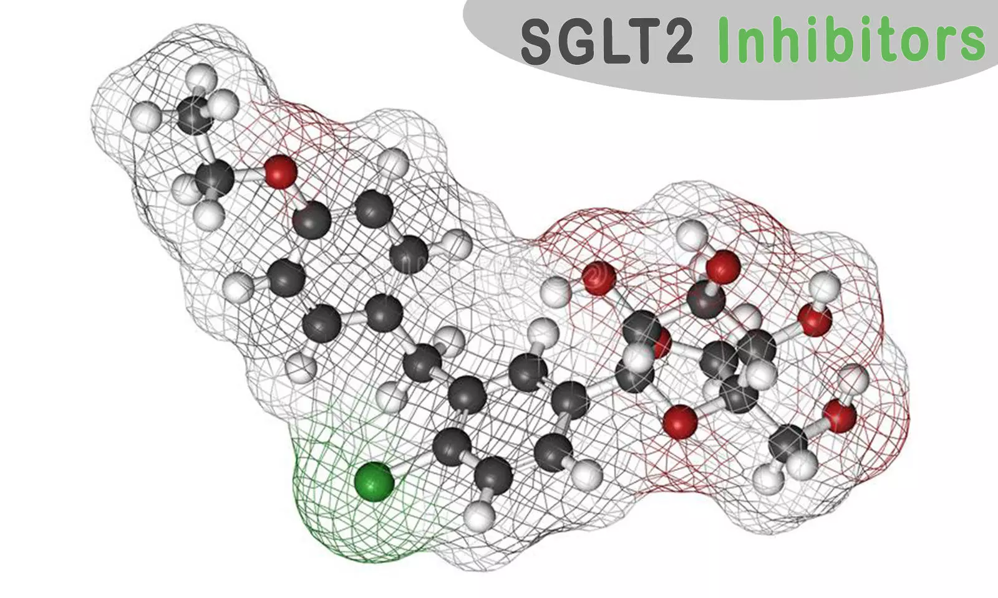

Planned design (adults)
ELIGIBLE PATIENTS
early immunomodulation - 1
SGLT-2i comparison
OUTCOMES
A
Dimethyl fumarate
or
Usual care alone
F
Empagliflozin
Usual care alone
or
R
Outcomes collected at earliest of death, discharge or 28 days
Participants enter ≥1 randomisation A, D, E or F
For hypoxic patients only:
corticosteroids
early immunomodulation - 2
E
High-dose corticosteroids
Usual care alone
D
Baricitinib
Usual care alone
or
or

Slide 3
SGLT-2 inhibitors and Empagliflozin (empa)
Empagliflozin is an SGLT-2 inhibitor (SGLT-2i)
SGLT-2 = sodium-glucose co-transporter 2 and is the main process by which glucose filtered into the urine is reabsorbed by the kidney
SGLT-2i were developed as treatments for diabetes because they can lower blood sugar
In addition to lowering blood sugar they have also been found to reduce the risk of:
  Atherosclerotic cardiovascular events (eg, myocardial infarction) in people with type 2 diabetes
  Cardiovascular death in people with heart failure
  Progression of chronic kidney disease in people with diabetes and CKD

Slide 4
SGLT-2i in COVID-19
SGLT-2i may have beneficial effects in COVID-19
  Shift in energy metabolism from glucose (which SARS-CoV-2 may rely on) to lipids
  Improve endothelial function
  Anti-inflammatory effects
DARE-19 trial compared dapagliflozin with placebo among 1250 patients hospitalised for COVID-19 with another ‘risk factor’ (eg, diabetes, cardiovascular disease)
  Primary outcome = time to organ failure or death
  HR 0.80 (95% CI 0.58 – 1.10; p=0.168)

Slide 5
Empagliflozin in RECOVERY
Available in all countries
Separate factorial randomisation to others (so can be given in addition to other study treatment allocations)
Dose: 10 mg once daily for up to 28 days (stopped at discharge if sooner)
Exclusions:
  Type 1 diabetes mellitus* or post-pancreatectomy diabetes mellitus
  History of ketoacidosis
  Current blood ketones ≥1.5 mmol/L (or urine ketones ≥2+)
  Pregnancy or breast-feeding
  (No exclusions around kidney or liver function)
  * If patient is only on insulin, consider carefully whether diabetes is type 1 and seek advice if necessary

Slide 6
Adverse effects of SGLT-2i
Mycotic genital infection (eg, vulvovaginal candidiasis or candidal balanitis)
  Commonest adverse effect
  Easily treated with topical antifungal eg, clotrimazole cream
Hypoglycaemia
  SGLT-2i do not cause hypoglycaemia unless given with insulin or insulin secretagogue (eg, sulphonylurea such as gliclazide)
Volume depletion
  SGLT-2i cause natriuresis and osmotic diuresis so care required with fluid balance

Slide 7
Adverse effects of SGLT-2i
Ketoacidosis
  Defined as combination of both ketosis (blood ketones ≥1.5 mmol/L or urine ketones ≥2+) and metabolic acidosis (bicarbonate <15 mmol/L)
  Only occurs in people with diabetes
  NB can occur with relatively normal blood sugar if on SGLT-2i
Participants with diabetes should have regular checks of ketones
  Twice daily blood ketones (or once daily urine ketones if blood ketone testing not available) or if clinical concern*
  If ketosis (blood ketones ≥1.5 mmol/L or urine ketones ≥2+) develops:
    Ensure adequate fluid and calorific intake
    Refer to local diabetes team (if available) and follow local protocols for ketosis
    Consider increasing insulin (if participant on it) and withholding empagliflozin while ketotic
* Blood ketones are quantitative whereas urine ketones only semi-quantitative

Slide 8
Additional outcomes to be collected
Ketoacidosis: defined as combination of both ketosis (blood ketones ≥1.5 mmol/L or urine ketones ≥2+) and metabolic acidosis (bicarbonate <15 mmol/L
Severe hypoglycaemia i.e. hypoglycaemia causing a reduced conscious level requiring another person to recover
Hyperglycaemia requiring new insulin or with hyperosmolar state
Peak creatinine during admission

Slide 9
Actions on discharge
When empagliflozin is stopped (on discharge or after 28 days), clinical teams need to provide advice on changes to any other diabetes medication
Information on enrolment in trial and treatments given should be included in discharge documentation

Slide 10
Summary
Empagliflozin may provide additional benefits to patients hospitalized with COVID-19
RECOVERY is testing 10 mg once daily for up to 28 days
Patients with diabetes are at risk of ketoacidosis
  Those at highest risk are excluded from comparison
  Others require regular ketone checks and action to be taken if ketones rise

