Slide 1
Randomised Evaluation of COVID-19 Therapy: the RECOVERY trial
Paediatric Training Slides
(infants and children equal to or over 44 weeks corrected gestational age)
Updated February 2021

Slide 2
Background: COVID-19
The majority of children who develop COVID-19 present with mild symptoms or are asymptomatic.
For the few children that develop severe or life-threatening acute respiratory presentations of COVID-19, a robust evidence base is essential to guide the use of effective treatments and to avoid potential harm
The RECOVERY trial has demonstrated that dexamethasone reduces the risk of death for adults patients requiring oxygen and this has now become standard of care for adults and children and continues to investigate the efficacy of other treatments for patients with COVID-19.
RCPCH treatment criteria should be used to guide the decision about treatment and therefore enrolment into RECOVERY for patients with acute respiratory presentations of COVID-19. (RCPCH guidelines are constantly being updated please make sure you are aware of the latest version).
It is anticipated that any child with COVID-19 being considered for treatment (over and above supportive care), should be enrolled in RECOVERY

Slide 3
Background: PIMS-TS
A small proportion of children who are exposed to SARS-CoV2 develop an inflammatory syndrome which has been recently identified and termed Paediatric multisystem inflammatory syndrome temporally associated with SARS-CoV-2 (PIMS-TS).
Some of these children will improve with no treatment and others are more unwell and may require intensive care and immunomodulation.
Children with PIMS-TS are eligible for inclusion in RECOVERY.

Slide 4
Patient information leaflets and Consent
Children <10 years of age: use the ‘younger’ children information leaflet and this should be read along with their parent(s) or guardian(s). The parent or guardian should sign the consent form.
Children aged 10-15 years of age: use the information for children 10-15 years. Children should be given the opportunity to sign the information sheet to indicate their assent, if they are well enough and signature is possible. The parent / guardian should sign the consent form (or witnessed consent used).
Young people aged >16 years should be provided with the information sheet for parents/ guardians and young people >16 year. They should sign the consent form (or witnessed consent used) themselves.
Witnessed consent may be obtained over the telephone or web video link if hospital visiting rules or parental infection mean a parent/guardian cannot be physically present.
No options in randomization 2, do not proceed to 2nd stage interventions
Any healthcare professional with appropriate training and knowledge of the trial can take consent

Slide 5
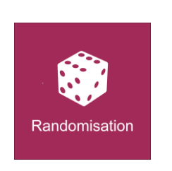
Options for Randomisation
Children and Young People with acute respiratory COVID
1st stage interventions:
Randomisation 1 A: (1:1)
No additional treatment
Baricitinib (>=2 years only)
Randomisation 1 B: (1:1)
No additional treatment
Synthetic neutralizing antibodies (>12years of age only, who have not received IVIG)
2nd stage interventions: No options for this indication
Children and Young People with PIMS-TS
1st stage interventions:
Randomisation 1 A: (1:1:1)
No additional treatment
IVIg
Methylprednisolone
Randomisation 1 B: No options for this indication
2nd stage interventions: only open to children > 1year of age (2:2:1)
Tocilizumab
Anakinra
No additional treatment

Slide 6
Acute respiratory presentation of COVID-19 scenario
Child meets RCPCH criteria for treatment of confirmed or suspected COVID-19 in child with acute respiratory presentation
www.rcpch.ac.uk/resources/covid-19-clinical-management-children-admitted-hospital-suspected-covid-19
Yes
Yes
No
Child ≥ 2 years of age
Treat according to standard of care
Randomise to 1st stage interventions:
Randomisation A:
No additional treatment vs
baricitinib
Randomisation B:
No additional treatment vs
synthetic neutralising antibodies (children ≥ 12 years and ≥ 40kg only )
Infants <44 weeks (See neonatal training slide set)
1st stage interventions:
- Randomisation 1 A:
Hydrocortisone vs
no additional treatment
Not suitable for enrolment into RECOVERY trial
If clinical deterioration, reassess against RCPCH criteria
Infants >44 weeks to
< 2years of age:
No current options for treatment in RECOVERY
No options in randomization 2, do not proceed to 2nd stage interventions

Slide 7
RECOVERY for PIMS-TS
Aim: compare steroids vs no additional treatment (in presence and absence of IVIg) and IVIg vs no additional treatment (in presence and absence of steroids).
This design:
Allow investigators to use no treatment, IVIg or steroids or as standard care if deemed necessary
Allow effects of steroids and IVIg to be compared with no additional treatment separately (in presence and absence of other drug)
Allow wide spectrum of severity to be recruited because some treatment can be guaranteed but not absolutely required
Second randomisation to tocilizumab and anakinra is available.
Also collects baseline use of steroids/IVIg at second randomisation (although not recommended this is in case clinicians go off-protocol in-between two randomisations)

Slide 8
PIMS-TS Scenarios
Patient with PIMS-TS enrolled in RECOVERY
Patient received IVIg or corticosteroids prior to enrolment?
IVIg and corticosteroids given
No
IVIg given
Corticosteroids given
1
2
3
4

Slide 9
Scenario 1: Patient with PIMS-TS who has not received treatment* prior to enrolment *IVIg, methylprednisolone or equivalent to ≥ 2mg/kg prednisolone
Randomise to IVIg vs methylprednisolone vs no additional treatment

Slide 10
Scenario 1: Patient with PIMS-TS who has not received treatment* prior to enrolment *IVIg, methylprednisolone or equivalent to ≥ 2mg/kg prednisolone
Randomise to IVIg vs methylprednisolone vs no additional treatment
Evidence of ongoing fever and inflammation or clinical deterioration?
Yes
Can transfer to tertiary centre if clinically necessary
No
Randomise to 2nd stage interventions:
Tocilizumab / anakinra / no additional treatment
Do not proceed to 2nd stage interventions
Tocilizumab and anakinra are only suitable for children ≥ 1year of age

Slide 11
Scenario 2: Patient with PIMS-TS who has already received IVIg prior to enrolment
Select IVIg as unsuitable for 1st stage intervention
Randomise to methylprednisolone vs no additional treatment

Slide 12
Scenario 2: Patient with PIMS-TS who has already received IVIg prior to enrolment
Select IVIg as unsuitable for 1st stage intervention
Randomise to methylprednisolone vs no additional treatment
Evidence of ongoing fever and inflammation or clinical deterioration?
Yes
Can transfer to tertiary centre if clinically necessary
No
Randomise to 2nd stage interventions:
Tocilizumab / anakinra / no additional treatment
Do not proceed to 2nd stage interventions
Tocilizumab and anakinra are only suitable for children ≥ 1year of age

Slide 13
Scenario 3: Patient with PIMS-TS who has already received methylprednisolone* prior to enrolment * (or equivalent to ≥ 2mg/kg prednisolone )
Select methylprednisolone as unsuitable for 1st stage intervention
Randomise to IVIg vs no additional treatment

Slide 14
Scenario 3: Patient with PIMS-TS who has already received methylprednisolone* prior to enrolment * (or equivalent to ≥ 2mg/kg prednisolone )
Select methylprednisolone as unsuitable for 1st stage intervention
Randomise to IVIg vs no additional treatment
Evidence of ongoing fever and inflammation or clinical deterioration?
Yes
Can transfer to tertiary centre if clinically necessary
No
Randomise to 2nd stage interventions:
Tocilizumab / anakinra / no additional treatment
Do not proceed to 2nd stage interventions
Tocilizumab and anakinra are only suitable for children ≥ 1year of age

Slide 15
Scenario 4: Patient with PIMS-TS who has already received IVIg AND methylprednisolone* prior to enrolment * (or equivalent to ≥ 2mg/kg prednisolone )
Evidence of ongoing fever and inflammation or clinical deterioration?
Mark IVIg and methylprednisolone as already given/unsuitable
(therefore no options in randomisation 1)
Access 2nd stage randomisation directly.
Yes
Randomise to 2nd stage interventions:
Tocilizumab vs anakinra vs no additional treatment
Tocilizumab and anakinra are only suitable for children ≥ 1year of age

Slide 16
PIMS-TS Scenarios 1-4
Patients with severe disease may receive off protocol IVIg or methylprednisolone if the investigator deems this clinically essential, before or after first stage randomisation
Where possible, use 2nd stage interventions (tocilizumab vs anakinra vs standard of care) rather than off protocol treatments
Use the paediatric case report form to record all use of immunomodulation (both on and off protocol)

Slide 17
Paediatric specific medication: Methylprednisolone
Methylprednisolone 10mg/kg for 3 days
Additional steroids are not recommended, and weaning is not considered necessary after 3 days of high dose methylprednisolone
However, if the attending clinician still deems this clinically necessary, receipt of additional corticosteroids should be listed in the paediatric case report form

Slide 18
Paediatric specific medication: IVIg
Use routine hospital stock (any brands with marketing authorisation)
Prior approval not required (as per Kawasaki disease)
NHS England has been informed that Trusts usage may increase (Note: overall usage of IVIg is likely to be reduced due to randomisation)
Pharmacists:
Complete MDASA database (PIMS-TS diagnosis has been added to the database)
Reimbursement by NHSE (via normal route)

Slide 19
Baricitinib
This option is only available to children with acute respiratory presentation of COVID-19 who are >= 2 years of age
Dosage adjustment is required for children with renal impairment (see FAQ document)
This is used enterally: orally or via NG tube (not to be administered via NJ tube)
A pregnancy test is required in females of child-bearing potential before randomisation to baricitinib
Baricitinib is given once daily for 10 days or until discharge

Slide 20
Synthetic neutralising antibodies
Individual investigators may choose to randomise children over the age of 12 years to synthetic neutralising antibodies in randomisation 1B, where it is available in a specific research site and local investigators consider this appropriate for that child.
This option is only available to children with acute respiratory presentation of COVID-19 who are >= 12 years of age and >= 40kg

Slide 21
Infants: <44 weeks corrected GA
See neonatal specific training
For neonates and infants with a corrected gestational age of < 44 weeks with respiratory COVID phenotype, options for RECOVERY randomisation include
Hydrocortisone
No additional treatment

Slide 22
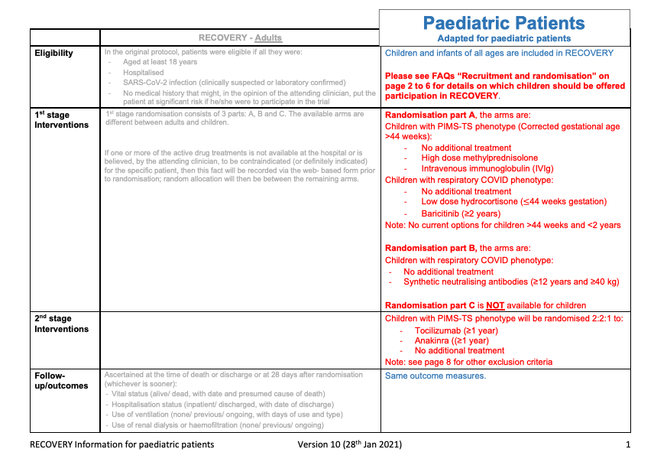
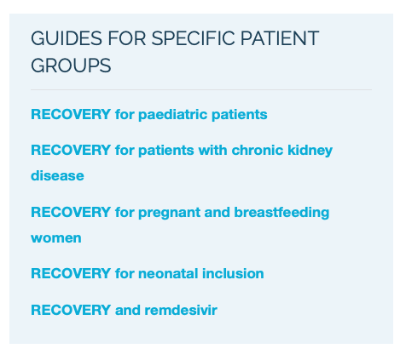
Further guidance: Frequently asked questions document

